Slide 1
  Security Protocol
  (Certificate Authority)
1

Slide 2
Roadmap
X.509 Certificate
Certificate Authority
Public Key Infrastructure
공인인증서
Rivals in standardization

Slide 3



X.509 Certificate
Is public-key crypto perfect?
  Man in the middle attack
I am Alice
I am Alice
R
-
K (R)
T
R
-
Send me your public key
K (R)
+
A
K
T
Send me your public key
+
K
A
+
K (m)
Trudy gets
T
-
+
+
m = K (K (m))
K (m)
T
T
-
A
sends m to Alice encrypted with Alice’s public key
+
m = K (K (m))
A
A
Computer Networking: A Top Down Approach, 7th edition, Jim Kurose, Keith Ross, Pearson/Addison Wesley, 2016

Slide 4
X.509 Certificate
Certificate
  Public key
  Identifier of the key owner
  Whole block signed by a trusted third party(certificate authority)
    Government agency, financial institutions, etc

Slide 5
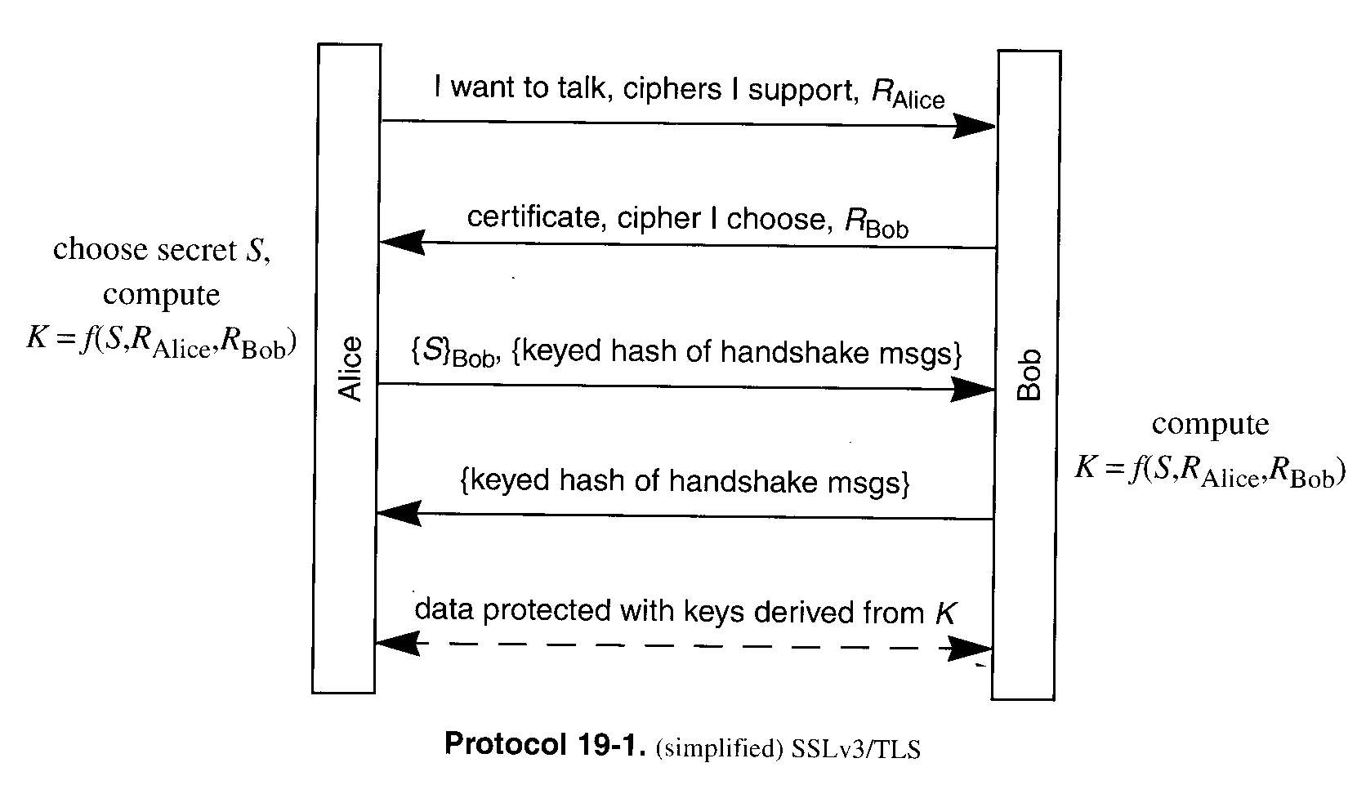
X.509 Certificate
JAVA SSL code revisited
  How does Alice trust the certificate?
  In our example, issuer(Bob) signed his certificate with his private key.
  Make sense?
client_hello
server_hello
client_key_exchange
finished
finished

Slide 6
X.509 Certificate
JAVA SSL code revisited
  Server side
    keytool –genkey –keystore name –keyalg RSA
    Self-signed certificate
      Whenever the -genkey command is called to generate a new public/private key pair, it also wraps the public key into a self-signed certificate.
  Client side
    keytool –import –keystore name –file filename
    Strong warning message. Are you sure?

Slide 7
X.509 Certificate
part of CCITT X.500 directory service standards
  distributed servers maintaining user info database
  v.s. LDAP(Lightweight Directory Access Protocol)
    ex) MS directory server
defines framework for authentication services
  directory may store public-key certificates
  with public key of user signed by certification authority
also defines authentication protocols
uses public-key crypto & digital signatures
  algorithms not standardised, but RSA recommended
X.509 certificates are widely used

Slide 8
X.509 Certificate
issued by a Certification Authority (CA), containing:
  version (1, 2, or 3)
  serial number (unique within CA) identifying certificate
  signature algorithm identifier
  issuer X.500 name (CA)
  period of validity (from - to dates)
  subject X.500 name (name of owner)
  subject public-key info (algorithm, parameters, key)
  issuer unique identifier (v2+)
  subject unique identifier (v2+)
  extension fields (v3)
  signature (of hash of all fields in certificate)
notation CA<<A>> denotes certificate for A signed by CA

Slide 9
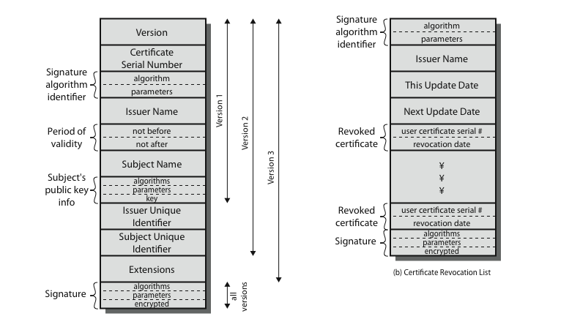
X.509 Certificate

Slide 10
Certificate authority
any user with access to CA can get any certificate from it
only the CA can modify a certificate
because cannot be forged, certificates can be placed in a public directory

Slide 11
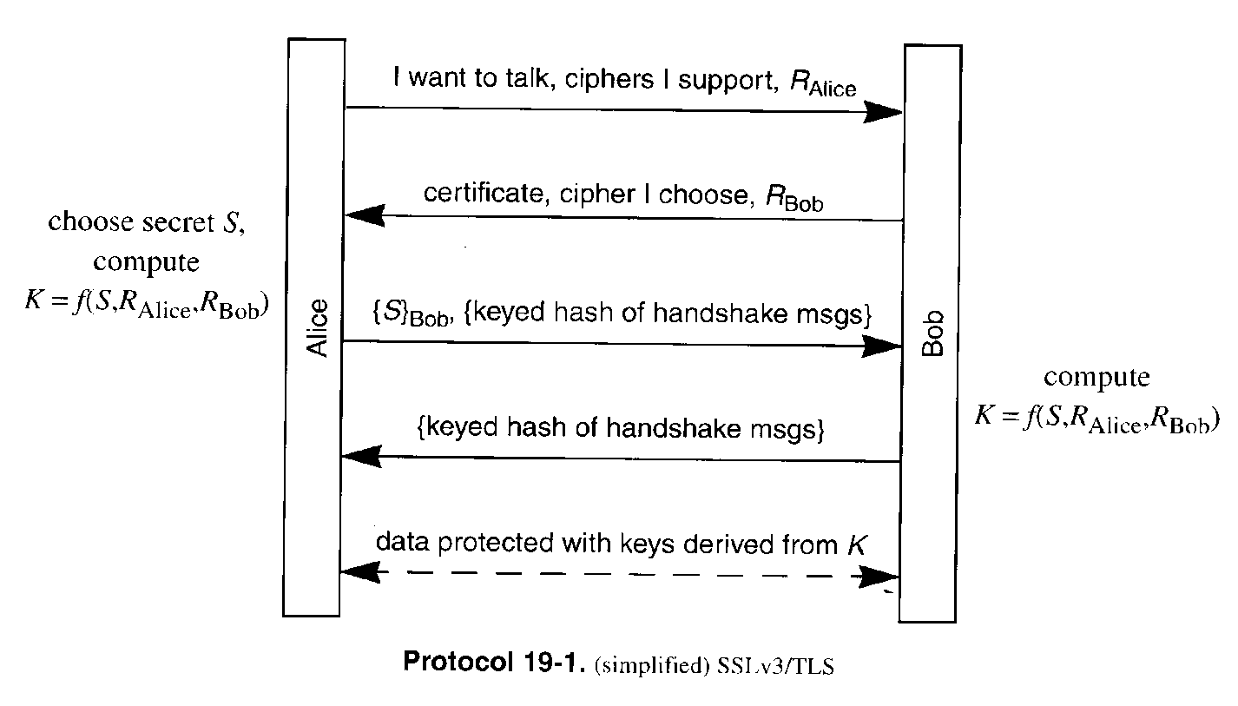
Certificate authority
Alice verifies that Bob’s certificate is valid.
She uses CA’s certificate.
How to verify that CA’s certificate is valid?
  CA’s web site, newspaper, etc.
client_hello
CA
server_hello
client_key_exchange
finished
Alice
Bob
Carol
finished

Slide 12
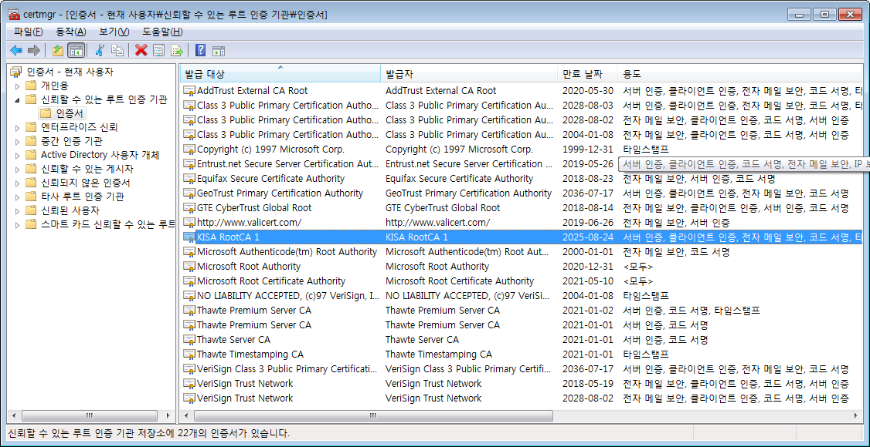
Certificate authority
Ex) window7 prof. certificate list

Slide 13
Certificate authority
In Korea, there are 5 공인인증기관
  행정안전부, 금융결제원, ㈜코스콤, ㈜한국무역정보통신, ㈜한국전자인증, ㈜한국정보인증
CA1
CA2
Alice
Bob
Carol
Dave
Eve

Slide 14
Certificate authority
CA hierarchy
  Browsers have the certificate of Root CA
  Manual install may be needed
Root CA
CA1
CA2
Alice
Bob
Carol
Dave
Eve

Slide 15
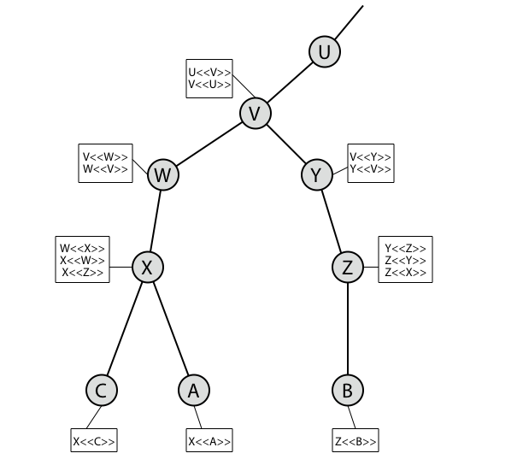
Certificate authority
CA hierarchy
  Chain of certificates

Slide 16
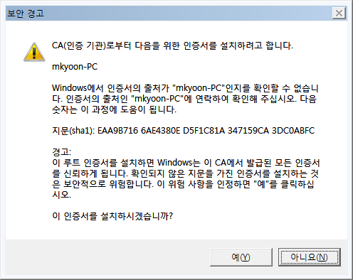
Certificate authority
What if a wrong certificate is trusted?
  Certificates can be forged by attackers
  Strong warning
    keytool import
    Window alarm

Slide 17
Certificate authority
keytool
  certreq option
    Certificate Signing Request (CSR)
  import option
    The response from the CA is imported

Slide 18
Public Key Infrastructure
PKI consists of
  certificates
  a repository for retrieving certificates
  a method of revoking certificates
  a method of evaluating a chain of certificates from a trust anchor to the target name
  A method of verifying the right person
CA(Certificate Authority) and RA(Registration Authority)
  ex) bank branches in Korea take the role of RA

Slide 19
Public Key Infrastructure
Certificate revocation
  certificates have a period of validity
  may need to revoke before expiry, eg:
    user's private key is compromised
    user is no longer certified by this CA
    CA's certificate is compromised
  CA’s maintain list of revoked certificates
    the Certificate Revocation List (CRL)
  users should check certificates with CA’s CRL

Slide 20
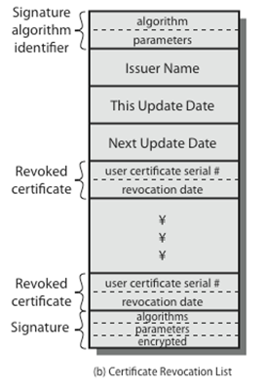
Public Key Infrastructure
CRL
  CA periodically publishes CRL or delta CRL.
  On-line revocation service allows query to validate a certificate.

Slide 21
공인인증서
개인인증서 > 서버인증서
  인감도장 대체 수단
  X.509 extension
    주민번호
공인인증기관
  행정안전부, 금융결제원, ㈜코스콤, ㈜한국무역정보통신, ㈜한국전자인증, ㈜한국정보인증

Slide 22
공인인증서
Until now, quite successful in Korea
  개인인증서, 상호인증, PKI
Issues
  Active-X
    Opposition of open platform guys
  Development delay
    Smart phone
  Market domination
    행정안전부, 금융결제원

Slide 23
Rivals in standardization
ITU-T/CCITT, ISO
  X.400
    Electronic data exchange
  X.500
    Directory service
  X.700
    Telecommunications Management Network
IETF
  SMTP
    RFC 5321
  LDAP
    RFC4511
  SNMP
    RFC 5343

Slide 24
Reference
Cryptography and network security, W. Stallings, Prentice Hall, 2011
Network security: private communication in a public world, C. Kaufman, etc., Prentice Hall, 2002
Lecture notes from “computer and network security”, S. Chen, University of Florida

