Slide 1
  Part3 : Attack & Defense
  (Web Security 1/2)
1

Slide 2
Roadmap
WEB Overview
Web Shell
Cookie
Session management
XSS
Paros

Slide 3
Roadmap
CSRF
SQL Injection
Web Server Information Disclosure
Access Control
OWASP Top10
Vulnerability Scanner

Slide 4

WEB Overview
Client/server model on TCP/IP
  client: browser that requests, receives, “displays” Web objects
  server: Web server sends objects in response to requests
Stateless protocol
HTTP 1.1: RFC 2068
HTTP request
PC running
Explorer
HTTP response
HTTP request
Server
running
Apache Web
server
HTTP response
Mac running
Navigator

Slide 5
WEB Overview
HTTP Request message (client to server)
HTTP Reply message (server to client)
request line
(GET, POST,
HEAD commands)
GET /somedir/page.html HTTP/1.1
Host: www.someschool.edu
User-agent: Mozilla/4.0
Connection: close
Accept-language:fr
(extra carriage return, line feed)
header
lines
Carriage return,
line feed
indicates end
of message
status line
(protocol
status code
status phrase)
HTTP/1.1 200 OK
Connection close
Date: Thu, 06 Aug 1998 12:00:15 GMT
Server: Apache/1.3.0 (Unix)
Last-Modified: Mon, 22 Jun 1998 …...
Content-Length: 6821
Content-Type: text/html
data data data data data ...
header
lines
data, e.g.,
requested
HTML file

Slide 6
WEB Overview
HTTP Request
Method
URL
Protocol Version
GET /index.html HTTP/1.1
Host: www.example.com
User-Agent: Mozilla/5.0
Accept: text/html, */*
Accept-Language: en-us
Accept-Charset: ISO-8859-1,utf-8
Connection: keep-alive
blank line
Headers
Body
(optional)

Slide 7
WEB Overview
HTTP Response
Version
Status
Status Message
HTTP/1.1 200 OK
Date: Thu, 24 Jul 2008 17:36:27 GMT
Server: Apache-Coyote/1.1
Content-Type: text/html;charset=UTF-8
Content-Length: 1846
blank line
<html>
...
</html>
Headers
Body

Slide 8
WEB Overview
Uniform Resource Locators (URLs)
Scheme
Port Number
Query
http://www.company.com:81/a/b/c.html?user=Alice&year=2008#p2
Host Name
Hierarchical portion
Fragment

Slide 9
Web Shell
MITRE Common Weakness Enumeration
  CWE-434
Vulnerability when a web server allows users to upload an executable file
  file uploading, job application uploading,…
Hackers execute system commands
  Equally powerful as if logged in by telnet
OS → shell, web server → web shell
  reverse shell

Slide 10
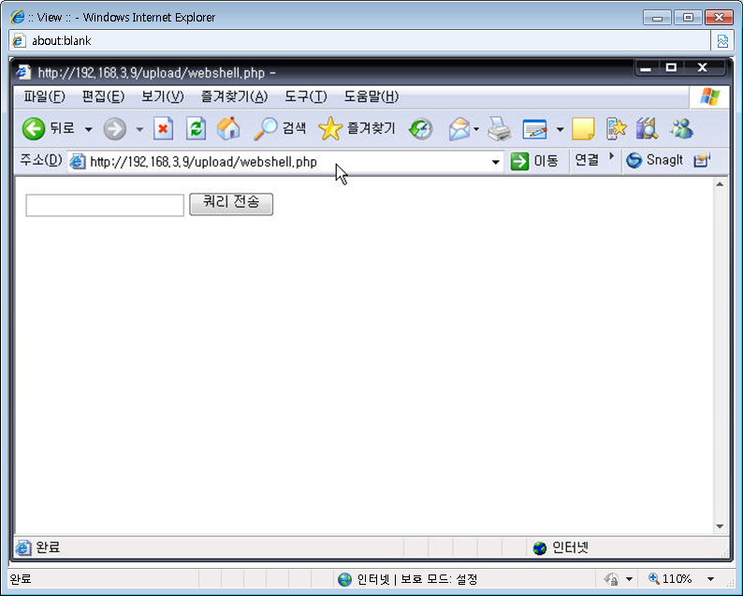
Web Shell

Slide 11
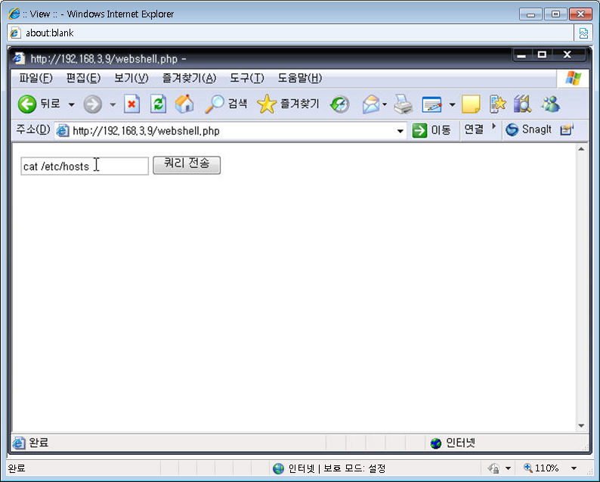
Web Shell

Slide 12
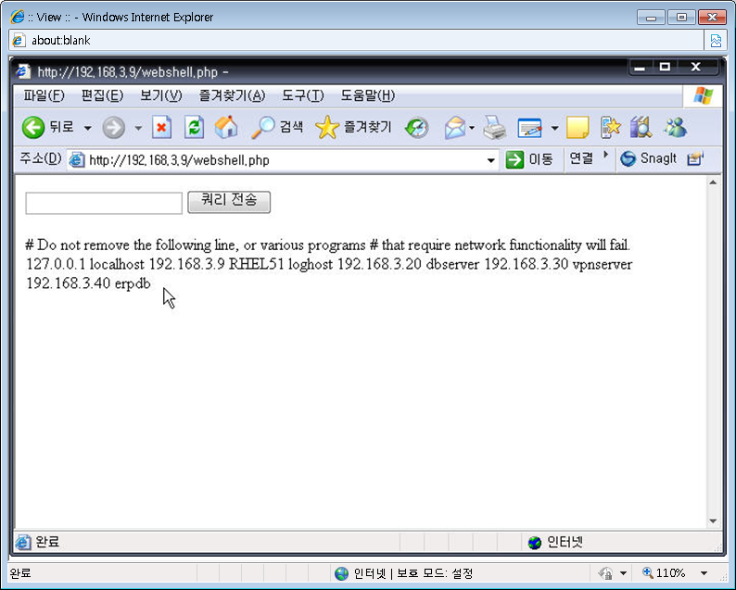
Web Shell

Slide 13
Web Shell
Countermeasure
  Restrict file uploading
  If not possible,
    Check the file extension type and size
    Special attention to cgi, jsp, php, php3, aspx
    Remove the execute permission of the directory
  The web application should not have the root privilege
    chown apache:apache /var/www/html/index.php

Slide 14
Cookie
a piece of text stored by a user's web browser
  arbitrary pieces of data chosen by the Web server and sent to the browser
  The browser returns them unchanged to the server, introducing a state (memory of previous events) into otherwise stateless HTTP transactions
  Without cookies, each retrieval of a Web page or component of a Web page is an isolated event

Slide 15
Cookie
a piece of text stored by a user's web browser
  used for authentication, storing site preferences, shopping cart contents, the identifier for a server-based session, or anything else that can be accomplished through storing text data.
  aka web cookie, browser cookie, and HTTP cookie

Slide 16
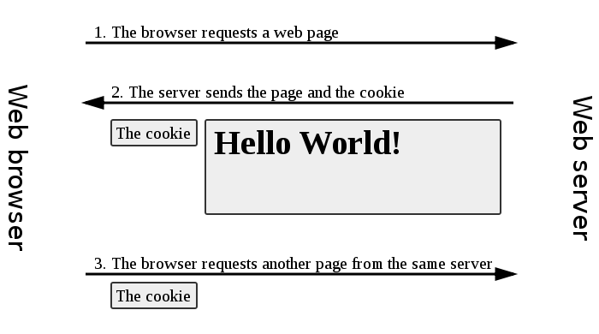
Cookie
Basic operation

Slide 17
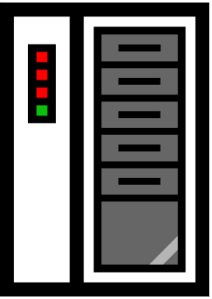

Cookie
Setting/deleting cookies
GET …
HTTP Header:
Set-cookie: NAME=VALUE ;
domain = (when to send) ;
path = (when to send)
secure = (boolean: only send over SSL);
expires = (when expires) ;
HttpOnly (boolean: later)
if expires=NULL:
this session only
scope

Slide 18
Cookie
Cookie example
  Server only sees “”name=vaule
GET /index.html HTTP/1.1
Host: www.example.org
HTTP/1.1 200 OK
Content-type: text/html
Set-Cookie: name=value
(content of page)
GET /spec.html HTTP/1.1
Host: www.example.org
Cookie: name=value
Accept: */*

Slide 19
Cookie
Cookie example
  Cookies are identified by (name,domain,path)
  Cookies are stored in broser’s “cookie jar”
cookie 1
name = userid
value = test
domain = login.site.com
path = /
secure
cookie 2
name = userid
value = test123
domain = .site.com
path = /
secure
distinct cookies

Slide 20
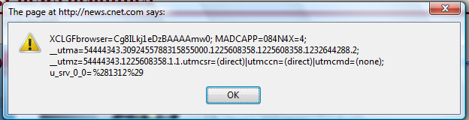
Cookie
Client side reading cookie using javascript
  javascript: alert(document.cookie)
  Displays all cookies for current document

Slide 21
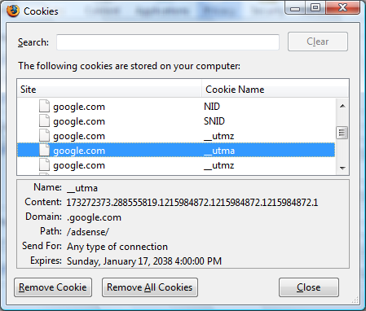
Cookie
Viewing/deleting cookies in Browser UI

Slide 22
Cookie
Problem
  If not protected by SSL, attackers can read cookies and manipulate them (For performance reason, many sites do not apply SSL to all the files except the login process)
  Server is blind
    Not see cookie attributes except “cookie name=value”
  Client can arbitrarily manipulate cookies
    Critical information should not be stored at cookies

Slide 23
Cookie
login server problems
  server is blind
  Alice logs in at login.site.com
    login.site.com sets session-id cookie for .site.com
  Alice visits evil.site.com
    overwrites .site.com session-id cookie with session-id of user “badguy”
  Alice visits cs142hw.site.com to submit homework.
    cs142hw.site.com thinks it is talking to “badguy”

Slide 24
Cookie
  Client can arbitrarily manipulate cookies
  User can change and delete cookie values !!
  Silly example: shopping cart software
    Set-cookie: shopping-cart-total = 150 ($)
    User edits cookie file (cookie poisoning)
    Cookie: shopping-cart-total = 15 ($)
  Similar to problem with hidden fields
    <INPUT TYPE=“hidden” NAME=price VALUE=“150”>
  Not so silly (as of 2000)
    D3.COM Pty Ltd, @Retail Corporation, Adgrafix,…

Slide 25
Cookie
Countermeasure
  Block set/write, erase cookies after browsing
  SSL for all the pages
  Cryptographic checksum : integrity
    server key K
Generate tag: T ← F(k, value)
Set-Cookie: NAME=
value
T
k
Cookie: NAME =
value
T
?
Verify tag: T = F(k, value)

Slide 26
Session management
Session management
  technique used by the web developer to make the stateless HTTP protocol support session state
    HTTP is stateless
  once a user has authenticated herself to the web server, her next HTTP request (GET or POST) should not cause the web server to ask her for her account and password again

Slide 27
Session management
Session management
  The session information is stored on the web server using the session identifier (session ID)
  The "storage" of session IDs and the associated session data (user name, account number, etc.) on the web server is accomplished using a variety of techniques including, but not limited to: local memory, flat files, and databases.

Slide 28
Session management
Session tokens
Browser
GET /index.html
Web Site
set anonymous session token
GET /books.html
anonymous session token
POST /do-login
Username & password
check
credentials
elevate to a logged-in session token
POST /checkout
logged-in session token
Validate
token

Slide 29
Session management
Session tokens : Lots of options
  Browse cookie
    Set-Cookie: SessionToken=fduhye63sfdb
  Embedded in all URL links
    https://site.com/checkout ? SessionToken=kh7y3b
  Hidden form field
    <input type=“hidden” name=“sessionid” value=“kh7y3b”>

Slide 30
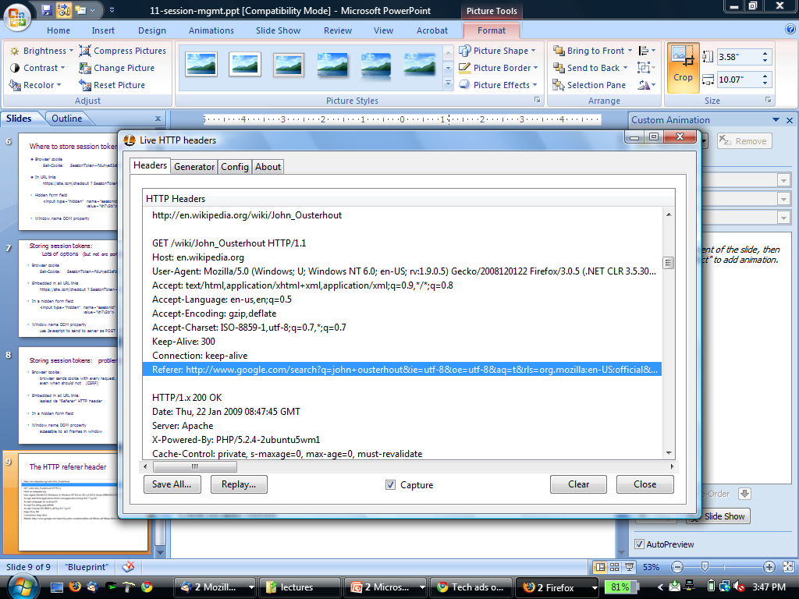
Session management
Session tokens : problems
  Browse cookie
  Hidden form field
  Embedded in all URL links
    token leaks via HTTP Referer header
    Referer leaks URL session token to 3rd parties

Slide 31
Session management
Session hijacking
  Attacker waits for user to login; then attacker obtains user’s Session Token and “hijacks” session
  Predictable tokens, cookie theft, session fixation attacks

Slide 32
Session management
Predictable tokens
  Ex) Verizon wireless used counter
    user logs in, gets counter value, can view sessions of other users
Cookie theft
  Cross Site Scripting (XSS)
    later

Slide 33
Session management
  session fixation attacks
  Suppose attacker can set the user’s session token:
    For URL tokens, trick user into clicking on URL
    For cookie tokens, set using XSS exploits (later)
  Attack: (URL tokens)
    Attacker gets anonymous session token for site.com
    Sends URL to user with attacker’s session token
    User clicks on URL and logs into site.com
      this elevates attacker’s token to logged-in token
    Attacker uses elevated token to hijack user’s session.

Slide 34
Session management
Countermeasure
  When elevating user from anonymous to logged-in, always issue a new session token
  Once user logs in, token changes to value
  unknown to attacker
    Attacker’s token is not elevated

Slide 35
Session management
Countermeasure
  Strong session token
    SID = [ userID, exp. time, data]
      data = (capabilities, user data, ...)
    SessionToken = HMAC (k, SID)
    k: key known to all web servers in site
    For better SID, embed machine specific data in SID
      Client IP address, client user agent (better than nothing)
    Server must still maintain some user state:
      e.g. logout status (should be checked on every request)

Slide 36
XSS
XSS(Cross-site scripting)
CWE-79 Improper Neutralization of Input During Web Page Generation
  The software does not neutralize or incorrectly neutralizes user-controllable input before it is placed in output that is used as a web page that is served to other users
  Type of code injection

Slide 37
XSS
Persistent XSS (or stored XSS)
Non-persistent XSS (or reflected XSS)

Slide 38
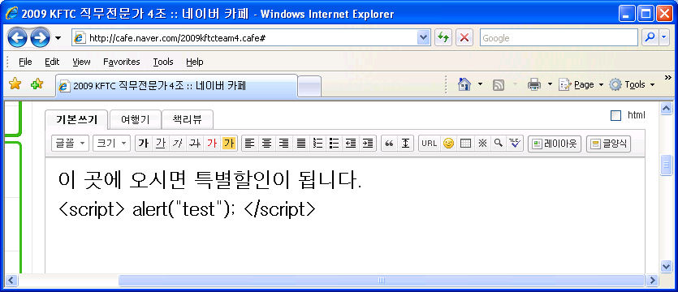
XSS
Persistent XSS (or stored XSS)
  Displaying user input without filtering causes XSS
  Ex) Webboard, webmail, warez,…
Hacking code can be inserted!

Slide 39

XSS
Persistent XSS (or stored XSS)
3.악의적인 code가
있는 게시물 읽음
Client
Server
4.cookie값 전송
2.악의적인 code가
있는 게시물 저장
1.악의적인 code가 있는
게시물 작성 및 전송
attacker

Slide 40
XSS
Non-persistent XSS (or reflected XSS)
  A classic example of a potential vector is a site search engine: if one searches for a string, the search string will typically be redisplayed verbatim on the result page to indicate what was searched for. If this response does not properly escape or reject HTML control characters, a cross-site scripting flaw will ensue.
http://www.vulnerablesite.com/search.jsp?keyword="<SCRIPT> attack code </SCRIPT>

Slide 41
XSS
Non-persistent XSS (or reflected XSS)
  Alice often visits a particular website, which is hosted by Bob. Bob's website allows Alice to log in with a username/password pair and stores sensitive data, such as billing information.
  Mallory observes that Bob's website contains a reflected XSS vulnerability.
  Mallory crafts a URL to exploit the vulnerability, and sends Alice an email, enticing her to click on a link for the URL under false pretenses. This URL will point to Bob's website, but will contain Mallory's malicious code, which the website will reflect.
  Alice visits the URL provided by Mallory while logged into Bob's website.
  The malicious script embedded in the URL executes in Alice's browser, as if it came directly from Bob's server (this is the actual XSS vulnerability). The script can be used to send Alice's session cookie to Mallory. Mallory can then use the session cookie to steal sensitive information available to Alice (authentication credentials, billing info, etc.) without Alice's knowledge.

Slide 42
XSS
Countermeasure
  HTML sanitization
    validate and reject undesirable characters in input fields
    Substitution
  Disabling scripts
JSP: str = str.replaceAll("<", "&lt;"); str = str.replaceAll(">", "&gt;"); str = str.replaceAll("\"", "&quot;"); str = str.replaceAll("'", "&rsquo;");

Slide 43
Reference
Cryptography and network security, W. Stallings, Prentice Hall, 2011
Network security: private communication in a public world, C. Kaufman, etc., Prentice Hall, 2002
Lecture notes from “computer and network security”, S. Chen, University of Florida
wikipedia
http://crypto.stanford.edu/cs142/

