Slide 1
  Part3 : Attack & Defense
  (Web Security 2/2)
1

Slide 2
Roadmap
WEB Overview
Web Shell
Cookie
Session management
XSS
Paros

Slide 3
Roadmap
CSRF
SQL Injection
Insecure Direct Object Reference
Access Control for Administration
Vulnerability Scanner

Slide 4
CSRF
Cross-Site Request Forgery(CSRF)
  aka one-click attack or session riding
CWE-352 Cross-Site Request Forgery (CSRF)
  a type of malicious exploit whereby unauthorized commands are transmitted from a user that the website trusts
  XSS
    exploits the trust a user has for a particular site
  CSRF
    exploits the trust that a site has in a user's browser

Slide 5
CSRF
18 million users of eBay's Internet Auction Co. at Auction.co.kr in Korea lost personal information in February 2008
The attack works by including a link or script in a page that accesses a site to which the user is known (or is supposed) to have been authenticated

Slide 6
CSRF
Ex1)
  Mallory has crafted an HTML image that references a script on Bob's bank's website, e.g.,
    <img src="http://bank.example/withdraw?account=bob&amount=1000000&for=mallory">
  Suppose that Bob's bank keeps his authentication information in a cookie, and the cookie hasn't expired,
  Then the attempt by Bob's brower will submit the withdrawal form with his cookie, thus authorizing a transaction without Bob's approval.

Slide 7
CSRF
Ex2)
  Suppose that a web server does not require the current password to set a new password for the admin account
  The attacker knows that the following request from the admin will reset his/her password
  The attacker uses XSS on the admin to execute
/changepasswd.jsp?newpassword=[new pwd]&confirmpassword=[new pwd confirmed]
<img src="http://www.victim.com/changepasswd.jsp?newpassword=PASSWORD&confirmpassword=PASSWORD">

Slide 8
CSRF
Precondition for successful CSRF
  must target either a site that doesn't check the “Referer” header (which is common).
  must find a form submission at the target site, or a URL that has side effects, that does something (e.g., transfers money, or changes the victim's e-mail address or password).
  must determine the right values for all the form's or URL's inputs: if any of them are required to be secret authentication values or IDs that the attacker can't guess, the attack will fail.
  The attacker must lure the victim to a Web page with malicious code while the victim is logged in to the target site.
Not easy, but powerful
  root user, root PKI, etc.

Slide 9
CSRF
Countermeasure
  Secure session management
  Requiring authentication in GET and POST parameters, not only cookies;
  Checking the HTTP Referrer header;
  Limiting the lifetime of authentication cookies
  When processing a POST, disregard GET parameters
  Requiring a secret, user-specific token in all form submissions

Slide 10
SQL Injection
CWE-89 Failure to Sanitize Data into SQL Queries (aka 'SQL Injection')
a code injection technique that exploits a security vulnerability occurring in the database layer of an application

Slide 11
SQL Injection
The vulnerability is present when user input is either incorrectly filtered for string literal escape characters embedded in SQL statements
or user input is not strongly typed and thereby unexpectedly executed
an instance of a more general class of vulnerabilities that can occur whenever one programming language is embedded inside another

Slide 12
SQL Injection
Structured Query Language
id | name | birth | gpa | password
14 | Anderson | 1987-10-22 | 3.9 | 1414
38 | Jones | 1990-4-16 | 2.4 | 3838
77 | Hernandez | 1989-8-12 | 3.1 | 7777
SELECT name, gpa FROM users WHERE gpa > 3.0;
+-----------+------+
| name | gpa |
+-----------+------+
| Anderson | 3.9 |
| Hernandez | 3.1 |
+-----------+------+

Slide 13
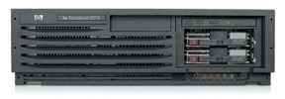
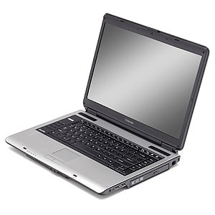
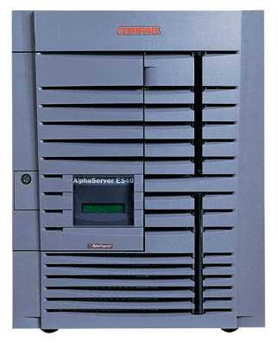
SQL Injection
Web Server
Basic picture
post malicious form
1
2
unintended SQL query
3
receive valuable data
Attacker
Victim SQL DB

Slide 14
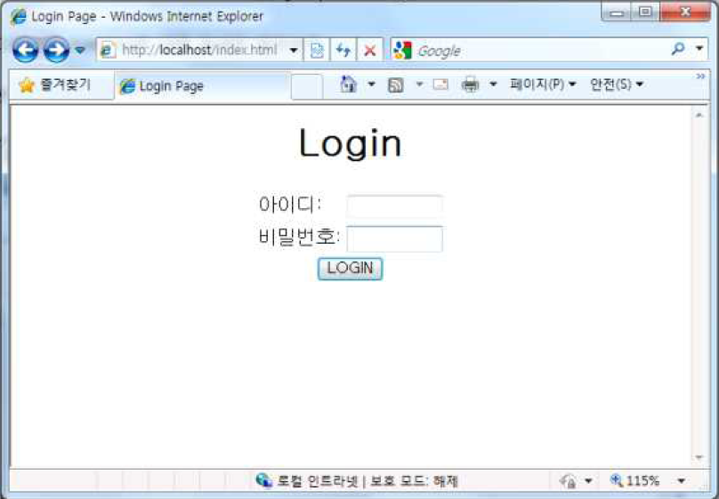
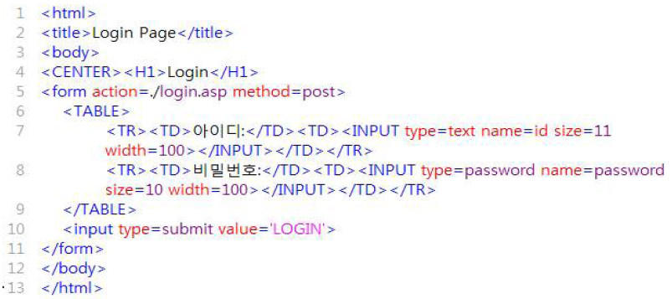
SQL Injection
Experiment
  MS-SQL/IIS/ASP

Slide 15
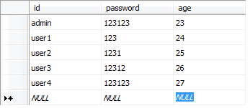
SQL Injection
“members” table

Slide 16
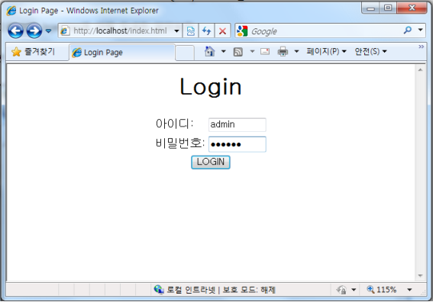
SQL Injection
$sql = "select * from members where id='$id' and password='$password';"

Slide 17
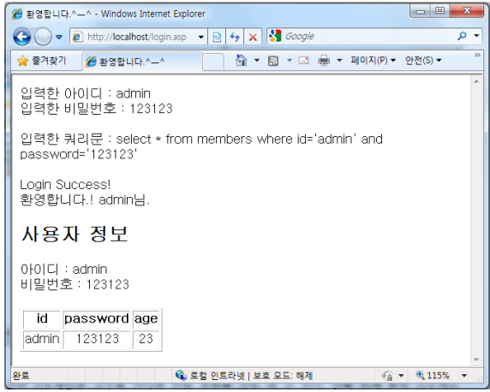
SQL Injection

Slide 18
SQL Injection
$sql = "select * from members where id='$id' and password='$password';"
What happens if either id or password equals ' or '1=1'-- ?
Then,
  $sql = "select * from users where id = '' or '1=1' -- and password = '123123' ";
  $sql = "select * from users where id = 'admin' and password = '' or '1=1'--; "
  In MSSQL, -- means a comment

Slide 19
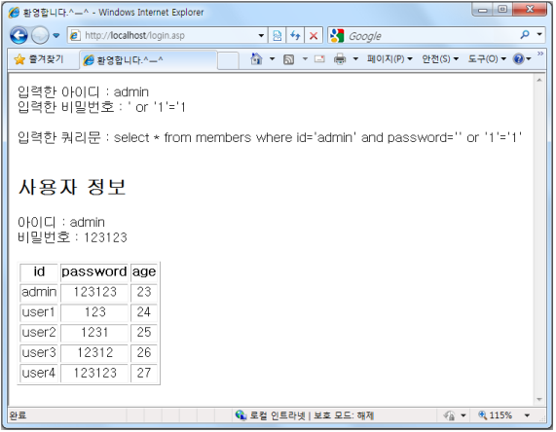
SQL Injection
SQL-Injection successfully done!

Slide 20
SQL Injection
Even worse
  user = “ ′ ; DROP TABLE members -- ”
  $sql = "select * from users where id = ' ′ ; DROP TABLE members -- and password = '123123' ";
  Table members are lost

Slide 21
SQL Injection
Countermeasure
  Never trust input parameters passed by users
  Filter out special characters for form inputs, such as ‘ “ / \ ;
  Do not expose error messages
  Lower the privilege of database account

Slide 22
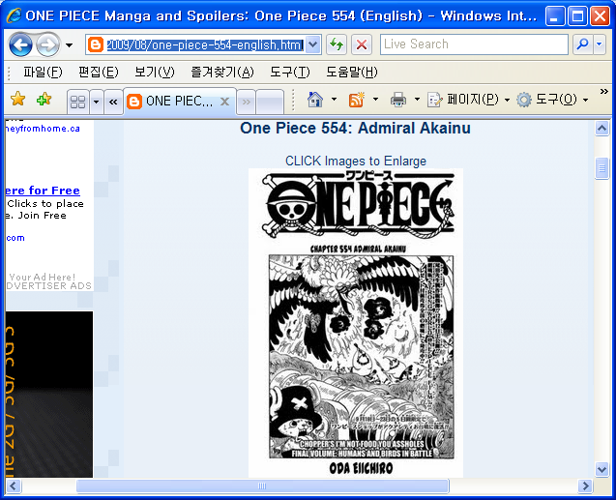
Insecure Direct Object Reference
Users can predict object references if you give them a hint
Why not try “one-piece-555-english.html”
http://onepiece-spoilers.blogspot.com/2009/08/one-piece-554-english.html

Slide 23
Access Control for Administration
Access to admin pages should be restricted
Those names easily guessed should not be used
http://www.site.com/adm http://www.site.com/admin_login.cgi http://www.site.com/admin http://www.site.com/webadmin http://www.site.com/rhksflwk http://www.site.com/manager http://admin.site.com http://manager.site.com http://adm.site.com

Slide 24
Access Control for Administration
Countermeasure
  Distinct port number & firewall access control
  Web server access control
<Directory /www/admin/> AllowOverride AuthConfig Order deny, allow Deny from all Allow from IP lists </Directory>

Slide 25
Vulnerability Scanner
Automatic tool(software) to find known vulnerabilities
  nmap, hping3, nessus, paros,…
Should be carefully used not to stop the services
  Some tools implemented real attacks
Black box v.s. White box

Slide 26
Vulnerability Scanner
Black box
  Goolag ,Nikto ,Whisker ,Wikto , Acunetix Web Vulnerability Scanner, Cenzic Hailstorm , Chinotec Technologies Paros ,HP WebInspect , IBM Watchfire AppScan , MileScan Web Security Auditor , N-Stalker Web Application Security Scanner , PanicSecurity PSScanW3B , Port Swigger Burp Scanner , Syhunt Sandcat
White box (source code verification)
  Amorize CodeSecure , Fortify Software SCA , HP DevInspect , Klockwork Insight , LAPSE , Ounce Labs Ounce ,PMD ,SWATT

Slide 27
Reference
Cryptography and network security, W. Stallings, Prentice Hall, 2011
Network security: private communication in a public world, C. Kaufman, etc., Prentice Hall, 2002
Lecture notes from “computer and network security”, S. Chen, University of Florida
wikipedia
http://crypto.stanford.edu/cs142/

