Slide 1
  Part3 : Attack & Defense
  (Network Security 2/3)
1

Slide 2
Roadmap
ARP level
TCP/IP level
Firewall
High Availability
Intrusion Detection System
DDoS
Intrusion Prevention System

Slide 3
TCP/IP level
IP spoofing
Session hijacking
Injecting false routing information
Port scan

Slide 4
IP spoofing
Easy to change the source IP address of packet
  Raw socket programming in C
    int fd = socket (PF_INET, SOCK_RAW, IPPROTO_TCP);
  Anybody can change the source IP address of the packets generated at his/her host

Slide 5
IP spoofing
Problems?
  DoS (Denial of Service)
    SYN flooding
  DDoS (Distributed Denial of Service)
    Smurf (already covered)
    If we block the source IP addresses of heavy traffic, we just stop normal users’ access
  Hiding the origin of the attacker
    If the source IP address is fake, how can we track the real source?

Slide 6
IP spoofing
Problems?
  Especially vulnerable services
    RPC (remote procedure call services)
    The R services suite (rlogin, rsh, etc.)
    Any service that uses IP address authentication
  Session hijacking
    Later discussed

Slide 7
IP spoofing
Countermeasure
  Ingress/egress filtering
    Based on packet filtering
    Ingress filtering : blocking of packets from outside the network with a source address inside the network
    Egress filtering : blocking of packets from inside the network with a source address that is not inside
      Good citizenship approach → hard to achieve
    RFC 2827

Slide 8
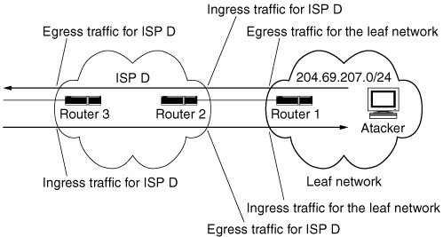
IP spoofing
Countermeasure
  Ingress/egress filtering

Slide 9
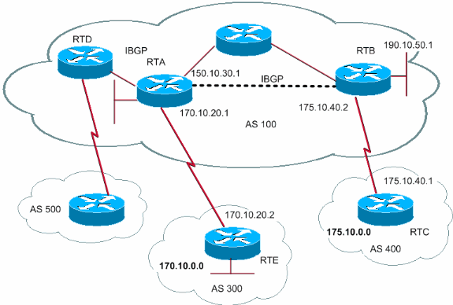
IP spoofing
Route-based Distributed Packet Filtering (at backbone)
  A router drops a packet if the packet is received from an adjacent link that is not on any routing path from the packet’s source to the packet’s destination

Slide 10
IP spoofing
Countermeasure
  design network protocols and services so that they do not rely on the IP source address for authentication

Slide 11
Session hijacking
The exploitation of a valid computer session to gain unauthorized access to information or services in a computer system
  We focus on TCP session hijacking, but it can happen at an application layer as well, HTTP cookie theft for example

Slide 12
Session hijacking
TCP Handshake
C
S
SYN_{C}
Listening
Store data
SYN_{S}, ACK_{C}
Wait
ACK_{S}
Connected

Slide 13
Session hijacking
TCP Sequence Numbers
  Need high degree of unpredictability
    If attacker knows initial seq # and amount of traffic sent, can estimate likely current values
    Send a flood of packets with likely seq numbers
    Attacker can inject packets into existing connection
  Some implementations are vulnerable

Slide 14
Session hijacking
Server A
A, B trusted connection
  Send packets with predictable seq numbers
E impersonates B to A
  IP spoofing, IP address of B
  Opens connection to A to get initial seq number
  DoS B’s queue
  Sends packets to A that resemble B’s transmission
  E cannot receive, but may execute commands on A
E
B

Slide 15
Session hijacking
Countermeasure
  Use a strong sequence number
    RFC 1948 proposes a method of TCP ISN generation that is not vulnerable to ISN guessing attacks
    ISN = M + F(sip, sport, dip, dport, <some secret>)
      M = monotonically increasing clock/counter
      F = crypto hash (typically MD4 or MD5)
      <some secret> = an optional fifth input into the hash function to make remote IP attacks unfeasible
    Most UNIX implementations use RFC 1948 recommendations

Slide 16
Session hijacking
Countermeasure
  Use encryption
  Application-level authentication for critical applications

Slide 17
Injecting false routing information
Routing provides the information required to forward traffic through networks
increasingly scrutinized for security vulnerabilities
various threats against routing protocols
Attackers can send forged protocol packets to a router with the intent of changing or corrupting the contents of its routing table

Slide 18
Injecting false routing information
Routing algorithm
routing algorithm
local forwarding table
header value
output link
0100
0101
0111
1001
3
2
2
1
value in arriving
packet’s header
0111
1
3
2

Slide 19
Injecting false routing information
Routing protocol
  OSPF, RIP, BGP, etc.

Slide 20
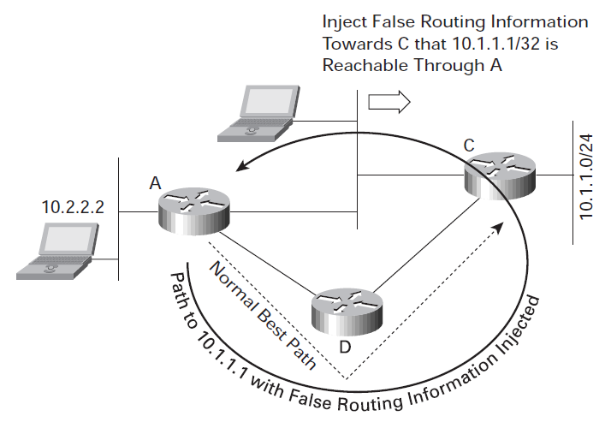
Injecting false routing information
Misdirecting traffic to form a routing loop

Slide 21
Injecting false routing information
Misdirecting traffic to form a routing loop
  Router A consults its routing table, finding the best match to reach 10.1.1.1 is through the route to 10.1.1.0/24, and the best path to 10.1.1.0/24 is through router D. Router A forwards the traffic to router D.
  Router D consults its routing table, finding the best match to reach 10.1.1.1 is through the route to 10.1.1.0/24, and the best path to 10.1.1.0/24 is through router C. Router D forwards the traffic to router C.
  Router C consults its routing table, finding the best match to reach 10.1.1.1 is through the route to 10.1.1.0/24, and the best path is apparently through router A. Router C forwards the traffic to router A.
  Router A, on receiving this traffic, consults its routing table and finds the best match to reach 10.1.1.1 is through the route to 10.1.1.0/24, and the best path is through router D. Router A forwards the traffic to router D.

Slide 22
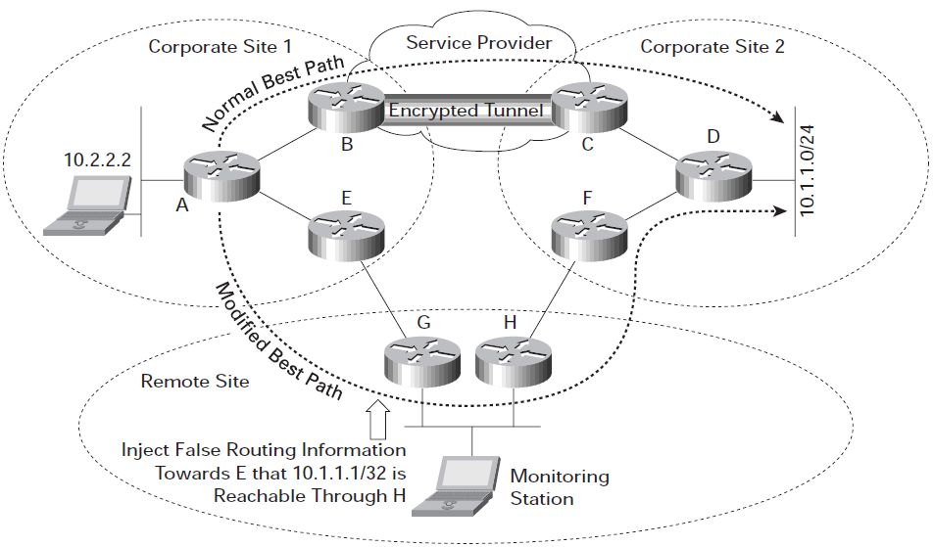
Injecting false routing information
Misdirecting Traffic to a Monitoring Point

Slide 23
Injecting false routing information
Countermeasure
  Ensure that routers form routing protocol peering or neighboring relationships with trusted peers
  Authenticating routing protocol messages
  Most routing protocols support HMAC-MD5 authentication, which uses a secret key combined with the data being protected to compute a hash
  IPSEC

Slide 24
Port scan
An attack that sends client requests to a range of server port addresses on a host, with the goal of finding an active port and exploiting a known vulnerability of that service
Preliminary step before the main attack
Often executed with a tool, called a port scanner
  NMAP, HPING3, etc.

Slide 25
Port scan
Example
  To exploit SSH vulnerability, port scan for TCP/22 or UDP/22
  To exploit LDAP vulnerability, port scan for TCP/389 or UDP/389

Slide 26


Port scan
TCP port scan
Target
Target
SYN
SYN
SYN/ACK
RST/ACK
ACK
<Port Open>
<Port Close>

Slide 27
Port scan
How to detect port scan?
  A large number of distinct destination port numbers are contacted by a source IP address
  How to detect fully distributed port scan?
Stealthy port scan
  To evade the detection, attackers use sophisticated techniques
    TCP SYN scan, ACK scan, FIN scan, XMAS, YMAS, etc…
  Old operating systems did not leave logs for these scans

Slide 28
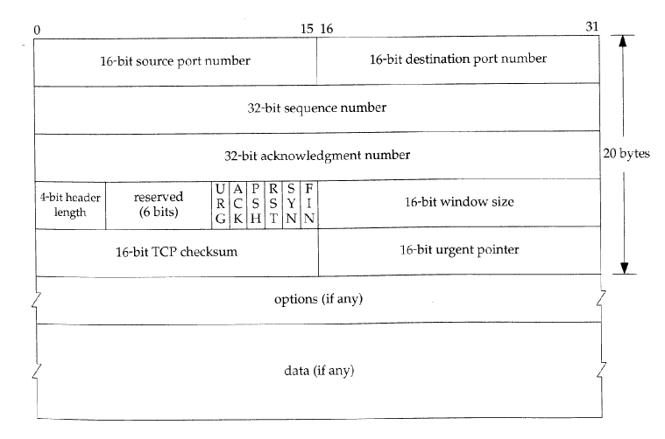
Port scan
TCP flags

Slide 29
Port scan
TCP SYN Scan
Target
Target
SYN
SYN
SYN/ACK
RST/ACK
RST
<Port Open>
<Port Close>

Slide 30
Port scan
TCP ACK Scan
Target
Target
ACK
ACK
RST
RST/ACK
<Port Open>
<Port Close>

Slide 31
Port scan
TCP FIN, XMAS, YMAS Scan
Target
Target
FIN,XMAS,YMAS
FIN,XMAS,YMAS
NO Reply
RST
<Port Open>
<Port Close>

Slide 32
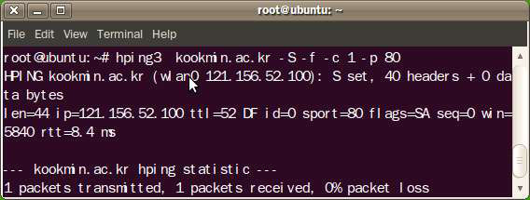
Port scan
Advanced scan with Hping3
  Hping3
    -S : TCP Syn scan
    -f : fragmentation. Divide packet data into multiple fragmented packets of 16byte size to evade security systems like firewalls.

Slide 33
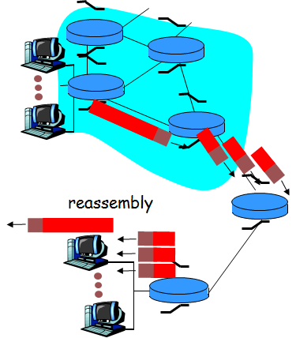
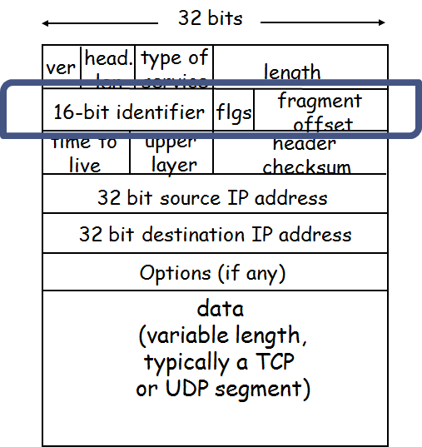
Port scan
Advanced scan with Hping3
  IP fragmentation
    Different MTU(Maximum Transmission Unit) size
    Packet reassembly is done at the destination host

Slide 34
Port scan
Countermeasure
  Do not respond to suspicious packets
  Actually, port scan is hard to stop

Slide 35
Reference
Lecture notes from “computer and network security”, S. Chen, University of Florida
wikipedia
CS 526: Information Security, Purdue

