Slide 1
Test-driven development
Laurent Michel
Software Architect
Softozor

Slide 2
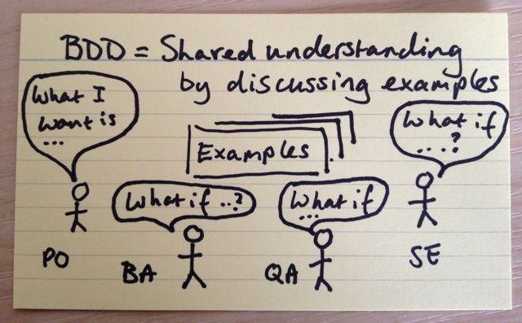
Concepts
BDD

Slide 3
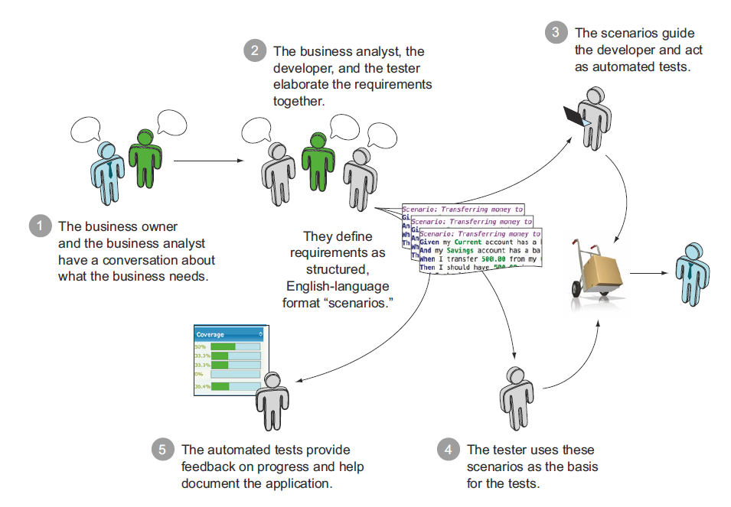
Concepts
Behavior-driven development

Slide 4
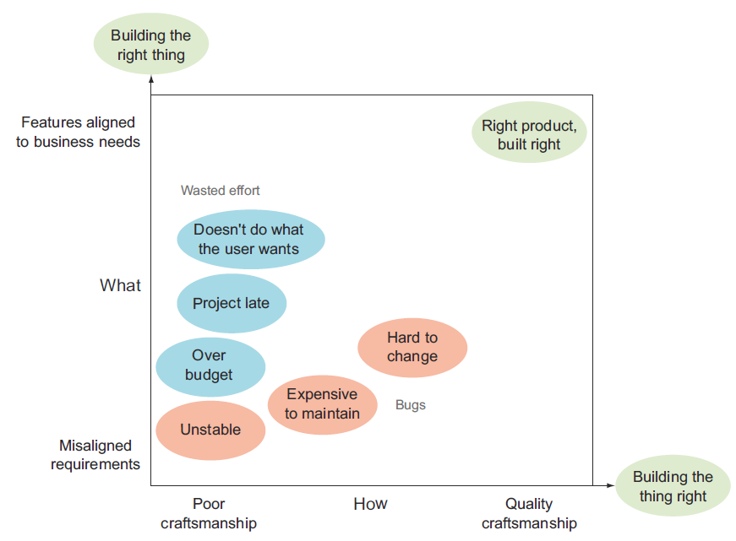
Concepts
Build right thing / build thing right

Slide 5
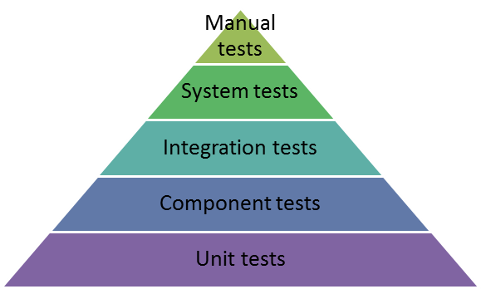
Concepts
Testing pyramid

Slide 6
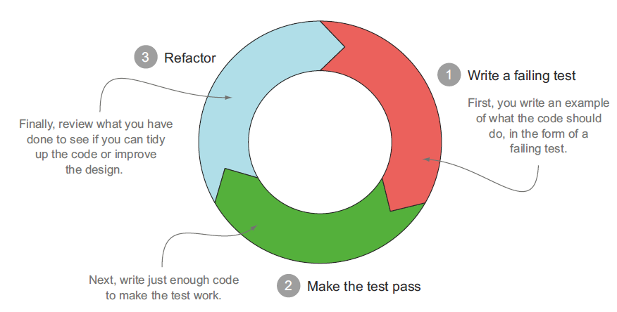
BDD / TDD

Slide 7
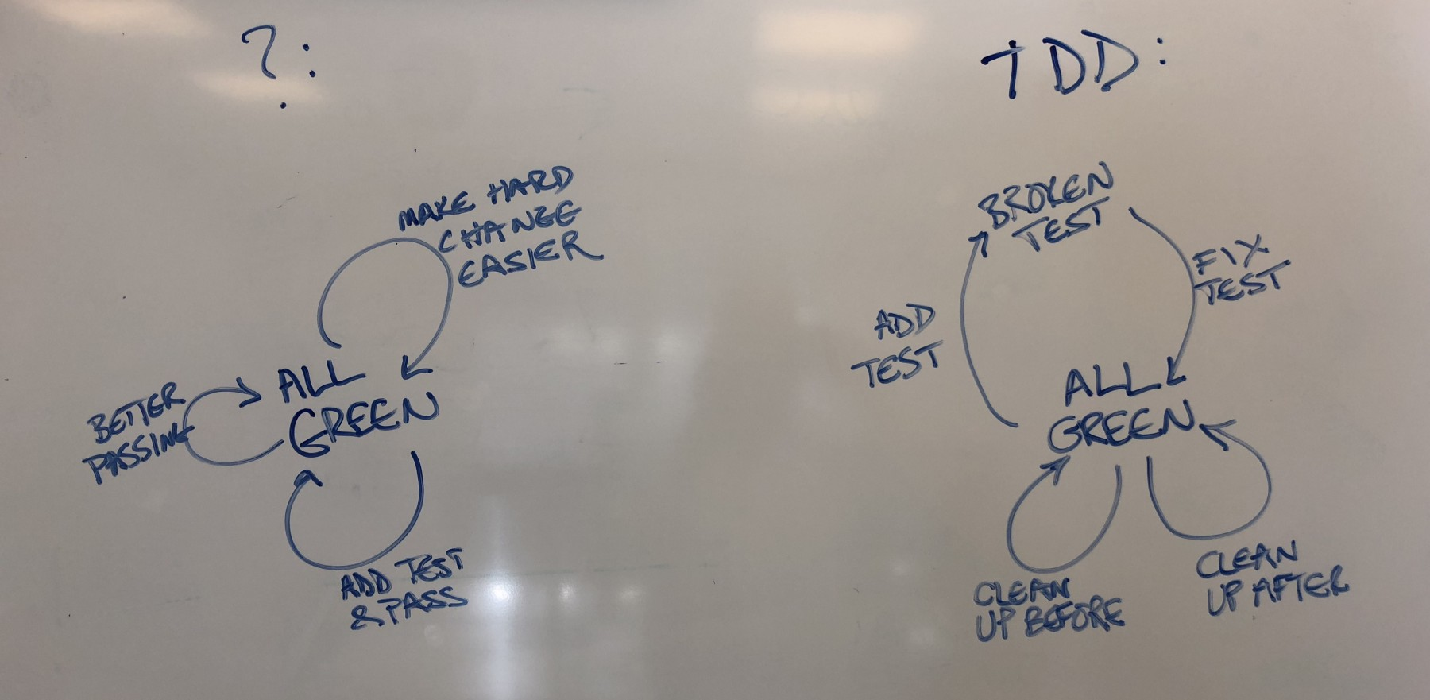
test && commit || revert, Kent Beck
https://medium.com/@kentbeck_7670/test-commit-revert-870bbd756864
https://medium.com/@tdeniffel/tcr-variants-test-commit-revert-bf6bd84b17d3
https://medium.com/@tdeniffel/tcr-test-commit-revert-a-test-alternative-to-tdd-6e6b03c22bec

Slide 8
BDD flow
Getting things done
Phase 1: COLLECT
The customer asks for features, e.g. «I want an Instructor to be able to log in»
Phase 2: CLARIFY→ Gherkin specification
What needs to be done to achieve Instructor login?
Database with user entries
Special permissions
GraphQL / REST API
Frontend form
Security considerations
Token generation
Session cookie
Token refresh mecanism

Slide 9
BDD flow
Getting things done
Phase 3: ORGANIZE
Write the acceptance tests to figure out architecture design in an «outside-in way»
Define backend – frontend contracts (API)
Use fake data whenever necessary, for example fake graphql server responses
Write the unit tests to figure out software design in an «outside-in way»
Phase 4: REFLECT
Regularly consult and maybe adapt the Gherkin spec to see what features haven’t been implemented yet in order to more or less what to do when
Regularly consult and maybe adapt unit tests results to see where you stand in your current implementation

Slide 10
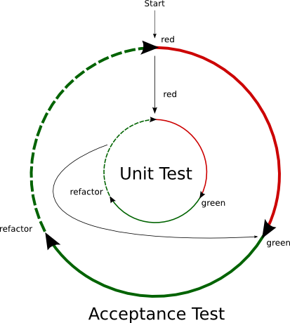
BDD flow
Getting things done
Phase 5: ENGAGE
Write production code

Slide 11
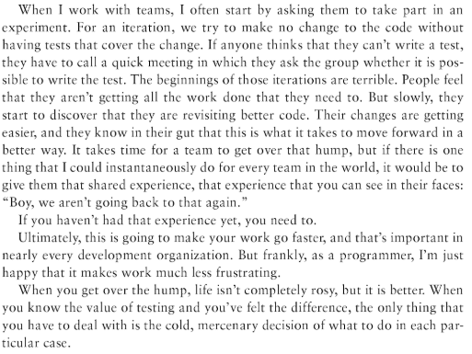
Test-driven development
Michael Feathers

Slide 12
What to test (Pragmatic Unit Testing, A. Hunt & D. Thomas)
Right-BICEP
Are the results right?
Are all the Boundary conditions CORRECT?
Can you check Inverse relationships?
Can you Cross-check results using other means?
Can you force Error conditions to happen?
Are Performance characteristic within bounds?

Slide 13
What to test
Are the results right?
If the code ran correctly, how would I know?
If you can’t answer that question satisfactorily, then writing the code or the tests may be a complete waste of time
Don’t forget that test data is more likely to be incorrect than the code you’re testing (e.g. hand-calculated data or data obtained from a system being replaced)

Slide 14

What to test
Are all the Boundary conditions CORRECT?
Many bugs in code occur around boundary conditions, that is, under conditions where the code’s behavior may be different from the normal, day-to-day routine.
Bogus or inconsistent input values
Badly formatted data that is missing delimiters or terminators
Empty or missing values
Values far in excess of reasonable expectations (age of 10000 years)
Duplicates in list that shouldn’t have duplicates
Ordered lists that aren’t

Slide 15
What to test
Can you check Inverse relationships?
Some methods can be checked by applying their logical inverse
Check a method that calculates a square root by squaring the result
Check that some data was successfully inserted into a database by searching for it
Use a different source for the inverse test as that of the original routine because some bugs might be masked by a common error in both routines

Slide 16
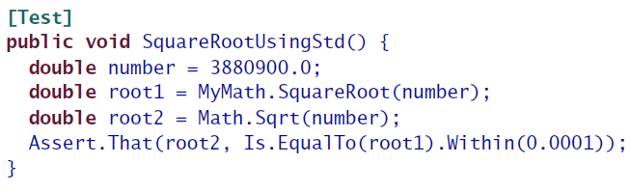
What to test
Can you Cross-check results using other means?
Use different code to verify the same result
When there is a proven way of accomplishing the task that happens to be too slow or inappropriate to use in production, you can use it to test your production solution
Another way of looking at this issue is to use different pieces of data from the class itself to make sure they all “add up” or reconcile

Slide 17
What to test
Can you force Error conditions to happen?
You should be able to test that your code handles real-world problems by forcing errors to occur (try invalid parameters, use mock objects, etc.):
Running out of memory / disk space
Network availability / errors
Insufficient file / path permissions
System load
Very high / low video resolution
Etc.

Slide 18
What to test
Are Performance characteristic within bounds?
Analyze trends as input sizes grow, as problems become more complex, etc.
Suppose you’ve written a filter that identifies web sites that you wish to block. The code works fine with a few dozen sample sites, but will it still work as well with 10’000? 100’000?

Slide 19
Boundary conditions (Pragmatic Unit Testing)
CORRECT
What else can go wrong?
Conformance: Does the value conform to an expected format?
Ordering: Is the set of values ordered or unordered as appropriate?
Range: Is the value within reasonable minimum and maximum values?
Reference: Does the code reference anything external that isn’t under direct control of the code itself?
Existence: Does the value exist (e.g., is non-null, nonzero, present in a set, etc.)?
Cardinality: Are there exactly enough values?
Time (absolute and relative): Is everything happening in order? At the right time? In time?

Slide 20
CORRECT
How would I attack this function?
Conformance
Many times you expect or produce data that must conform to some specific format
E-mails addresses: name@somewhere.com, firstname.lastname@subdomain.somewhere.com, firstname.lastname%somewhere@subdomain.somewhere.com
Internationalization problems
This directly applies to any code that parses file formats or network protocols, avenues by which attacks will come either on purpose or unwittingly

Slide 21
CORRECT
Ordering
Suppose you are writing a method that is passed a collection containing a restaurant order. You would probably expect that the appetizers will appear first in the order, followed by the salad (and that all important dressing choice), then the entree and finally a decadent dessert involving lots of chocolate.
What happens to your code if the dessert is first, and the entree is last?

Slide 22
CORRECT
Range
User who’s 1000 years old
Index of out array bounds
Almost any indexing concept should be extensively tested
Start and end index have the same value
First is greater than last
Index is negative
Index is greater than allowed
Count doesn’t match actual number of items
…

Slide 23
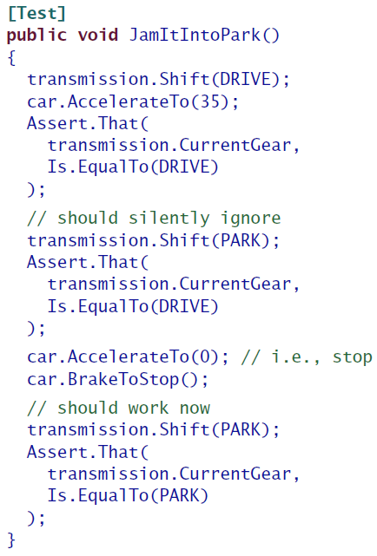
CORRECT
Reference
What things does your method reference that are outside the scope of the method itself? Any external dependencies? What state does the class have to be in? What other conditions must exist in order for the method to work?
The preconditions for a given method specify what state the
world must be in for this method to run. In this case, the precondition for putting the transmission in park is that the car’s engine (a separate component elsewhere in the application’s world) must be at a stop. That’s a documented requirement for the method, so we want to make sure that the method will behave gracefully (in this particular case, just ignore the request silently) in case the precondition is not met.

Slide 24
CORRECT
Reference
What are your method’s post-conditions? Are there any side-effects you need to check?
Code contracts? https://docs.microsoft.com/en-us/dotnet/framework/debug-trace-profile/code-contracts

Slide 25
CORRECT
Does some given thing exist?
Existence
For any value you are passed in or maintain, ask yourself what would happen to the method if the value didn’t exist: if it were null, or blank, or zero, or an empty string, or an empty collection
Things in the environment can wink out of existence as well: networks, files’ URLs, license keys, users, printers, permissions that had been fine last time you checked. All of these things may not exist when you expect them to, so be sure to test with plenty of nulls, zeros, empty strings and other nihilist trappings

Slide 26
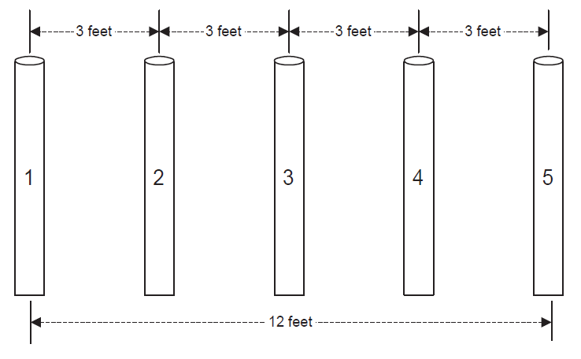
CORRECT
Do I have exactly as many as I need?
Cardinality
Off-by-one errors («fence post errors»)
«0-1-n Rule»
Beware of the number 260 on Windows ☺

Slide 27
CORRECT
Time
Does the order in which you call your methods matter? Try calling methods out of the expected order
Absolute time (elapsed and wall clock)
Concurrency issues → exercise time-outs, asynchronous calls, etc.

Slide 28
Properties of good tests (Pragmatic Unit Testing)
A-TRIP
Automatic
Thorough
Repeatable
Independent
Professional

Slide 29
Properties of good tests (Pragmatic Unit Testing)
Automatic
You will run the tests over and over again → they need to be automatic
You need a server that continuously runs the tests automatically
You need an automated way of checking whether the tests have passed or not
Unit-tests need to be silent, self-contained, and fast

Slide 30
Properties of good tests (Pragmatic Unit Testing)
Thorough
Test everything that’s likely to break
Test every line of code?
Test the most likely candidates (boundary conditions, missing and malformed data, …)?
Bugs tend to clump together in problematic areas

Slide 31
Why most unit testing is waste, J. O. Coplien
Keep regression tests around for up to a year — but most of those will be system-level tests rather than unit tests.
Keep unit tests that test key algorithms for which there is a broad, formal, independent oracle of correctness, and for which there is ascribable business value.
Except for the preceding case, if X has business value and you can test X with either a system test or a unit test, use a system test — context is everything.
Design a test with more care than you design the code.
Turn most unit tests into assertions.
Throw away tests that haven’t failed in a year.
Testing can’t replace good development: a high test failure rate suggests you should shorten development intervals, perhaps radically, and make sure your architecture and design regimens have teeth
If you find that individual functions being tested are trivial, double-check the way you incentivize developers’ performance. Rewarding coverage or other meaningless metrics can lead to rapid architecture decay.
Be humble about what tests can achieve. Tests don’t improve quality: developers do.

Slide 32
Properties of good tests (Pragmatic Unit Testing)
Repeatable
Tests must be independent of the environment
Must be able to run over and over again in any order and produce the very same results
Tests must not rely on anything in the external environment that isn’t under your direct control (databases, system time, network conditions, global variables [e.g. Singletons], etc.)

Slide 33
Properties of good tests (Pragmatic Unit Testing)
Independent
Tests need to be kept neat and tidy, tightly focused, and independent from the environment and each other
When a test fails, it should be obvious where in the code the underlying bug exists without looking at the test code itself; the name of the test should tell us all we need to know
No test relies on any other test; we should be able to run any individual test at any time and in any order
Per-test setup / tear down
Per-fixture setup / tear down

Slide 34
Properties of good tests (Pragmatic Unit Testing)
Professional
Test code needs to be written and maintained to the same professional standards as your production code
Test code is real code
Test code must be thorough in that it must test everything about a behavior that might break → don’t waste your time testing e.g. simple getters / setters
Expect that there will be at least as much test code written as there will be production code

Slide 35
What about testing the test code?
Improve tests when fixing bugs
Prove tests by introducing bugs

Slide 36
How to fix a bug in production code?
Pragmatic bug fixing
The testers notify a bug
The testers / developers write a series of tests that fail because of the bug
The developers write the minimum amount of code that makes the tests pass
The developers refactor the fixed code until it reaches satisfying quality
Ask yourself the question: «could this same kind of problem happen anywhere else?» → catch a whole class of bugs
➔ One huge advantage of this is that the testers really provide the most precise possible bug descriptions, therefore we minimize the amount of unclear communication

Slide 37
Prove tests by introducing bugs
Cause the production code to exhibit the very bug you’re trying to detect and verify that the test fails as expected

Slide 38
Spike solutions
Quick’n’dirty experimentations
If
you are new to the framework you are using
you are not 100% confident with your framework
then, go for a spike solution:
code just enough to get the answers you need
instead of carefully building things up layer by layer, just brute-force your code
throw your spike away when you’re done with it

Slide 39
Gotchas
Flickering tests: some of our tests fail randomly
Brittle tests: we keep breaking tests unintentionally
Slow tests: our tests take too long to run

Slide 40
Gotchas
Flickering tests
A flickering test fails occasionally and at random. The same scenario, run on the same codebase in the same environment, will mostly pass but sometimes fail. These apparently uncontrollable failures cause the team to lose confidence in their tests, in their code, and in themselves.
For a suite of automated tests to be useful, the team must have absolute trust in it
To fix such a test, you have to study the code and try to understand why it might be happening → very hard
Such a gotcha is usually caused by one of the following underlying problems:
Shared environments → make it easy to spin up the system in a new environment (e.g. by a one-click system setup)
Leaky tests
Race conditions and sleepy steps

Slide 41
Gotchas
Flickering tests
Such a gotcha is usually caused by one of the following underlying problems:
Shared environments
You need to make it easy to spin up the system in a new environment (e.g. by a one-click system setup)
Leaky tests
You need to clean up the environment when any test is finished
You don’t want a test’s state to be dependent on another test’s results
Race conditions and sleepy steps
Resist the temptation to leave a sleep in your tests once you understand the cause of the problem!

Slide 42
Gotchas
Brittle tests
A brittle test is easy to break. When tests are brittle, a necessary change in one part of the test suite or main codebase causes apparently unrelated tests to break.
Such a gotcha is usually caused by one of the following underlying problems:
Fixture data:
some experts consider that an anti-pattern because of the bloating of data fixtures; rather use test data builders instead (http://www.natpryce.com/articles/000714.html)
Duplication
Leaky scenario

Slide 43
Gotchas
Slow tests
The main reason to keep a test running is for feedback: you want that test to warn you if you somehow accidentally break the functionality that it checks for. The value of the feedback diminishes as your test run starts taking longer and longer
When the build is slow, developers don’t run all the tests before committing code and will rely on the CI server to give them feedback instead
Longer test runs mean people are scared to refactor and do other general maintenance on the tests themselves

Slide 44
Gotchas
Slow tests
Such a gotcha is usually caused by one of the following underlying problems:
Race conditions and sleepy steps
Lots of scenarios
You can choose to run partitioned sets of tests in parallel or devote some of them to run in a nightly build
Big ball of mud (http://www.laputan.org/mud/)
The Big Ball of Mud is an ironic name given to the type of software design you see when nobody has really made much effort to actually do any software design. In other words, it’s a big, tangled mess.

Slide 45
Good reads on the topic
«The Cucumber Book», M. Wynne and A. Hellesoy
«Working effectively with Legacy Code», M. Feathers
«Pragmatic Unit Testing in C# with NUnit», A. Hunt and D. Thomas

Slide 46
Application to the development of the PersonManagement module

Slide 47
Executable specification tools
Some references
https://jp-lambert.me/comparing-executable-specification-tools-b7081cc26315

Slide 48
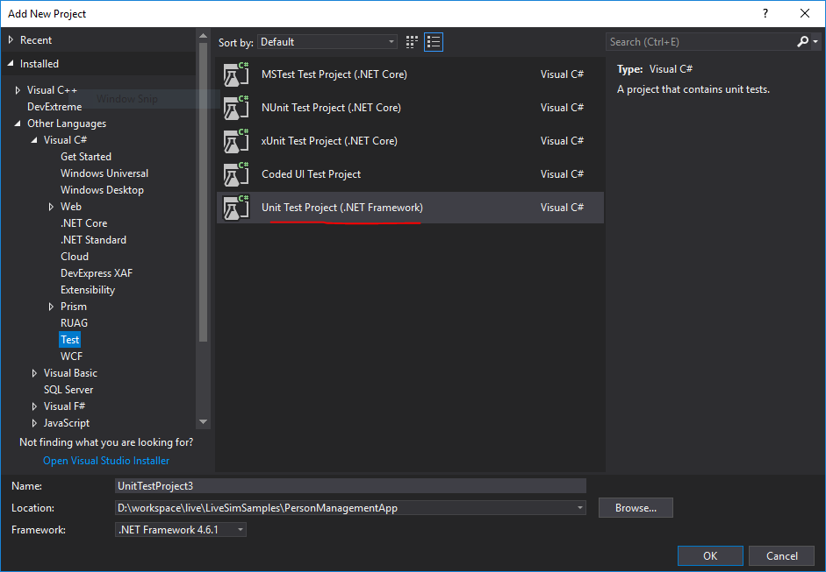
Specifying the modules features
https://specflow.org/getting-started/
SpecFlow installation
Install Visual Studio’s SpecFlow extension
Create a new LiveSim Application and Module Template
Add a new «Unit Test Project (.NET Framework)»

Slide 49
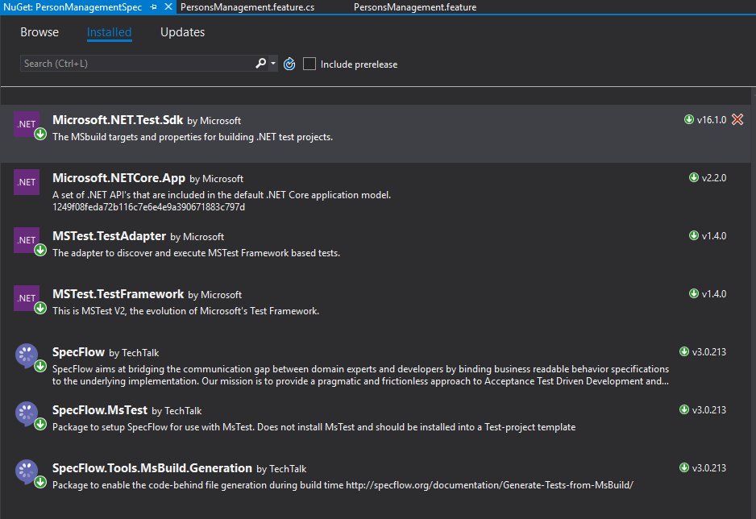
Specifying the modules features
https://specflow.org/getting-started/
SpecFlow configuration
Install SpecFlow, SpecFlow.MsTest, and SpecFlow.Tools.MsBuild.Generation nuget packages in test project

Slide 50
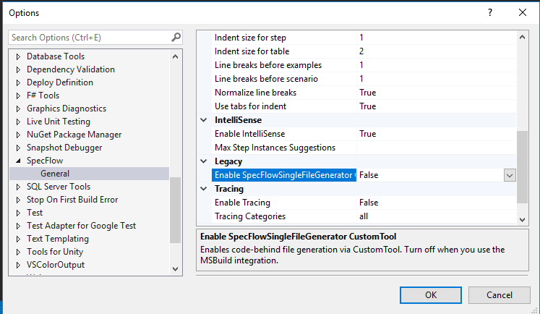
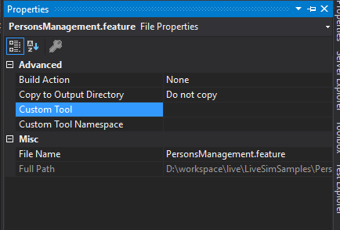
Specifying the modules features
SpecFlow configuration

Slide 51
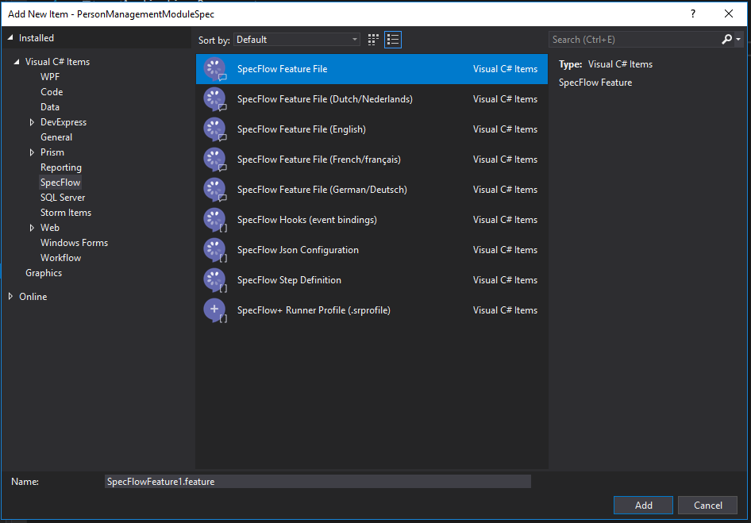
Specifying the modules features
Creating feature file
Live coding session

Slide 52
Specifying the modules features
Planning work with user stories
Feature files are discussed at least in refinement sessions together with
PO
Developers
Testers
Feature files are ready before the next sprint
Ideally the acceptance tests are written before the next sprint because their writing addresses architecture / software design which eases estimation

