Slide 1
Group 19
Nil Patel
Sopheap Sok
Jackson Boyd
Omar Desvergunat

Slide 2
Purpose and Motivation
Create a Study aid for students that allows them to study in a productive and efficient way

Slide 3
Compared to Alternatives
They do not have a pomodoro timer
Evernote does not have the option to make flash cards

Slide 4
User Stories and Requirements
As a user, I want to be able to create a new note
As a user, I want to be able to update an existing note
As a user, I want to be able to view all saved notes in my account
As a user, I want to be able to input how long I want to study for
As a user, I want to be able to view how long I’ve studied certain materials
As a user, I want to be able to create a new flashcard
As a user, I want to be able to update an existing flashcard
As a user, I want to be able to view all saved flashcards in my account

Slide 5

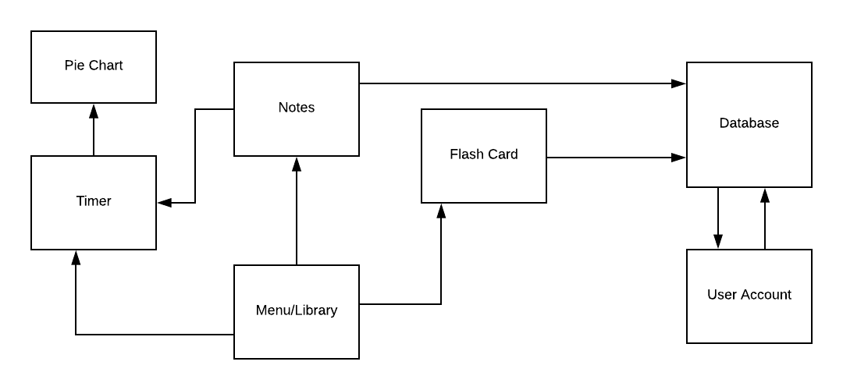
Architecture

Slide 6
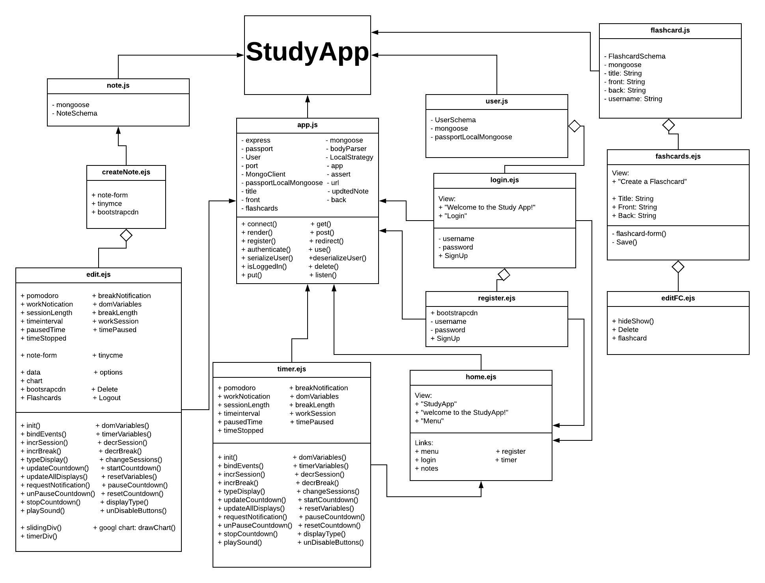
UML Diagram

Slide 7
Technologies Used
Node.js
HTML/CSS
MongoDB
Bootstrap
C9
Katalon
Mocha
Chai

Slide 8
Algorithms
Saving and counting the time elapsed while on a note’s page

Slide 9
Testing Methods
Katalon used for acceptance tests
Mocha and Chai used for testing routes

Slide 10
Future Plans
Collaborate with other users on notes/flashcard
Shuffle flashcard deck
Download notes
User able to upload files
Organize notes based on category/preference
Save study times to database

Slide 11
Demo
https://warm-eyrie-11186.herokuapp.com/

Slide 12
Questions?

