Slide 1
PiBery
Diagrams

Slide 2
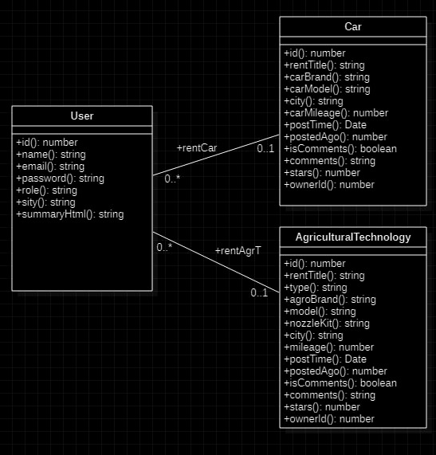
Class Diagram

Slide 3
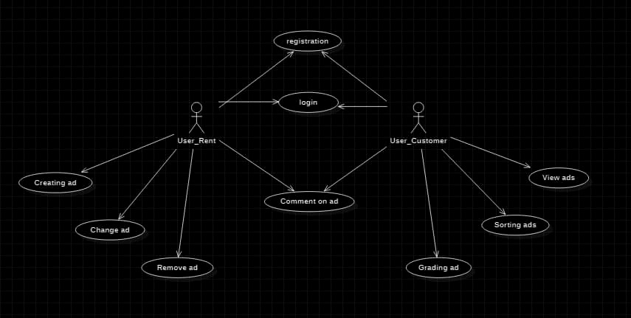
Use Case Diagram

Slide 4
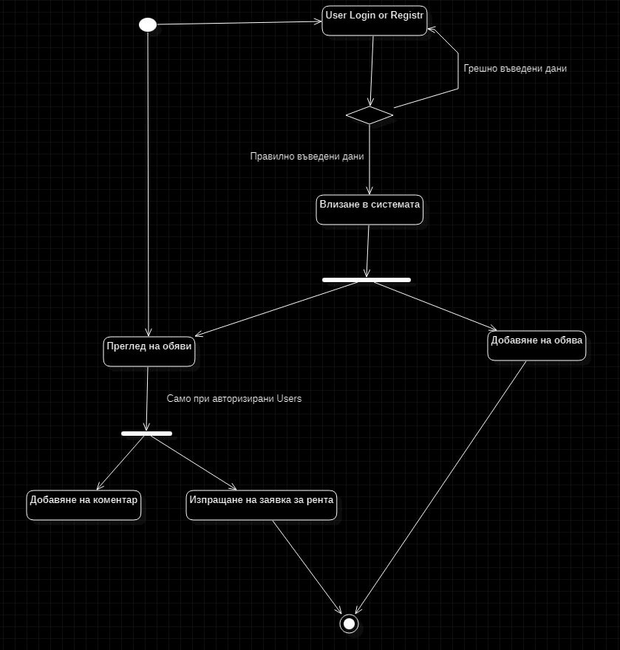
Activity Diagram

