Slide 1
Connection Between Back End and Python code
Green: Alireza
Blue: Mojtaba
Red: Database
Black: Mehdi

Slide 2
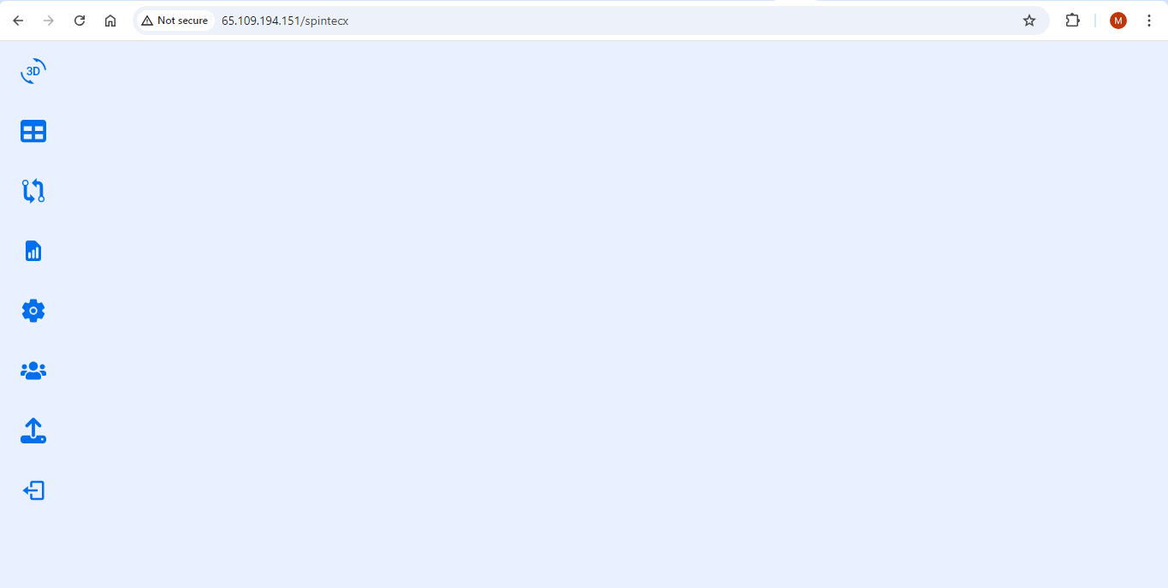
Pages
3D Visual
One scan analysis
One Scan analysis detail(Table Graph)
Compare results of multiple scan (Compare Data)
Generate Report
Setting
Users
Upload
Logout
If the page scrolling can not be removed, the footer can be hide with button.
The object must be have adaptable size for different resolution of screen or screen size
Add Footer Table

Slide 3
Footer
Select Scan
% of process state
Image Folder Name
Modality
Orientation
Series Description
Series Date
Sequence name
Bandwidth
Field Strength
Gradient Strength (mT/m)
Encoding
Manufacture
Model
Engine version
Number of Slices
Series UID
Station Name
Add Footer Table

Slide 4
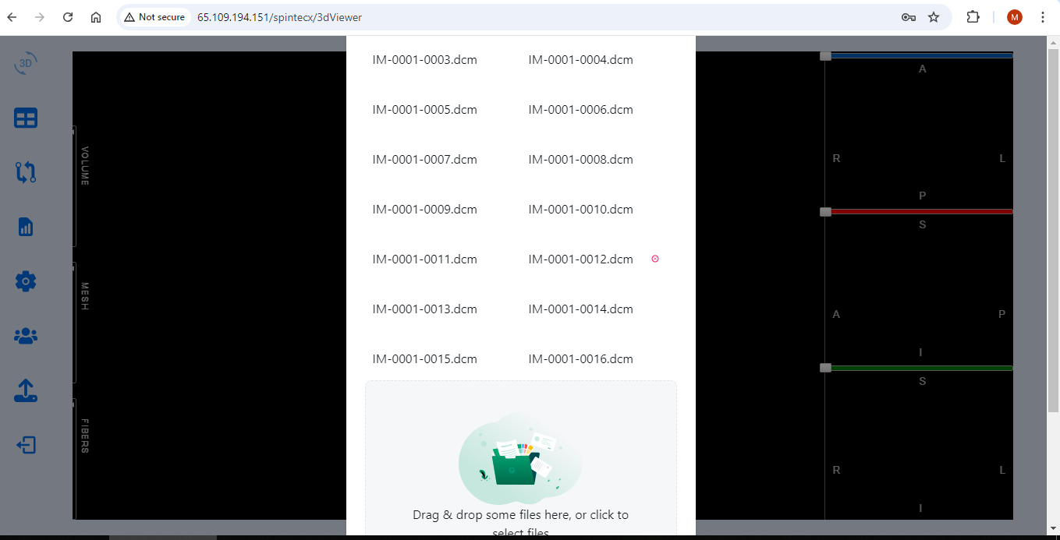
Load Dialog
دکمه OK در پایین صفحه امکان کلیک کردن را ندارد و با Scroll کردن dialog بارگذاری بسته میشود.

Slide 5
Load Dialog
Front Request:
After Loading Image
send to Python -> id
Python Output:
Python find Location from id in Database
Sorting & Generate Folder. Write End of Work and location with Id in Database
Extract Dicom Information for Footer table and image size in Database

Slide 6
Analysis
Front Request:
send to Python -> id
Python find Location from id in Database
Python Output:
Analysis Progress percent in Database
Analysis Output: Write for Id:
Distortion for all points (dx, dy, dz, dr) in Database
Summary of Statistic: dx, dy, dz, dr (Number of find points,mean, max & coordinate, min& coordinate , std, % above ???) in Database (??? Read from Database)
Phantom Alignment In Database
Find the Slices limits of (X,Y,Z) in Database
Curves: Json in Database
Cumulative
Histogram (bin & width?)
Mean distortion
Scatter plot of distortion

Slide 7
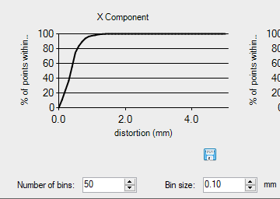
Curves Definition: Cumulative
Cumulative point with less that specific distortion
Can be saved as csv file
Number of Bins and Bin size define the curve zoom.(check if we have all points what happen for linear curve) otherwise must be request for each curve to generate by Python and write in Database

Slide 8
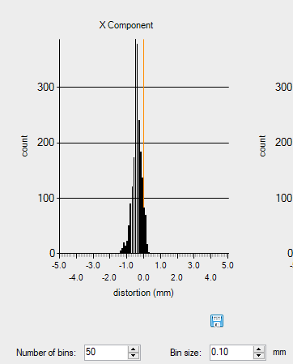
Curves Definition: Histogram
Histogram of Number of Points with the specific distortion inside the specific bin of distortion
Can be saved as csv file
Number of Bins and Bin size define the curve zoom.(check if we have all points what happen for linear curve) otherwise must be request for each curve to generate by Python and write in Database

Slide 9
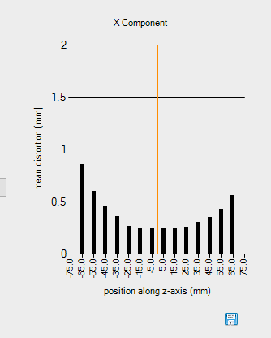
Curves Definition: Mean distortion
In distance of z from isocenter, what is mean of distortion on x-y plan
Can be saved as csv file

Slide 10
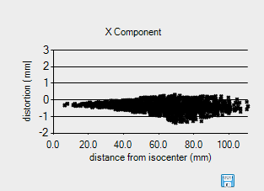
Curves Definition: Scatter distortion
Distortion for all points on the sphere with radius of r from center of Isocenter.
Can be saved as csv file

Slide 11
Page: One Scan Analysis
All Data for this Page can be find in Database
Statistics Summary
 | Mean(mm) | STD(mm) | Max(mm) | % above ??
dx
dy |  |  |  | ???????
dz |  |  |  | ???????
dr
Curve Type selection
X curve
y curve
Z curve
abs curve

Slide 12
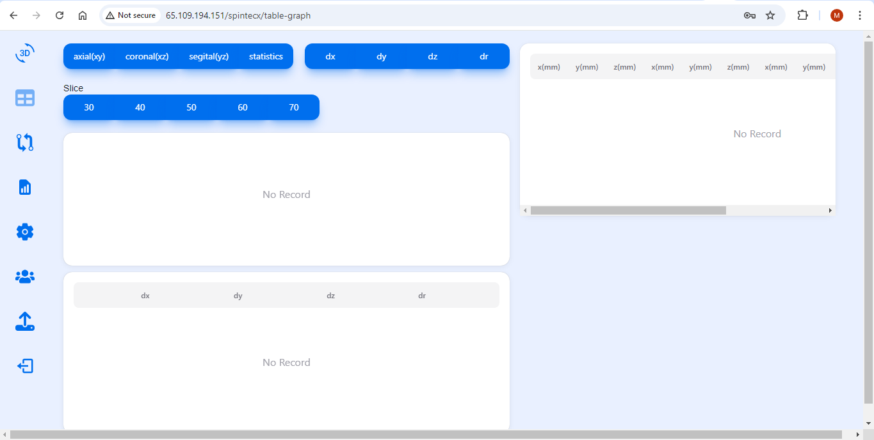
Page: One Scan Analysis Detail (Table Graph)
All Data for this Page can be find in Database
All Data for this Page can be find in Database
Front request:
id,(ax, cor, sag), slice
Python: find Slice from database and write as Json in DataBase
All Data for this Page can be find in Database
Max,min,std,find points, max coordinate,min coordinate
A Button for showing and Hiding, Top Table Expanding when it is hidden.

Slide 13
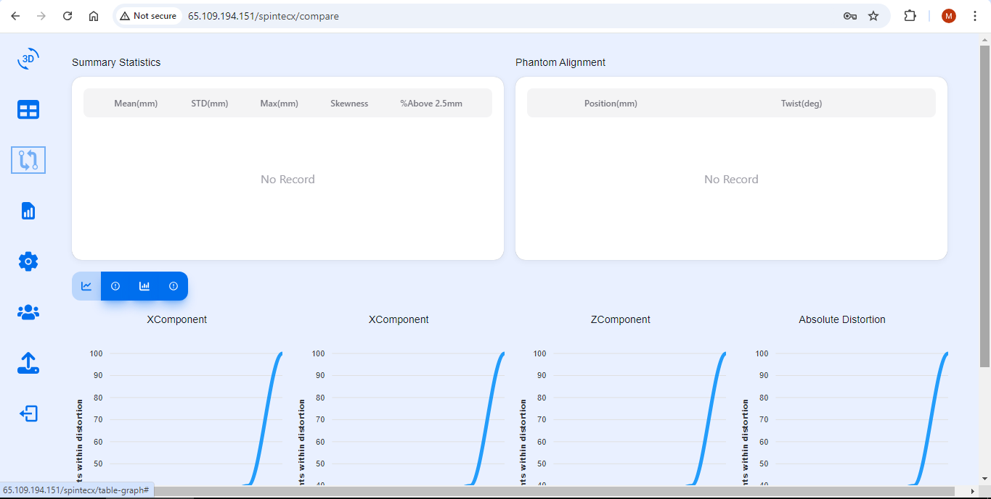
Page: Compare results of multiple scan (Compare Data)
All Data for this Page can be find in Database
For all analyzed scans tou should show datas
Phantom Alignment can be hide in this state
Curve must be pushed up so that the user is not required scroll the page.
Curves:
Cumulative
Histogram
Scatter (bandwidth-mean distortion)
dx
dy
dz
dr
 | Mean(mm) | STD(mm) | Max(mm) | % above ??
Scan1
Scan2

Slide 14
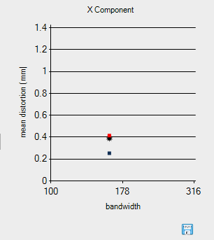
Curves Definition: bandwidth–mean distortion
Plot of Mean distortion of each series against its bandwidth
Can be saved as csv file

Slide 15
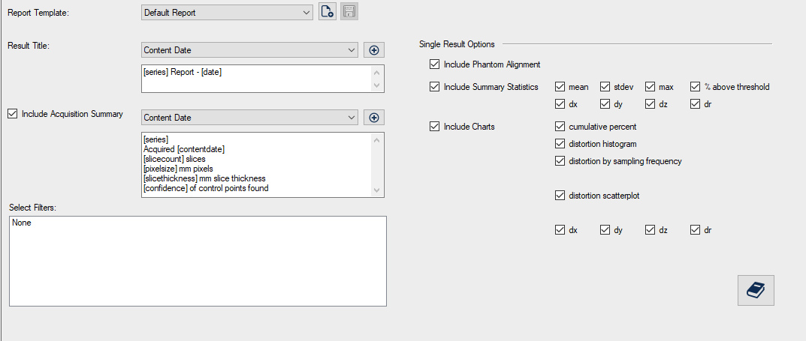
Page: Generate report
Generate PDF File according this

Slide 16
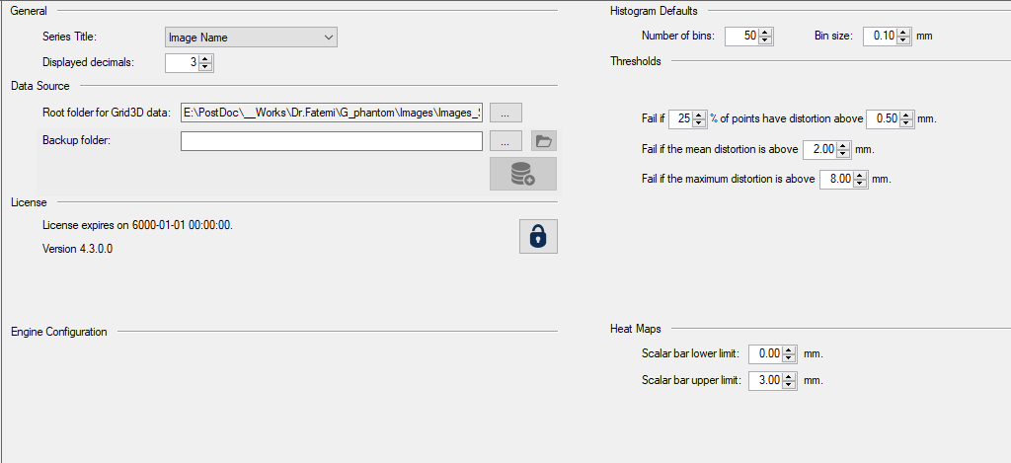
Page: Settings
Mojtaba

