Slide 1
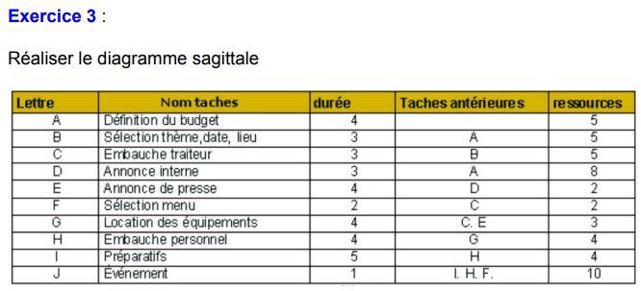

Slide 2
Diagramme sagittal
3
C
5
B
F
9
J
10
1
A
2
C’
I
D
4
6
7
8
E
G
H

