Slide 1

Academia 2015 - jQuery

Slide 2
Disclaimer
Document Name:
Data Classification: INTERNAL
Disclaimer
The contents of this document are property of Softtek, and are classified as Confidential. Any reproduction in whole or in part is strictly prohibited without the written permission of Softtek.
This document is subject to change. Comments, corrections or questions should be directed to the author.
Audience/Viewership | Purpose
Java Academiy trainees | Training
Revision Chart
The following chart list the revisions made to this document. Use this to describe the changes and additions each time this document is re-published. The description should be detailed as possible and include the names of the reviewers who request the changes.
Version No. | Version Date | Types of Changes | Owner/Author | Date of Review/Expiration
1.0 | 20-08-15 | Initial draft | David Orozco

Slide 3
Level 1 What is jQuery

Slide 4
What is jQuery
Query is a fast, small, and feature-rich JavaScript library. It makes things like HTML document traversal and manipulation, event handling, animation, and Ajax much simpler with an easy-to-use API that works across a multitude of browsers

Slide 5





jQuery characteristics
jQuery makes it easy to:
Find
elements in an HTML document
Change
HTML content
Listen
to what a user does and react accordingly
Animate
content on the page
Talk
over the network to fetch new content

Slide 6

Changing Content
<!DOCTYPE html>
<html>
<head>
<title>jQuery Adventures</title>
</head>
<body>
<h1>Where do you want to go?</h1>
<p>Plan your next adventure.</p>
</body>
</html>
How can we modify the text
of the <h1> element?
Find it
Change it

Slide 7
Finding the proper HTML
<!DOCTYPE html>
<html>
<head>
<title>jQuery Adventures</title>
</head>
<body>
<h1>Where do you want to go?</h1>
<p>Plan your next adventure.</p>
</body>
</html>
Find it
How can we search
through our html?
We need to understand how our browser
organizes the HTML it receives.

Slide 8
Document Object Model
A tree-like structure created by browsers so we can quickly find HTML Elements using JavaScript.
“DOM”

Slide 9
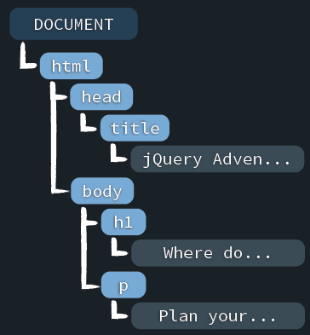
What does that DOM structure look like?
<!DOCTYPE html>
<html>
<head>
<title>jQuery Adventures</title>
</head>
<body>
<h1>Where do you want to go?</h1>
<p>Plan your next adventure.</p>
</body>
</html>
Inside the DOM, HTML elements become “nodes” which have relationships with one another.
node types:

Slide 10

How do we search through the DOM?
JavaScript
JavaScript gives developers a
language to interact with the DOM.
node types:

Slide 11

How do we search through the DOM?
Web Server
Web Browser
Loads into
Requests a Webpage
HTML
HTML
DOM
Sends the HTML
+ other files needed
to load that page
Interacts with
JavaScript
JavaScript

Slide 12





Of course, there’s a catch
DOM
DOM
each browser has a slightly different DOM interface
DOM
JavaScript
DOM
DOM

Slide 13

jQuery to the rescue!
DOM
DOM
DOM
JavaScript
DOM
If our JavaScript uses jQuery to interact
with the DOM then it will work on most
modern browsers.
DOM

Slide 14
Basic jQuery usage
jQuery(<code>);
JavaScript
this is the jQuery function
But how can we search through the DOM?

Slide 15
We need to use CSS selectors
<!DOCTYPE html>
<html>
<head>
<title>jQuery Adventures</title>
</head>
<body>
<h1>Where do you want to go?</h1>
<p>Plan your next adventure.</p>
</body>
</html>
CSS selectors
h1 { font-size: 3em; }
p { color: blue; }

Slide 16

Using the jQuery function to find nodes
<!DOCTYPE html>
<html>
<head>
<title>jQuery Adventures</title>
</head>
<body>
<h1>Where do you want to go?</h1>
<p>Plan your next adventure.</p>
</body>
</html>
jQuery selectors
jQuery("h1");
$("h1");
jQuery("p");
$("p");
short & sweet syntax

Slide 17
Changing the content of an element
<!DOCTYPE html>
<html>
<head>
<title>jQuery Adventures</title>
</head>
<body>
<h1>Where do you want to go?</h1>
<p>Plan your next adventure.</p>
</body>
</html>
How can we modify the text
of the <h1> element?
Find it
Change it

Slide 18
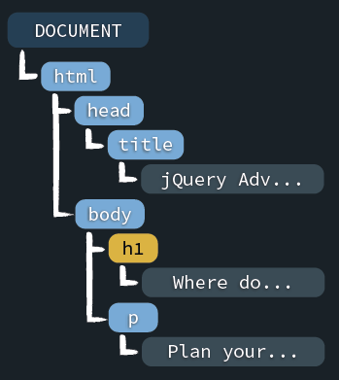
Selecting by HTML element name
text() is a method offered by jQuery
$("h1").text();
"Where do you want to go"
$("h1").text("Where to?");
text() also allows to modify the text node

Slide 19

JavaScript may execute before the DOM loads
HTML
DOM
0%
50%
100%
$("h1").text("Where to?");
We need to make sure the DOM has finished loading the HTML content before we can reliably use jQuery.

Slide 20


The DOM ready event
HTML
DOM
0%
50%
100%
“I’m ready!”
How can we listen for this signal?
Listen for “I’m ready” then run <code>
jQuery(document).ready(function(){
<code>
});
Will only run this code once the DOM is “ready”

Slide 21
Our completed code
jQuery(document).ready(function(){
$("h1").text("Where to?");
});

Slide 22
Using jQuery

Slide 23
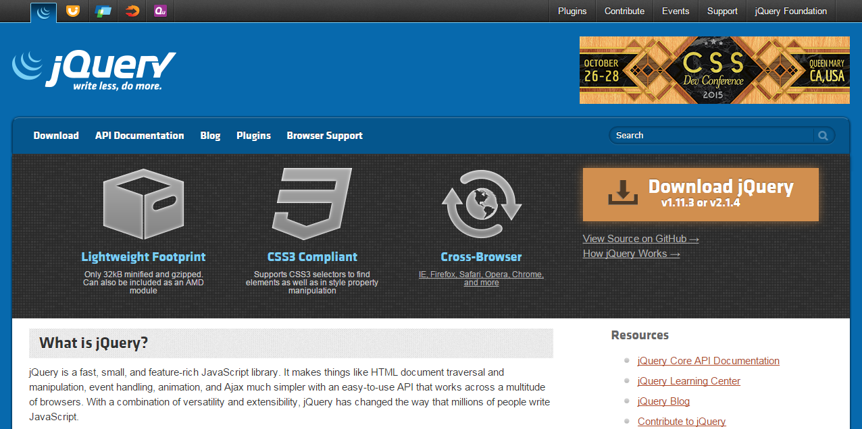
Getting started
1
download jQuery
2
3
load it in your HTML document
start using it
<script src="jquery.min.js"></script>
<script src="application.js"></script>

Slide 24
Changing multiple elements at once
<h1>Where do you want to go?</h1>
<h2>Travel Destinations</h2>
<p>Plan your next adventure.</p>
<ul id="destinations">
<li>Rome</li>
<li>Paris</li>
<li class='promo'>Rio</li>
</ul>
How do we change the text of
every <li> in this page?
Find them
modify their text

Slide 25
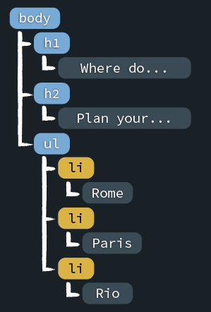
Load HTML into the DOM
<h1>Where do you want to go?</h1>
<h2>Travel Destinations</h2>
<p>Plan your next adventure.</p>
<ul id="destinations">
<li>Rome</li>
<li>Paris</li>
<li class='promo'>Rio</li>
</ul>
Selecting multiple elements
$(“li”);

Slide 26
We can find elements by ID or Class
CSS
jQuery
p { ... }
$("p");
#container { ... }
$("#container");
.articles { ... }
$(".articles");

Slide 27
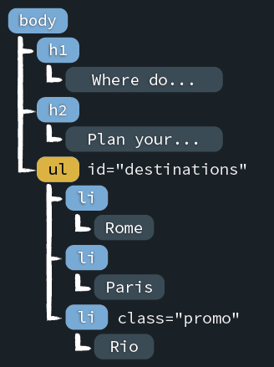
Selecting by unique ID
<h1>Where do you want to go?</h1>
<h2>Travel Destinations</h2>
<p>Plan your next adventure.</p>
<ul id="destinations">
<li>Rome</li>
<li>Paris</li>
<li class='promo'>Rio</li>
</ul>
How do we specifically select the <ul>
that has a “destinations” ID?
$("#destinations");

Slide 28
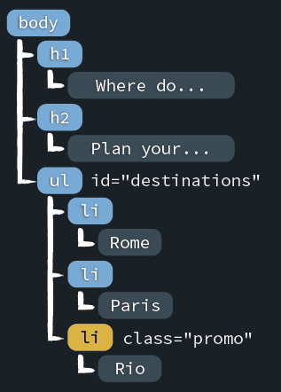
Selecting by Class Name
<h1>Where do you want to go?</h1>
<h2>Travel Destinations</h2>
<p>Plan your next adventure.</p>
<ul id="destinations">
<li>Rome</li>
<li>Paris</li>
<li class='promo'>Rio</li>
</ul>
How can we select just the <li> that
has a “promo” class attribute?
$(".promo");

Slide 29
Level 2 Searching the DOM

Slide 30
Selecting descendants
<h1>Where do you want to go?</h1>
<h2>Travel Destinations</h2>
<p>Plan your next adventure.</p>
<ul id="destinations">
<li>Rome</li>
<li>Paris</li>
<li class='promo'>Rio</li>
</ul>
How do we find the <li> elements that are inside of the <ul> with a “destinations” ID?
descendant selector

Slide 31
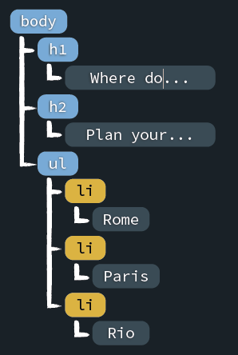
Using the descendant selector
<h1>Where do you want to go?</h1>
<h2>Travel Destinations</h2>
<p>Plan your next adventure.</p>
<ul id="destinations">
<li>Rome</li>
<li>Paris</li>
<li class='promo'>Rio</li>
</ul>
the space matters
$("#destinations li");
parent
descendant

Slide 32
Selecting direct children
<h1>Where do you want to go?</h1>
<h2>Travel Destinations</h2>
<p>Plan your next adventure.</p>
<ul id="destinations">
<li>Rome</li>
<li>
<ul id="france">
<li>Paris</li>
</ul>
<li>
<li class='promo'>Rio</li>
</ul>
How do we find only the <li> elements that are children of the “destinations” <ul>?
descendant selector?

Slide 33
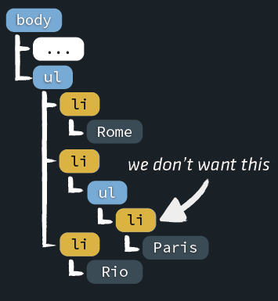
Selecting direct children
<h1>Where do you want to go?</h1>
<h2>Travel Destinations</h2>
<p>Plan your next adventure.</p>
<ul id="destinations">
<li>Rome</li>
<li>
<ul id="france">
<li>Paris</li>
</ul>
<li>
<li class='promo'>Rio</li>
</ul>
$("#destinations li");

Slide 34
Selecting only direct children
<h1>Where do you want to go?</h1>
<h2>Travel Destinations</h2>
<p>Plan your next adventure.</p>
<ul id="destinations">
<li>Rome</li>
<li>
<ul id="france">
<li>Paris</li>
</ul>
<li>
<li class='promo'>Rio</li>
</ul>
How do we find only the <li> elements that are
direct children of the “destinations” <ul> then?
Child selector

Slide 35
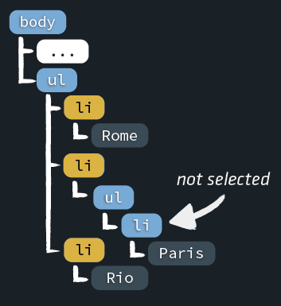
Selecting only direct children
<h1>Where do you want to go?</h1>
<h2>Travel Destinations</h2>
<p>Plan your next adventure.</p>
<ul id="destinations">
<li>Rome</li>
<li>
<ul id="france">
<li>Paris</li>
</ul>
<li>
<li class='promo'>Rio</li>
</ul>
the sign matters
$("#destinations > li");
parent
child

Slide 36
Selecting multiple elements
<h1>Where do you want to go?</h1>
<h2>Travel Destinations</h2>
<p>Plan your next adventure.</p>
<ul id="destinations">
<li>Rome</li>
<li>
<ul id="france">
<li>Paris</li>
</ul>
<li>
<li class='promo'>Rio</li>
</ul>
How do we find only elements
with either a “promo” class or a “france” ID
Multiple selector

Slide 37
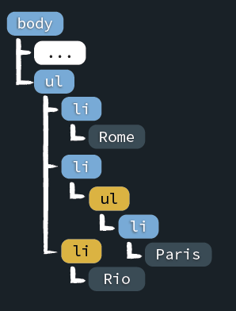
Selecting multiple elements
<h1>Where do you want to go?</h1>
<h2>Travel Destinations</h2>
<p>Plan your next adventure.</p>
<ul id="destinations">
<li>Rome</li>
<li>
<ul id="france">
<li>Paris</li>
</ul>
<li>
<li class='promo'>Rio</li>
</ul>
the comma matters
$(".promo, #france");

Slide 38
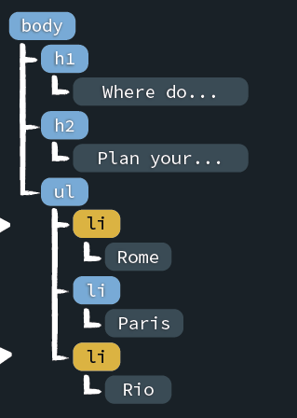
CSS-like pseudo classes
$("#destinations li:first");
$("#destinations li:last");
filter

Slide 39
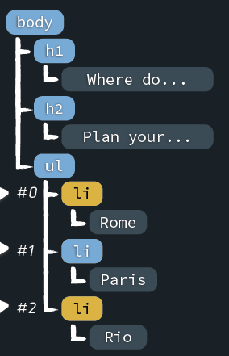
CSS-like pseudo classes
$("#destinations li:even");
$("#destinations li:odd");
watch out, the index starts at 0

Slide 40
Traversing

Slide 41

Walking the DOM by traversing it
<h1>Where do you want to go?</h1>
<h2>Travel Destinations</h2>
<p>Plan your next adventure.</p>
<ul id="destinations">
<li>Rome</li>
<li>Paris</li>
<li class='promo'>Rio</li>
</ul>
Can we find all the <li> elements that
the “destinations” list contains without
using a descendant selector?
filter by traversing

Slide 42
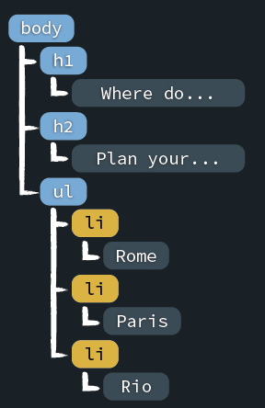




Filtering by traversing
$("#destinations li");
$("#destinations").find("li");
selection
traversal
It takes a bit more code, but it’s faster.

Slide 43



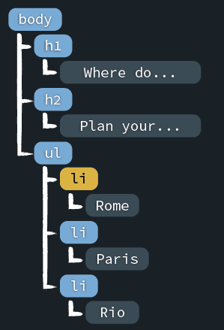
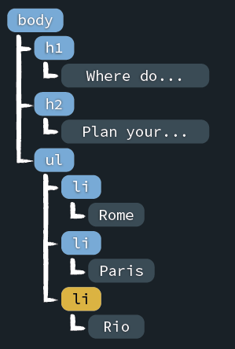
Filtering by traversing
$("li:first");
$("li:last");
$("li").first();
$("li").last();

Slide 44
Walking the DOM
<h1>Where do you want to go?</h1>
<h2>Travel Destinations</h2>
<p>Plan your next adventure.</p>
<ul id="destinations">
<li>Rome</li>
<li>Paris</li>
<li class='promo'>Rio</li>
</ul>
Can we find the middle list item, knowing
there is no filter to find it unlike :first or :last?
traversing

Slide 45
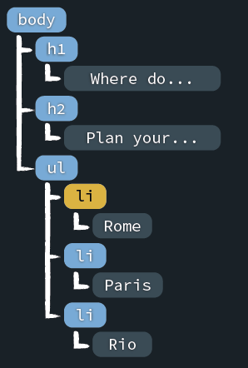
Walking the DOM
$("li").first();

Slide 46
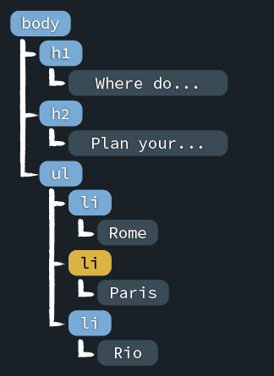
Walking the DOM
$("li").first();
$("li").first().next();

Slide 47
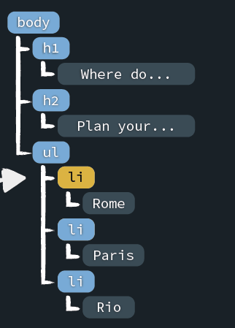
Walking the DOM
$("li").first();
$("li").first().next();
$("li").first().next().prev();

Slide 48
Walking up the DOM
<h1>Where do you want to go?</h1>
<h2>Travel Destinations</h2>
<p>Plan your next adventure.</p>
<ul id="destinations">
<li>Rome</li>
<li>Paris</li>
<li class='promo'>Rio</li>
</ul>
If we started by selecting a child, can we figure out what element is its direct parent?
traversing up

Slide 49
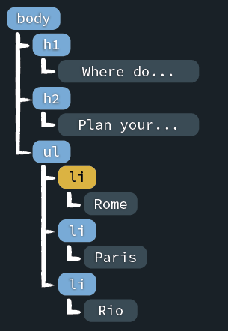
Walking up the DOM
$("li").first();

Slide 50
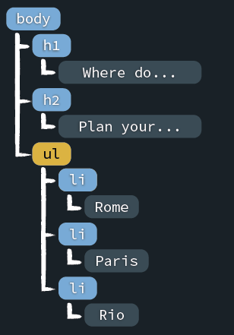
Walking up the DOM
$("li").first();
$("li").first().parent();

Slide 51
Walking down the DOM
<h1>Where do you want to go?</h1>
<h2>Travel Destinations</h2>
<p>Plan your next adventure.</p>
<ul id="destinations">
<li>Rome</li>
<li>
<ul id="france">
<li>Paris</li>
</ul>
<li>
<li class='promo'>Rio</li>
</ul>
With a parent that has many children who in
turn have their own children, how could we
find only the first generation of children?
traversing down

Slide 52
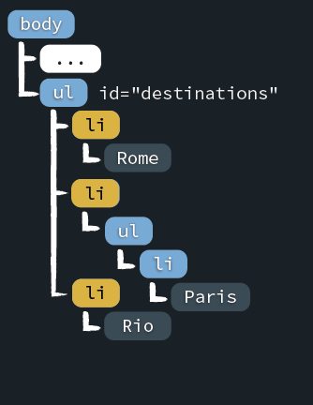
Walking the DOM up and down
$("#destinations").children("li");
children(), unlike find(), only selects direct children

Slide 53
Level 3 Working with the DOM

Slide 54
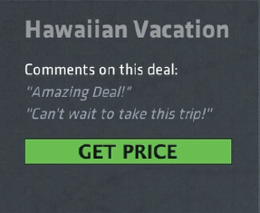
Manipulating the DOM
Vacation Packages
jQuery Travels
Call us to make your reservation today
Rendered HTML

Slide 55
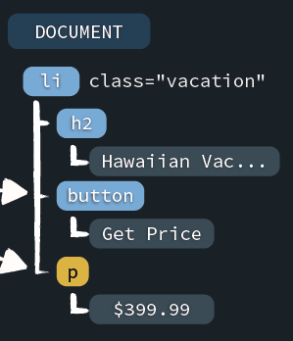
Appending to the DOM
1
append a new DOM node
2
Remove a DOM node

Slide 56
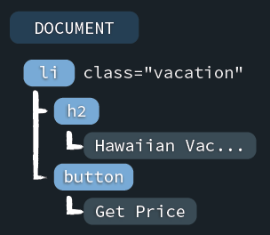



Appending to the DOM
$(document).ready(function() {
// create a <p> node with the price
});
var price = "From $399.99";
var price = "<p>From $399.99</p>";
Price node (not in the DOM yet)
var price = $('<p>From $399.99</p>');
Creates a node but doesn’t add it to the DOM

Slide 57
Appending to the DOM
$(document).ready(function() {
var price = $('<p>From $399.99</p>');
});
ways to add this price node to the DOM
.append(<element>)
.prepend(<element>)
.after(<element>)
.before(<element>)
Price node (not in the DOM yet)

Slide 58
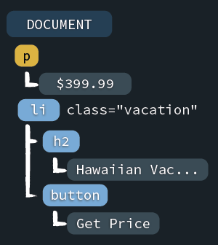

Before
$(document).ready(function() {
var price = $('<p>From $399.99</p>');
$('.vacation').before(price);
});
Puts the price node before .vacation

Slide 59
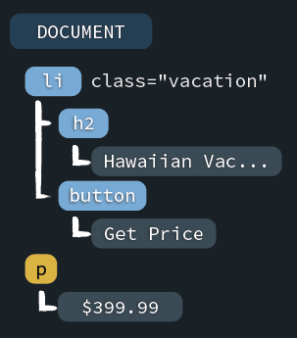
After
$(document).ready(function() {
var price = $('<p>From $399.99</p>');
$('.vacation').after(price);
});
Puts the price node after .vacation

Slide 60
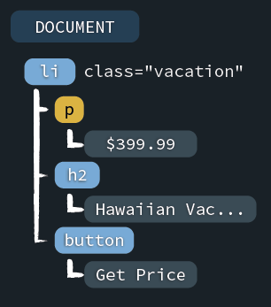
Prepend
$(document).ready(function() {
var price = $('<p>From $399.99</p>');
$('.vacation').prepend(price);
});
Adds the node to the top of .vacation

Slide 61
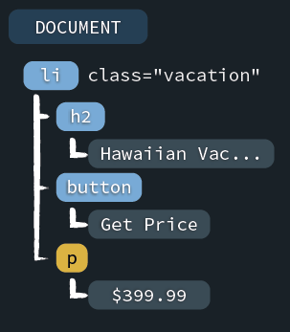

Prepend and Append
$(document).ready(function() {
var price = $('<p>From $399.99</p>');
$('.vacation').append(price);
});
Puts the price node at the bottom of .vacation
price.appendTo($('.vacation'));

Slide 62
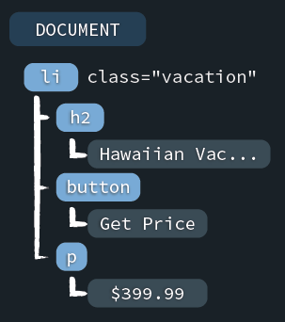
Removing from the DOM
$(document).ready(function() {
var price = $('<p>From $399.99</p>');
$('.vacation').append(price);
$('button').remove();
});
Removes the <button> from the DOM

Slide 63
Acting on interaction

Slide 64
Passing in a function
$(document).ready(<event handler function>);
The ready method takes an event handler function as argument
function() {
// executing the function runs the code
// between the braces
}
We create a function with the function keyword
$(document).ready(function() {
// this function runs when the DOM is ready
});
And we pass this function as an argument to the ready method.

Slide 65
Watching for Click
Vacation Packages
jQuery Travels
Call us to make your reservation today
Rendered HTML

Slide 66
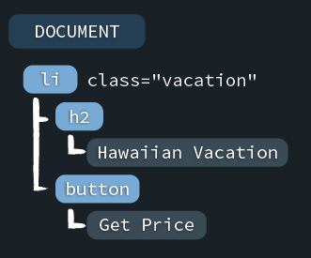
Watching for Click
$(document).ready(function() {
// runs when the DOM is ready
});
Target all buttons
Watch for any clicks
$('button').on('click', function() {
// runs when any button is clicked
});
jQuery Object Methods
Run the code inside of this function
.on(<event>, <event handler>)

Slide 67

Removing from the DOM
runs when the DOM is ready
$(document).ready(function() {
$('button').on('click', function() {
// run this function on click
});
});
runs when a button is clicked

Slide 68
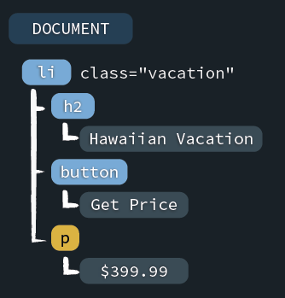
Removing from the DOM
$(document).ready(function() {
$('button').on('click', function() {
var price = $('<p>From $399.99</p>');
$('.vacation').append(price);
$('button').remove();
});
});
Now the price will be shown when we click the button

Slide 69
Refactor using Traversing

Slide 70
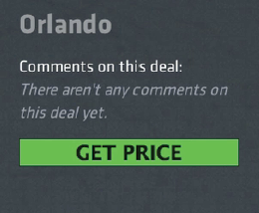
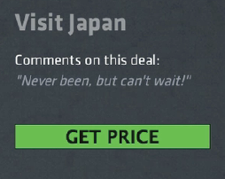
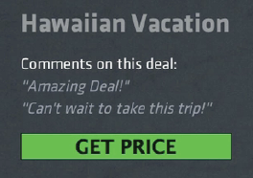
What if there are multiple vacation packages?
Vacation Packages
jQuery Travels
Call us to make your reservation today
Rendered HTML

Slide 71
Working, but with Errors
$(document).ready(function() {
$('button').on('click', function() {
var price = $('<p>From $399.99</p>');
$('.vacation').append(price);
$('button').remove();
});
});
The price will be appended to
both .vacation elements
Every button will be removed

Slide 72
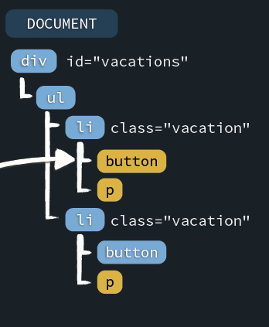

An Introduction to $(this)
$(document).ready(function() {
$('button').on('click', function() {
var price = $('<p>From $399.99</p>');
$('.vacation').append(price);
$('button').remove();
});
});
If clicked, the button will be ‘this’
this.remove();
Not a jQuery object, needs to be converted
$(this).remove();

Slide 73
Traversing from $(this)
$(document).ready(function() {
$('button').on('click', function() {
var price = $('<p>From $399.99</p>');
$(this).after(price);
$(this).remove();
});
});
Add the price as a sibling after button
Only removes whichever button was clicked

Slide 74
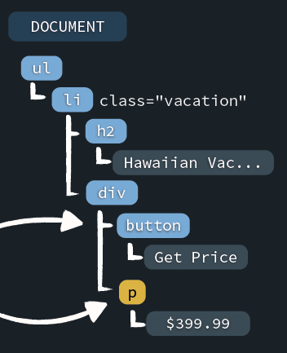
What if the button is moved?
$(document).ready(function() {
$('button').on('click', function() {
var price = $('<p>From $399.99</p>');
$(this).after(price);
$(this).remove();
});
});
If the button is moved, the price will be moved
How do we keep the
price as a child of <li>?

Slide 75
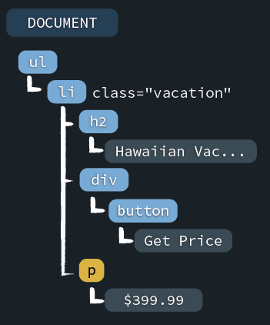


Using .closest(<selector>)
$(this).after(price);
$(this).parent().parent().append(price);
$(this).parents('.vacation').append(price);
$(this).closest('.vacation').append(price);

Slide 76
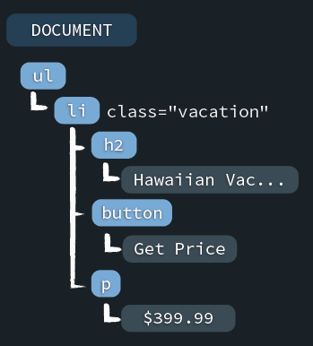
Our Finished Handler
$(document).ready(function() {
$('button').on('click', function() {
var price = $('<p>From $399.99</p>');
$(this).closest('.vacation')
.append(price);
$(this).remove();
});
});
Adds the <p> node at the bottom of .vacation
The prices will be added at the right place

Slide 77
Traversing and Filtering

Slide 78
How do we allow vacations to have different prices?
Vacation Packages
jQuery Travels
Call us to make your reservation today
Rendered HTML

Slide 79
Tackling the HTML
index.html
<li class="vacation onsale“ data-price='399.99‘>
<h3>Hawaiian Vacation</h3>
<button>Get Price</button>
<ul class='comments'>
<li>Amazing deal!</li>
<li>Want to go!</li>
</ul>
</li>
All data attributes begin with ‘data-’
jQuery Object Methods
$('.vacation').first().data('price');
"399.99"
.data(<name>)
.data(<name>, <value>)

Slide 80

Refactoring ‘Get Price’
$(document).ready(function() {
$('button').on('click', function() {
var price = $('<p>From $399.99</p>');
$(this).closest('.vacation').append(price);
$(this).remove();
});
});
Reads from the data-price attribute
var amount = $(this).closest('.vacation').data('price');
var price = $('<p>From $‘ + amount + '</p>');
Joins two strings to create the price

Slide 81
Refactoring ‘Get Price’
$(document).ready(function() {
$('button').on('click', function() {
var amount = $(this).closest('.vacation').data('price');
var price = $('<p>From $'+amount+'</p>');
$(this).closest('.vacation').append(price);
$(this).remove();
});
});
Each vacation can have its own price

Slide 82
Reusing jQuery Objects
We’ll only query the DOM
once for this element
$(document).ready(function() {
$('button').on('click', function() {
var vacation = $(this).closest('.vacation');
var amount = vacation.data('price');
var price = $('<p>From $'+amount+'</p>');
vacation.append(price);
$(this).remove();
});
});

Slide 83

Each vacation can have its dynamic own price now
Vacation Packages
jQuery Travels
Call us to make your reservation today
Rendered HTML

Slide 84

On With a Selector
$(document).ready(function() {
$('button').on('click', function() {
...
});
});
If we add new buttons anywhere, they will trigger this click handler
$('.vacation button').on('click', function() {});
$('.vacation').on('click', 'button', function() {});
Only target a ‘button’
if it’s inside a ‘.vacation’

Slide 85
We’ll implement our new filters next
Vacation Packages
jQuery Travels
Call us to make your reservation today
Rendered HTML

Slide 86
Filtering HTML
<div id='filters'>
...
<button class='onsale-filter'>On Sale Now</button>
<button class='expiring-filter'>Expiring</button>
...
</div>
We’ll write 2 event handlers for our buttons
We’ll highlight vacations with these traits

Slide 87
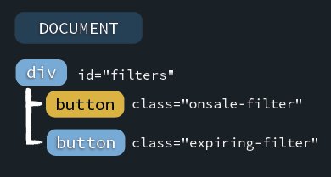
Filtering for Vacations On sale
$('#filters').on('click', '.onsale-filter', function() {
// find all vacations that are on-sale
// add a class to these vacations
});

Slide 88
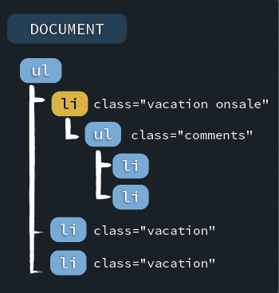
Filtering for Vacations On sale
$('#filters').on('click', '.onsale-filter', function() {
// find all vacations that are on-sale
// add a class to these vacations
});
$('.vacation.onsale')
$('.vacation').filter('.onsale')
Finds elements with a class
of .vacation and .onsale

Slide 89
Filtering for Vacations On sale
$('#filters').on('click', '.onsale-filter', function() {
$('.vacation').filter('.onsale')
// add a class to these vacations
});
Class Manipulation
.addClass(<class>)
.removeClass(<class>)
$('.vacation').filter('.onsale').addClass('highlighted');

Slide 90
Filtering for Vacations On sale
$('#filters').on('click', '.onsale-filter', function() {
$('.vacation').filter('.onsale').addClass('highlighted');
});
Finds only the right vacations
Adds a class of ‘highlighted’
The same can be done for our expiring filter
$('#filters').on('click', '.expiring-filter', function() {
$('.vacation').filter('.expiring').addClass('highlighted');
});

Slide 91
How do we make sure not all vacations are highlighted?
Vacation Packages
jQuery Travels
Call us to make your reservation today
Rendered HTML

Slide 92
Unhighlighting Vacations
$('#filters').on('click', '.onsale-filter', function() {
$('.highlighted').removeClass('highlighted');
$('.vacation').filter('.onsale').addClass('highlighted');
});
Remove the highlighted
class before adding it back

Slide 93
We clear the highlighted class on click, only highlighting the targeted vacations
Vacation Packages
jQuery Travels
Call us to make your reservation today
Rendered HTML

Slide 94
Level 4 On DOM load

Slide 95
On DOM Load
jQuery Air Atlantic – Vacation Confirmation
Confirmations
Hawaiian Vacation
Paid $399.99 on January 14, 2015
Flight Details
Call us to make your reservation today
Rendered HTML

Slide 96



Adding Ticket Confirmation
<li class="confirmation">
…
<button>FLIGHT DETAILS</button>
<ul class="ticket">...</ul>
</li>
Clicking this button...
...will show the ticket
watch for click
Hide ticket on page load
.ticket {
display: none;
}
find the ticket
show the ticket

Slide 97
Using slideDown to Show Elements
<li class="confirmation">
...
<ul class="ticket">...</ul>
</li>
<button>FLIGHT DETAILS</button>
jQuery Object Methods
.slideDown()
.slideUp()
.slideToggle()
$('.confirmation').on('click', 'button', function() {
$(this).closest('.confirmation').find('.ticket').slideDown();
});
Searches up through ancestors
Searches down through children

Slide 98
Why doesn’t the button work?
jQuery Air Atlantic – Vacation Confirmation
Confirmations
Hawaiian Vacation
Paid $399.99 on January 14, 2015
Flight Details
Call us to make your reservation today
Rendered HTML

Slide 99
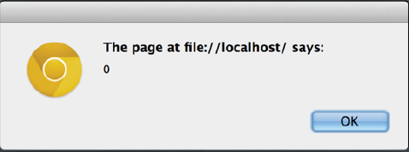
Debugging with Alert
alert($('button').length);
$('.confirmation').on('click', 'button', function() {
$(this).closest('.confirmation').find('.ticket').slideDown();
});
The alert dialog

Slide 100
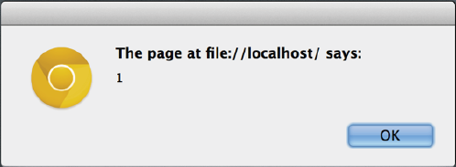
We Forgot $(document).ready() already
$(document).ready(function() {
alert($('button').length);
$('.confirmation').on('click', 'button', function() {
$(this).closest('.confirmation').find('.ticket').slideDown();
});
});
The button is found after the DOM has loaded

Slide 101
Now that the DOM has loaded, jQuery can find our button
jQuery Air Atlantic – Vacation Confirmation
Confirmations
Hawaiian Vacation
Paid $399.99 on January 14, 2015
Flight Details
Call us to make your reservation today
Rendered HTML

Slide 102
Expanding on on()

Slide 103
What if we also want to show the ticket when they hover over the <h3> tag?
jQuery Air Atlantic – Vacation Confirmation
Confirmations
Hawaiian Vacation
Paid $399.99 on January 14, 2015
Flight Details
Call us to make your reservation today
Rendered HTML

Slide 104
Deciding on an Event
$(document).ready(function() {
$('.confirmation').on('click', 'button', function() {
$(this).closest('.confirmation').find('.ticket').slideDown();
});
$('.confirmation').on('?', 'h3', function() {
$(this).closest('.confirmation').find('.ticket').slideDown();
});
});
What event should we watch for?
Mouse Events
click
focusin
mousedown
mousemove
mouseover
dblclick
focusout
mouseup
mouseout
mouseleave
mouseenter
Fires when the mouse is first positioned over the element

Slide 105
Mouse Events
$(document).ready(function() {
$('.confirmation').on('click', 'button', function() {
$(this).closest('.confirmation').find('.ticket').slideDown();
});
$('.confirmation').on(‘mousenter', 'h3', function() {
$(this).closest('.confirmation').find('.ticket').slideDown();
});
});

Slide 106
We have two ways of showing the ticket now
jQuery Air Atlantic – Vacation Confirmation
Confirmations
Hawaiian Vacation
Paid $399.99 on January 14, 2015
Flight Details
Call us to make your reservation today
Rendered HTML

Slide 107

Refactoring Handler Functions
$(document).ready(function() {
$('.confirmation').on('click', 'button', function() {
$(this).closest('.confirmation').find('.ticket').slideDown();
});
$('.confirmation').on(‘mousenter', 'h3', function() {
$(this).closest('.confirmation').find('.ticket').slideDown();
});
});
This code is duplicated, how can we refactor this? function showTicket
Extract out and name our event handler
function showTicket () {
$(this).closest('.confirmation').find('.ticket').slideDown();
}

Slide 108
Refactoring Handler Functions
function showTicket () {
$(this).closest('.confirmation').find('.ticket').slideDown();
}
$(document).ready(function() {
$('.confirmation').on('click', 'button', showTicket);
$('.confirmation').on(mouseenter', 'button', showTicket);
});
Don’t add () at the end - that would execute the function immediately
Now the exact same code is run for both events

Slide 109
Keyboard Events

Slide 110
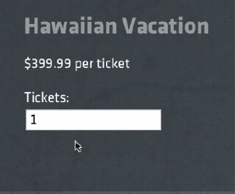
Changing this “Tickets” input field should recalculate the total
jQuery Travels – Trip Planner
Packages
Total Price $399.99
Call us to make your reservation today
Rendered HTML

Slide 111
Trip Planner Page
<div class="vacation" data-price='399.99'>
<h3>Hawaiian Vacation</h3>
<p>$399.99 per ticket</p>
<p>
Tickets:
<input type='number' class='quantity' value='1' />
</p>
</div>
<p>
Total Price: $<span id='total'>399.99</span>
</p>
When this updates...
...we’ll update the calculated price here

Slide 112
Keyboard and Form Events
$(document).ready(function() {
$('.vacation').on('?', '.quantity', function() {
});
});
Which event should we use?
Keyboard Events
Form Events
keypress
blur
select
change
keydown
focus
submit
keyup
http://api.jquery.com/category/events/keyboard-events/
http://api.jquery.com/category/events/form-events/

Slide 113
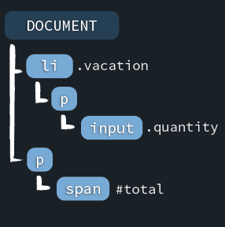
Writing our Event Handler
$(document).ready(function() {
$('.vacation').on('keyup', '.quantity', function() {
// Get the price for this vacation
// Get the quantity entered
// Set the total to price * quantity
});
});
var price = $(this).closest('.vacation').data('price');
'399.99'
Returns price as a string
var price = +$(this).closest('.vacation').data('price');
'399.99'
Use + to convert the string to a number

Slide 114

Getting the Quantity of Tickets
$(document).ready(function() {
$('.vacation').on('keyup', '.quantity', function() {
var price = +$(this).closest('.vacation')
.data('price');
// Get the quantity entered
// Set the total to price * quantity
});
});
var quantity = this.val();
Errors - not a jQuery object
jQuery Object Methods
var quantity = $(this).val();
Sets quantity to a string
.val(<new value)
var quantity = +$(this).val();
Sets quantity to a number
.val()

Slide 115
Setting the Total Price
$(document).ready(function() {
$('.vacation').on('keyup', '.quantity', function() {
var price = +$(this).closest('.vacation')
.data('price');
var quantity = +$(this).val();
$('#total').text(price * quantity);
});
});
You can pass a number or a string to the .text() method
Whenever the quantity is changed, the total will be updated

Slide 116
Link Layover

Slide 117
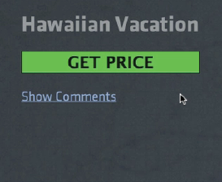

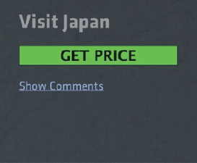
Clicking Show Comments will cause them to fade in
jQuery Travels - Vacation Packages
Packages
Call us to make your reservation today
Rendered HTML

Slide 118
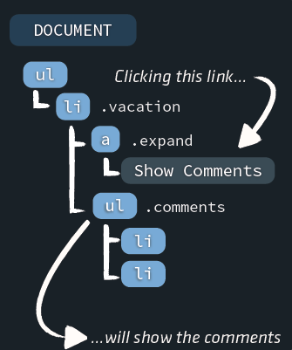
Preparing for Flight
.comments {
display: none;
}
$(document).ready(function() {
$('.vacation').on('click', '.expand', function() {
// Find the comments ul
// Show the comments ul
});
});
We need to write the event handler

Slide 119
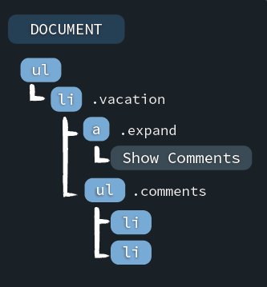
Preparing for Flight
$(document).ready(function() {
$('.vacation').on('click', '.expand', function() {
// Find the comments ul
// Show the comments ul
});
});
$(this).closest('.vacation').find('.comments')
Find the .comments ul using traversing

Slide 120
Preparing for Flight
$(document).ready(function() {
$('.vacation').on('click', '.expand', function() {
$(this).closest('.vacation')
.find('.comments')
// Show the comments ul
});
});
jQuery Object Methods
.fadeIn()
.fadeOut()
.fadeToggle()
These are similar to the slide methods

Slide 121
Handling the Click
$(document).ready(function() {
$('.vacation').on('click', '.expand', function() {
$(this).closest('.vacation')
.find('.comments')
.fadeToggle();
});
});
fadeIn() .comments on first click,
fadeOut() .comments on next click.

Slide 122
Why does the page jump to the top?
jQuery Travels - Vacation Packages
Packages
Call us to make your reservation today
Rendered HTML

Slide 123
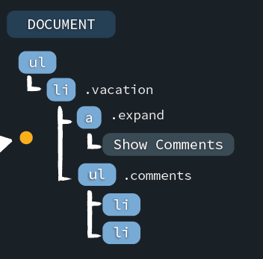
How the Browser Handles the Click
<a href='#' class='expand'>Show Comments</a>
Follows the link!
(goes to the top of the page)
The click event will “bubble up”
to each parent node

Slide 124
The Event Object
$(document).ready(function() {
$('.vacation').on('click', '.expand',
function(event) {
$(this).closest('.vacation')
.find('.comments')
.fadeToggle();
});
});
Add the event parameter

Slide 125
event.stopPropagation()
$(document).ready(function() {
$('.vacation').on('click', '.expand',
function(event) {
event.stopPropagation();
$(this).closest('.vacation')
.find('.comments')
.fadeToggle();
});
});
The browser will still handle the click event but will prevent it from “bubbling up” to each parent node.

Slide 126
event.preventDefault()
$(document).ready(function() {
$('.vacation').on('click', '.expand',
function(event) {
event.preventDefault();
$(this).closest('.vacation')
.find('.comments')
.fadeToggle();
});
});
The click event will “bubble up” but the browser won’t handle it
We’re preventing the default action of the browser now.

Slide 127
Level 5 Taming CSS

Slide 128
Separation of Concerns
HTML
content
CSS
To style something based on user
interaction, which would we use?
style
JavaScript
behavior

Slide 129
Changing our Style
jQuery Travels - Vacation Packages
Packages
Call us to make your reservation today
Let’s make all .vacation elements clickable...
Rendered HTML

Slide 130
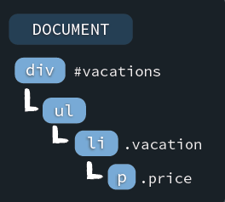
Changing the Style
$(document).ready(function() {
$('#vacations').on('click', '.vacation', function() {
$(this).css('background-color', '#252b30');
$(this).css('border-color', '1px solid #967');
});
});
$(this).css('background-color', '#252b30')
.css('border-color', '1px solid #967');
jQuery Object Methods
.css(<attr>, <value>)
$(this).css({'background-color': '#252b30',
'border-color': '1px solid #967'});
.css(<attr>)
Passing in a JavaScript Object as an argument is a common jQuery pattern
.css(<object>)

Slide 131

Showing the Price
$(document).ready(function() {
$('#vacations').on('click', '.vacation', function() {
$(this).css({'background-color': '#252b30',
'border-color': '1px solid #967'});
$(this).find('.price').show();
});
});
$(this).find('.price').css('display', 'block');
$(this).find('.price').show();
jQuery Object Methods
Same as CSS syntax, but easier to read and understand
.show()
.hide()
Our .vacation elements are highlighted when we click on them

Slide 132
Moving Styles to External CSS
$(document).ready(function() {
$('#vacations').on('click', '.vacation', function() {
$(this).css({'background-color': '#252b30',
'border-color': '1px solid #967'});
$(this).find('.price').show();
});
});
Can we move these to a CSS stylesheet?
.highlighted {
background-color: #563;
border-color: 1px solid #967;
}
.highlighted .price {
display: block;
}
$(this).addClass('highlighted');

Slide 133
Moving Styles to External CSS
$(document).ready(function() {
$('#vacations').on('click', '.vacation', function() {
$(this).addClass('highlighted');
});
});
It’s now much easier to manipulate with external CSS styles

Slide 134
Moving Styles to External CSS
$(document).ready(function() {
$('#vacations').on('click', '.vacation', function() {
$(this).addClass('highlighted');
});
});
We can only show price, but how would we hide price?
$(this).toggleClass('highlighted');
jQuery Object Methods
.toggleClass()
Adds the class if $(this) doesn’t have it, removes it if $(this) already has it
.addClass(<class>)
.removeClass(<class>)
Our refactored page still works, and will be much easier to maintain

Slide 135
Challenges

Slide 136
Challenges
Animation

Slide 137
What can we do to add a bit more movement to this?
jQuery Travels - Vacation Packages
Packages
Call us to make your reservation today
Rendered HTML

Slide 138
Adding Movement
$(document).ready(function() {
$('#vacations').on('click', '.vacation', function() {
$(this).toggleClass('highlighted');
});
});
$(this).css({'top': '-10px'});
The box will jump up 10 px
jQuery Object Methods
$(this).animate({'top': '-10px'});
.animate(<object>)
Takes in a JavaScript object
similar to the .css() method

Slide 139
Adding Movement
$(document).ready(function() {
$('#vacations').on('click', '.vacation', function() {
$(this).toggleClass('highlighted');
$(this).animate({'top': '-10px'});
});
});
Will adjust a CSS property pixel by pixel in order to animate it
Our animation can slide up but not slide down

Slide 140
Moving Back Down
$(document).ready(function() {
$('#vacations').on('click', '.vacation', function() {
$(this).toggleClass('highlighted');
$(this).animate({'top': '-10px'});
});
});
How do we set ‘top’ to ‘0px’ if a second click occurs?
if(<vacation has the class highlighted>) {
// animate the vacation up
} else {
// animate the vacation back down
}
“If statements” allow your code to make decisions at runtime

Slide 141
Moving Back Down
$(document).ready(function() {
$('#vacations').on('click', '.vacation', function() {
$(this).toggleClass('highlighted');
if(<vacation has the class highlighted>) $(this).animate({'top': '-10px'});
else
$(this).animate({'top': '0px'});
});
});
jQuery Object Methods
$(this).hasClass('highlighted')
.hasClass(<class>)
Returns true or false

Slide 142
Moving Back Down
$(document).ready(function() {
$('#vacations').on('click', '.vacation', function() {
$(this).toggleClass('highlighted');
if($(this).hasClass('highlighted'))
$(this).animate({'top': '-10px'});
else
$(this).animate({'top': '0px'});
});
});
Our vacation package will move up and down

Slide 143
Could we speed this up a little? Our customers don’t have all day.
jQuery Travels - Vacation Packages
Packages
Call us to make your reservation today
Rendered HTML

Slide 144
Changing the Speed
$(this).animate({'top': '-10px'});
We can optionally pass in the speed as a second argument to animate()
$(this).animate({'top': '-10px'}, 400);
$(this).animate({'top': '-10px'}, 'fast');
$(this).animate({'top': '-10px'}, 200);
$(this).animate({'top': '-10px'}, 'slow');
$(this).animate({'top': '-10px'}, 600);
E!ects methods like animate(), slideToggle() and fadeToggle() can also be given a specific speed as a String or in milliseconds

Slide 145
Moving Back Down
$(document).ready(function() {
$('#vacations').on('click', '.vacation', function() {
$(this).toggleClass('highlighted');
if($(this).hasClass('highlighted'))
$(this).animate({'top': '-10px'}, 'fast');
else
$(this).animate({'top': '0px'},’fast’);
});
});
And with this we now have specific speeds for our animation
Isn’t this still styling? Shouldn’t it be inside of a stylesheet?

Slide 146
Animation Duration
$(document).ready(function() {
$('#vacations').on('click', '.vacation', function() {
$(this).toggleClass('highlighted');
});
});
.vacation {
transition: top 0.2s;
}
.highlighted {
top: -10px;
}
Will only work with browsers that implement CSS transitions

Slide 147
Working with Modern Browsers
$(document).ready(function() {
$('#vacations').on('click', '.vacation', function() {
$(this).toggleClass('highlighted');
});
});
.vacation {
-moz-transition: top 0.2s;
-o-transition: top 0.2s;
-webkit-transition: top 0.2s;
transition: top 0.2s;
}
.highlighted {
top: -10px;
}
Unlike jQuery, with CSS we have
to account for specific browsers

Slide 149
The End

Slide 150
References
Official jQuery page
https://jquery.com/
Videos, challenges, tutorials
http://try.jquery.com/
Official jQuery API documentation
http://api.jquery.com/

