Slide 1
Java Advanced
Exceptions

Slide 2
AGENDA
1

Slide 3
AGENDA
This presentation is an introductory course to the Java Exception API, the student will learn the following
Exception core classes
Throwable
Exception
RuntimeException & Error
Handling Exceptions with try-catch-finally clauses
Differences between Checked Exceptions and Runtime Exceptions
1

Slide 4
GENERAL CONCEPTS
1

Slide 5
GENERAL CONCEPTS
Exceptions are, as their name implies, to be used only for exceptional conditions; they should never be used for ordinary control flow. Use checked exceptions for recoverable conditions and runtime exceptions for programming errors.
There is some confusion among programmers as to when it is appropriate to use each kind of throwable. While the decision is not always clear-cut, there are some general rules that provide strong guidance. The cardinal rule in deciding whether to use a checked or an unchecked exception is this:
Use checked exceptions for conditions from which the caller can reasonably be expected to recover.
Use runtime exceptions to indicate programming errors
1

Slide 6
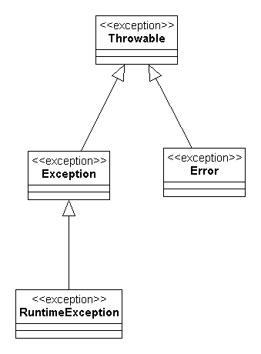
GENERAL CONCEPTS - EXCEPTION BASIC CLASSES
https://docs.oracle.com/javase/6/docs/api/index.html?java/lang/package-summary.html
1

Slide 7
(EXAMPLE) BUSINESS CONTEXT
1

Slide 8
BUSINESS CONTEXT
An inventory is a stock or store of goods. You can also use inventory to manage the delivery of services.
There are three reasons why a business may concern itself with inventories.
It needs to maintain a stock of items for sale.
It needs to maintain a stock of parts or materials to supply a manufacturing process or to support the delivery of services.
It needs to sell and deliver services.
Inventory has different functions in different business domains.
1

Slide 9
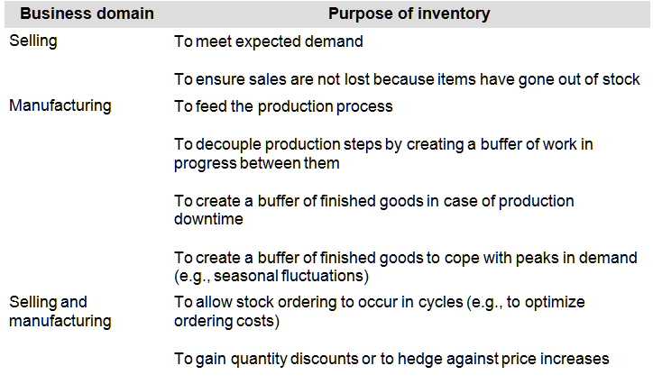
BUSINESS CONTEXT
1

Slide 10
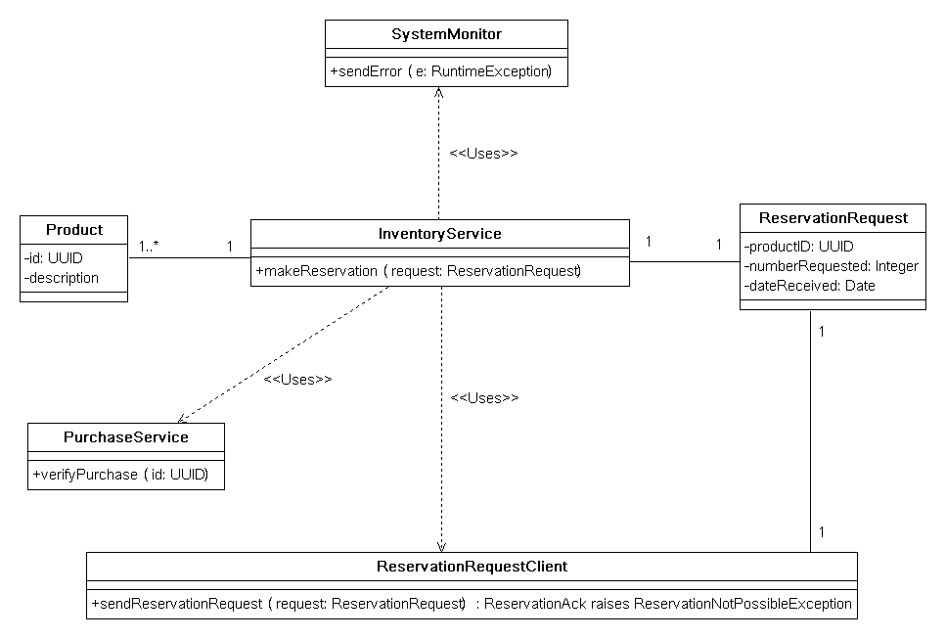
BUSINESS CONTEXT
1

Slide 11
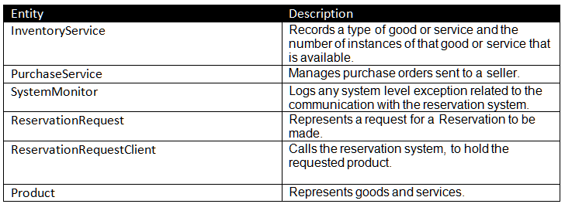
BUSINESS CONTEXT
1

Slide 12
WORKING WITH THE CORE CONCEPTS
1

Slide 13
WORKING WITH THE CORE CONCEPTS
Checked Exceptions
By throwing a checked exception, you force the caller to handle the exception in a catch clause or to propagate it outward.
Each checked exception that a method is declared to throw is therefore a potent indication to the API user that the associated condition is a possible outcome of invoking the method. By confronting the API user with a checked exception, the API designer presents a mandate to recover from the condition. The user can disregard the mandate by catching the exception and ignoring it, but this is usually a bad idea.
SRC
InventoryService.java
Test
InventoryServiceCheckedExceptionTest.java
Scope:
Checked exceptions, business and system exceptions
1

Slide 14
WORKING WITH THE CORE CONCEPTS
Runtime Exceptions
If a program throws an unchecked exception, it is generally the case that recovery is impossible and continued execution would do more harm than good. If a program does not catch such a throwable, it will cause the current thread to halt with an appropriate error message.
The great majority of runtime exceptions indicate precondition violations. A precondition violation is simply a failure by the client of an API to adhere to the contract established by the API specification. For example, the contract for array access specifies that the array index must be between zero and the array length minus one. ArrayIndexOutOfBoundsException indicates that this precondition was violated.
<number>

Slide 15
WORKING WITH THE CORE CONCEPTS
There is a strong convention that errors are reserved for use by the JVM to indicate resource deficiencies, invariant failures, or other conditions that make it impossible to continue execution. Given the almost universal acceptance of this convention, it’s best not to implement any new Error subclasses. Therefore, all of the unchecked throwables you implement should subclass RuntimeException (directly or indirectly).
SRC
InventoryService.java
InventoryServiceRuntimeExceptionTest.java
Scope:
RuntimeException due to illegal arguments
<number>

Slide 16
REFERENCES
http://www.amazon.com.mx/Effective-Java-Joshua-Bloch/dp/0321356683/ref=sr_1_1?ie=UTF8&qid=1437791622&sr=8-1&keywords=effective+java
https://docs.oracle.com/javase/tutorial/essential/exceptions/index.html
http://www.amazon.es/Enterprise-Patterns-MDA-Archetype-Technology/dp/032111230X/ref=sr_1_2?s=foreign-books&ie=UTF8&qid=1437446918&sr=1-2&keywords=Enterprise+MDA
<number>

Slide 18
Softtek
hugo.arroyo@softtek.com

