Slide 1
JPA/HIBERNATE
Java Persistence API

Slide 2
Disclaimer
Document Name:
Data Classification: INTERNAL
Disclaimer
The contents of this document are property of Softtek, and are classified as Confidential. Any reproduction in whole or in part is strictly prohibited without the written permission of Softtek.
This document is subject to change. Comments, corrections or questions should be directed to the author.
Audience/Viewership | Purpose
Java Beginners | Training
Revision Chart
The following chart list the revisions made to this document. Use this to describe the changes and additions each time this document is re-published. The description should be detailed as possible and include the names of the reviewers who request the changes.
Version No. | Version Date | Types of Changes | Owner/Author | Date of Review/Expiration
1 | 2015/09/14 | Creation | Benjamin Concha | NA

Slide 3
DAY 2: JPA Entity Mapping

Slide 4
COURSE STRUCTURE
Introduction to JPA 2.1
Basic Configuration
Entity Mapping and Relationships
Persistence Operations and Queries
Transaction operation and Locking
Spring Data and JPA*
Spring Data and JPA and Mysema*

Slide 5
JPA Persistable Types
The term persistable types refers to data types that can be used in storing data in the database. all the JPA persistable :
User defined classes - Entity classes, Mapped superclasses, Embeddable classes.
Simple Java data types: Primitive types, Wrappers, String, Date and Math types.
Multi value types - Collections, Maps and Arrays.
Miscellaneous types: Enum types and Serializable types (user or system defined)

Slide 6
Persistence Identifiers
Entities must define an id field/fields corresponding the database primary key
The id can either be simple or composite value
Strategies:
@Id: single valued type - most common
@IdClass: map multiple fields to table PK
@EmbeddedId map PK class to table PK
Composite PK classes must:
implement Serializable
override equals() and hashCode()

Slide 7
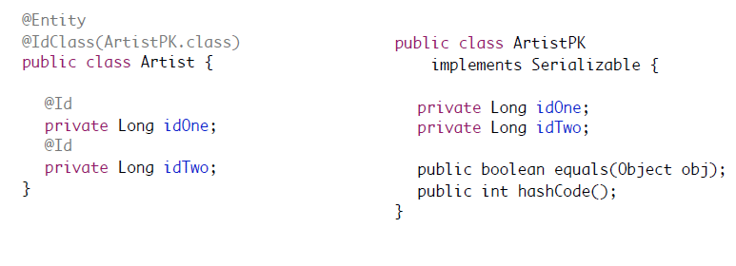
@IdClass
Maps multiple fields of persistent entity to PK class

Slide 8
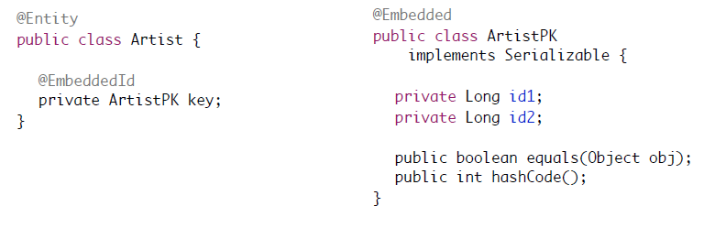
@EmbeddedId
Primary key is formal member of persistent entity

Slide 9
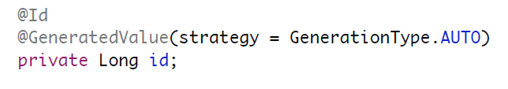
@GeneratedValue
Supports auto-generated primary key values
Strategies defined by GenerationType enum:
GenerationType.AUTO (preferred)
GenerationType.IDENTITY
GenerationType.SEQUENCE
GenerationType.TABLE

Slide 10
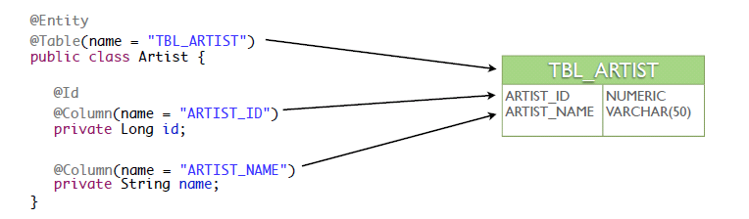
@Table and @Column
Used to define name mappings between Java object and database table/columns
@Table applied at the persistent class level
@Column applied at the persistent field/property level

Slide 11
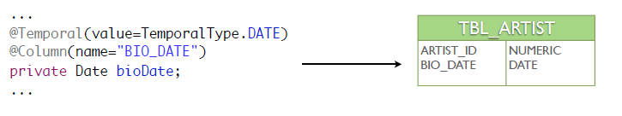
@Temporal
Used with java.util.Date or java.util.Calendar to determine how value is persisted
Values defined by TemporalType:
TemporalType.DATE (java.sql.Date, java.util.Date)
TemporalType.TIME (java.sql.Time, java.util.Date)
TemporalType.TIMESTAMP (java.sql.Timestamp)

Slide 12
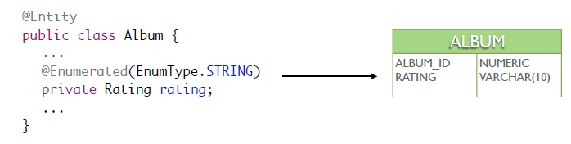
@Enumerated
Used to determine strategy for persisting Java enum values to database
Values defined by EnumType:
EnumType.ORDINAL (default)
EnumType.STRING

Slide 13
EnumType.STRING vs EnumType.ORDINAL
public enum Rating {
UNRATED,
G,
PG,
PG13,
R,
NC17
}
@Enumerated(EnumType.STRING) Rating rating the value of rating.name() is written and read from the corresponding database column; e.g. G, PG, PG13
@Enumerated(EnumType.ORDINAL) Rating rating the value of rating.ordinal() is written and read from the corresponding database column; e.g. 0, 1, 2

Slide 14
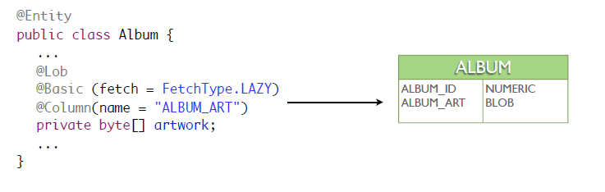
@Lob
Used to persist values to BLOB/CLOB fields
Often used with a lazy load value
BLOB : Variable-length binary large object string that can be up to 2GB. BLOB strings are not associated with a character set, as with FOR BIT DATA strings.
CLOB : Variable-length character large object string that can be up to 2GB long. A CLOB can store single-byte character strings or multibyte, character-based data. A CLOB is considered a character string

Slide 15
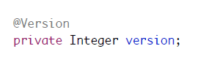
@Version
JPA has automatic versioning support to assist optimistic locking
Version field should not be modified by the application
Value can be primitive or wrapper type of short, int, long or java.sql.Timestamp field

Slide 16
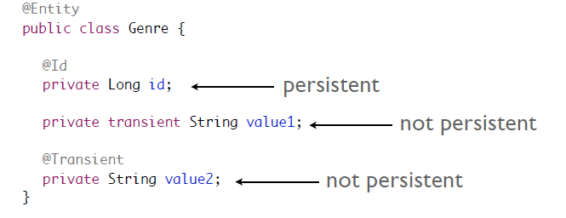
@Transient
By default, JPA assumes all fields are persistent
Non-persistent fields should be marked as transient or annotated with @Transient

Slide 17
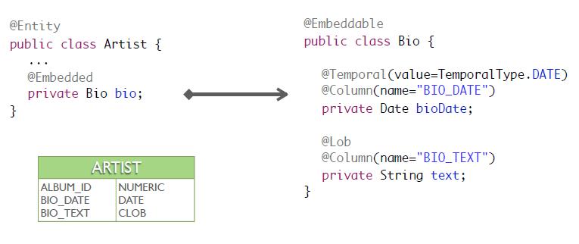
@Embedded & @Embeddable

Slide 19
DAY 2: JPA Annotating Relationships

Slide 20
Relationships
JPA supports all standard relationships
One-To-One
One-To-Many
Many-To-One
Many-To-Many
Supports unidirectional and bidirectional relationships
Supports both composite and aggregate relationships

Slide 21
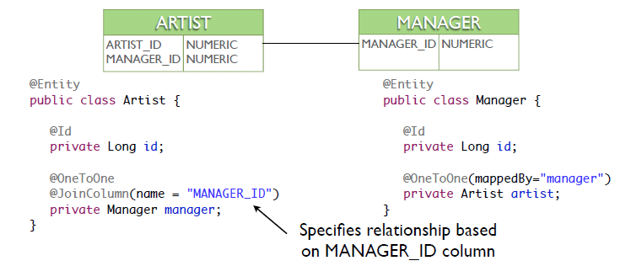
@OneToOne
Can be based on shared primary key or foreign key relationship
using either @PrimaryKeyJoinColumn or @JoinColumn

Slide 22
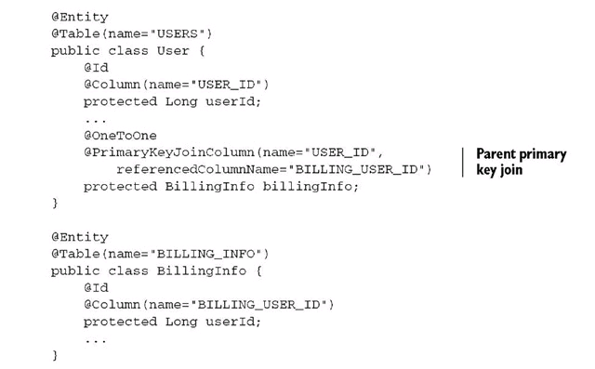

Slide 23
@OneToMany
@OneToMany defines the one side of a one-tomany relationship
The mappedBy element of the annotation defines the object reference used by the child entity
@OrderBy defines an collection ordering required when relationship is retrieved
The child (many) side will be represented using an implementation of the java.util.Collection interface

Slide 24
@ManyToOne
@ManyToOne defines the many side of a one-tomany relationship
@JoinColumn defines foreign key reference
The many side is considered to be the owning side of the relationship

Slide 25
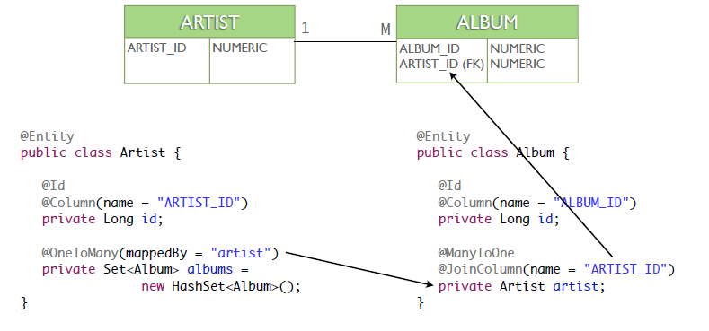
@OneToMany

Slide 26
@ManyToMany
@ManyToMany annotation is defined on both sides of the relationship
Each entity contains a collection of the other
@JoinTable is specified on the owning side of the relationship
The owning side in a many-to-many is arbitrary
@JoinColumn is used to specify the owning and inverse columns of the join table

Slide 27
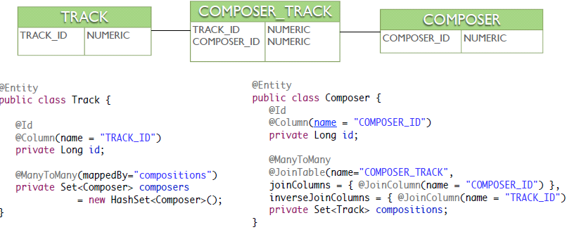
@ManyToMany

Slide 28
Cascading Operations
JPA supports multiple cascade styles
Defined by the CascadeType enum:
CascadeType.PERSIST
CascadeType.MERGE
CascadeType.REMOVE
CascadeType.REFRESH
CascadeType.ALL

Slide 29
DAY 2 what’s next? : JPA Queries

Slide 30
Query Interface
Obtained from the EntityManager using:
createQuery()
createNamedQuery()
createNativeQuery()
Supports bind parameters, both named and ordinal
Returns query result:
getSingleResult()
getResultList()
Pagination Support:
setFirstResult()
setMaxResults()

Slide 31
JPA Queries
Supports static & dynamic queries
Queries can be written using JPQL or SQL
Named and positional bind parameters
Supports both static and dynamic queries
Static queries are written as annotations of the entity
Supports eager fetching using the fetch keyword

Slide 32
JPQL Features
Java Persistence Query Language (JPQL)
Extension of EJB QL language
SQL like syntax
Reference objects/properties instead of tables/columns
Supports common SQL features:
Projections
Inner & Outer Joins - Eager fetching supported
Subqueries
Bulk operations (update and delete)

Slide 33
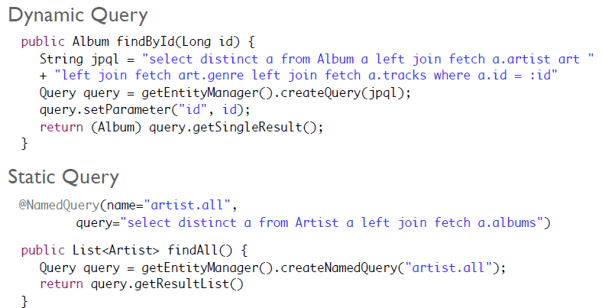
JPQL Examples

Slide 35
Benjamin Concha
Benjamin.concha@softtek.com
Related to training material
(Java JPA module)
Alejandro Guerrero
Alejandro.guerrero@softtek.com
Instructor

