Slide 1
JPA
Java Persistence API

Slide 2
Disclaimer
Document Name:
Data Classification: INTERNAL
Disclaimer
The contents of this document are property of Softtek, and are classified as Confidential. Any reproduction in whole or in part is strictly prohibited without the written permission of Softtek.
This document is subject to change. Comments, corrections or questions should be directed to the author.
Audience/Viewership | Purpose
Java Beginners | Training
Revision Chart
The following chart list the revisions made to this document. Use this to describe the changes and additions each time this document is re-published. The description should be detailed as possible and include the names of the reviewers who request the changes.
Version No. | Version Date | Types of Changes | Owner/Author | Date of Review/Expiration
1 | 2015/09/14 | Creation | Benjamin Concha | NA

Slide 3
DAY 1: JPA BASIC CONCEPTS

Slide 4
Course Structure
Introduction to JPA
Basic Configuration
Entity Mapping and Relationships
Persistence Operations and Queries
Transaction operation and Locking
Spring Data and JPA*
Spring Data ,JPA and Mysema*

Slide 5
Introduction To JPA 2.1
JPA is not an implementation , is not a product.
JPA Is a set of interfaces[especifications] and requires implementation.
Specification given under the roof of EJB 3.1

Slide 6
JPA—defines:
How Java objects are stored in relational databases (specified using a standard set of mappings)
A programmer API for reading, writing, and querying persistent Java objects (“Entities”)
A full featured query language
A container contract that supports plugging any JPA runtime in to any compliant container

Slide 7
Hibernate used to use a *.hbm.xml
Struts a Form
Hibernate move to used the standar
So we need now a Persistence.xml to all implementations that use JPA
JPA Implementations
Hibernate, EclipseLink, OpenJpa, TopLink, Datanucleus, …etc.
There is no need to run an application server to use JPA. It can run as a standalone, you need just a JPA implementation and properly configured XML file

Slide 8
What does a typical JPA project consists of?
JPA implementation
Entities
Entity manager
Configuration file : persistence.xml

Slide 9
JPA Entities
Concrete classes
No required interfaces
– No required business interfaces
– No required callback interfaces
new() for instance creation
Direct access or getter/setter methods
– Can contain logic (e.g. for validation, etc.)
“Managed” by an EntityManager
Is annotated as a @Entity
Must implement Serializable
Must have declaraded ID attriubute.

Slide 10
Object-Relational Mappings
Core JPA Mappings
– Id
– Basic
– Relationships
OneToOne
OneToMany/ManyToOne
ManyToMany

Slide 11
Java Beans (Entities)
JPA
HIbernate
JDBC API
DB

Slide 12
Persistence Unit
A persistence unit is a logical grouping that includes:
Entity manager factory and its entity managers + their configuration information
Set of entity classes
Mapping metadata (annotations or XML file) that specifies mapping of the classes to the database.
PU is represented by persistence.xml file in META-INFfolder of JAR file or application.

Slide 13
Persistence Context
A persistence context is a set of managed entity instances in which for any persistent entity identity there is a unique entity instance. Within the persistence context, the entity instances and their lifecycle are managed by the entity manager.
Persistence contexts are always associated with an entity manager factory. Entity manager instances obtained from different entity manager factories never share the same persistence context.
transaction scoped persistence context – lifetime of transaction is scoped to a single transaction. After transaction completes (TO CONFIRM no matter how whether with success or failure), persistence contexts die.
extended persistence context – extended lifetime that can spans multiple transactions
Container-managed persistence contexts – When a container-managed entity manager is used, the lifecycle of the persistence context is always managed automatically, transparently to the application,

Slide 14
Entity Manager
There are, generally speaking, two main kinds of entity managers:
container-managed: Entity Manager may only be obtained from JEE container
transaction-scoped container-managed
extended container-managed
application-managed (or also non-managed): Second option for JEE, only option for JSEenvironment. Application must manually manage EntityManager instance lifecycle with close() method.
import javax.persistence.*
EntityManagerFactory emf = Persistence.createEntityManagerFactory(“SHOP”);
EntityManager em = emf.createEntityManager();
em.close();
emf.close();

Slide 15
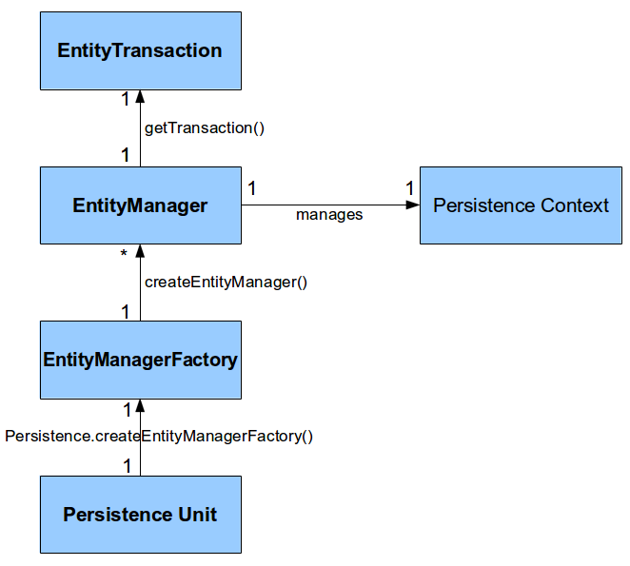
Entity Manager
Entity manager is not thread-safe and must be accessed in single-thread manner. also persistence contexts are not required to be thread-safe.
Unlike entity manager, entity manager factory is thread-safe.

Slide 16
What else
JDBC connection pooling
Diagnostics: Logging, Profiling
DDL Generation
Database and Server Platforms
Customization callbacks
Mappings
Caching
Query

Slide 17
Additional Mappings
@Converter
@BasicMap and @BasicCollection
Mapping to database structures
– @StructConverter – Structs, ADTs
– XML types, PL/SQL Records
Mapping features
– Private Owned
– Join/Batch Fetch
– Returning

Slide 19
Benjamin Concha
Benjamin.concha@softtek.com
Related to training material
(Java JPA module)
Alejandro Guerrero
Alejandro.guerrero@softtek.com
Instructor

