Slide 1
MAVEN
Introduction to MAVEN

Slide 2
Disclaimer
Document Name:
Data Classification: INTERNAL
Disclaimer
The contents of this document are property of Softtek, and are classified as Confidential. Any reproduction in whole or in part is strictly prohibited without the written permission of Softtek.
This document is subject to change. Comments, corrections or questions should be directed to the author.
Audience/Viewership | Purpose
Java Beginners | Training
Revision Chart
The following chart list the revisions made to this document. Use this to describe the changes and additions each time this document is re-published. The description should be detailed as possible and include the names of the reviewers who request the changes.
Version No. | Version Date | Types of Changes | Owner/Author | Date of Review/Expiration
1 | 2017/01/01 | Creation | Benjamin Concha | NA

Slide 3
DAY 1: MAVEN BASIC CONCEPTS

Slide 4
Course Structure
Introduce Maven
Basic Maven Pom File and Project Structure
Dependencies

Slide 5
Maven Background
Is a Java build tool
“project management and comprehension tool”
An Apache Project
Mostly sponsored by Sonatype
History
Maven 1 (2003)
Very Ugly
Used in Stack 1
Maven 2 (2005)
Complete rewrite
Not backwards Compatible
Used in Stack 2.0,2.1,2.2,3.0
Maven 3 (2010)
Same as Maven 2 but more stable
Used in Stack 2.3, 3.1

Slide 6
Maven Features
Dependency System
Multi-module builds
Consistent project structure
Consistent build model
Plugin oriented
Project generated sites

Slide 7
The Maven Mindset
All build systems are essentially the same:
Compile Source code
Copy Resource
Compile and Run Tests
Package Project
Deploy Project
Cleanup
Describe the project and configure the build
You don’t script a build
Maven has no concept of a condition
Plugins are configured

Slide 8
Other Java Build Tools
Ant (2000)
Granddaddy of Java Build Tools
Scripting in XML
Very flexible
Ant+Ivy (2004)
Ant but with Dependency Management
Gradle (2008)
Attempt to combine Maven structure with Groovy Scripting
Easily extensible
Immature

Slide 9
Maven Learning Resources
Maven Homepage
http://maven.apache.org
Reference Documentation for Maven
Reference Documentation for core Plugins
Sonatype Resources
http://www.sonatype.com/resource-center.html
Free Books
Videos

Slide 10
Maven POM
Stands for Project Object Model
Describes a project
Name and Version
Artifact Type
Source Code Locations
Dependencies
Plugins
Profiles (Alternate build configurations)
Uses XML by Default
Not the way Ant uses XML

Slide 11
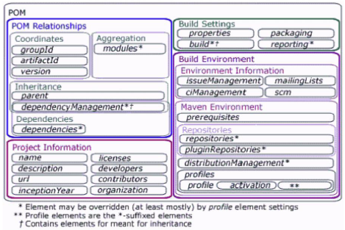
MAVEN POM

Slide 12
Project Name (GAV)
Maven uniquely identifies a project using:
groupID: Arbitrary project grouping identifier (no spaces or colons)
Usually loosely based on Java package
artfiactId: Arbitrary name of project (no spaces or colons)
version: Version of project
Format {Major}.{Minor}.{Maintanence}
Add ‘-SNAPSHOT ‘ to identify in development
GAV Syntax: groupId:artifactId:version
<?xml version="1.0" encoding="UTF-8"?>
<project>
<modelVersion>4.0.0</modelVersion>
<groupId>org.lds.training</groupId>
<artifactId>maven-training</artifactId>
<version>1.0</version>
</project>

Slide 13
Packaging
Build type identified using the “packaging” element
Tells Maven how to build the project
Example packaging types:
pom, jar, war, ear, custom
Default is jar
<?xml version="1.0" encoding="UTF-8"?>
<project>
<modelVersion>4.0.0</modelVersion>
<artifactId>maven-training</artifactId>
<groupId>org.lds.training</groupId>
<version>1.0</version>
<packaging>jar</packaging>
</project>

Slide 14
Project Inheritance
Pom files can inherit configuration
groupId, version
Project Config
Dependencies
Plugin configuration
Etc.
<?xml version="1.0" encoding="UTF-8"?>
<project>
<parent>
<artifactId>maven-training-parent</artifactId>
<groupId>org.lds.training</groupId>
<version>1.0</version>
</parent>
<modelVersion>4.0.0</modelVersion>
<artifactId>maven-training</artifactId>
<packaging>jar</packaging>
</project>

Slide 15
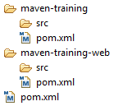
Multi Module Projects
Maven has 1st class multi-module support
Each maven project creates 1 primary artifact
A parent pom is used to group modules
<project>
...
<packaging>pom</packaging>
<modules>
<module>maven-training</module>
<module>maven-training-web</module>
</modules>
</project>

Slide 16
Maven Conventions
Maven is opinionated about project structure
target: Default work directory
src: All project source files go in this directory
src/main: All sources that go into primary artifact
src/test: All sources contributing to testing project
src/main/java: All java source files
src/main/webapp: All web source files
src/main/resources: All non compiled source files
src/test/java: All java test source files
src/test/resources: All non compiled test source files

Slide 17
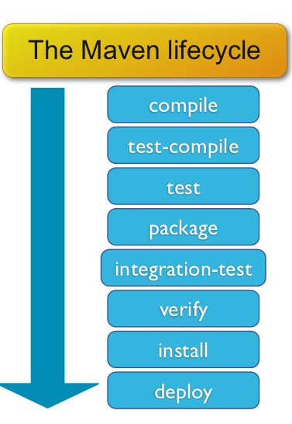
Maven Build Lifecycle
A Maven build follow a lifecycle
Default lifecycle
generate-sources/generate-resources
compile
test
package
integration-test (pre and post)
Install
deploy
There is also a Clean lifecycle

Slide 18
Example Maven Goals
To invoke a Maven build you set a lifecycle “goal”
mvn install
Invokes generate* and compile, test, package, integration-test, install
mvn clean
Invokes just clean
mvn clean compile
Clean old builds and execute generate*, compile
mvn compile install
Invokes generate*, compile, test, integration-test, package, install
mvn test clean
Invokes generate*, compile, test then cleans

Slide 19
Maven and Dependencies
Maven revolutionized Java dependency management
No more checking libraries into version control
Introduced the Maven Repository concept
Established Maven Central
Created a module metadata file (POM)
Introduced concept of transitive dependency
Often include source and javadoc artifacts

Slide 20
Adding a Dependency
Dependencies consist of:
GroupId, ArtifactId, Version
Scope: compile, test, provided (default=compile)
Type: jar, pom, war, ear, zip (default=jar)
<project>
...
<dependencies>
<dependency>
<groupId>javax.servlet</groupId>
<artifactId>servlet-api</artifactId>
<version>2.5</version>
<scope>provided</scope>
</dependency>
</dependencies>
</project>

Slide 21
Maven Repositories
Dependencies are downloaded from repositories
Via http
Downloaded dependencies are cached in a local repository
Usually found in ${user.home}/.m2/repository
Repository follows a simple directory structure
{groupId}/{artifactId}/{version}/{artifactId}-{version}.jar
groupId ‘.’ is replaced with ‘/’
Maven Central is primary community repo
http://repo1.maven.org/maven2

Slide 22
Proxy Repositories
Proxy Repositories are useful:
Organizationally cache artifacts
Allow organization some control over dependencies
Combines repositories
ICS uses the Nexus repository manager
All artifacts in Nexus go through approval process
License verified
Improve organizational reuse
To request approval create issue in SDS jira project:
https://jira.ldschurch.org/jira/browse/SDS

Slide 23
Defining a repository
Repositories are defined in the pom
Repositories can be inherited from parent
Repositories are keyed by id
Downloading snapshots can be controlled
<project>
...
<repositories>
<repository>
<id>lds-main</id>
<name>LDS Main Repo</name>
<url>http://code.lds.org/nexus/content/groups/main-repo</url>
<snapshots>
<enabled>false</enabled>
</snapshots>
</repository>
</repositories>
</project>

Slide 24
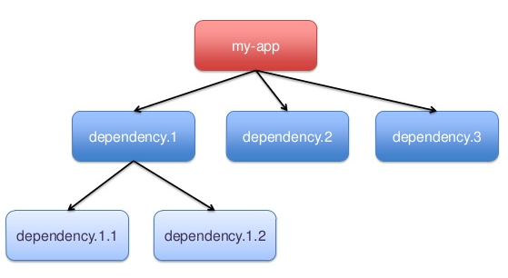
Transitive Dependencies
Transitive Dependency Definition:
A dependency that should be included when declaring project itself is a dependency
ProjectA depends on ProjectB
If ProjectC depends on ProjectA then ProjectB is automatically included
Only compile and runtime scopes are transitive
Transitive dependencies are controlled using:
Exclusions
Optional declarations

Slide 25
Dependency Exclusions
Exclusions exclude transitive dependencies
Dependency consumer solution
<project>
...
<dependencies>
<dependency>
<groupId>org.springframework</groupId>
<artifactId>spring-core</artifactId>
<version>3.0.5.RELEASE</version>
<exclusions>
<exclusion>
<groupId>commons-logging</groupId>
<artifactId>commons-logging</artifactId>
</exclusion>
</exclusions>
</dependency>
</dependencies>
</project>

Slide 26
Optional Dependencies
Don’t propagate dependency transitively
Dependency producer solution
Optional is under used
<project>
...
<dependencies>
<dependency>
<groupId>org.springframework</groupId>
<artifactId>spring-core</artifactId>
<version>3.0.5.RELEASE</version>
<optional>true</optional>
</dependency>
</dependencies>
</project>

Slide 27
Dependency Management
What do you do when versions collide?
Allow Maven to manage it?
Complex and less predictable
Take control yourself
Manage the version manually
In Java you cannot use both versions
<project>
...
<dependencyManagement>
<dependencies>
<dependency>
<groupId>org.springframework</groupId>
<artifactId>spring-core</artifactId>
<version>3.0.5.RELEASE</version>
</dependency>
</dependencies>
</dependencyManagement>
</project>

Slide 28
Using Dependency Management
<project>
...
<dependencyManagement>
<dependencies>
<dependency>
<groupId>org.springframework</groupId>
<artifactId>spring-core</artifactId>
<version>3.0.5.RELEASE</version>
</dependency>
</dependencies>
</dependencyManagement>
<dependencies>
<dependency>
<groupId>org.springframework</groupId>
<artifactId>spring-core</artifactId>
</dependency> <!-- Look ma, no version! -->
</dependencies>
</project>
Other uses for Dependency Management
Allowing parent pom to manage versions
Unify exclusions

Slide 29
Summary
Maven is a different kind of build tool
It is easy to create multi-module builds
Dependencies are awesome

Slide 31
Benjamin Concha
Benjamin.concha@softtek.com
Related to training material
(MAVEN Module)
Instructor

