Slide 1
Java Advanced
I/O Input Output

Slide 2
AGENDA

Slide 3
AGENDA
This presentation is an introductory course to the Java I/O (Input Output) API, the student will learn the following
I/O core interfaces and classes
InputStream & OutputStream
Read & Writer
Buffers
Working with Files

Slide 4
GENERAL CONCEPTS

Slide 5
GENERAL CONCEPTS
Java’s IO libraries are designed in an abstract way that enables you to read from external data sources and write to external targets, regardless of the kind of thing you are writing or reading from. You use the same methods to read from a file that you do to read from a console or from a network connection. You use the same methods to write to a file that you do to write to a byte array or serial port device.
Reading and Writing without caring where your data is coming from or where it’s going is a very powerful abstraction. Among other things, this enable you to define I/O streams that automatically compress, encrypt, and filter from one data format to another.
I/O is the means for communication between software and the outside world. Java provides a powerful and flexible set of tools for doing this crucial part of the job.

Slide 6
GENERAL CONCEPTS
A stream is and ordered sequence of bytes of indeterminate length.
Input streams move bytes of data into a Java program from some generally external source
Output streams move bytes of data into a Java program from some generally external target.
The world stream is derived from an analogy between a sequence and stream of water. An input stream is like a siphon that sucks up water; an output stream is like a hose that sprays out water. Siphons can be connected to hoses to move water from one place to another.
All input and output operations are simply treated as streams using the same classes and the same methods. You don’t need to learn a new API for every different kind of device. The same API that reads files can read network sockets, serial ports, etc.

Slide 7
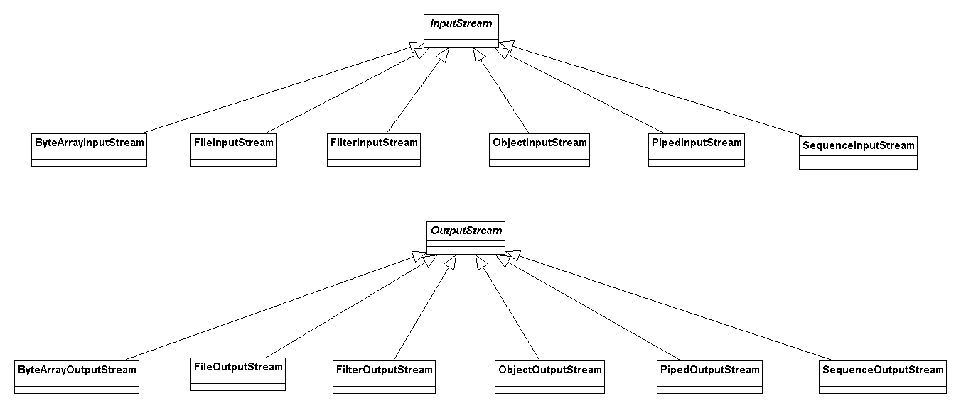
GENERAL CONCEPTS – I/O BASIC STREAM CLASSES

Slide 8
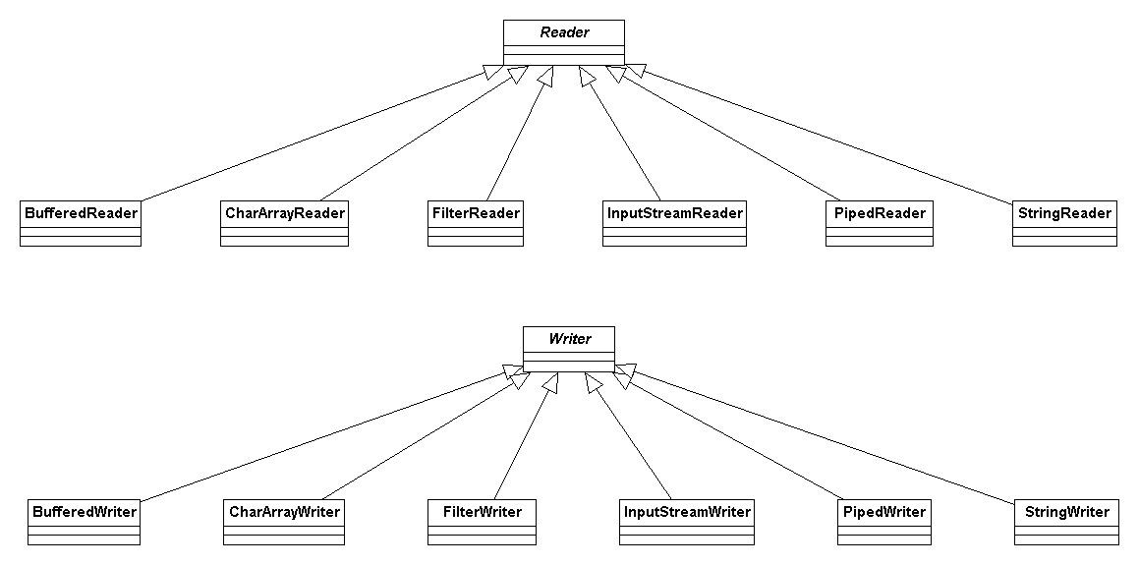
GENERAL CONCEPTS – I/O BASIC CHARACTER STREAM CLASSES
https://docs.oracle.com/javase/6/docs/api/index.html?java/io/package-summary.html

Slide 9
GENERAL CONCEPTS
Programs use byte streams to perform input and output of 8-bit bytes. All byte stream classes are descended from InputStream and OutputStream.
The Java platform stores character values using Unicode conventions. Character stream I/O automatically translates this internal format to and from the local character set. In Western locales, the local character set is usually an 8-bit superset of ASCII.
For most applications, I/O with character streams is no more complicated than I/O with byte streams. Input and output done with stream classes automatically translates to and from the local character set. A program that uses character streams in place of byte streams automatically adapts to the local character set and is ready for internationalization — all without extra effort by the programmer.

Slide 10
GENERAL CONCEPTS
Un-buffered I/O, this means each read or write request is handled directly by the underlying OS. This can make a program much less efficient, since each such request often triggers disk access, network activity, or some other operation that is relatively expensive.
To reduce this kind of overhead, the Java platform implements buffered I/O streams. Buffered input streams read data from a memory area known as a buffer; the native input API is called only when the buffer is empty. Similarly, buffered output streams write data to a buffer, and the native output API is called only when the buffer is full.
A program can convert an un-buffered stream into a buffered stream using the wrapping idiom we've used several times now, where the un-buffered stream object is passed to the constructor for a buffered stream class.

Slide 11
GENERAL CONCEPTS
A file system stores and organizes files on some form of media, generally one or more hard drives, in such a way that they can be easily retrieved. Most file systems in use today store the files in a tree (or hierarchical) structure. At the top of the tree is one (or more) root nodes. Under the root node, there are files and directories (folders in Microsoft Windows). Each directory can contain files and subdirectories, which in turn can contain files and subdirectories, and so on, potentially to an almost limitless depth.
A file system may implement restrictions to certain operations on the actual file-system object, such as reading, writing, and executing. These restrictions are collectively known as access permissions. The file system may have multiple sets of access permissions on a single object. For example, one set may apply to the object's owner, and another may apply to all other users. The access permissions on an object may cause some methods in this class to fail.

Slide 12
WORKING WITH THE CORE CONCEPTS

Slide 13
WORKING WITH THE CORE CONCEPTS
File I/O with streams
SRC
FileStreamResource.java
Test
FileStreamResourceTest.java
Scope
Read and write Softtek.jpg image

Slide 14
WORKING WITH THE CORE CONCEPTS
File I/O with character streams
SRC
FileCharacterResource.java
Test
FileCharacterResourceTest.java
Scope
Read and write object.txt file

Slide 15
WORKING WITH THE CORE CONCEPTS
File I/O with buffered streams
SRC
FileBufferedStreamResource.java
Test
FileBufferedStreamResourceTest.java
Scope
Read and write JavaAcademy-Collections.pptx file with buffers

Slide 16
REFERENCES
http://www.amazon.com.mx/gp/product/B0043D2F6M?keywords=Java%20I%2FO&qid=1438570779&ref_=sr_1_1&s=digital-text&sr=1-1
http://www.amazon.com.mx/gp/product/B00B8V09HY?keywords=effective%20java&qid=1438389998&ref_=sr_1_2&s=digital-text&sr=1-2
https://docs.oracle.com/javase/tutorial/essential/io/index.html

Slide 18
Softtek
hugo.arroyo@softtek.com

