Slide 1
Java Advanced
Collections

Slide 2
AGENDA

Slide 3
AGENDA
This presentation is an introductory course to the Java Collection Framework, the student will learn the following
Collection core interfaces and classes
Collection
Set
List
Queue
Map

Slide 4
BEFORE WE CONTINUE YOU NEED TO THINK ABOUT GENERICS, AND WHAT IS GENERICS ANYWAY?

Slide 5
GENERICS IN A NUTSHELL
Generics enable types (classes and interfaces) to be parameters when defining classes, interfaces and methods. Much like the more familiar formal parameters used in method declarations, type parameters provide a way for you to re-use the same code with different inputs. The difference is that the inputs to formal parameters are values, while the inputs to type parameters are types.
Code that uses generics has many benefits over non-generic code:
Stronger type checks at compile time. A Java compiler applies strong type checking to generic code and issues errors if the code violates type safety. Fixing compile-time errors is easier than fixing runtime errors, which can be difficult to find.

Slide 6
GENERICS IN A NUTSHELL
Elimination of casts. The following code snippet without generics requires casting:
List list = new ArrayList();
list.add("hello");
String s = (String) list.get(0);
When re-written to use generics, the code does not require casting:
List<String> list = new ArrayList<String>();
list.add("hello");
String s = list.get(0); // no cast
Enabling programmers to implement generic algorithms. By using generics, programmers can implement generic algorithms that work on collections of different types, can be customized, and are type safe and easier to read.

Slide 7
GENERAL CONCEPTS

Slide 8
GENERAL CONCEPTS
The Java Collections Framework is a unified set of classes and interfaces defined in the java.util package for representing and manipulating collections, remember that a collection is simply an object that groups multiple elements into a single unit. By providing useful data structures and algorithms, the Collections Framework frees you to concentrate on the important parts of your program, rather than on the low-level "plumbing" required to make it work.
Java Collections Framework can help you to organize your objects depending on the business problem. In one situation, you might want to organize your program’s objects on a sequential list because the ordering is important, and there are duplicates. In another, a set might be the right data type because now ordering is unimportant and you want to discard duplicates. These two data types (and others) are represented by different interfaces in the Collections Framework.

Slide 9
GENERAL CONCEPTS - COLLECTIONS BASIC CLASSES AND INTERFACES
The java.util package contains a group of interfaces referred to as the collections interfaces to represent the various types of collections. The root interface of the collections interfaces is Collection. There are different types of collections, and the sub interfaces of Collection reflect these various types of collections, as follows:
Lists A list is an ordered collection of elements that allows duplicate entries. Lists implement the List interface, and elements in a list can be accessed by an integer index.
Sets A set is a collection that does not allow duplicate entries. Sets implement the Set interface.
Queues A queue is a collection that orders its elements in a specific order for processing.
A typical queue processes its elements in a first - in, first - out (FIFO) fashion, but other ordering is possible. Queues implement the Queue interface.
Maps A map is a collection that maps keys to values, with no duplicate keys allowed.
The elements in a map are key - value pairs. Maps implement the Map interface, which is unique because the Map interface is not a sub interface of Collection like the other types of collections.

Slide 10
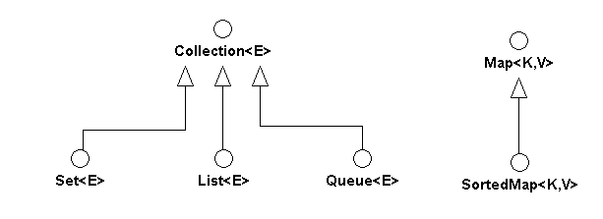
GENERAL CONCEPTS - COLLECTIONS BASIC CLASSES AND INTERFACES
https://docs.oracle.com/javase/6/docs/api/index.html?java/util/package-summary.html

Slide 11
BUSINESS CONTEXT

Slide 12
BUSINESS CONTEXT
The Party pattern describes how to represent essential information about people and organizations. We use Party as a general term for a person or an organization such as a business.
Almost every business is concerned to some degree with maintaining information about parties and about the roles that these parties play in various relationships with them. This concern is as old as business itself. Even in very early business activities based around barter, transactions were predicated on trust, and that was based on having some knowledge, whether formally represented or not, of your trading partners.

Slide 13
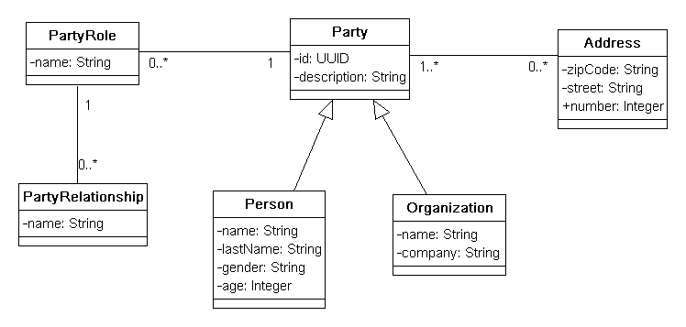
BUSINESS CONTEXT

Slide 14
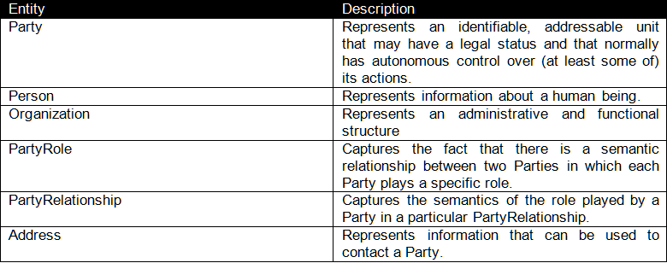
BUSINESS CONTEXT

Slide 15
WORKING WITH THE CORE CONCEPTS

Slide 16
WORKING WITH THE CORE CONCEPTS
Collection
A collection represents a group of objects known as its elements. The Collection interface is used to pass around collections of objects where maximum generality is desired. For example, by convention all general-purpose collection implementations have a constructor that takes a Collection argument. This constructor, known as a conversion constructor, initializes the new collection to contain all of the elements in the specified collection, whatever the given collection's sub interface or implementation type. In other words, it allows you to convert the collection's type.
SRC
CollectionTest.java
Scope:
Bulk operations and Ordering

Slide 17
WORKING WITH THE CORE CONCEPTS
Set
A Set is a collection that cannot contain duplicate elements. It models the mathematical set abstraction. The Set interface contains only methods inherited from Collection and adds the restriction that duplicate elements are prohibited. Set also adds a stronger contract on the behavior of the equals and hashCode operations, allowing Set instances to be compared meaningfully even if their implementation types differ. Two Set instances are equal if they contain the same elements.
SRC
PartyFilter.java
PartyFilterTest.java
Scope:
Filter, eliminate and detect organization duplicates

Slide 18
WORKING WITH THE CORE CONCEPTS
List
A List is an ordered collection (sometimes called a sequence). Lists may contain duplicate elements. In addition to the operations inherited from Collection, the List interface includes operations for the following:
Positional Access: Manipulates elements based on their numerical position in the list. This includes methods such as get, set, add, addAll, and remove.
Search: Searches for a specified object in the list and returns its numerical position. Search methods include indexOf and lastIndexOf.
Iteration: Extends Iterator semantics to take advantage of the list's sequential nature. The list Iterator methods provide this behavior.
Range-view: The sub list method performs arbitrary range operations on the list.
SRC
OrganizationService.java
OrganizationServiceTest.java
Scope:
Service that handles adding and removing organizations

Slide 19
WORKING WITH THE CORE CONCEPTS
Queue
A Queue is a collection for holding elements prior to processing. Besides basic Collection operations, queues provide additional insertion, removal, and inspection operations.
Deque
Usually pronounced as deck, a deque is a double-ended-queue. A double-ended-queue is a linear collection of elements that supports the insertion and removal of elements at both end points. The Deque interface is a richer abstract data type than both Stack and Queue because it implements both stacks and queues at the same time. The Deque interface, defines methods to access the elements at both ends of the Deque instance. Methods are provided to insert, remove, and examine the elements. Predefined classes like ArrayDeque and LinkedList implement the Deque interface.
SRC
PartyWorkScheduler.java
PartyWorkSchedulerTest.java
Scope:
Work scheduler

Slide 20
WORKING WITH THE CORE CONCEPTS
Map
A Map is an object that maps keys to values. A map cannot contain duplicate keys: Each key can map to at most one value. It models the mathematical function abstraction. The Map interface includes methods for basic operations (such as put, get, remove, containsKey, containsValue, size, and empty), bulk operations (such as putAll and clear), and collection views (such as keySet, entrySet, and values).
SRC
PartyDictionary.java
PartyDictionaryTest.java
Scope:
Person or Organization dictionary

Slide 21
REFERENCES
http://www.amazon.es/Java-Generics-Collections-Maurice-Naftalin/dp/0596527756
https://docs.oracle.com/javase/tutorial/collections/TOC.html
http://www.amazon.es/Enterprise-Patterns-MDA-Archetype-Technology/dp/032111230X/ref=sr_1_2?s=foreign-books&ie=UTF8&qid=1437446918&sr=1-2&keywords=Enterprise+MDA

Slide 23
Softtek
hugo.arroyo@softtek.com

