Slide 1
Java Advanced
JDBC

Slide 2
AGENDA

Slide 3
AGENDA
This presentation is an introductory course to the JDBC API, the student will learn the following
JDBC core classes
Connection
Statement
PreparedStatement
CallableStatement
Difference between DriverManager and DataSource
Handling Errors

Slide 4
GENERAL CONCEPTS

Slide 5
GENERAL CONCEPTS
Working with leaders in the database field, Sun developed JDBC as a unified API for database access. As part of the JDBC design process, they kept in mind three main goals:
JDBC should be an SQL-level API.
JDBC should capitalize on the experience of existing database APIs.
JDBC should be relatively simple.
As an SQL-level API, JDBC enables you to construct SQL statements and embed them inside API calls. You are essentially using JDBC to make a smooth transition between the SQL and Java.
Your application sends a query to the database as SQL and gets the results back through a Java object. Any database error you encounter is thrown to your application as a Java exception.

Slide 6
GENERAL CONCEPTS
JDBC accomplishes its goals through a set of Java interfaces, each implemented differently by individual vendors. The set of classes that implements the JDBC interfaces for a particular database engine combine into a tool called a JDBC driver. In building a database application, you do not have to think about the implementation of these underlying classes at all; the whole point of JDBC is to hide the specifics of each database and enable you to focus on your application logic.

Slide 7
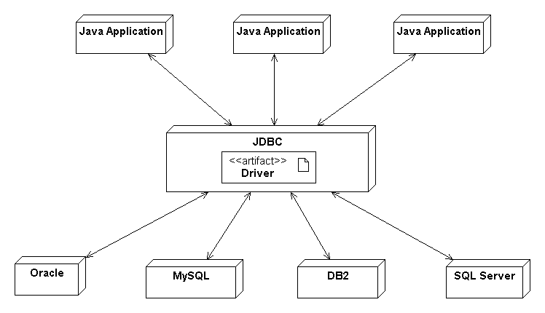
GENERAL CONCEPTS

Slide 8
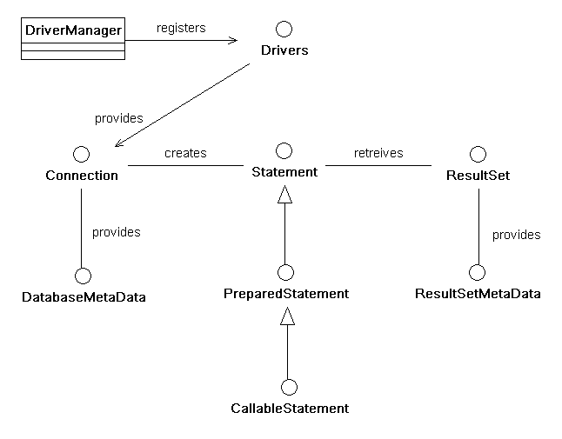
GENERAL CONCEPTS – JDBC BASIC INTERFACES AND CLASSES
https://docs.oracle.com/javase/6/docs/api/index.html?java/sql/package-summary.html

Slide 9
GENERAL CONCEPTS
Databases and Drivers
You need to have a database to connect to. Once your database engine is installed and your database is all set up, you will need a JDBC driver to connect to that database engine. Whatever your database of choice, it should be very simple to find a driver free of charge. Most commercial databases ship with a JDBC driver. Other database engines allow you to download a driver from their web site. In addition, you can opt for a commercially developed driver that probably performs better than the vendor-supported driver.

Slide 10
GENERAL CONCEPTS
JDBC drivers come in four distinct categories. Sun has named the categories types 1-4.
Type 1
A type 1 driver is a bridge between JDBC and another database-independent API like ODBC. The JDBC-ODBC driver that comes with the Java SDK is the primary example of a type 1 driver.
Type 2
A type 2 driver translates JDBC calls into a native API provided by the database vendor.
Type 3
Type 3 drivers are network bridges that enable an application to take advantage of the WORA (Write Once, Run Anywhere) capabilities of type 4 drivers even when your database of choice supports only type 2 drivers.

Slide 11
GENERAL CONCEPTS
Type 4
A type 4 driver talks directly to a database using a network protocol. Because it makes no native calls, it can run on any JVM.
For the purpose of this course we are going to use MySQL
http://dev.mysql.com/downloads/mysql/
http://dev.mysql.com/doc/refman/5.6/en/windows-installation.html
After download, please execute the following scripts:
1_OrderDatabase.sql
2_Order.sql
3_OrderCatalog.sql
4_DeleteOrderProc.sql

Slide 12
BUSINESS CONTEXT

Slide 13
BUSINESS CONTEXT
When a customer decides to make a purchase, you need to have some way to record exactly what is required. This record is known as an order. It is a request by a buyer for a seller to deliver some goods or services. In return the seller normally receives some payment or other compensation.
You can use an order whenever you need to capture the details of the relationship between the various parties, goods, and services that come together in a particular sales transaction.

Slide 14
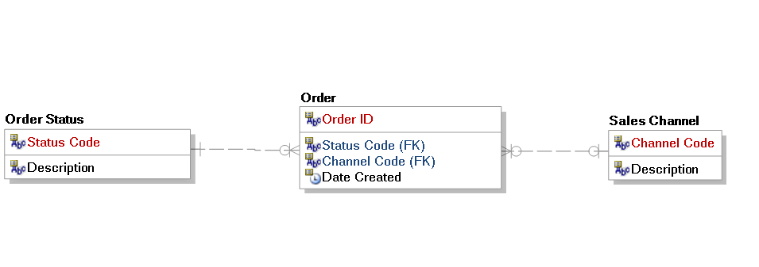
BUSINESS CONTEXT
Logical View

Slide 15
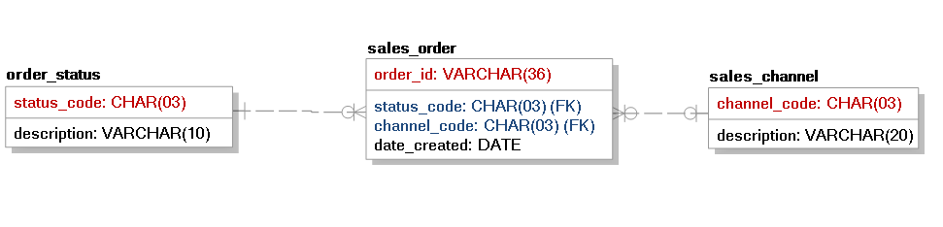
BUSINESS CONTEXT
Physical View

Slide 16
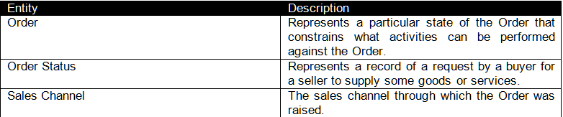
BUSINESS CONTEXT

Slide 17
WORKING WITH THE CORE CONCEPTS

Slide 18
WORKING WITH THE CORE CONCEPTS
Connection
JDBC represents a connection to a database through the Connection interface. Thus, connecting to a database requires you to get an instance of the Connection interface from your JDBC driver. JDBC supports two ways of getting access to a database connection:
Through the JDBC DataSource
Using the JDBC DriverManager
The data source method is the preferred approach to database connectivity. Data sources, however, tend to be usable only in application server contexts. You should therefore understand both forms of connectivity since you can rely on DriverManager connectivity no matter what environment you are working in.

Slide 19
WORKING WITH THE CORE CONCEPTS
DataSource connectivity
Data source connectivity is very simple. In fact, the following code makes a connection to any database for any application:
Context ctx = new InitialContext( );
DataSource ds = (DataSource)ctx.lookup("jdbc/dsn");
Connection conn = ds.getConnection( );
The only requirement is that you have a JNDI-supported directory service containing a DataSource configured with the name jdbc/dsn.
The first line gets an InitialContext object in accordance with the JNDI specification. If your environment isn't set up properly, you catch a javax.naming.NoInitialContextException. The InitialContext enables you to navigate a directory service. You use it in your database applications to look up a JDBC DataSource instance. Finally, once you have found that DataSource, you use it to make a connection.

Slide 20
WORKING WITH THE CORE CONCEPTS
DriverManager connectivity
One of the few implementation classes in the java.sql package is the class DriverManager. It maintains a list of implementations of the java.sql.Driver interface and provides you with connections based on a JDBC URL that you provide. This JDBC URL comes in the form jdbc:protocol:subprotocol. This URL tells a DriverManager which database engine you wish to connect to and provides the DriverManager with enough information to make a connection.
Connection conn = DriverManager.getConnection("jdbc:mysql:/localhost/Web", "userID", "password");

Slide 21
WORKING WITH THE CORE CONCEPTS
DataSource Connectivity
SRC
DataSourceDatabase.java
Test
DataSourceDatabaseTest.java
Scope:
Get connection from simple data source
Driver Manager Connectivity
SRC
DriverManagerDatabase.java
Test
DriverManagerDatabaseTest.java
Scope:
Get connection from DriverManager

Slide 22
WORKING WITH THE CORE CONCEPTS
Statement
The most basic element of communication over a Connection is the Statement. Your application encapsulates SQL queries into a Statement or one of its subclasses and processes the results. An SQL query can be an INSERT, UPDATE, DELETE, or any other valid SQL statement.
The Connection class enables you to create Statement instances via the createStatement( ) method:
Statement stmt = conn.createStatement( );
You can then use that statement to send SQL to the database:
stmt.executeUpdate("UPDATE test SET val = 'cheese' WHERE id = 1");

Slide 23
WORKING WITH THE CORE CONCEPTS
The PreparedStatement interface extends the Statement interface. It enables a SQL statement to contain parameters like a function call. You can execute a single statement repeatedly with different values. The act of assigning values to parameters is called binding parameters.
With a prepared statement, you send the actual SQL to the database when you get the PreparedStatement object through the prepareStatement( ) method in java.sql.Connection.
SRC
OrderRepository.java
Test
OrderRepositoryTest.java
Scope:
Create an order
Update an order

Slide 24
WORKING WITH THE CORE CONCEPTS
ResultSet
A table of data representing a database result set, which is usually generated by executing a statement that queries the database.
A ResultSet object maintains a cursor pointing to its current row of data. Initially the cursor is positioned before the first row. The next method moves the cursor to the next row, and because it returns false when there are no more rows in the ResultSet object, it can be used in a while loop to iterate through the result set.
A default ResultSet object is not updatable and has a cursor that moves forward only. Thus, you can iterate through it only once and only from the first row to the last row. It is possible to produce ResultSet objects that are scrollable and/or updatable. The following code fragment, in which con is a valid Connection object, illustrates how to make a result set that is scrollable and insensitive to updates by others, and that is updatable. See ResultSet fields for other options.

Slide 25
WORKING WITH THE CORE CONCEPTS
Statement stmt = conn.createStatement( );
ResultSet rs = stmt.executeQuery("SELECT id, val FROM test");
while( rs.next( ) ) {
System.out.println("ID: " + rs.getInt(1) + ", rs.getString(2));
}
SRC
OrderViewRepository.java
Test
OrderViewRepositoryTest.java
Scope:
Select an order by id
Select orders by status
Select orders by channel

Slide 26
WORKING WITH THE CORE CONCEPTS
While prepared statements enable you to access similar database queries through a single PreparedStatement object, stored procedures attempt to take the "black box" concept for database access one step further. A stored procedure is built inside the database before you run your application. You access that stored procedure by name at runtime. In other words, a stored procedure is almost like a method you call in the database. Stored procedures have the following advantages:
Because the procedure is precompiled in the database for most database engines, it executes much faster than dynamic SQL. Even if your database does not compile the stored procedure before it runs, it will be precompiled for subsequent runs just like prepared statements.
Syntax errors in the stored procedure can be caught at compile time rather than runtime.
Java developers need to know only the name of the procedure and its inputs and outputs. The way in which the procedure is implemented is totally irrelevant.

Slide 27
WORKING WITH THE CORE CONCEPTS
The downside to stored procedures, however, is that every database has its own stored procedure language. If you use stored procedures heavily, you can go to great lengths to make sure your Java application is database-independent yet still be tied to a specific database because of the stored procedures
SRC
OrderRepository.java
Test
OrderRepositoryTest.java
Scope:
Delete orders with the specified status

Slide 28
REFERENCES
http://www.amazon.com.mx/gp/product/B00BQN40HY?keywords=Java%20Database%20Best%20Practices&qid=1437877551&ref_=sr_1_1&s=digital-text&sr=1-1
https://docs.oracle.com/javase/tutorial/jdbc/overview/index.html
https://docs.oracle.com/javase/tutorial/jdbc/basics/index.html
http://www.amazon.es/Enterprise-Patterns-MDA-Archetype-Technology/dp/032111230X/ref=sr_1_2?s=foreign-books&ie=UTF8&qid=1437446918&sr=1-2&keywords=Enterprise+MDA

Slide 30
Softtek
hugo.arroyo@softtek.com

