Slide 1
AngularJS
Angular Architecture

Slide 2
Disclaimer
Document Name:
Data Classification: INTERNAL
Disclaimer
The contents of this document are property of Softtek, and are classified as Confidential. Any reproduction in whole or in part is strictly prohibited without the written permission of Softtek.
This document is subject to change. Comments, corrections or questions should be directed to the author.
Audience/Viewership | Purpose
Java Beginners | Training
Revision Chart
The following chart list the revisions made to this document. Use this to describe the changes and additions each time this document is re-published. The description should be detailed as possible and include the names of the reviewers who request the changes.
Version No. | Version Date | Types of Changes | Owner/Author | Date of Review/Expiration
1 | 05/08/2015 | Initial revision | Jose Francisco Gonzalez Avila | 05/08/2016

Slide 3
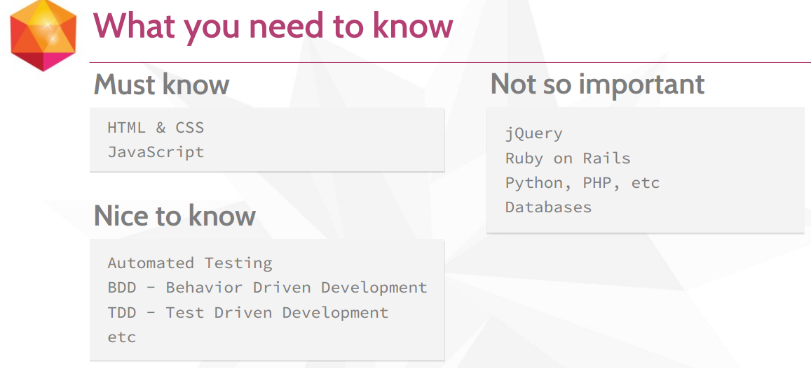
What you need to know before starting this course?

Slide 4
What is Angular?
What Is Angular?
AngularJS is a structural framework for dynamic web apps. It lets you use HTML as your template language and lets you extend HTML's syntax to express your application's components clearly and succinctly. Angular's data binding and dependency injection eliminate much of the code you would otherwise have to write. And it all happens within the browser, making it an ideal partner with any server technology.
Angular is what HTML would have been, had it been designed for applications. HTML is a great declarative language for static documents. It does not contain much in the way of creating applications, and as a result building web applications is an exercise in what do I have to do to trick the browser into doing what I want?
The impedance mismatch between dynamic applications and static documents is often solved with:
a library - a collection of functions which are useful when writing web apps. Your code is in charge and it calls into the library when it sees fit. E.g., jQuery.
frameworks - a particular implementation of a web application, where your code fills in the details. The framework is in charge and it calls into your code when it needs something app specific. E.g., durandal, ember, etc.
Angular takes another approach. It attempts to minimize the impedance mismatch between document centric HTML and what an application needs by creating new HTML constructs. Angular teaches the browser new syntax through a construct we call directives. Examples include:
Data binding, as in {{}}.
DOM control structures for repeating, showing and hiding DOM fragments.
Support for forms and form validation.
Attaching new behavior to DOM elements, such as DOM event handling.
Grouping of HTML into reusable components.

Slide 5
Key Angular Concepts
Template | HTML with additional markup, meaning HTML + directives
Directives | elements that extend HTML with additional markup, two kind of directives, the normal ones such as ng-app that extend html elements or the ones within double curly braces {{ expression | filter}} containing expressions and filters
Model | the data shown to the user in the view and with wich the user interacts Whenever the view changes, the model changes as well, angular recualculates the DOM immediately Model stores simply variables
Scopes | The context that stores the MODEL so that CONTROLLERS, DIRECTIVES, and EXPRESSIONS can access it
Expressions | access variables and functions from the scope, special kind of directives within {} that are used in the templates
Compiler | parses the template and instantiates directives and expressions
Filter | formats the values of expressions for display to the user
View | What the users seems in the DOM
Data Binding | sync data between the model and the view
Controller | The business logic behind the views
Dependency Injection | Creates and wires objects and functions
Injector | dependency injector container
Module | a container for the differen parts of an app including controllers, services, filters, directives, which configures the injector
Service | reusable business logic independent of views

Slide 6
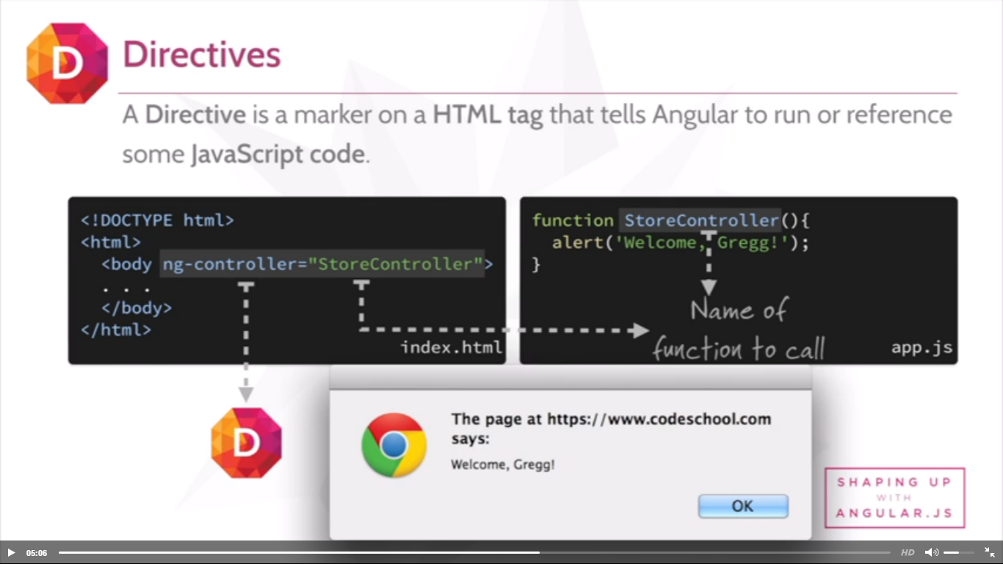
Key Angular Concepts
What is angular JS?
A client-side JavaScript framework for adding interactivity to HTML.
What is a Directive?
A directive is a marker on a HTML tag that tells angular to run or reference some JavaScript code.
Example:

Slide 7
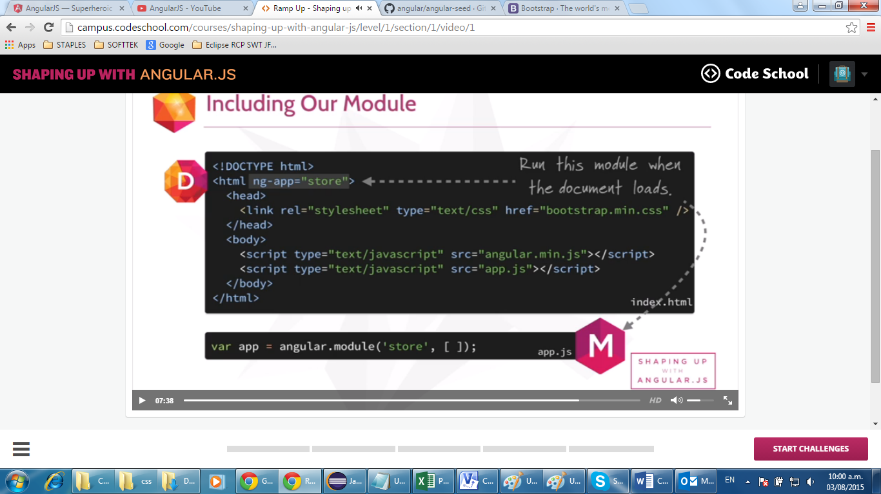
Key Angular Concepts
What is a module?
Where we write pieces of our Angular application. We also establish dependencies to other modules in each module.

Slide 8
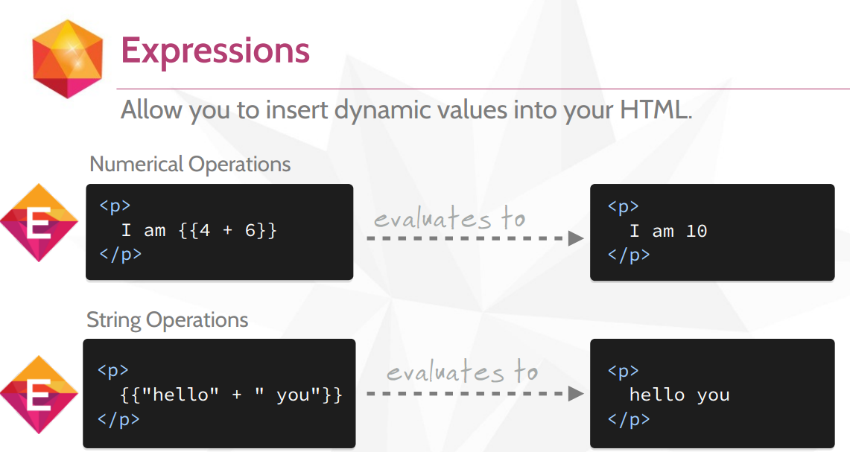
Key Angular Concepts
More on expressions: https://docs.angularjs.org/guide/expression

Slide 9
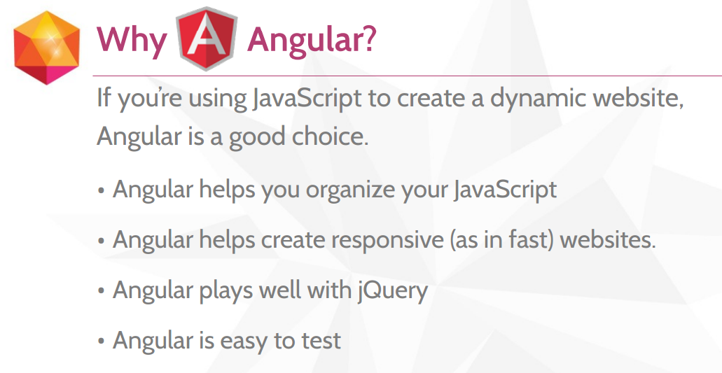
Why Angular?

Slide 10
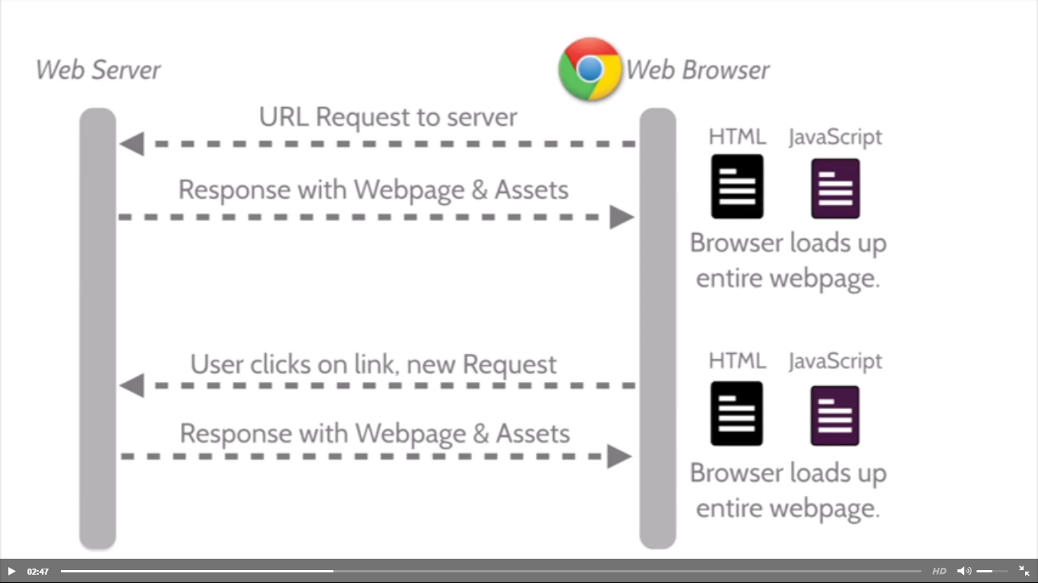
Why Angular?
Traditional websites load entire pages every time which is not quite efficient:

Slide 11
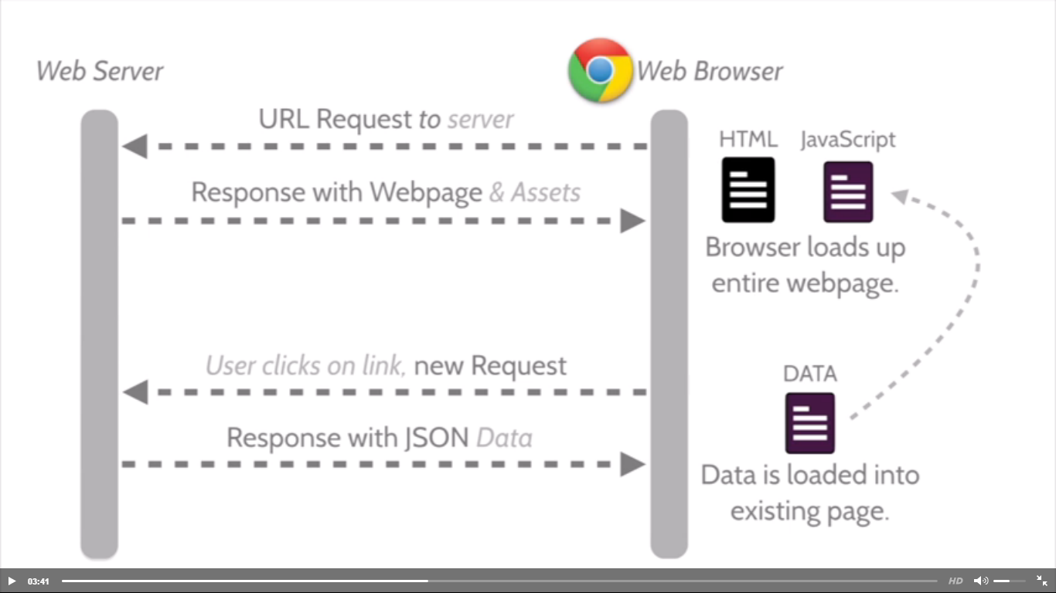
Why Angular?
Responsive/Fast websites loads entire pages only once, and then its links will request data, but page is not fully re-loaded. The data requested by clicking on a link for instance will get data in form of JSON and that input will be used to update the already loaded page without having to reload the entire page again.

Slide 12
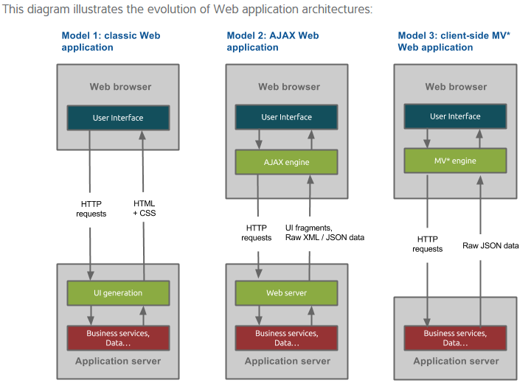
Why Angular?

Slide 13
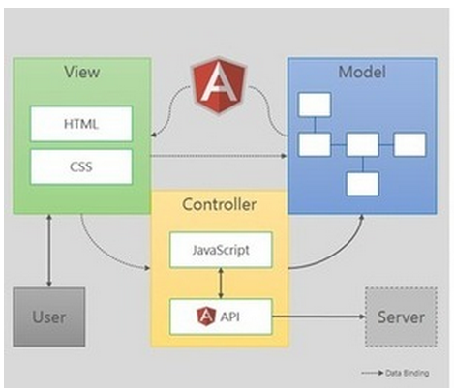
Overall Architecture MVC
Angular augments the view by providing the ability to include specific directives (new HTML markup and behavior);
Angular provides 2-way binding between View & Model;
Angular provides API for accessing the backend (Server);

Slide 14
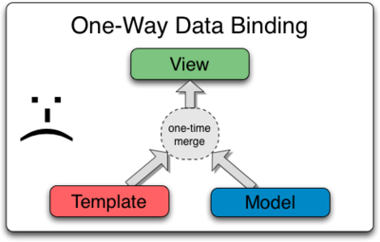
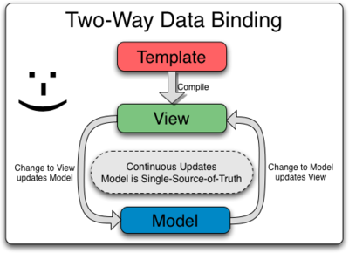
2-Way Binding
Data Binding in Classical Template Systems
Most templating systems bind data in only one direction: they merge template and model components together into a view. After the merge occurs, changes to the model or related sections of the view are NOT automatically reflected in the view. Worse, any changes that the user makes to the view are not reflected in the model. This means that the developer has to write code that constantly syncs the view with the model and the model with the view.
Data Binding in Angular Templates
Angular templates work differently. First the template (which is the uncompiled HTML along with any additional markup or directives) is compiled on the browser. The compilation step produces a live view. Any changes to the view are immediately reflected in the model, and any changes in the model are propagated to the view. The model is the single-source-of-truth for the application state, greatly simplifying the programming model for the developer. You can think of the view as simply an instant projection of your model.
Because the view is just a projection of the model, the controller is completely separated from the view and unaware of it. This makes testing a snap because it is easy to test your controller in isolation without the view and the related DOM/browser dependency.

Slide 15
2-Way Binding - Example
Open chrome and load the 1_ANGULAR_ARCHITECTURE_TWO_WAY_BINDING.html file;
Click on the “Chili” and “Jalapeño” buttons.
RESULT: You will see that the model is updated in the scope object and the 2-way binding implementation between the view and the model reflects in the text that appears in the page. The controller is not “refreshing” de page by a explicit instruction. 2-way binding between model/view does it automatically.

Slide 16
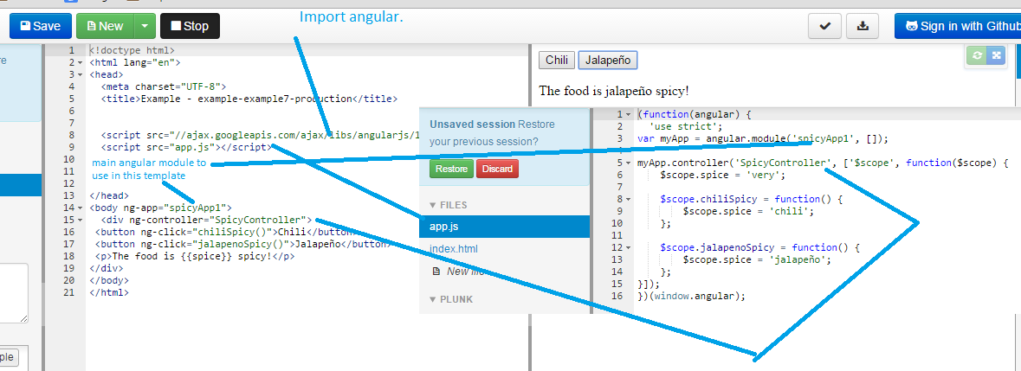
2-Way Binding - Example
Angular’s compiler compiles template (html+angular directives) and Angular’s injector instantiates the controller specified in the angular module (ng-app=“spicyApp1”). The result of both compilation and injection creates the view (Actual web page) which is augmented by Angular automatic 2-way binding (when controller changes the model value of spice via chilliSpicy() or jalapenoSpicy() functions the view automatically reflects the new value of spice variable in the model. This feature is called 2-way binding between model and view.

Slide 17
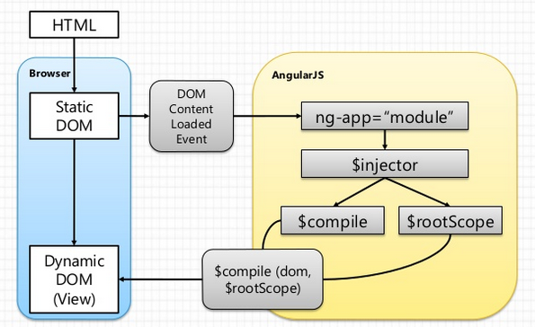
Compilation & Dependency Injection

Slide 18
Angular in Detail
Open the 2_ANGULAR_ARCHITECTURE_CONCEPTUAL_MAP.vsd file. Open the “Document Information” sheet, learn the instructions, and proceed explaining the “AngularJS Conceptual Overview”, “AngularJS Directives”, & “AngularJS Providers” sheets.

Slide 19
Reference Material
Angular’s API (directives):
https://docs.angularjs.org/api
Developer’s guide:
https://docs.angularjs.org/guide/introduction
Quick course:
http://campus.codeschool.com/courses/shaping-up-with-angular-js/intro
Expressions:
https://docs.angularjs.org/guide/expression

Slide 21
Jose Francisco Gonzalez Avila
josef.Gonzalez@softtek.com
Author of training material
Jorge Luis Gonzalez
jorge.gonzalezm@softtek.com
Instructor

