Slide 1
AngularJS
Binding with model (2-way binding between VIEW & MODEL)

Slide 2
Disclaimer
Document Name:
Data Classification: INTERNAL
Disclaimer
The contents of this document are property of Softtek, and are classified as Confidential. Any reproduction in whole or in part is strictly prohibited without the written permission of Softtek.
This document is subject to change. Comments, corrections or questions should be directed to the author.
Audience/Viewership | Purpose
Java Beginners | Training
Revision Chart
The following chart list the revisions made to this document. Use this to describe the changes and additions each time this document is re-published. The description should be detailed as possible and include the names of the reviewers who request the changes.
Version No. | Version Date | Types of Changes | Owner/Author | Date of Review/Expiration
1 | 05/08/2015 | Initial revision | Jose Francisco Gonzalez Avila | 05/08/2016

Slide 3
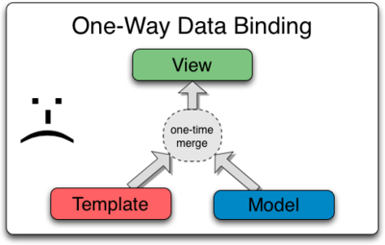
What is Data Binding?
Data Binding
Data-binding in Angular apps is the automatic synchronization of data between the model and view components. The way that Angular implements data-binding lets you treat the model as the single-source-of-truth in your application. The view is a projection of the model at all times. When the model changes, the view reflects the change, and vice versa.
Data Binding in Classical Template Systems
Most templating systems bind data in only one direction: they merge template and model components together into a view. After the merge occurs, changes to the model or related sections of the view are NOT automatically reflected in the view. Worse, any changes that the user makes to the view are not reflected in the model. This means that the developer has to write code that constantly syncs the view with the model and the model with the view.

Slide 4
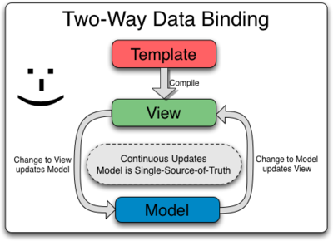
What is Data Binding?
Angular templates work differently. First the template (which is the uncompiled HTML along with any additional markup or directives) is compiled on the browser. The compilation step produces a live view. Any changes to the view are immediately reflected in the model, and any changes in the model are propagated to the view. The model is the single-source-of-truth for the application state, greatly simplifying the programming model for the developer. You can think of the view as simply an instant projection of your model.
Because the view is just a projection of the model, the controller is completely separated from the view and unaware of it. This makes testing a snap because it is easy to test your controller in isolation without the view and the related DOM/browser dependency.

Slide 5
2-Way Binding - Example
Open chrome and load the 2_BINDING_WITH_MODEL_EXERCISE_1.html file;
Click on the “Chili” and “Jalapeño” buttons.
RESULT: You will see that the model is updated in the scope object and the 2-way binding implementation between the view and the model reflects in the text that appears in the page. The controller is not “refreshing” de page by a explicit instruction. 2-way binding between model/view does it automatically.

Slide 6
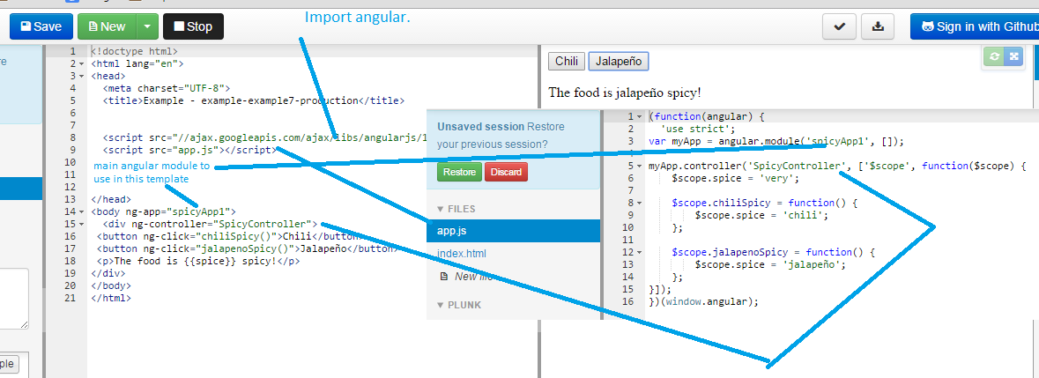
2-Way Binding - Example
Angular’s compiler compiles template (html+angular directives) and Angular’s injector instantiates the controller specified in the angular module (ng-app=“spicyApp1”). The result of both compilation and injection creates the view (Actual web page) which is augmented by Angular automatic 2-way binding (when controller changes the model value of spice via chilliSpicy() or jalapenoSpicy() functions the view automatically reflects the new value of spice variable in the model. This feature is called 2-way binding between model and view.

Slide 7
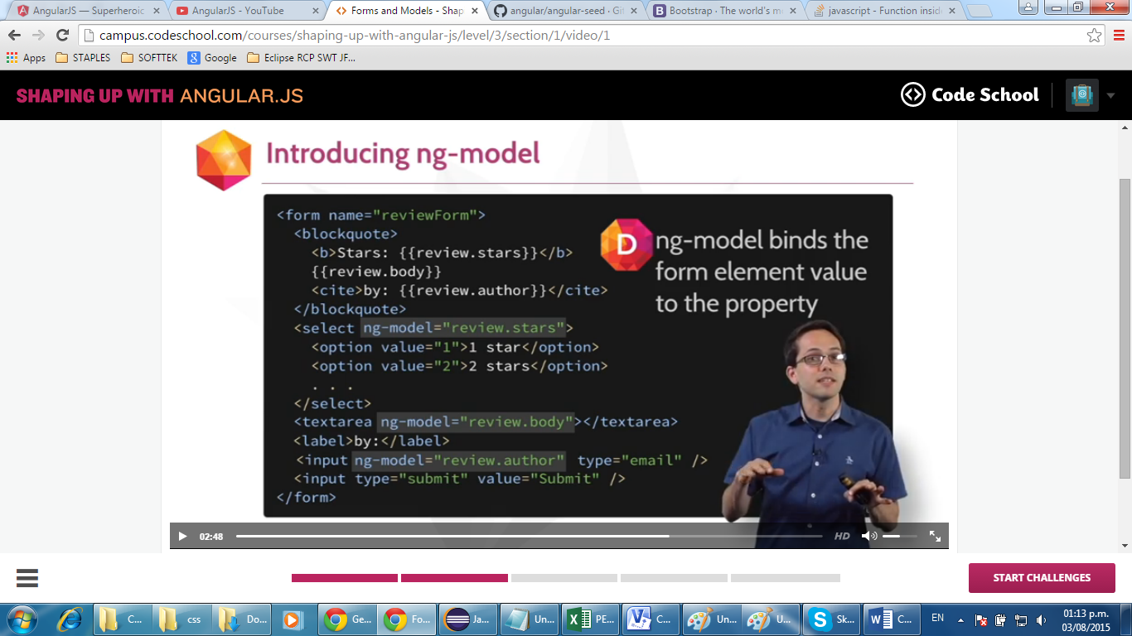
ng-model Angular Directive
ng-model directive: Binds HTML elements with model elements in a 2-way-binding fashion.

Slide 8
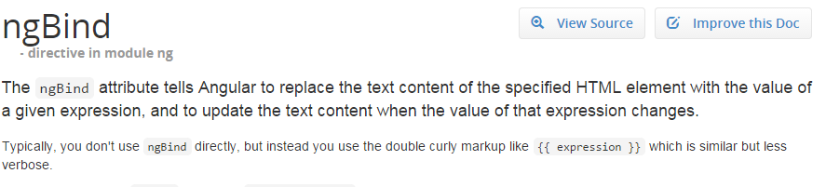
ng-bind Angular Directive

Slide 9
Exercises: ng-model & ng-bind directives
Conduct the 2_BINDING_WITH_MODEL_EXERCISE_2.html & 2_BINDING_WITH_MODEL_EXERCISE_3.html to learn about the usage of the following 2 directives: ng-model & ng-bind.

Slide 10
Test
Open the 2_BINDING_WITH_MODEL_TEST__UNSOLVED_1.html
Test objective: You need to make sure the "EXAM RESULTS" section relfects automatically the responses from the "EXAM QUESTIONS" section in real time. Basically, you need to implement 2-way binding between the HTML controls in the "EXAM QUESTION" section and the "EXAM RESULT" section that read the model.

Slide 11
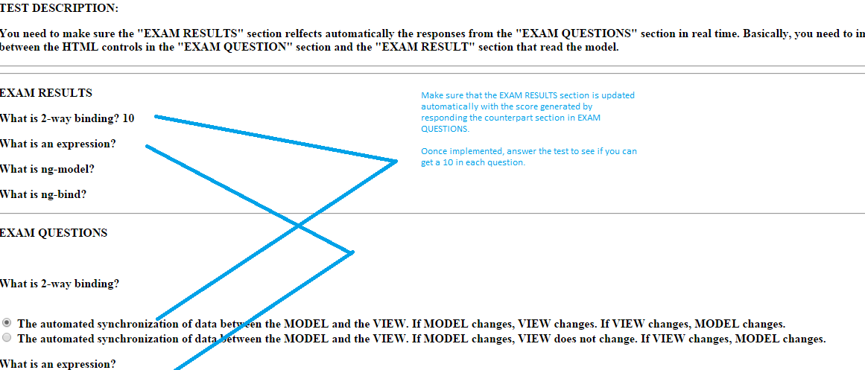
Test

Slide 12
Test Results
Open the 2_BINDING_WITH_MODEL_TEST__SOLVED_1.html answered version of the exam to contrast the student results with the solution.

Slide 14
Jose Francisco Gonzalez Avila
josef.Gonzalez@softtek.com
Author of training material
Jorge Luis Gonzalez
jorge.gonzalezm@softtek.com
Instructor

