Slide 1
AngularJS
Controllers

Slide 2
Disclaimer
Document Name:
Data Classification: INTERNAL
Disclaimer
The contents of this document are property of Softtek, and are classified as Confidential. Any reproduction in whole or in part is strictly prohibited without the written permission of Softtek.
This document is subject to change. Comments, corrections or questions should be directed to the author.
Audience/Viewership | Purpose
Java Beginners | Training
Revision Chart
The following chart list the revisions made to this document. Use this to describe the changes and additions each time this document is re-published. The description should be detailed as possible and include the names of the reviewers who request the changes.
Version No. | Version Date | Types of Changes | Owner/Author | Date of Review/Expiration
1 | 06/08/2015 | Initial revision | Jose Francisco Gonzalez Avila | 06/08/2016

Slide 3
What are Scopes?
Scope is an object that refers to the application model. It is an execution context for expressions. Scopes are arranged in hierarchical structure which mimic the DOM structure of the application. Scopes can watch expressions and propagate events.
HINT: Refer to the 1_ANGULAR_ARCHITECTURE_CONCEPTUAL_MAP.vsd file to understand the scope in relation to the model and to the view.

Slide 4
What are Controllers?
In Angular, a Controller is defined by a JavaScript constructor function that is used to augment the Angular Scope.
When a Controller is attached to the DOM via the ng-controller directive, Angular will instantiate a new Controller object, using the specified Controller's constructor function. A new child scope will be created and made available as an injectable parameter to the Controller's constructor function as $scope.
If the controller has been attached using the controller as syntax then the controller instance will be assigned to a property on the new scope.
Use controllers to:
Set up the initial state of the $scope object.
Add behavior to the $scope object.

Slide 5
More about controllers
Controllers are attached to the VIEW (DOM) with the ng-controller directive;
Controllers provides functions that update the model that reside in the scope;
Controllers decorate the scopes (model holders) with functions and values (in the model);
Controllers may invoke reusable functions that reside in services;
Services will be covered in another lesson.
An alternative way to attach controllers to the VIEW (DOM) is by utilizing the $route service (which utilizes itself the $routeProvider and $routeParam services)

Slide 6
ng-controller directive
ngController
- directive in module ng
The ngController directive attaches a controller class to the view. This is a key aspect of how angular supports the principles behind the Model-View-Controller design pattern.
MVC components in angular:
Model — Models are the properties of a scope; scopes are attached to the DOM where scope properties are accessed through bindings.
View — The template (HTML with data bindings) that is rendered into the View.
Controller — The ngController directive specifies a Controller class; the class contains business logic behind the application to decorate the scope with functions and values
Note that you can also attach controllers to the DOM by declaring it in a route definition via the $route service. A common mistake is to declare the controller again using ng-controller in the template itself. This will cause the controller to be attached and executed twice.

Slide 7
$route service
$route
- $routeProvider
- service in module ngRoute
$route is used for deep-linking URLs to controllers and views (HTML partials). It watches $location.url()and tries to map the path to an existing route definition.
Requires the ngRoute module to be installed.
You can define routes through $routeProvider's API.
The $route service is typically used in conjunction with the ngView directive and the $routeParams service.

Slide 8
Ng-view directive (that is used in conjunction with the $route service)
ngView
- directive in module ngRoute
Overview
ngView is a directive that complements the $route service by including the rendered template of the current route into the main layout (index.html) file. Every time the current route changes, the included view changes with it according to the configuration of the $routeservice.
Requires the ngRoute module to be installed.
Directive Info
This directive creates new scope.
This directive executes at priority level 400.

Slide 9
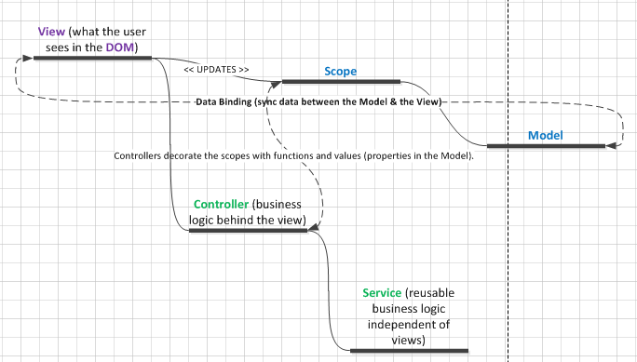
Controllers (conceptual map)

Slide 10
Exercises
EXERCISE 1: Open the 3_CONTROLLERS_EXERCISE_1.html file in chrome. Review the code. You should gain the following understanding:
How to define a controller in angular;
How to instantiate a controller in angular and assigning it an alias via the ng-controller directive;
How to define properties in the scope and modify them in the controller;
How to read properties from the scope when using a controller.
EXERCISE 2: Open the 3_CONTROLLERS_EXERCISE_2.html file in chrome. Review the code. You should gain the following understanding:
How to define properties in the scope and modify them in the controller;
How to invoke functions that accept arguments in the controller (from within the view) to update the scope with these arguments, and then how to retrieve the updated properties from the scope.

Slide 11
Exercises
EXERCISE 3: Open the 3_CONTROLLERS_EXERCISE_3.html file in chrome. Review the code. You should gain the following understanding:
How certain directives create scopes when used, such as the ng-controller directive;
How controllers and their respective scopes can be nested;
How scopes inherit properties from their parent scope.
EXERCISE 4: Open the 3_CONTROLLERS_EXERCISE_4.html file in chrome. Review the code. You should gain the following understanding:
Identify the 2 ways in which you can use controllers in angular (ng-controller directive and/or $route services which relies on $routeProvider/$routeParams services);
How to use the $route service (along with $routeProvider/$routeParams services) for redirecting to different html resources which logic reside in counterpart angular controllers in a [templateUrl, controller] pairs fashion.
The purpose of the ng-view directive that is used in conjunction with the $route service.

Slide 12
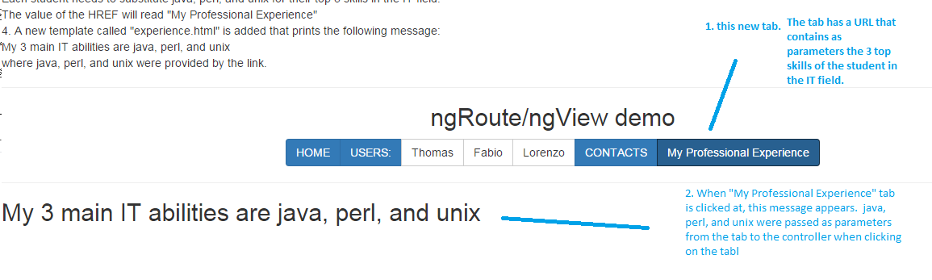
Exam
Give the students the 3_CONTROLLERS_TEST_UNSOLVED_1.html file so they open it in Chrome. The instructions appear at the top of the page.
Basically: Each student should follow the instructions in the html page and implement the code required to show this:

Slide 13
Exam solution
Open the 3_CONTROLLERS_TEST_SOLVED_1.html file in Chrome. Click on the “My Professional Experience” link. Contrast the solution with the solution of the students and do a final quick review of the solution with them in group.

Slide 15
Jose Francisco Gonzalez Avila
josef.Gonzalez@softtek.com
Author of training material
Jorge Luis Gonzalez
jorge.gonzalezm@softtek.com
Instructor

