Slide 1
AngularJS
Forms

Slide 2
Disclaimer
Document Name:
Data Classification: INTERNAL
Disclaimer
The contents of this document are property of Softtek, and are classified as Confidential. Any reproduction in whole or in part is strictly prohibited without the written permission of Softtek.
This document is subject to change. Comments, corrections or questions should be directed to the author.
Audience/Viewership | Purpose
Java Beginners | Training
Revision Chart
The following chart list the revisions made to this document. Use this to describe the changes and additions each time this document is re-published. The description should be detailed as possible and include the names of the reviewers who request the changes.
Version No. | Version Date | Types of Changes | Owner/Author | Date of Review/Expiration
1 | 11/08/2015 | Initial revision | Jose Francisco Gonzalez Avila | 11/08/2016

Slide 3
What are Forms?
Controls (input, select, textarea) are ways for a user to enter data. A Form is a collection of controls for the purpose of grouping related controls together.
Form and controls provide validation services, so that the user can be notified of invalid input before submitting a form. This provides a better user experience than server-side validation alone because the user gets instant feedback on how to correct the error. Keep in mind that while client-side validation plays an important role in providing good user experience, it can easily be circumvented and thus can not be trusted. Server-side validation is still necessary for a secure application.

Slide 4
Using CSS classes
To allow styling of form as well as controls, ngModel adds these CSS classes:
ng-valid: the model is valid
ng-invalid: the model is invalid
ng-valid-[key]: for each valid key added by $setValidity
ng-invalid-[key]: for each invalid key added by $setValidity
ng-pristine: the control hasn't been interacted with yet
ng-dirty: the control has been interacted with
ng-touched: the control has been blurred
ng-untouched: the control hasn't been blurred
ng-pending: any $asyncValidators are unfulfilled

Slide 5
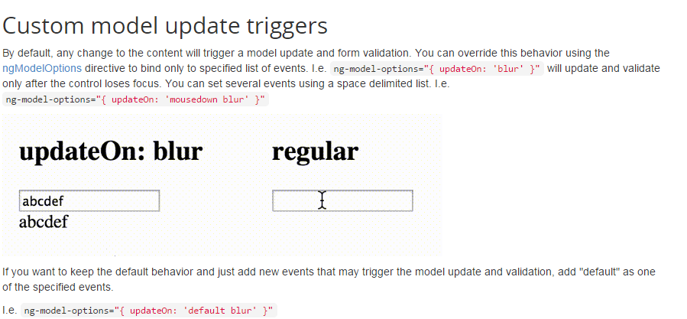
Custom model update triggers

Slide 6
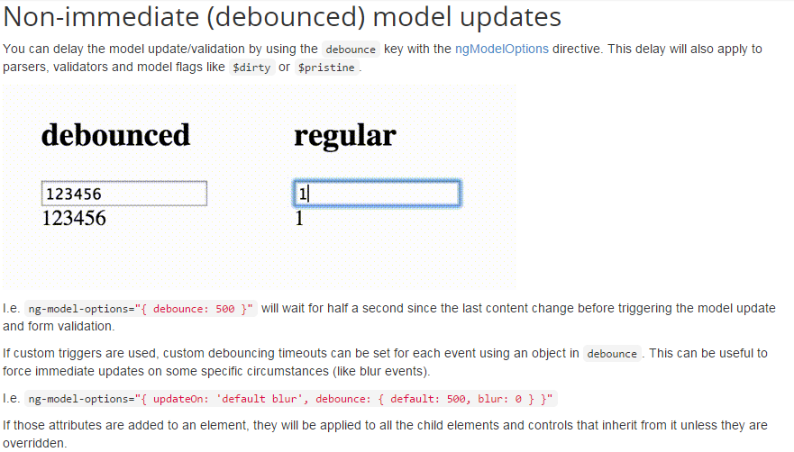
Non-immediate model updates

Slide 7
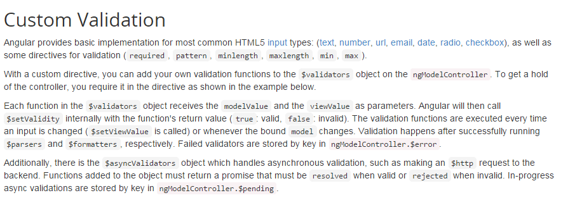

Custom Validations

Slide 8
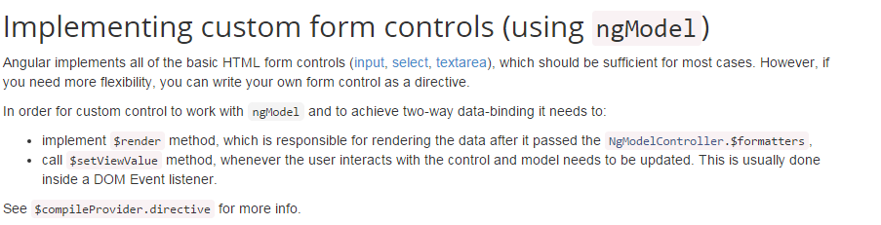
Implementing custom controls

Slide 9
Exercises
EXERCISE 1: Open the 4_FORMS_EXERCISE_1.html file in chrome. Review the code. You should gain the following understanding:
How the novalidate word at the form level is necessary when working in angular to disable native browser validation. This is necessary provided angular controls such as input type email provide their own input validation;
How a form is a group of controls that work together.
EXERCISE 2: Open the 4_FORMS_EXERCISE_2.html file in chrome. Review the code. You should gain the following understanding:
How predefined CSS classes are applied to form controls depending on whether the control has been touched, it is valid, etc.;
How to customize the style (font, color, etc.) of controls by defining the actual styles for CSS class combinations that angular uses by default in our html pages.

Slide 10
Exercises
EXERCISE 3: Open the 4_FORMS_EXERCISE_3.html file in chrome. Review the code. You should gain the following understanding:
How <form>.<controlname>.$touched let us know if a control has already had any kind of interaction with the user (i.e. in case of an input text box, whether the user has clicked on it for instance);
How <form>.$submitted let us know if the form has been submitted;
How controls marked with “required” will prevent the form from getting submitted if at least one of these controls is marked as invalid by angular (i.e. if an email type has an invalid email and it is marked as submitted, the form won’t be submitted;
How the ng-show directive shows content if the expression associated with it evaluates to true.

Slide 11
Exercises
EXERCISE 4: Open the 4_FORMS_EXERCISE_4.html file in chrome. Review the code. You should gain the following understanding:
How individual controls have changed the way they propagate changes to the model; default consists in automatic changes, but updates can be applied on a particular event control such as on blur, or updates can be delayed by x number of milliseconds.

Slide 12
Exercises
EXERCISE 5: Open the 4_FORMS_EXERCISE_5.html file in chrome. Review the code. You should gain the following understanding:
How you can create directives that customize the validations that are applied at the <input type=“number”> and <input type=“text”> standard angular controls. These directives are used as follows <input type=“number” directivename> and <input type=“text” directivename>;
How you can add functions to the $validators object (each function in the $validators object receives the modelValue and the viewValue as parameters). These functions are executed automatically by angular every time the input changes or whenever the model changes. Failed validations are stored in ngModelController.$error.
How you can add functions to the $anyncValidators object which handles asynchronous validations, such as making an $http request to the backend. These functions must return a promise that must be resolved when valid or rejected when invalid. In progress async validations are stored by key in ngModelController.$pending.

Slide 13
Exercises
EXERCISE 6: Open the 4_FORMS_EXERCISE_6.html file in chrome. Review the code. You should gain the following understanding:
How to overwrite the default validation of an input type email control.
EXERCISE 7: Open the 4_FORMS_EXERCISE_7.html file in chrome. Review the code. You should gain the following understanding:
How to create new controls using directives.

Slide 14
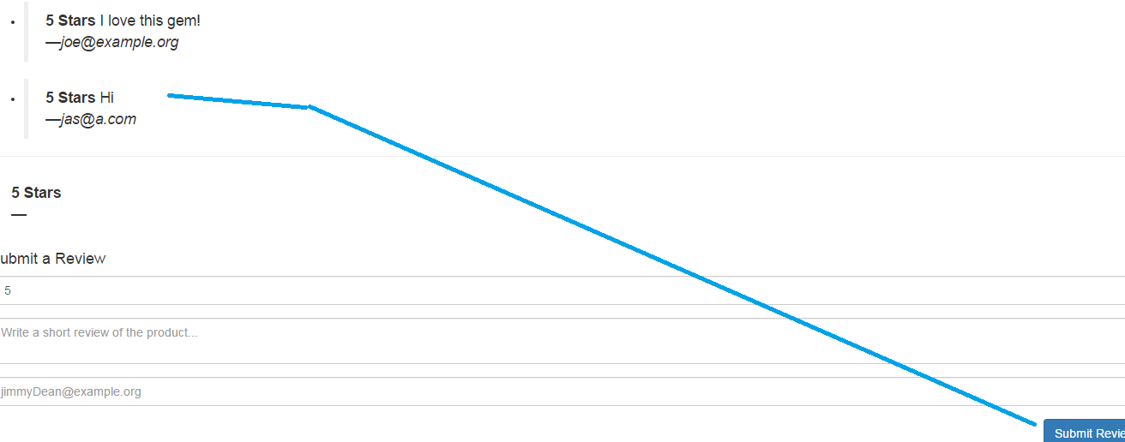
Exam
Open the 4_FORM_TEST_1_UNSOLVED.html file and proceed per the instructions. You need to be able to add new reviews to the reviews section (1 review already there, you need to be able to add more by inputting data in the 3 controls and hitting Submit button).

Slide 15
Exam resolution
Open the 4_FORM_TEST_1_SOLVED.html file and contrast the solution with the one reported by the students.

Slide 17
References
https://docs.angularjs.org/guide/forms
https://docs.angularjs.org/api/ng/directive/ngSubmit

Slide 18
Jose Francisco Gonzalez Avila
josef.Gonzalez@softtek.com
Author of training material
Jorge Luis Gonzalez |
jorge.gonzalezm@softtek.com
Instructor

