Slide 1
AngularJS
Directives

Slide 2
Disclaimer
Document Name:
Data Classification: INTERNAL
Disclaimer
The contents of this document are property of Softtek, and are classified as Confidential. Any reproduction in whole or in part is strictly prohibited without the written permission of Softtek.
This document is subject to change. Comments, corrections or questions should be directed to the author.
Audience/Viewership | Purpose
Java Beginners | Training
Revision Chart
The following chart list the revisions made to this document. Use this to describe the changes and additions each time this document is re-published. The description should be detailed as possible and include the names of the reviewers who request the changes.
Version No. | Version Date | Types of Changes | Owner/Author | Date of Review/Expiration
1 | 10/08/2015 | Initial revision | Jose Francisco Gonzalez Avila | 10/08/2016

Slide 3
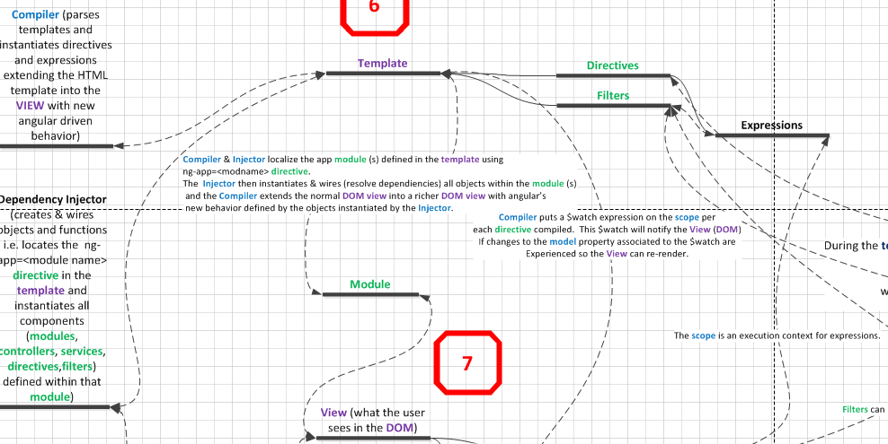
Directives(conceptual map)

Slide 4
What is a Directive?
At a high level, directives are markers on a DOM element (such as an attribute, element name, comment or CSS class) that tell AngularJS's HTML compiler ($compile) to attach a specified behavior to that DOM element or even transform the DOM element and its children.
A directive is a marker on a HTML tag that tells angular to run or reference some Java Scritp code.
There are 2 classification of directives in angular:
Bult-in directives: The ones that angular provides by default. A list of these directives can be found at:https://docs.angularjs.org/api/
Custom directives: The ones you create via code using Angular.
List of all directives at:

Slide 5
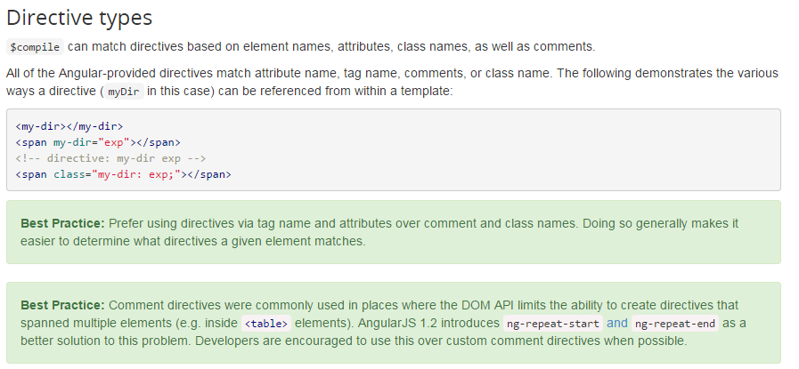
Directive types

Slide 6
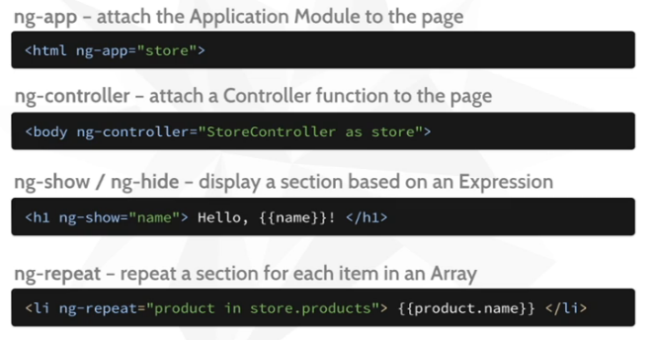
Built-in directives

Slide 7
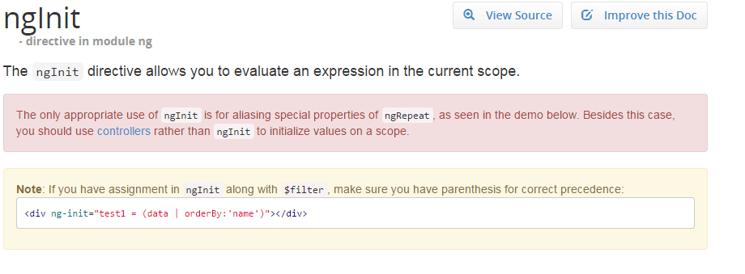
Built-in directives
ng-init:

Slide 8
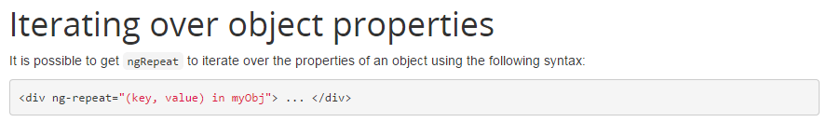
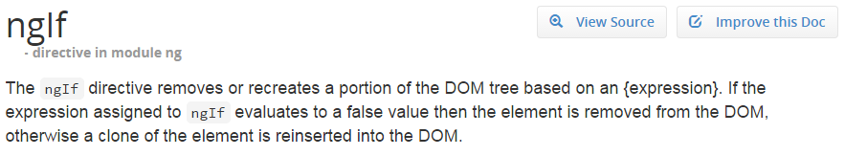
Built-in directives
ng-repeat
ng-if

Slide 9
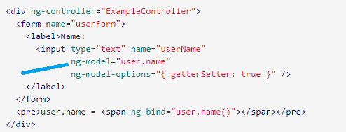
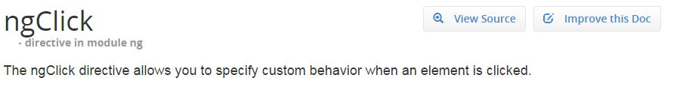
Built-in directives
ng-model: Associates an html element with a property model.
ng-click

Slide 10
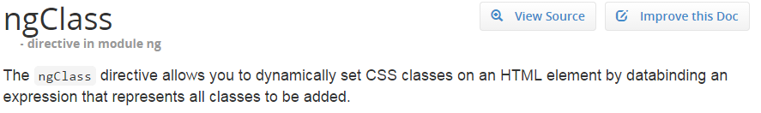
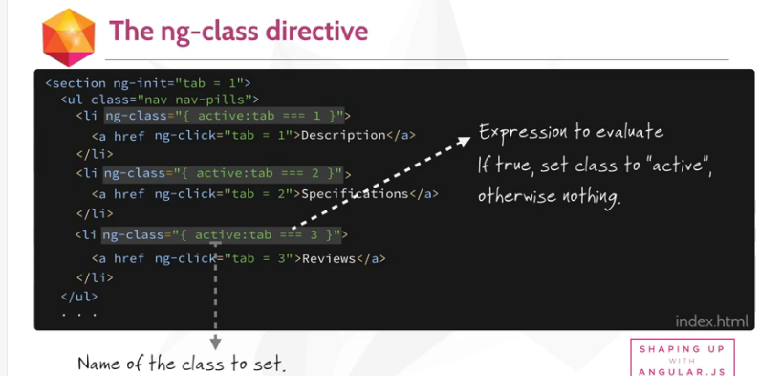
Built-in directives
ng-class

Slide 11
Exercises
EXERCISE 1: Open the 6_DIRECTIVES_EXERCISE_1.html file in chrome. Review the code. You should gain the following understanding:
How to use the ng-app directive;
How to use the ng-show directive;
How to use the ng-hide directive.
EXERCISE 2: Open the 6_DIRECTIVES_EXERCISE_2.html file in chrome. Review the code. You should gain the following understanding:
How to use the following directives: ng-app, ng-init, ng-repeat, ng-model, and ng-if.
EXERCISE 3: Open the 6_DIRECTIVES_EXERCISE_3.html file in chrome. Review the code. You should gain the following understanding:
How to use ng-click directive.
EXERCISE 4: Open the 6_DIRECTIVES_EXERCISE_4.html file in chrome. Review the code. You should gain the following understanding:
How to use ng-class directive.

Slide 12
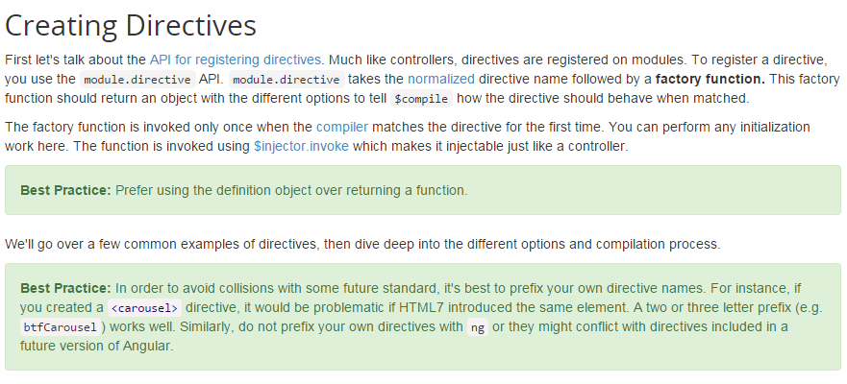
Custom directives

Slide 13
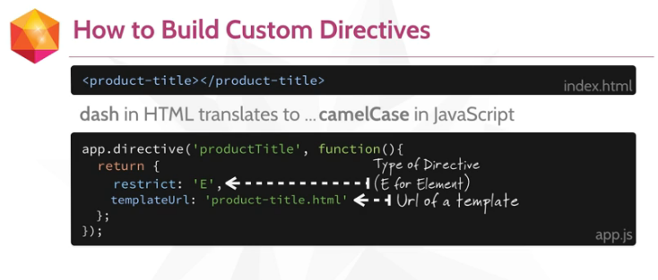
How to build custom directives?

Slide 14
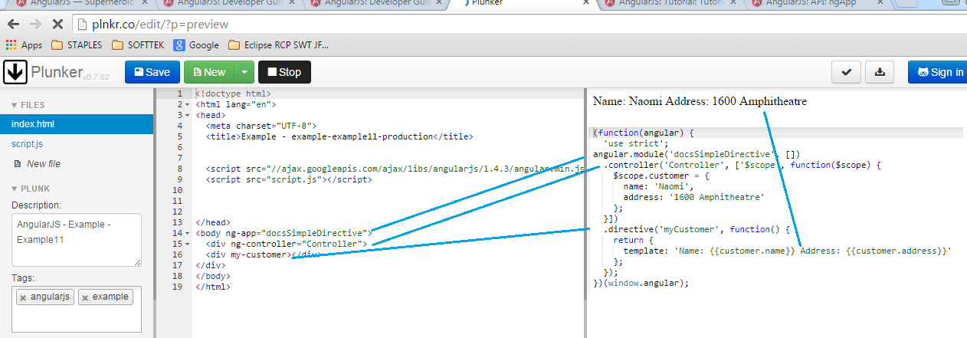
Directive example

Slide 15
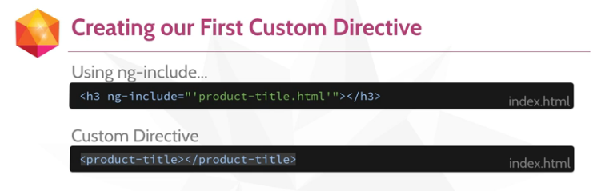
How does a custom directive looks in your html?
In the above example, we are contrasting ng-include bulit-in directive vs a custom directive called product-title. As you can see, a directive can be used to include contents in your HTML page just as ng-include does.

Slide 16
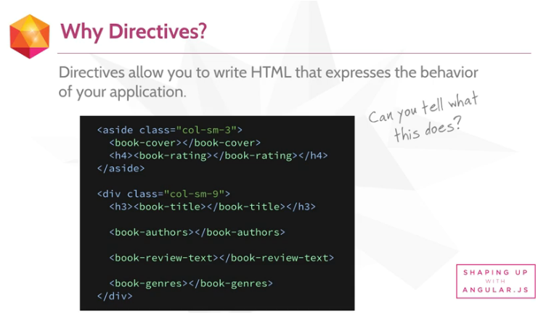
Why using custom directives?

Slide 17
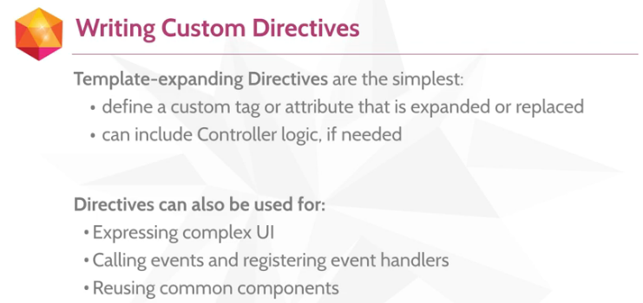
Why using custom directives?
Custom Directives have several usages you can find useful. Most common use is using them to provide html templates to the current page using controller logic in needed.
They can, however, be used for expressing complex UI, calling events, reusing common components, etc.
Refer to 4_FORMS.pptx lesson to learn how to use directives to add custom directives for validating input controls.

Slide 18
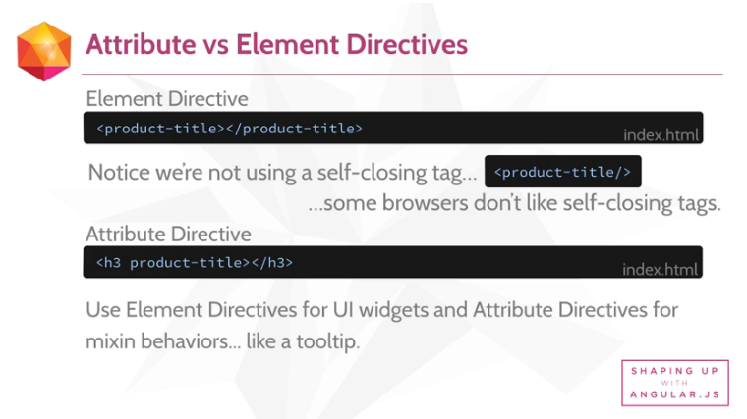
Attribute vs Element directives

Slide 19
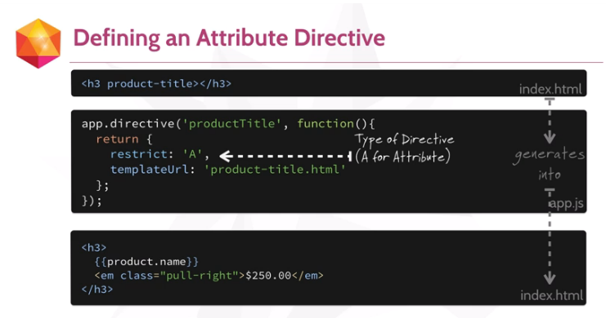
Defining an Attribute Directive
An element directive will have restrict: ‘E’ instead.

Slide 20
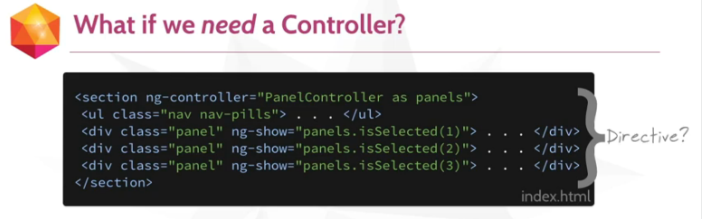
Directive controllers
You can define a controller inside a custom directive
Example: If the following piece of code needs to be moved to a directive we can proceed as follows.

Slide 21
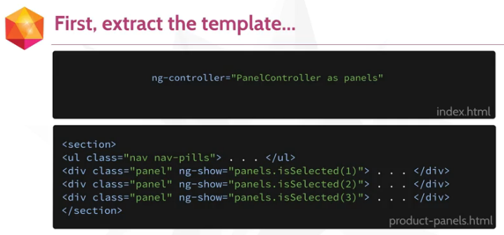
Directive controllers
Extract the html code you want to move to a directive to a new html template:

Slide 22
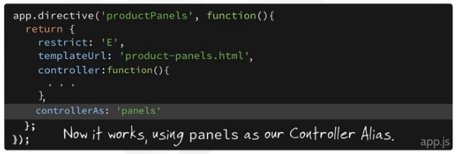

Directive controllers
Now write the actual directive:
Now invoke the directive instead:

Slide 23
Exercises
EXERCISE 5: Open the 6_DIRECTIVES_EXERCISE_5.html file in chrome. Review the code. You should gain the following understanding:
How to define a directive in angular at the module level using the directive clause i.e. <module>.directive(‘directiveName’, function()
The difference between the name of the directive at definition time and its counterpart name at HTML level i.e. myTraning vs my-training, respectively.
EXERCISE 6: Open the 6_DIRECTIVES_EXERCISE_6.html file in chrome. Review the code. You should gain the following understanding:
How to define directives as element directives;
How to define directives as attribute directives;
How to include template URL files in a directive;
How to correctly use a directive if the directive is an element directive;
How to correctly use a directive if the directive is an attribute directive.

Slide 24
Exercises
EXERCISE 7: Open the 6_DIRECTIVES_EXERCISE_7.html file in chrome. Review the code. You should gain the following understanding:
How to separate the scope from the parent scope so the actual directive has its own scope.
EXERCISE 8: Open the 6_DIRECTIVES_EXERCISE_8.html file in chrome. Review the code. You should gain the following understanding:
How to use the link function to create directives that manipulate the DOM.

Slide 25
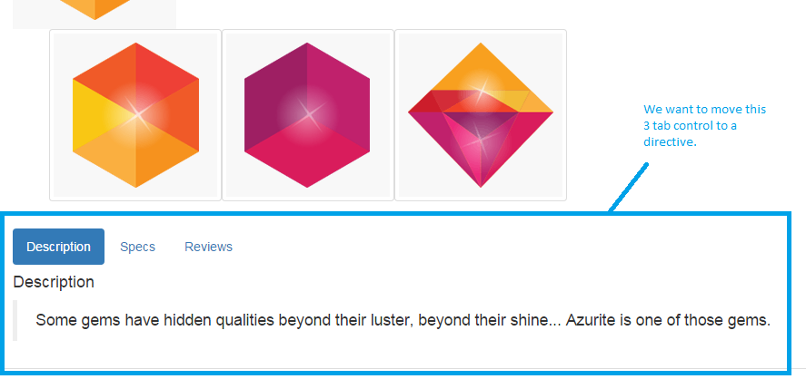
Exam
Copy the 6_DIRECTIVES_TEST_1_UNSOLVED.html, gem-02.gif, gem-05.gif, and gem-09.gif to C:\Angular. Then open in Chrome the 6_DIRECTIVES_TEST_8_UNSOLVED.html file.
Proceed with the instructions in the html file.

Slide 26
Exam results
Open the 6_DIRECTIVES_TEST_1_SOLVED.html in chrome. Review the results.

Slide 28
References
Directives:
https://docs.angularjs.org/guide/directive

Slide 29
Jose Francisco Gonzalez Avila
josef.Gonzalez@softtek.com
Author of training material
Jorge Luis Gonzalez |
jorge.gonzalezm@softtek.com
Instructor

