Slide 1
AngularJS
Services

Slide 2
Disclaimer
Document Name:
Data Classification: INTERNAL
Disclaimer
The contents of this document are property of Softtek, and are classified as Confidential. Any reproduction in whole or in part is strictly prohibited without the written permission of Softtek.
This document is subject to change. Comments, corrections or questions should be directed to the author.
Audience/Viewership | Purpose
Java Beginners | Training
Revision Chart
The following chart list the revisions made to this document. Use this to describe the changes and additions each time this document is re-published. The description should be detailed as possible and include the names of the reviewers who request the changes.
Version No. | Version Date | Types of Changes | Owner/Author | Date of Review/Expiration
1 | 11/08/2015 | Initial revision | Jose Francisco Gonzalez Avila | 11/08/2016

Slide 3
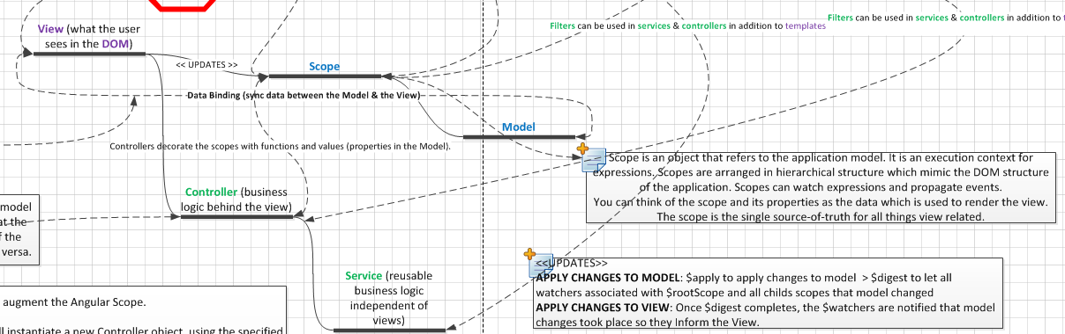
Services (conceptual map)

Slide 4
What is a Service?
Services
Angular services are substitutable objects that are wired together using dependency injection (DI). You can use services to organize and share code across your app.
Angular services are:
Lazily instantiated – Angular only instantiates a service when an application component depends on it.
Singletons – Each component dependent on a service gets a reference to the single instance generated by the service factory.
Angular offers several useful services (like $http), but for most applications you'll also want to create your own.
Note: Like other core Angular identifiers, built-in services always start with $ (e.g. $http).

Slide 5
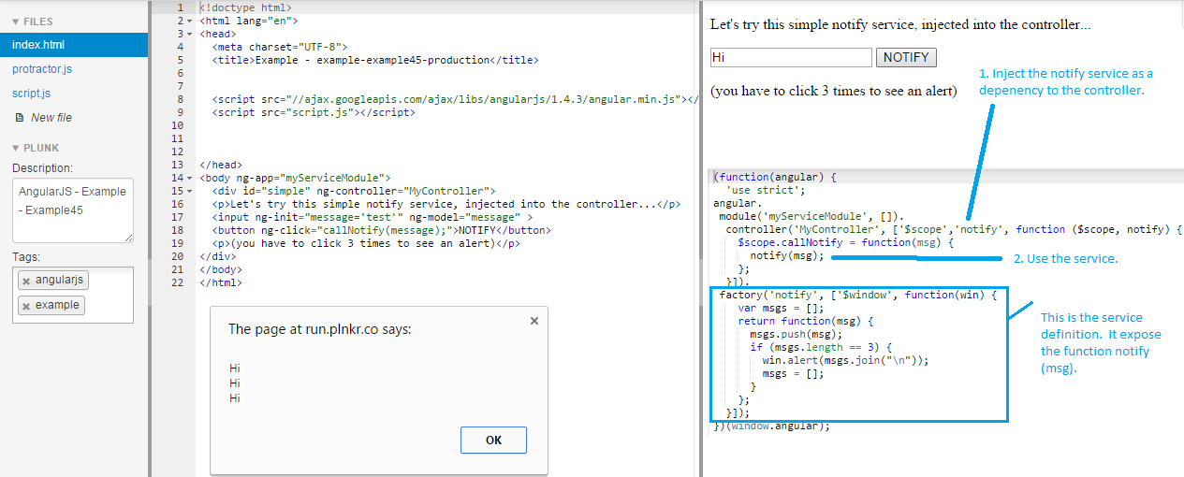
Using a service
To use an Angular service, you add it as a dependency for the component (controller, service, filter or directive) that depends on the service. Angular's dependency injection subsystem takes care of the rest.

Slide 6
Creating Services
Creating Services
Application developers are free to define their own services by registering the service's name and service factory function, with an Angular module.
The service factory function generates the single object or function that represents the service to the rest of the application. The object or function returned by the service is injected into any component (controller, service, filter or directive) that specifies a dependency on the service.

Slide 7
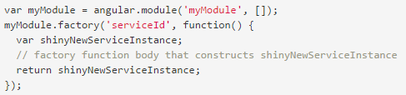
Registering services: via Module Factory API at module level.
Registering Services
Services are registered to modules via the Module API. Typically you use the Module factory API to register a service:
Note that you are not registering a service instance, but rather a factory function that will create this instance when called.

Slide 8
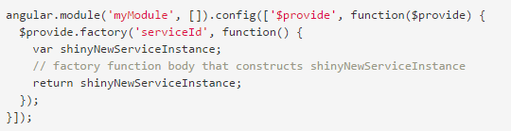
Registering services: via $provide service inside a module´s config function
You can also register services via the $provide service inside of a module's config function:

Slide 9
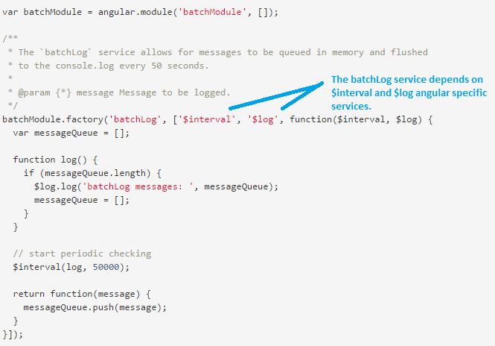
Service dependencies
Services can have their own dependencies. Just like declaring dependencies in a controller, you declare dependencies by specifying them in the service's factory function signature.

Slide 10
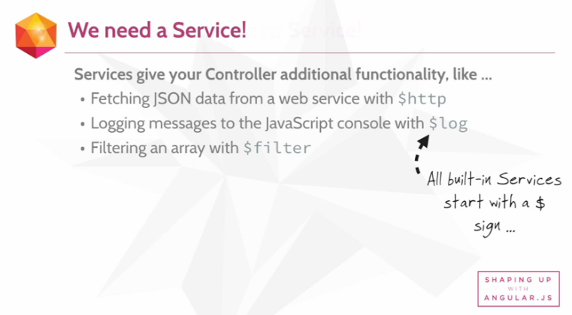
Why Services?

Slide 11
Built-in services vs Custom services
Just as in Directives, angular offers some built-in services that can be used in custom services or in controllers. You simple pass those built-in services as parameters to the custom service definition.
Custom services extend the functionality of the controller an encapsulate logic that should be re-usable and well organized.

Slide 12
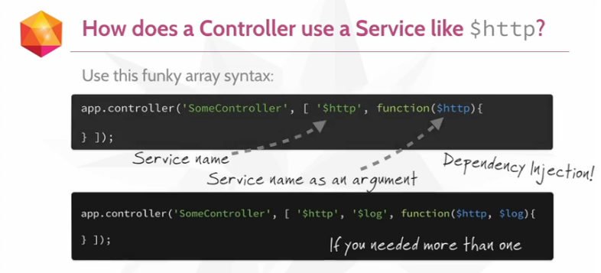
How does a controller use services?

Slide 13
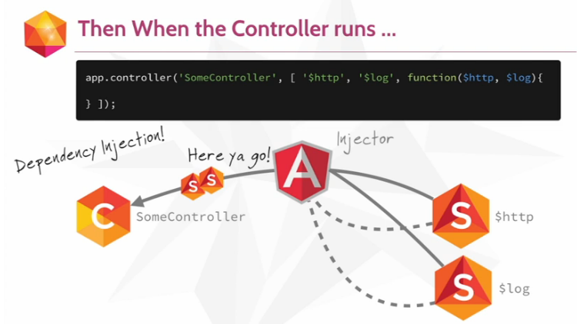
How does a controller use services?

Slide 14
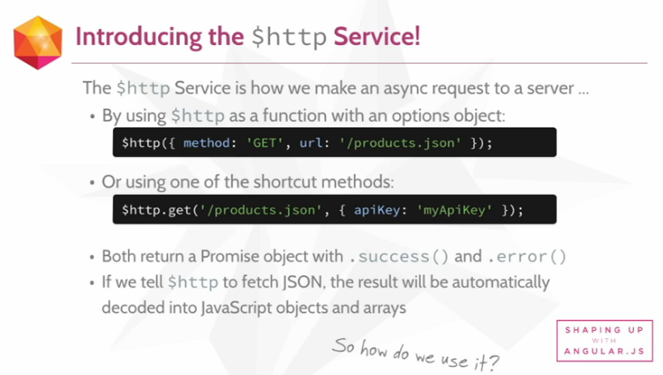
Built-in services: $http service

Slide 15
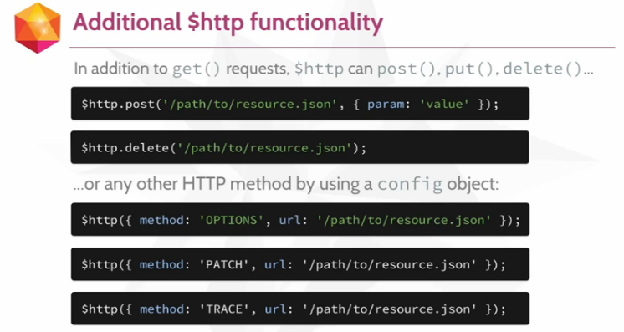
Built-in services: $http service

Slide 16
Exercises
EXERCISE 1: Open the 4_SERVICES_EXERCISE_1.html file in chrome. Review the code. You should gain the following understanding:
How services can be defined and registered at the module level by using the <module>.factory( API;
How services receives dependencies;
How angular provides built-in services ready to use in your custom services;
The generals of the angular specific $window service and how it is used for launching alerts.

Slide 17
Exam
EXAM 1: Open the 7_SERVICES_TEST_1_SOLVED.html file in chrome. Review the code. You should gain the following understanding:
How you can use modules to organize your code;
How modules can be added as dependencies of other modules.
EXAM 2: Open the 7_SERVICES_TEST_2_SOLVED.html file in chrome. Review the code. You should gain the following understanding:
How to inject dependencies to your controllers;
How to use the $http angular built-in service in your controllers to consume JSON files.

Slide 18
Examp results
Check the results of the previous 2 exams with the students. Solutions are given by 7_SERVICES_TEST_1_SOLVED.html & 7_SERVICES_TEST_2_SOLVED.html files.

Slide 20
References
Angular-specific services:
https://docs.angularjs.org/api/ng/service/$window
https://docs.angularjs.org/api/ng/service/$http
$http service example:
http://www.w3schools.com/angular/angular_http.asp
Services:
https://docs.angularjs.org/guide/services

Slide 21
Jose Francisco Gonzalez Avila
josef.Gonzalez@softtek.com
Author of training material
Jorge Luis Gonzalez |
jorge.gonzalezm@softtek.com
Instructor

