Slide 1

Academy 2015 –SOAP Web Services

Slide 2
Disclaimer
Document Name: ACADEMY 2015 – SOAP WEB SERVICES
Data Classification: INTERNAL
Disclaimer
The contents of this document are property of Softtek, and are classified as Confidential. Any reproduction in whole or in part is strictly prohibited without the written permission of Softtek.
This document is subject to change. Comments, corrections or questions should be directed to the author.
Audience/Viewership | Purpose
Java Academy trainees | Training
Revision Chart
The following chart list the revisions made to this document. Use this to describe the changes and additions each time this document is re-published. The description should be detailed as possible and include the names of the reviewers who request the changes.
Version No. | Version Date | Types of Changes | Owner/Author | Date of Review/Expiration
1.0 | 20-10-2015 | Initial draft | Jose Antonio Hernandez Vazquez

Slide 3
1 SOAP Web Services in nutshell

Slide 4
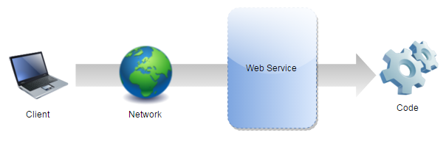
What are Web Services?
A web service is a network accessible interface to application functionality, built using standard Internet technologies.

Slide 5
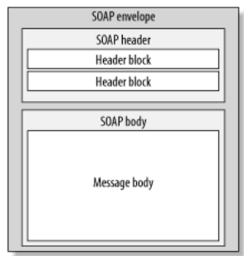
What are SOAP Web Services?
SOAP is stand for Simple Object Access Protocol.
SOAP Web services are web services which use a standardized XML messaging system (SOAP).

Slide 6
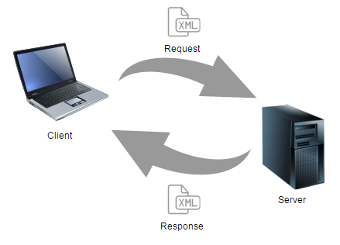
How does SOAP Web Services work?

Slide 7
Characteristics
XML based protocol.
Loosely coupled.
Interoperability.
Simple and extensible.
Neutrality.

Slide 8
2 Architecture

Slide 9
Components
XSD.
WSDL.
SOAP request and SOAP response.
Provider.
Consumer.
UDDI.

Slide 10
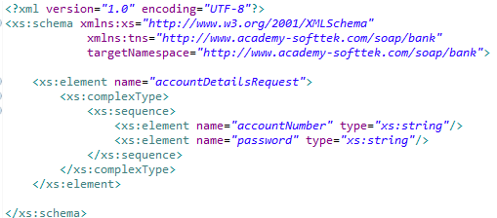
XSD
XML Schema Definition.
Describes the structure of an XML document.
Define the legal building blocks of an XML document.

Slide 11
WSDL
Web Service Description Language.
Lists all operations available in the service as well as all required parameters.
Provides all necessary information to consume the web service.
Is a contract for clients defined inside an XML file.

Slide 12
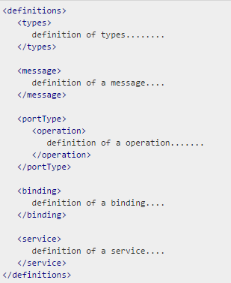
WSDL Structure

Slide 13
WSDL Definitions
Is the root element of all WSDL documents.
It defines the name of the web service, declares multiple namespaces used throughout the remainder of the document, and contains all the service elements.

Slide 14
WSDL Types
The data types to be used in the messages are in the form of XML schemas.
XSD is used to define this data types.

Slide 15
WSDL Message
Represents an abstract definition of the data being transmitted.
Consist of logical parts, each of which is associated with some type.

Slide 16
WSDL Port type and operations
Port type is an abstract set of operations mapped to one or more end-points.
Each operation refers to an input message and output messages

Slide 17
WSDL Binding
Is the concrete protocol and data formats for the operations and messages defined for a particular port type.

Slide 18
WSDL Service and Port
Service is a collection of related end-points.
Service map the binding to the port and include any extensibility definitions.
Port is a combination of a binding and a network address, providing the target address of the service communication

Slide 19
SOAP request and response
Data sent to server and retrieved from server.
Data in XML format which follows SOAP protocol.
Contains the following elements:
Element | Description | Required
Envelope | Identifies the XML document as a SOAP message. | Yes
Header | Contains header information. | No
Body | Contains call, and response information. | Yes
Fault | Provides information about errors that occurred while processing the message. | No

Slide 20
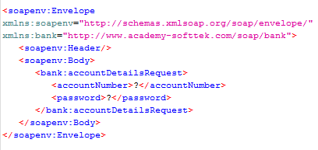
SOAP request example

Slide 21
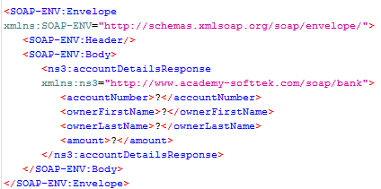
SOAP response example

Slide 22
Provider
SOAP Provider is a software system that process the request and provide the response.
Exposes services to be consumed by the clients.

Slide 23
Consumer
The software system that requests data.

Slide 24
UDDI
Universal Description, Discovery and Integration.
Registry based on XML to list services on the Internet, and a mechanism to register and locate web service applications.

Slide 25
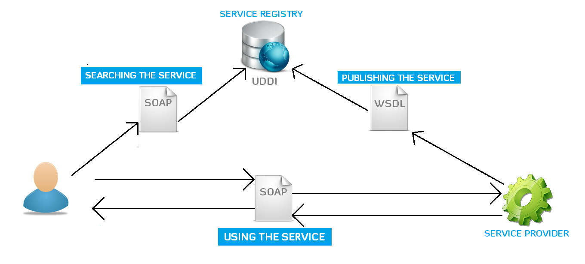
Architecture

Slide 26
3 Spring Web Service

Slide 27
Spring WS
Spring Web Services facilitates contract-first SOAP web service development.
Allows the creation of flexible web services using one of the many ways to manipulate XML payloads.
Based on JAX-WS.

Slide 28
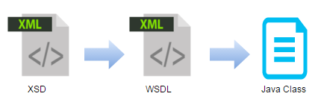
Contract-first
Start with the WSDL contract, and use Java to implement said contract.
WSDL is based on XSD.
When using contract-first, you explicitly describe what XML is sent where, thus making sure that it is exactly what you want.

Slide 29
4 Writing Contract-First Web Services

Slide 30
Writing Contract-First Web Services
The most important thing when doing contract-first Web service development is to try and think in terms of XML.
Define XML messages (request and response).
Define format and rules for messages (XSD).
Define contract for service (WSDL). Based on the XSD.
Spring-WS can create the WSDL for you.
Implementing Endpoint. Create java class for handling SOAP request and SOAP response (@Endpoint, @PayloadRoot, @RequestPayload, @XPathParam, @ResponsePayload).
Publishing WSDL.
Consume Web Service.

Slide 31
5 JAXB & Xpath

Slide 32
Xpath
Used to navigate through elements and attributes in an XML document.
Uses path expressions to navigate in XML documents.
There are seven kinds of nodes: element, attribute, text, namespace, processing-instruction, comment, and document nodes.
XML documents are treated as trees of nodes.

Slide 33
Xpath Syntax
Expression | Description
nodename | Selects all nodes with the name "nodename"
/ | Selects from the root node
// | Selects nodes in the document from the current node that match the selection no matter where they are
. | Selects the current node
.. | Selects the parent of the current node
@ | Selects attributes

Slide 34
JAXB
Java Architecture for XML Binding.
Marshalling – Convert a Java object into a XML file.
Unmarshalling – Convert XML content into a Java Object.
Most common annotations @XmlRootElement, @XmlElement, @XmlAttribute

Slide 36
The End

Slide 37
References
Official Spring WS page
http://projects.spring.io/spring-ws/
W3C
http://www.w3.org/TR/wsdl

