Slide 1


Slide 2

Development & Working of an API

Slide 3
Agenda:
Introduction to an API
API Testing using Postman
Demo – Build a CRUD Rest API
How the understanding of API development helps Testing

Slide 4


Questions
Have you worked on API Testing?
Are you aware of what happens between a sending a request and receiving a response ?
Have you seen an API code base of the project?
Do you know how APIs are developed and deployed ?

Slide 5
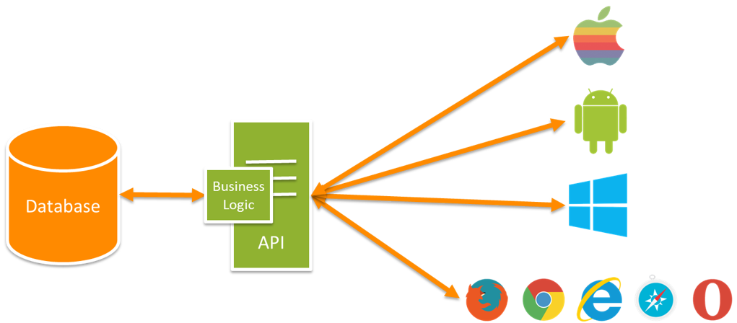
What is a Web API
API over the web which can be accessed using HTTP protocol

Slide 6
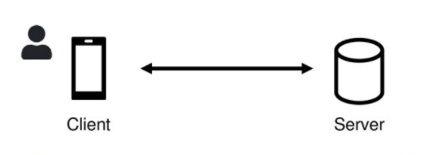
What is REST?
Rest is short for Representational State Transfer.
Rest is Software Architecture Style
- Set of Rules and Conventions for the creation of an API
REST Principles
Client-Server Architecture
Stateless
Cacheability
Layered System
Code on Demand
Uniform Interface

Slide 7
REST consists of.
Resource
Endpoint
HTTP Method
HTTP Header

Slide 8
HTTP Methods
HTTP Method | CRUD Operation | Description
POST | INSERT | Adds to existing resource
GET | SELECT | Fetches a resource. The resource is never changed via a GET request
PUT | UPDATE | Overrides existing resource
DELETE | DELETE | Deletes a resource

Slide 9
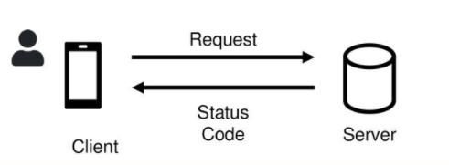
HTTP Status Codes
Code | Description
1xx | Informational Codes
2xx | Successful
3xx | Redirection codes
4xx | Client Error codes
5xx | Server error codes

Slide 10
Demo : Inventory Service
List all products : HTTP Get method
Get product detail : HTTP Get method
Update product detail : HTTP Put method
Create product : HTTP Post method
Delete product : HTTP Delete method

Slide 11
Testing Inventory Service
Common Test Cases
Basic Positive Tests
Positive + Optional Parameters
Negative Testing – Valid inputs
Negative Testing – Invalid Inputs
Security, Authorization and Permission Tests

Slide 12
Build a CRUD Rest API
Blank Project - ASP.NET Core Web Application
Install necessary NuGet packages
Connect Existing Database to the application
- Reverse engineer the database to create database context and POCO classes
Build REST APIs
- Products API
Run and test APIs using Postman
Create a JWT
- Create Token Controller.
Secure API endpoint

Slide 13
Advantages for testers
Same language as that of developers
Easily understand errors and related issues
Able to separate out and test features
Able to contribute in development if needed
Leverages API & Performance testing

Slide 14
Q & A

Slide 15
"You can never understand everything, but you should push yourself to understand the system" - Ryan Dahl (Creator of Node JS)
T H A N K Y O U !

