Slide 1


Slide 2

Chaos Engineering and Demo using Chaos For Spring Boot - Rahula

Slide 3
Agenda:
* Why Chaos engineering was discovered ?
* What is Chaos Engineering ?
* When should Chaos Testing be done ?
* Different types of Chaos
* Low Chaos
* Medium Chaos
* High Chaos
* Extreme Chaos

Slide 4
Agenda:
* Chaos Monkey’s introduced by Netflix
* Latency Monkey
* Conformity Monkey / Security Monkey
* Doctor Monkey
* 10-18 Monkey (Localisation Monkey)
* Chaos Gorilla
* LET’S START CHAOS (DEMO Using spring boot REST applications)

Slide 5

Why Chaos Engineering
Advances in large-scale, distributed software systems are changing the game for software engineering
~ 10-100 deployments happens during a day in a particular software development cycle.
How much confidence we can have in the complex systems that we put into production?
Unpredictable outcome + real world events which affects production makes these distributed systems chaotic.
Service not available, retry storms, cascading failures, examples
We need to identify weaknesses before they manifest in system-wide, aberrant behaviors.

Slide 6
What is Chaos Engineering
Intentionally introducing failure into a system with the purpose of validating resilience design.
Steps followed :
* Start by defining ‘steady state’ (normal behavior)
* hypothesize steady state will be found in both control group and experimental group
* Introduce variables that reflect real world events
(server crashes , hard drive malfunctions, networks severed)
* disapprove the hypothesis by looking for difference in steady state between the control group and experimental group.

Slide 7
What is Chaos Engineering (Contd.)
Advanced Principles :
* Run chaos experiments in production
(Chaos strongly prefers to experiment directly on production traffic.)
* Automate experiments to run continuously (better analysis)
* Minimize Blast Radius
Responsibility and obligation of the Chaos Engineer to ensure the fallout from experiments are minimized and contained. Measured attacks on a system can be controlled, reducing the extent of damage.

Slide 8
When should Chaos Testing be done ?
Chaos engineering was introduced by Netflix, one of the largest media subscription services with around 150 million paid subscriptions worldwide
‘Cost of Downtime’ becoming the KPI
Avoid Costly outage
Netflix created Chaos Monkey ,.., Netflix’s moved from physical infrastructure to cloud infrastructure provided by Amazon Web Services, and the need to be sure that a loss of an Amazon instance wouldn’t affect the Netflix streaming experience. (2010)

Slide 9
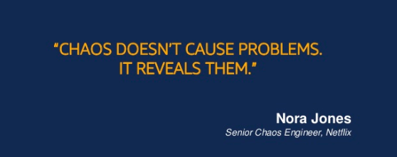
Contd.
“The cloud is all about redundancy and fault-tolerance. Since no single component can guarantee 100% uptime (and even the most expensive hardware eventually fails), we have to design a cloud architecture where individual components can fail without affecting the availability of the entire system” (Netflix,2011)
* Twilio, Netflix, LinkedIn, Facebook, Google, Microsoft, Amazon, and many others (practice chaos engineering)

Slide 10
Different types of Chaos
Low Chaos - refers to failures that our system can recover from gracefully with minimal or no interruption to service availability.
Medium Chaos - Are failures that can also be recovered from gracefully, but may result in degraded service performance or availability.
High Chaos - Are failures that are more catastrophic and will interrupt service availability.
Extreme Chaos - Are operations that are failures which cause ungraceful degradation of the service, result in data loss, or that simply fail silently without raising alerts.
Once failure found , reducing the severity, Extreme -> High -> Medium -> Low

Slide 11
Chaos Monkey’s introduced by Netflix
Latency Monkey - Induces artificial delays into the client-server communication layer to simulate service degradation and determine how consumers respond in this situation.
Conformity Monkey /Security Monkey - Finds instances that don’t adhere to best-practices and shuts them down.
Doctor Monkey - Checks existing health checks that run on each instances to detect unhealthy instances. Unhealthy instances are removed from service.
Janitor Monkey - Checks for unused resources and deletes or removes them.
10-18 Monkey - Ensures that services continue to work in different international environments by checking that languages other then the base system continue to work
Chaos Gorilla - Similar to Chaos Monkey, but simulates an outage of an entire Amazon availability zone.

Slide 12

LET’s START Chaos (Demo)
Description

Slide 13
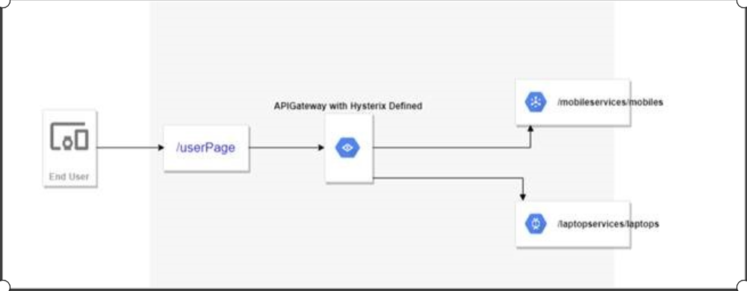
Chaos For SpringBoot
* APIGateway /userPage app consisting of 2 REST applications : 1) /mobiles 2) /laptops

Slide 14
Q & A

Slide 15
Useful links
http://principlesofchaos.org/?lang=ENcontent
https://boyter.org/2016/07/chaos-testing-engineering/
https://www.gremlin.com/community/tutorials/chaos-engineering-the-history-principles-and-practice/
https://www.slideshare.net/BruceWong3/the-case-for-chaos - Bruce Wong , Engineering Manager , Chaos Engineering – Netflix
https://codecentric.github.io/chaos-monkey-spring-boot/ (project provides a Chaos Monkey for Spring Boot and will try to attack your running Spring Boot App.)
Github url for the application developed in the demo - https://github.com/svcerahula/ChaosMonkeySpringBootDemo

Slide 16
T H A N K Y O U !

