Slide 1
Cypress.io Automation overview

Slide 2
Agenda
Cypress Introduction
Selenium vs Cypress Architecture
Software Installation and Execution
Framework Overview
Sample Test Execution
Pros and Cons

Slide 3
Cypress Introduction
Cypress is a front end testing tool build for automating modern web applications.
The tests are written only using JavaScript.
JavaScript test framework Mocha is used.
Assertions are done using combination of jQuery and Chai library.
Cypress only run on chrome browser and inbuilt lite version of chrome called Electron.
Cypress focuses on three main points like simplicity, reliability and faster execution to address the pain points faced in existing automation tools.

Slide 4
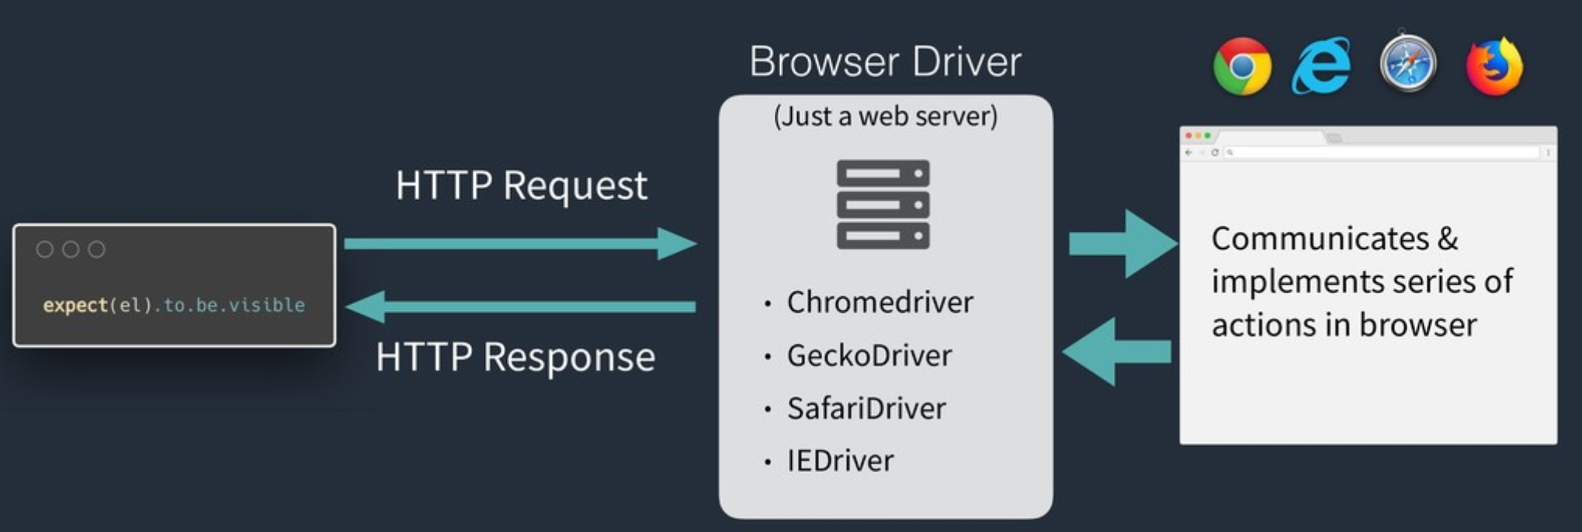
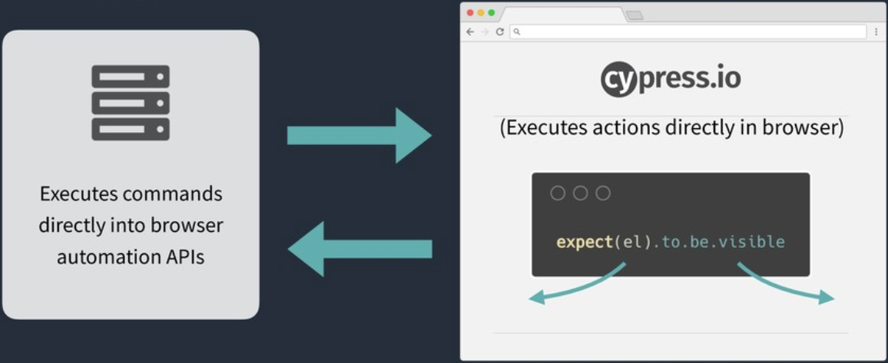
Selenium vs Cypress Architecture
In selenium architecture the webdriver acts as a communication channel between the code and the browser.
In Cypress architecture the code directly interacts with the browser as the browser is opened inside cypress and DOM manipulation is simple.

Slide 5
Software Installation and Execution
Visual Studio Code
Node.js 8 and above
Installation steps
npm init –(Create package.json)
npm install cypress –-save -dev -(install cypress dependencies)
Execution steps
node_modules\.bin\cypress run --headed (To run test in headed mode)
node_modules\.bin\cypress run (To run test in headless mode)

Slide 6
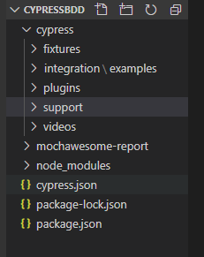
Framework Overview
Fixtures - To maintain test data.
Integration – All the test cases are written here.
Plugins – To configure browser settings like Full screen mode. It acts as a kind of listeners.
Support – To maintain reusable methods and Page objects.
Node_modules – This is the heart of the cypress project.
Cypress.json – To maintain configurations like Environment url, default timeout etc.
Package.json – To maintain dependencies.

Slide 7
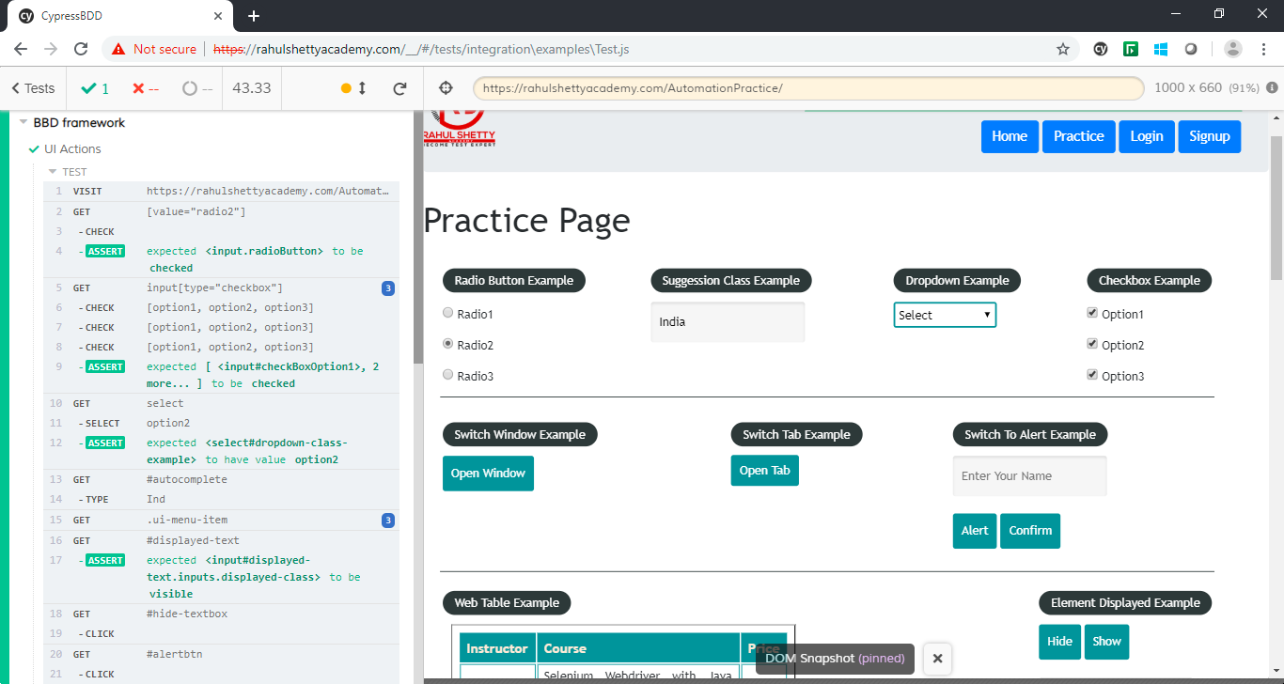
Sample Test Execution
Test is executed inside the inbuilt browser

Slide 8
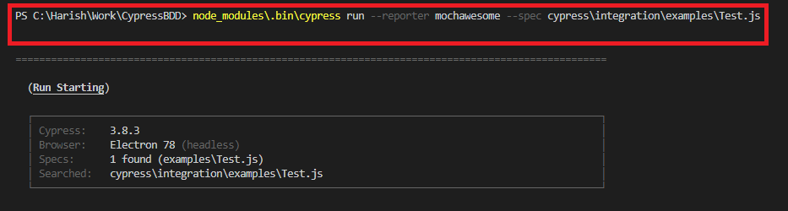
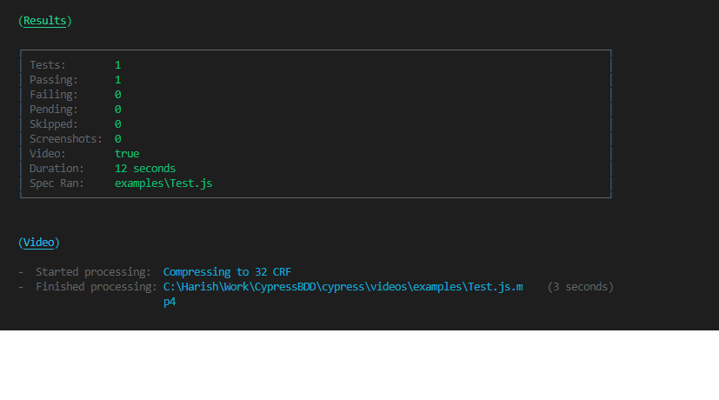
Headless run

Slide 9
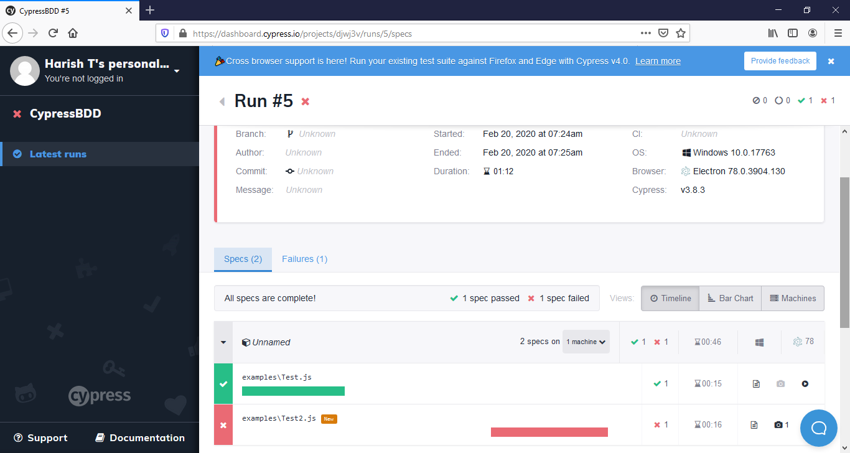
Cypress cloud dashboard

Slide 10
Pros
Faster execution time.
No Code Flakiness.
Ability to mock server response and view API calls and status response.
Easy DOM manipulation.
Asynchronous nature.
Ability to review the test execution flow visually.
Cons
Cross browser testing is not possible as of now (Firefox and edge beta version is out).
Does not support frames (There is a workaround in progress).
Lesser community support.

Slide 11
Thank You

