Slide 1


Slide 2

Protractor –An Automation Tool

Slide 3
Agenda:
What is Protractor
Difference between Protractor and Selenium
Protractor– Installation
Demo

Slide 4

Protractor
Protractor is an automation tool for angular and angular JS application. It comes with a right mix of the power of NodeJS, Selenium WebDriver, Jasmine, Cucumber and Mocha – which makes it a preferred testing tool for web applications. We can use protractor for non angular application as protractor support all the features supported by selenium WebDriver plus extra features or additional support to the angular website.
WebDriver + Angular support= Protractor
@Cant be use selenium to automate angular application -- So yes selenium can be used to automate angular application but there are some specific features for angular which web driver may or may not handle. and also WebDriver is little inconsistence with some core features of angular or to make them features works we may need to come of lot of coding from selenium WebDriver. But using protractor we can handle it very smoothly.

Slide 5
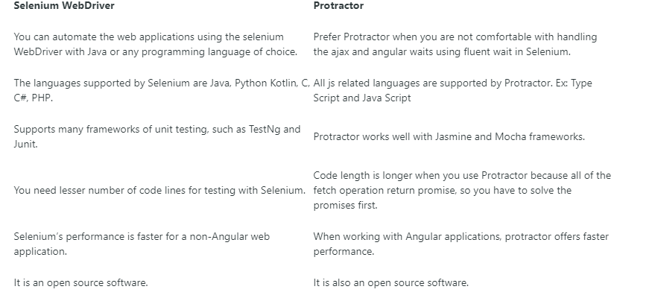
Difference between Protractor vs Selenium

Slide 6
Protractor Installation
Protractor is a Node.js program. To run, you will need to have Node.js installed. You will download Protractor package using npm, which comes with Node.js.
Pre- requisite:
NodeJS Eclipse for JavaScript or VS-Code
Use npm to install Protractor globally : npm install -g protractor
(This will install two command line tools, protractor and webdriver-manager and The webdriver-manager is a helper tool to easily get an instance of a Selenium Server running)
Selenium server: if we want to work with protractor first we need to start selenium server so this selenium server
will help you to connect protractor commands to the browser. So this server is the middle layer
Update the webdriver : webdriver-manager update
Now start up a server : webdriver-manager start
Pacakge.json : npn init –f (project path)
Install all dependencies : npn install (project path)

Slide 7
DEMO

Slide 8
T H A N K Y O U !

