Slide 1


PUPPETEER AUTOMATION

Slide 2
Agenda
Puppeteer Introduction
Advantages of Puppeteer
Drawbacks of Puppeteer
Demo
Q and A.

Slide 3

Puppeteer Introduction
Puppeteer is a Node library which provides a high-level API to control headless Chrome over the DevTools Protocol.
[DevTools Protocol allows for tools to instrument, inspect, debug and profile Chromium]
Puppeteer is developed by the Google team.
Puppeteer runs headless by default, but can be configured to run full(non-headless)Chrome or chromium

Slide 4
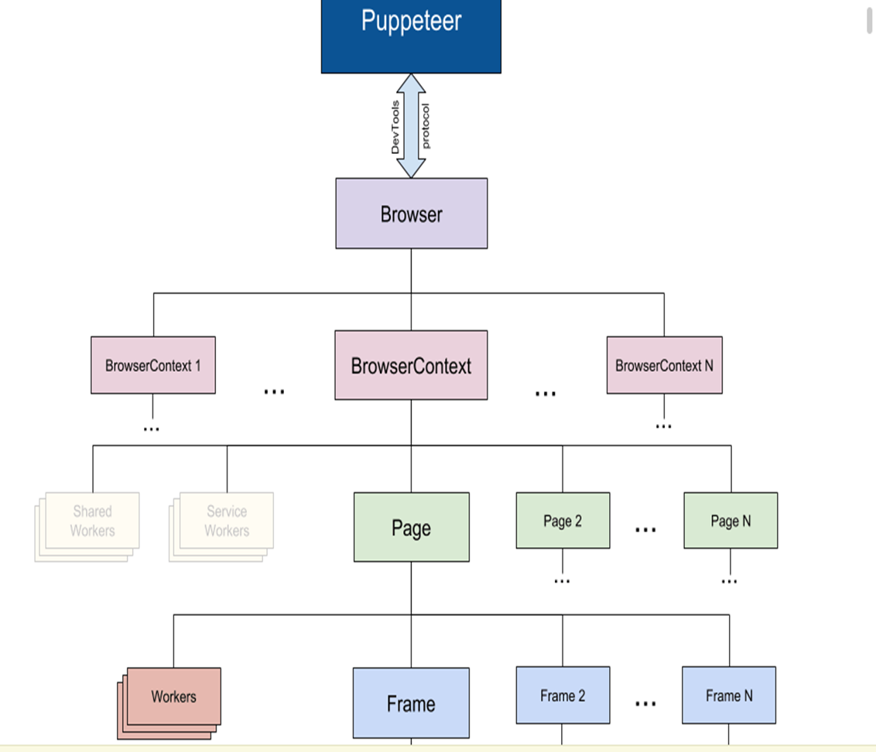
Puppeteer
Puppeteer communicates with the browser using DevTools Protocol
Browser instance can own multiple browser contexts
Browser Context instance defines a browsing session and can own multiple pages
Can be integrated with different kind of framework like mocha,BDD cucumber etc.,
Easy to integrate with Bamboo, Jenkins etc., for the CI and CD.
The Puppeteer API is hierarchical and mirrors the browser structure

Slide 5
Advantages of Puppeteer
Simple to configure and implement.
Execution is bit faster when compared to selenium.
Generate screenshots and PDFs of pages.
Puppeteer affords more control over Chrome's browsers than Selenium WebDriver offers (likely due to Google’s support and sophisticated knowledge of Chrome).
API Testing also can be done with minimal effort.
Open source tool which help us to customize on our need basis.
Helps in testing chrome extension.

Slide 6
Drawbacks of Puppeteer
Puppeteer is limited to Chrome browser only for now, until Firefox support is completed.
Puppeteer scripting only available in JavaScript for Node.js, and it is unclear if other languages will be supported in the future
Puppeteer has a smaller testing community using the tool currently, there is more test-specific support for Selenium

Slide 7
DEMO
Software Installation and Adding dependencies
Visual Studio Code
Node.js 8 and above
Adding Puppeteer dependencies
Install the puppeteer in the terminal of VS code with below command inside the folder:
npm i puppeteer or npm i puppeteer-core[puppeteer-core is intended to be a lightweight version of Puppeteer for launching an existing browser installation or for connecting to a remote one]

Slide 8
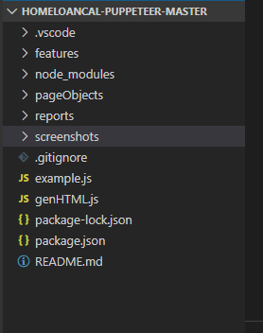
Framework-BDD Cucumber
Feature:
To maintain feature and step-definition files.
PageObject:
To maintain POM structure
Reports:
To maintain the cucumber report of every execution.
Screenshots:
To maintain the screenshots of the execution.
Package.json – To maintain dependencies

Slide 9
Q & A

Slide 10
T H A N K Y O U !

