Slide 1


Slide 2

Python

Slide 3
Agenda:
1.Introduction
2.Python Vs other languages
3.Installation
4.Code Examples
5. Q and A
Notes:
Agenda: 1.Introduction
2.Python Vs other languages
3.Installation
4.Code Examples
5. Q and A

Slide 4

Introduction
Python is an interpreted, high-level, general-purpose programming language
Python works on different platforms (Windows, Mac, Linux, Raspberry Pi, etc).
Python has a simple syntax similar to the English language.
Python has syntax that allows developers to write programs with fewer lines than some other programming languages.
Stable release: 3.8.5 / 20 July 2020
Notes:
Python

Slide 5
Python Vs Other languages
Speed
Legacy
Code - helloWorld
Rapid Prototyping
Dynamic-meetingIdle
Learning curve

Slide 6
Installation
Python
- Download Python from http://www.python.org. Download the version 3.8.5
Eclipse Python plugin-pydev
- Istall Eclipse
- For Python development under Eclipse you can use the PyDev Plugin
- Help > Eclipse Marketplace > Search PyDev
Configuration of Eclipse
- Window-->Preference-->Pydev-->Interpreters--> Python Interpreter.
Your first Python program in Eclipse
- Select File New Project. Select Pydev → Pydev Project.

Slide 7
Code Examples
IDLE python docs
String methods , slicer, math module, usemodule
and, or operators
if, for, while
Notes:
Code Examples

Slide 8
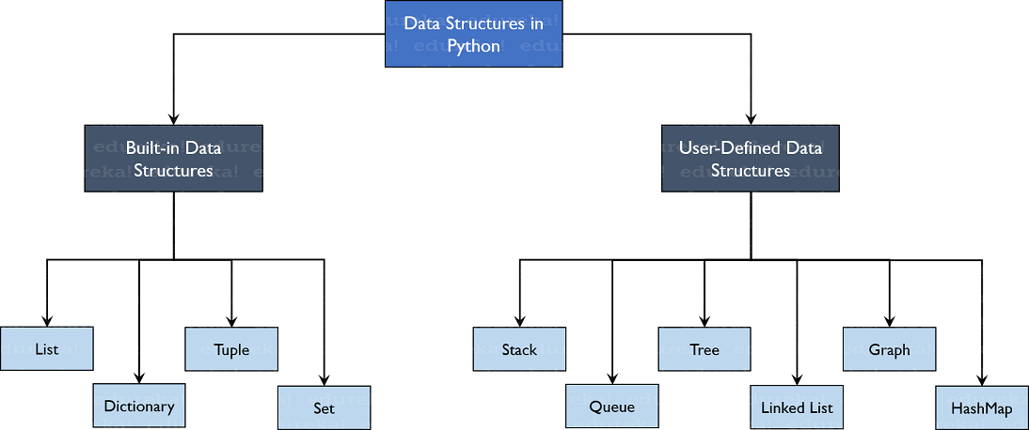
Data Structure
Notes:
Code Examples

Slide 9
Data Structure
List- Lists are used to store data of different data types in a sequential manner. There are addresses assigned to every element of the list, which is called as Index.
Dictionary- Dictionaries are used to store key-value pairs.
dictionary = {"key name": value}
Tuple - Same as list, except
Tuples are defined by enclosing the elements in parentheses (()) instead of square brackets ([]).
Tuples are immutable.
A tuple can have any number of items and they may be of different types (integer, float, list, string)
Sets- A set is an unordered collection with no duplicate elements.
Basic uses include membership testing and eliminating duplicate entries. Set objects also support mathematical operations like union, intersection, difference, and symmetric difference.
Notes:
Code Examples

Slide 10
Functions
scope
parameter
Arbitrary Arguments, *args:
add a * before the parameter name in the function definition.
This way the function will receive a tuple of arguments, and can access the items accordingly
Keyword Arguments
You can also send arguments with the key = value syntax
This way the order of the arguments does not matter
Arbitrary Keyword Arguments, **kwargs
If you do not know how many keyword arguments that will be passed into your function, add two asterisk: ** before the parameter name in the function definition.
This way the function will receive a dictionary of arguments, and can access the items accordingly
Notes:
Code Examples

Slide 11
Classes and objects
class Person:
def __init__(self, name, age):
self.name = name
self.age = age
p = Person("xyz", 23)
print(p.name)
-The self is used to represent the instance of the class
Notes:
Code Examples

Slide 12
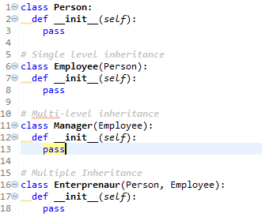
Inheritance
Notes:
Code Examples

Slide 13
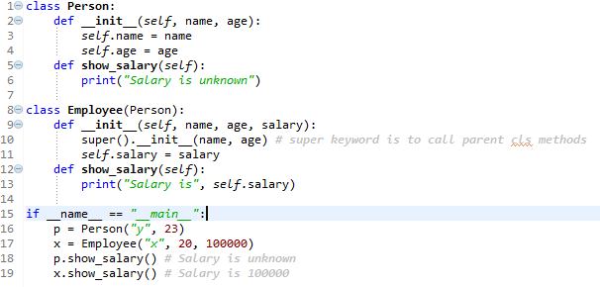
Polymorphism
Notes:
Code Examples

Slide 14
Encapsulation
-Done by private, protected variables and methods.
-Private properties have double underscore (__) in the start, while protected properties have single underscore (_). By default, all other variable and methods are public.
-Private properties are accessible from within the class only and are not available for child class(if inherited). Protected properties are accessible from within the class but are available to child class as well. All these restrictions are removed for public properties.
Notes:
Code Examples

Slide 15
Q & A

Slide 16
T H A N K Y O U !

