Slide 1


Slide 2

Taiko Gauge- JavaScript Automation

Slide 3
Agenda: 1.Introduction To Taiko and Gauge 2.Features of Taiko and Gauge
3. Anti Page Object Pattern
4. Page Object Flow vs Gauge Flow 5. Gauge VS BDD 6. Tools Comparison 7. Demo 8. Q and A

Slide 4

Introduction to Taiko
Taiko is a free and open source browser automation tool built by the team behind Gauge from ThoughtWorks.
Taiko is a Node.js library with a clear and concise API to automate Chromium based browsers(Chrome, Microsoft Edge, Opera).
Tests written in Taiko are highly readable and maintainable.
Taiko’s smart selectors make tests reliable by adapting to changes in the structure of your web application.
With Taiko there’s no need for id/css/xpath selectors or adding explicit waits (for XHR requests) in test scripts.

Slide 5
Introduction to Gauge
Gauge is a free and open source framework for writing and running acceptance tests. Some of the key features of Gauge that makes it unique include:
Simple, flexible and rich syntax based on Markdown.
Consistent cross platform/language support for writing test code.
A modular architecture with plugins support
Extensible through plugins and hackable.
Supports data driven execution and external data sources
Helps you create maintainable test suites

Slide 6
Features of Taiko and Gauge
Taiko :
Smart Selectors : Proximity , Xpath, Css
Ability to handle XHR and dynamic content
Request/Response stubbing and mocking
Inbuilt wait mechanism
Device Emulator
Gauge:
Uses Markdown language for writing Spec Files
Uses Concepts for reusability
Inbuilt Parallel Execution
Date Store
Reusing scenarios with concepts
Lazy execution
In built reporting

Slide 7
Anti Page Objects Pattern
Gauge uses the following coding techniques
You aren’t gonna need it (YAGNI) : states that a programmer should not add functionality until deemed necessary.
Single Responsibility Principle(SRP): The SRP states that every module or class should have responsibility over a single part of the functionality provided by the software, and that responsibility should be entirely encapsulated by the class.
Open Closed Principle (OCP): The OCP states “software entities (classes, modules, functions, etc.) should be open for extension, but closed for modification”

Slide 8
Page Objects Flow With BDD
Base Class
Contains the code to start of the execution
Common Utils
Common Selenium Functions
Common method for reading test data
Page Objects/Actions
Contains Elements of different Pages and their actions
Ex: Driver Initialization
Feature File
Contains the Feature of the Jira story and the scenario flow
Runner Class
To Run the Feature file
Step File
Step Definition of the scenarios in feature file
Extends the base class, common utils , Page Objects

Slide 9
Taiko Gauge Flow
Env
Multiple Environment for testing
Specs
Scenarios and Concepts
Dynamic test Data through tables and CSV
Test Step
Step Definition for Spec Files, Contains Elements of the page relevant to the spec flow, hooks for organizing the flow
Browser Path, Properties,

Slide 10
Gauge vs BDD
GAUGE | CUCUMBER
Run test suites on multiple environment with ease. | No such built-in feature available
Has the ability to combine re-usable logical groups of steps into a single unit scenarios known as concepts | No such built-in feature available.
Both Start up (or Background steps) steps and tear down step available at specification/feature level) | Only Background steps are available at feature level.
Data driven testing can be achieved by both inline tables and csv files. | It only provides data driven test though inline tables
Parallel execution of scenarios is very simple without extra plugin | Requires extra plugins to achieve that.
In built facility to store run time context data. | No inbuilt object to store run time data
In build Facility to read data from external file. | No built-in Facility to read data from external file.
In build Facility to start capturing screen shots. | No built-in Facility to start capturing screen shots.

Slide 11
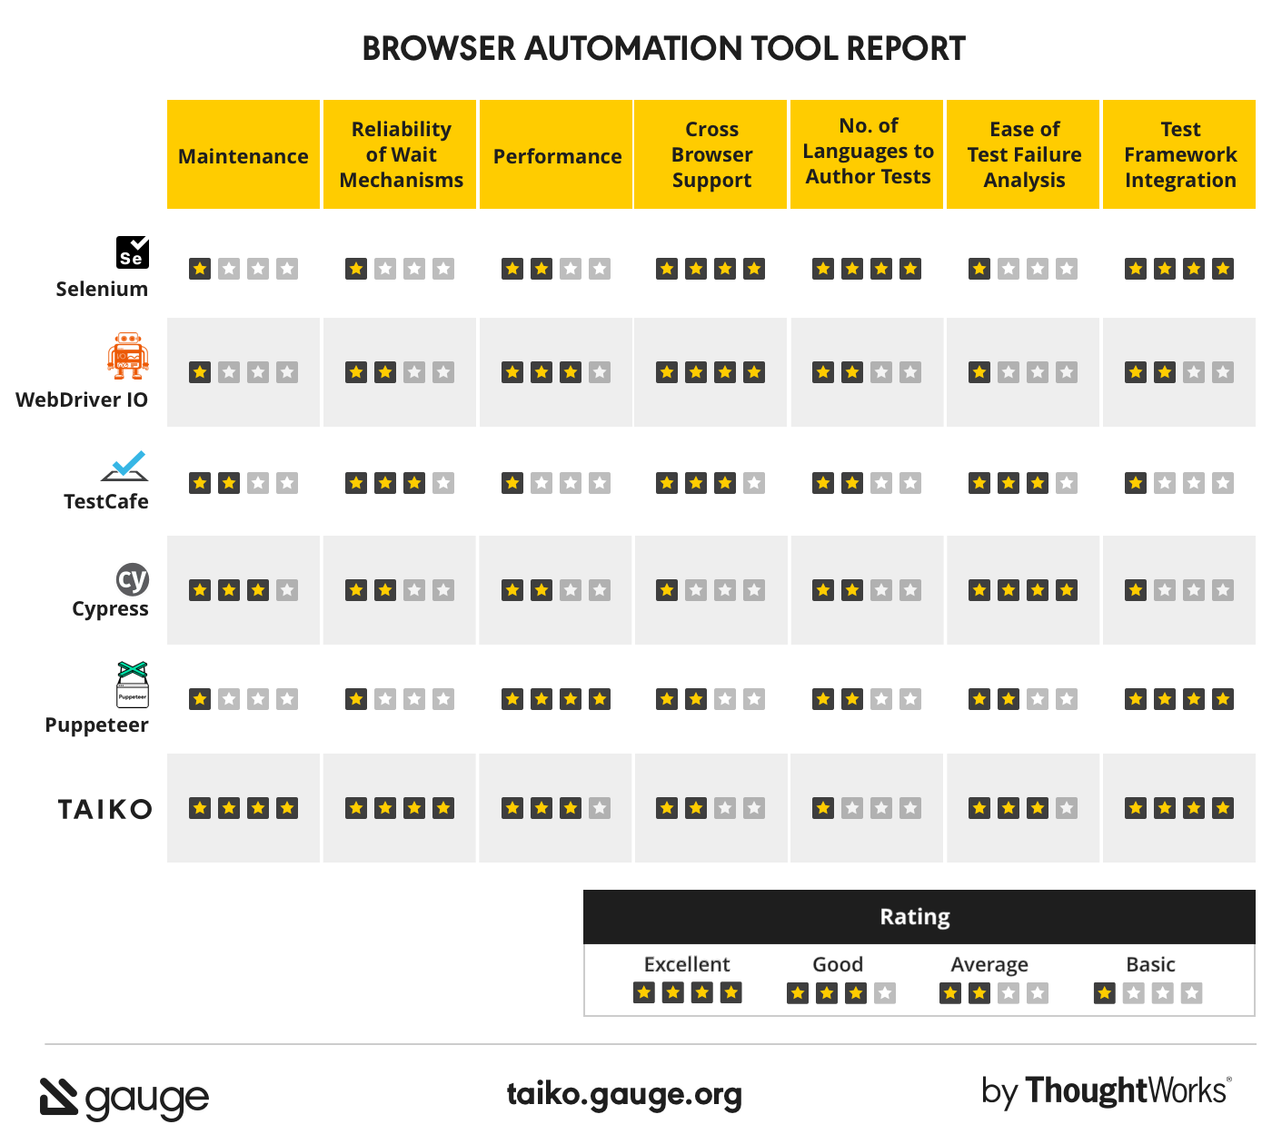
Tools Comparison

Slide 12
Installation and Execution
Pre requisite:
VS-Code (Recommended as it has in built support for Gauge)
Add Gaguge Plugin from VS code Market place
Execution:
gauge run specs- to run entire spec folder
gauge run specs/spec1.spec – to run a single spec
gauge run –p specs – to run specs in parallel

Slide 13
Q & A

Slide 14
T H A N K Y O U !

