Slide 1


Chapter 4

Slide 2

x
i
y
i
Carry-in
c
i
Sum
s
i
Carry-out
c
i
+1
At the i^{th} stage:
Input:
c_{i} is the carry-in
Output:
s_{i} is the sum
c_{i+1} carry-out to (i+1)^{st}
state
0
0
0
0
0
0
0
1
1
0
0
1
0
1
0
0
1
1
0
1
1
0
0
1
0
1
0
1
0
1
1
1
0
0
1
1
1
1
1
1
s
i
=
x
i
y
i
c
i
+
x
i
y
i
c
i
+
x
i
y
i
c
i
+
x
i
y
i
c
i
=
x
i
⊕
y
i
⊕
c
i
c
=
y
i
c
i
+
x
i
c
i
+
x
i
y
i
i
+1
E
xample:
X
7
0
1
1
1
Carry-out
x
i
Carry-in
+
Y
=
+ 6
=
+
0
0
1
1
1
1
0
0
0
c
y
i
c
Z
13
1
1
0
1
i
+1
s
i
i
Legend for stage
i

Slide 3

Sum
Carry
y
i
c
i
x
i
y
s
x
i
c
i
i
c
i
i
+
1
c
i
x
x
i
y
i
y
i
i
c
i
+
1
Full adder
c
i
(F
A)
s
i
Full Adder (FA): Symbol for the complete circuit
for a single stage of addition.

Slide 4
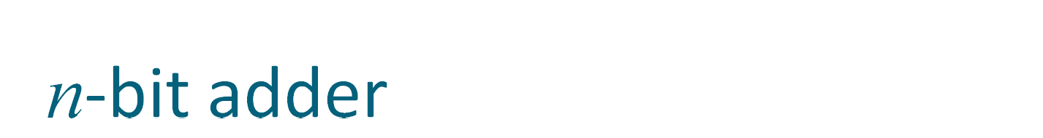
Cascade n full adder (FA) blocks to form a n-bit adder.
Carries propagate or ripple through this cascade, n-bit ripple carry adder.
x
n
-
1
y
n
-
1
x
1
y
1
x
0
y
0
c
n
-
1
c
1
c
n
F
A
F
A
F
A
c
0
s
n
-
1
s
1
s
0
Most significant bit
Least significant bit
(MSB) position
(LSB) position
Carry-in c₀ into the LSB position provides a convenient way to
perform subtraction.

Slide 5

K n-bit numbers can be added by cascading k n-bit adders.
x
k
n
-
1
y
k
n
-
1
x
2
n
-
1
y
2
n
-
1
x
n
y
n
x
n
-
1
y
n
-
1
x
0
y
0
n
-
bit
n
-
bit
c
n
n
-
bit
c
k
n
adder
adder
adder
c
0
s
k
n
-
1
s
(
k
-
1
)
n
s
2
n
-
1
s
n
s
n
-
1
s
0
Each n-bit adder forms a block, so this is cascading of blocks.
Carries ripple or propagate through blocks, Blocked Ripple Carry Adder

Slide 6
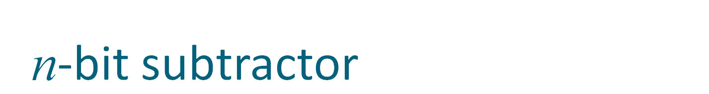
Recall X – Y is equivalent to adding 2’s complement of Y to X.
2’s complement is equivalent to 1’s complement + 1.
X – Y = X + Y + 1
2’s complement of positive and negative numbers is computed similarly.
x
n
-
1
y
n
-
1
x
1
y
1
x
0
y
0
c
n
-
1
c
1
c
n
F
A
F
A
F
A
1
s
n
-
1
s
1
s
0
Most significant bit
Least significant bit
(MSB) position
(LSB) position

Slide 7
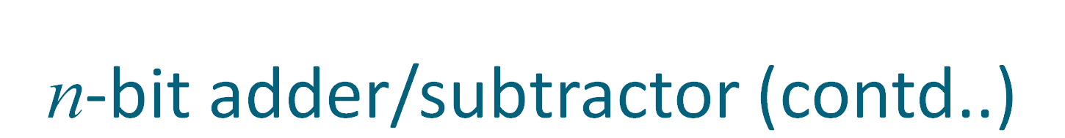
y
n
-
1
y
1
y
0
Add/Sub
control
x
n
-
1
x
1
x
0
c
n
-bit adder
n
c
0
s
n
-
1
s
1
s
0
Add/sub control = 0, addition.
Add/sub control = 1, subtraction.

Slide 8


Detecting overflows
Overflows can only occur when the sign of the two operands is the same.
Overflow occurs if the sign of the result is different from the sign of the operands.
Recall that the MSB represents the sign.
  x_{n-1}, y_{n-1}, s_{n-1} represent the sign of operand x, operand y and result s respectively.
Circuit to detect overflow can be implemented by the following logic expressions:

Slide 9

x₀
y₀
Consider 0th stage:
c₁ is available after 2 gate delays.
s₁ is available after 1 gate delay.
c₁
FA
c₀
s₀
Sum
Carry
y
i
c
i
x
i
y
s
x
i
c
i
i
c
i
i
+
1
c
i
x
y
i
i

Slide 10

Cascade of 4 Full Adders, or a 4-bit adder
x₀
y₀
x₀
y₀
x₀
y₀
x₀
y₀
FA
FA
FA
c₁
FA
c₀
c₄
c₃
c₂
s₃
s₂
s₁
s₀
s₀ available after 1 gate delays, c₁ available after 2 gate delays.
s₁ available after 3 gate delays, c₂ available after 4 gate delays.
s₂ available after 5 gate delays, c₃ available after 6 gate delays.
s₃ available after 7 gate delays, c₄ available after 8 gate delays.
For an n-bit adder, s_{n-1} is available after 2n-1 gate delays
c_{n} is available after 2n gate delays.

Slide 11

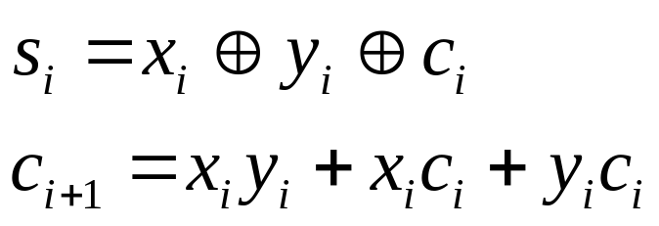
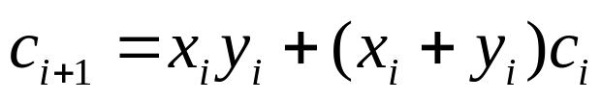
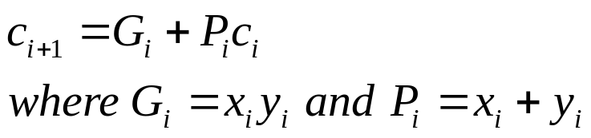
Recall the equations:
Second equation can be written as:
We can write:
G_{i} is called generate function and P_{i} is called propagate function
G_{i} and P_{i} are computed only from x_{i} and y_{i} and not c_{i}, thus they can
be computed in one gate delay after X and Y are applied to the
inputs of an n-bit adder.

Slide 12

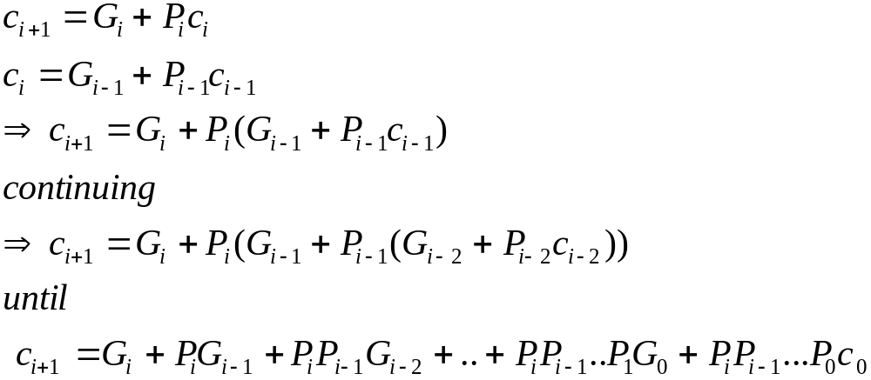
All carries can be obtained 3 gate delays after X, Y and c₀ are applied.
-One gate delay for P_{i} and G_{i}
-Two gate delays in the AND-OR circuit for c_{i+1}
All sums can be obtained 1 gate delay after the carries are computed.
Independent of n, n-bit addition requires only 4 gate delays.
This is called Carry Lookahead adder.

Slide 13

x
3
y
3
x
2
y
2
x
1
y
1
x
0
y
0
.
4-bit
carry-lookahead
adder
c
c
3
c
2
c
1
c
4
B cell
B cell
B cell
B cell
0
s
3
s
2
s
1
s
0
G
3
P
3
G
2
P
2
G
1
P
1
G
0
P
0
Carry-lookahead logic
x
i
y
i
.
.
.
c
i
B-cell for a single stage
B cell
G
i
P
i
s
i

Slide 14
Carry lookahead adder (contd..)
Performing n-bit addition in 4 gate delays independent of n is good only theoretically because of fan-in constraints.
Last AND gate and OR gate require a fan-in of (n+1) for a n-bit adder.
  For a 4-bit adder (n=4) fan-in of 5 is required.
  Practical limit for most gates.
In order to add operands longer than 4 bits, we can cascade 4-bit Carry-Lookahead adders. Cascade of Carry-Lookahead adders is called Blocked Carry-Lookahead adder.
c
=
G
+
P
G
+
P
P
G
+
..
+
P
P
..
P
G
+
P
P
...
P
c₀
i
+
1
i
i
i
−
1
i
i
−
1
i
−
2
i
i
−
1
1
0
i
i
−
1
0

Slide 15

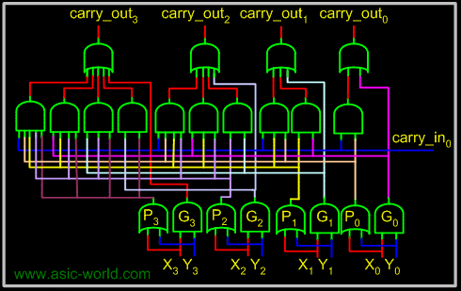

Slide 16

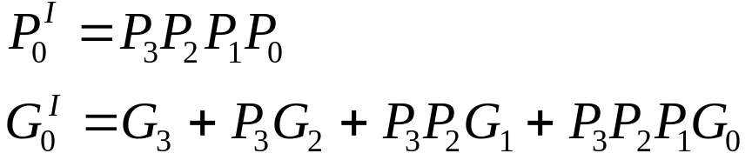
Carry-out from a 4-bit block can be given as:
Rewrite this as:
Subscript I denotes the blocked carry lookahead and identifies the block.
Cascade 4 4-bit adders, c₁₆ can be expressed as:

Slide 17
x
15-12
y
15-12
x
11-8
y
11-8
x
7-4
y
7-4
x
3-0
y
3-0
.
c
12
c
8
c
4
c
16
4-bit adder
4-bit adder
4-bit adder
4-bit adder
c
0
s
15-12
s
11-8
s
7-4
s
3-0
G
3
I
P
3
I
G
2
I
P
2
I
G
1
I
P
1
I
G
0
I
P
0
I
Carry-lookahead logic
After x_{i}, y_{i} and c₀ are applied as inputs:
- G_{i} and P_{i} for each stage are available after 1 gate delay.
- P^{I} is available after 2 and G^{I} after 3 gate delays.
- All carries are available after 5 gate delays.
- c₁₆ is available after 5 gate delays.
- s₁₅ which depends on c₁₂ is available after 8 (5+3)gate delays
(Recall that for a 4-bit carry lookahead adder, the last sum bit is
available 3 gate delays after all inputs are available)

Slide 18


Slide 19

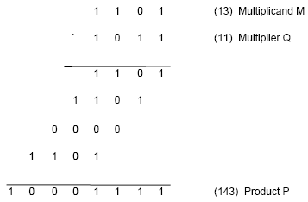
Product of 2 n-bit numbers is at most a 2n-bit number.
Unsigned multiplication can be viewed as addition of shifted
versions of the multiplicand.

Slide 20
Multiplication of unsigned numbers (contd..)
We added the partial products at end.
  Alternative would be to add the partial products at each stage.
Rules to implement multiplication are:
  If the i^{th} bit of the multiplier is 1, shift the multiplicand and add the shifted multiplicand to the current value of the partial product.
  Hand over the partial product to the next stage
  Value of the partial product at the start stage is 0.

Slide 21

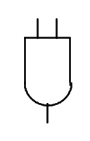
Typical multiplication cell
Bit of incoming partial product (PPi)
j^{th} multiplicand bit
i^{th} multiplier bit
i^{th} multiplier bit
carry out
FA
carry in
Bit of outgoing partial product (PP(i+1))

Slide 22

Combinatorial array multiplier
Multiplicand
(PP0)
0
m
3
0
m
2
0
m
1
0
m
0
q
0
PP1
0
q
p
0
0
1
PP2
p
Multiplier
q
2
1
0
PP3
p
2
q
3
0
p
p
p
p
p
,
7
6
5
4
3
Product is: p₇,p₆,..p₀
Multiplicand is shifted by displacing it through an array of adders.

Slide 23
Combinatorial array multiplier (contd..)
Combinatorial array multipliers are:
  Extremely inefficient.
  Have a high gate count for multiplying numbers of practical size such as 32-bit or 64-bit numbers.
  Perform only one function, namely, unsigned integer product.
Improve gate efficiency by using a mixture of combinatorial array techniques and sequential techniques requiring less combinational logic.

Slide 24
Sequential multiplication
Recall the rule for generating partial products:
  If the ith bit of the multiplier is 1, add the appropriately shifted multiplicand to the current partial product.
  Multiplicand has been shifted left when added to the partial product.
However, adding a left-shifted multiplicand to an unshifted partial product is equivalent to adding an unshifted multiplicand to a right-shifted partial product.

Slide 25

Register A (initially 0)
Shift right
C
a
n
-
1
a
q
q
0
n
-
1
0
Multiplier Q
Add/Noadd
control
n-bit
Adder
MUX
Control
sequencer
0
0
m
n
-
1
m
0
Multiplicand M

Slide 26

M
1 1 0 1
Initial configuration
0
0 0 0 0
1 0 1 1
C
A
Q
0
1 1 0 1
1 0 1 1
Add
First cycle
0
0 1 1 0
1 1 0 1
Shift
1
0 0 1 1
1 1 0 1
Add
Second cycle
0
1 0 0 1
1 1 1 0
Shift
0
1 0 0 1
1 1 1 0
No add
Third cycle
0
0 1 0 0
1 1 1 1
Shift
1
0 0 0 1
1 1 1 1
Add
0
1 0 0 0
1 1 1 1
Shift
Fourth cycle
Product

Slide 27


Slide 28
Signed Multiplication
Considering 2’s-complement signed operands, what will happen to (-13)×(+11) if following the same method of unsigned multiplication?
1
0
0
1
1
(
-
13
)
0
1
0
1
1
(
+
11
)
1
1
1
1
1
1
0
0
1
1
1
1
1
1
1
0
0
1
1
Sign extension is
0
0
0
0
0
0
0
0
shown in blue
1
1
1
0
0
1
1
0
0
0
0
0
0
1
1
0
1
1
1
0
0
0
1
(
-
143
)
Sign extension of negative multiplicand.

Slide 29
Signed Multiplication
For a negative multiplier, a straightforward solution is to form the 2’s-complement of both the multiplier and the multiplicand and proceed as in the case of a positive multiplier.
This is possible because complementation of both operands does not change the value or the sign of the product.
A technique that works equally well for both negative and positive multipliers – Booth algorithm.

Slide 30
Booth Algorithm
Consider in a multiplication, the multiplier is positive 0011110, how many appropriately shifted versions of the multiplicand are added in a standard procedure?
0
1
0
1
1
0
1
0
0
+
1
+
1
+
1
+
1
0
0
0
0
0
0
0
0
0
1
0
1
1
0
1
0
1
0
1
1
0
1
0
1
0
1
1
0
1
0
1
0
1
1
0
1
0
0
0
0
0
0
0
0
0
0
0
0
0
0
0
0
0
1
0
1
0
1
0
0
0
1
1
0

Slide 31
Booth Algorithm
Since 0011110 = 0100000 – 0000010, if we use the expression to the right, what will happen?
0
1
0
1
1
0
1
0
+
1
0
0
0
-
1
0
0
0
0
0
0
0
0
0
0
0
0
0
0
0
2's complement of
1
1
1
1
1
1
1
0
1
0
0
1
1
the multiplicand
0
0
0
0
0
0
0
0
0
0
0
0
0
0
0
0
0
0
0
0
0
0
0
0
0
0
0
0
0
0
0
0
0
0
0
0
1
0
1
1
0
1
0
0
0
0
0
0
0
0
0
0
0
1
0
1
0
1
0
0
0
1
1
0

Slide 32
Booth Algorithm
In general, in the Booth scheme, -1 times the shifted multiplicand is selected when moving from 0 to 1, and +1 times the shifted multiplicand is selected when moving from 1 to 0, as the multiplier is scanned from right to left.
0
0
1
0
1
1
0
0
1
1
1
0
1
0
1
1
0
0
0
+
1
-
1
+
1
0
-
1
0
+
1
0
0
-
1
+
1
-
1
+
1
0
-
1
0
0
Booth recoding of a multiplier.

Slide 33
Booth Algorithm
0
1
1
0
1
(
+
13
)
0
1
1
0
1
X
1
1
0
1
0
(
-
6
)
0
-
1
+1
-
1
0
0
0
0
0
0
0
0
0
0
0
1
1
1
1
1
0
0
1
1
0
0
0
0
1
1
0
1
1
1
1
0
0
1
1
0
0
0
0
0
0
1
1
1
0
1
1
0
0
1
0
(
-
78
)
Booth multiplication with a negative multiplier.

Slide 34
Booth Algorithm
Multiplier
V
ersion of multiplicand
selected by bit
i
Bit
i
Bit
i
-
1
0
0
0
X
M
0
1
+
1
X
M
1
0
−
1
X
M
1
1
0
X
M
Booth multiplier recoding table.

Slide 35
Booth Algorithm
Best case – a long string of 1’s (skipping over 1s)
Worst case – 0’s and 1’s are alternating
0
1
0
1
0
1
0
1
0
1
0
1
0
1
0
1
Worst-case
multiplier
+
1
-
1
+
1
-
1
+
1
-
1
+
1
-
1
+
1
-
1
+
1
-
1
+
1
-
1
+
1
-
1
1
1
0
0
0
1
0
1
1
0
1
1
1
1
0
0
Ordinary
multiplier
0
-
1
0
0
+
1
-
1
+
1
0
-
1
+
1
0
0
0
-
1
0
0
0
0
0
0
1
1
1
1
1
0
0
0
0
1
1
1
Good
multiplier
0
0
0
+
1
0
0
0
0
-
1
0
0
0
+
1
0
0
-
1

Slide 36


Slide 37
Bit-Pair Recoding of Multipliers
Bit-pair recoding halves the maximum number of summands (versions of the multiplicand).
Sign extension
Implied 0 to right of LSB
1
1
1
0
1
0
0
0
0
−
1
+
1
−
1
0
0
−
1
−
2
(a) Example of bit-pair recoding derived from Booth recoding

Slide 38
Bit-Pair Recoding of Multipliers
Multiplier bit-pair
Multiplier bit on the right
Multiplicand
i
+
1
i
i
−
1
selected at position
i
0
0
0
0
X M
0
0
1
+
1
X M
0
1
0
+
1
X M
0
1
1
+
2
X M
1
0
0
−
2
X M
1
0
1
−
1
X M
1
1
0
−
1
X M
1
1
1
0
X M
(b) Table of multiplicand selection decisions

Slide 39
Bit-Pair Recoding of Multipliers
0
1
1
0
1
0
-
1
+
1
-
1
0
0
0
0
0
0
0
0
0
0
0
1
1
1
1
1
0
0
1
1
0
0
0
0
1
1
0
1
1
1
1
0
0
1
1
0
1
1
0
1
(
+
13
)
0
0
0
0
0
0
×
1
1
0
1
0
(
-
6
)
1
1
1
0
1
1
0
0
1
0
(
-
78
)
0
1
1
0
1
0
-
1
-
2
1
1
1
1
1
0
0
1
1
0
1
1
1
1
0
0
1
1
0
0
0
0
0
0
1
1
1
0
1
1
0
0
1
0
Figure 6.15. Multiplication requiring only n/2 summands.

Slide 40
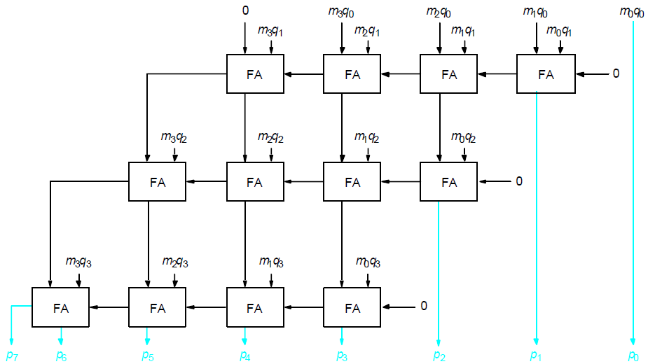
Carry-Save Addition of Summands
CSA speeds up the addition process.
P7
P6
P5
P4
P3
P2
P1
P0

Slide 41
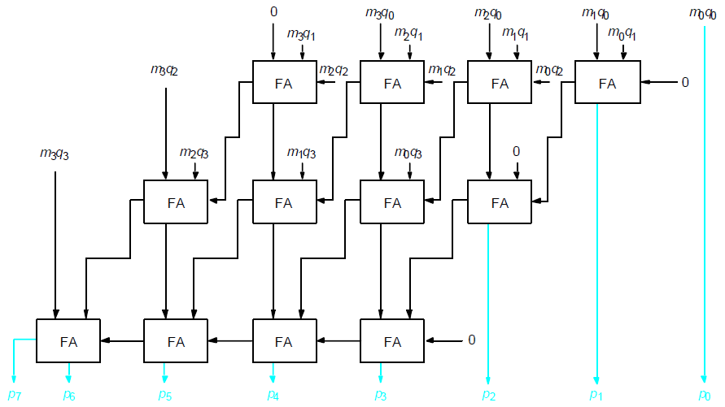
Carry-Save Addition of Summands(Cont.,)
P7
P6
P5
P4
P3
P2
P1
P0

Slide 42
Carry-Save Addition of Summands(Cont.,)
Consider the addition of many summands, we can:
Group the summands in threes and perform carry-save addition on each of these groups in parallel to generate a set of S and C vectors in one full-adder delay
Group all of the S and C vectors into threes, and perform carry-save addition on them, generating a further set of S and C vectors in one more full-adder delay
Continue with this process until there are only two vectors remaining
They can be added in a RCA or CLA to produce the desired product

Slide 43
Carry-Save Addition of Summands
1
0
1
1
0
1
(45)
M
X
1
1
1
1
1
1
(63)
Q
1
0
1
1
0
1
A
1
0
1
1
0
1
B
1
0
1
1
0
1
C
1
0
1
1
0
1
D
1
0
1
1
0
1
E
1
0
1
1
0
1
F
1
0
1
1
0
0
0
1
0
0
1
1
(2,835)
Product
Figure 6.17. A multiplication example used to illustrate carry-save addition as shown in Figure 6.18.

Slide 44
1
0
1
1
0
1
M
x
1
1
1
1
1
1
Q
1
0
1
1
0
1
A
1
0
1
1
0
1
B
1
0
1
1
0
1
C
1
1
0
0
0
0
1
1
S
1
0
0
1
1
1
1
0
0
C
1
1
0
1
1
0
1
D
1
0
1
1
0
1
E
1
0
1
1
0
1
F
1
1
0
0
0
0
1
1
S
2
0
0
1
1
1
1
0
0
C
2
1
1
0
0
0
0
1
1
S
1
0
0
1
1
1
1
0
0
C
1
1
1
0
0
0
0
1
1
S
2
1
1
0
1
0
1
0
0
0
1
1
S
3
0
0
0
0
1
0
1
1
0
0
0
C
3
0
0
1
1
1
1
0
0
C
2
0
1
0
1
1
1
0
1
0
0
1
1
S
4
+
0
1
0
1
0
1
0
0
0
0
0
C
4
1
0
1
1
0
0
0
1
0
0
1
1
Product
Figure 6.18. The multiplication example from Figure 6.17 performed using
carry-save addition.

Slide 45


Slide 46
Manual Division
13
21
1101
10101
274
100010010
26
1101
14
10000
13
1101
1
1110
1101
1
Longhand division examples.

Slide 47
Longhand Division Steps
Position the divisor appropriately with respect to the dividend and performs a subtraction.
If the remainder is zero or positive, a quotient bit of 1 is determined, the remainder is extended by another bit of the dividend, the divisor is repositioned, and another subtraction is performed.
If the remainder is negative, a quotient bit of 0 is determined, the dividend is restored by adding back the divisor, and the divisor is repositioned for another subtraction.

Slide 48
Circuit Arrangement
Shift left
a_{n}
a_{n-1}
a₀
q_{n-1}
q₀
Dividend Q
A
Quotient
Setting
N+1 bit
adder
Add/Subtract
Control
Sequencer
0
m_{n-1}
m₀
Divisor M
Figure 6.21. Circuit arrangement for binary division.

Slide 49
Restoring Division
Shift A and Q left one binary position
Subtract M from A, and place the answer back in A
If the sign of A is 1, set q₀ to 0 and add M back to A (restore A); otherwise, set q₀ to 1
Repeat these steps n times

Slide 50
Examples
Initially
0
0
0
0
0
1
0
0
0
0
0
0
1
1
Shift
0
0
0
0
1
0
0
0
Subtract
1
1
1
0
1
First cycle
Set
q
0
1
1
1
1
0
Restore
1
1
1
0
0
0
0
0
1
0
0
0
0
Shift
0
0
0
1
0
0
0
0
1
1
1
0
0
0
Subtract
1
1
1
0
1
1
1
Set
q
0
1
1
1
1
1
Second cycle
Restore
1
1
1
1
0
0
0
0
1
0
0
0
0
0
Shift
0
0
1
0
0
0
0
0
Subtract
1
1
1
0
1
Set
q
0
0
0
0
0
1
Third cycle
Shift
0
0
0
1
0
0
0
0
1
Subtract
1
1
1
0
1
0
0
1
Set
q
0
1
1
1
1
1
Fourth cycle
Restore
1
1
0
0
0
1
0
0
0
1
0
Remainder
Quotient
Figure 6.22. A restoring-division example.

Slide 51
Nonrestoring Division
Avoid the need for restoring A after an unsuccessful subtraction.
Any idea?
Step 1: (Repeat n times)
If the sign of A is 0, shift A and Q left one bit position and subtract M from A; otherwise, shift A and Q left and add M to A.
Now, if the sign of A is 0, set q₀ to 1; otherwise, set q₀ to 0.
Step2: If the sign of A is 1, add M to A

Slide 52
Examples
Initially
0
0
0
0
0
1
0
0
0
0
0
0
1
1
Shift
0
0
0
0
1
0
0
0
First cycle
Subtract
1
1
1
0
1
Set
q
0
1
1
1
1
0
0
0
0
0
Shift
1
1
1
0
0
0
0
0
Add
0
0
0
1
1
Second cycle
Set
q
0
1
1
1
1
1
0
0
0
0
Shift
1
1
1
1
0
0
0
0
1
1
1
1
1
Restore
remainder
Add
0
0
0
1
1
Third cycle
0
0
0
1
1
Set
q
0
0
0
0
0
1
0
0
0
1
Add
0
0
0
1
0
Remainder
Shift
0
0
0
1
0
0
0
1
Subtract
1
1
1
0
1
Fourth cycle
Set
q
0
1
1
1
1
1
0
0
1
0
A nonrestoring-division example.
Quotient

Slide 53


Slide 54

If b is a binary vector, then we have seen that it can be interpreted as
an unsigned integer by:
V(b) = b₃₁.2³¹ + b₃₀.2³⁰ + b_{n-3}.2²⁹ + .... + b₁.2¹ + b₀.2⁰
This vector has an implicit binary point to its immediate right:
b₃₁b₃₀b₂₉....................b₁b₀. implicit binary point
Suppose if the binary vector is interpreted with the implicit binary point is
just left of the sign bit:
implicit binary point .b₃₁b₃₀b₂₉....................b₁b₀
The value of b is then given by:
V(b) = b₃₁.2⁻¹ + b₃₀.2⁻² + b₂₉.2⁻³ + .... + b₁.2⁻³¹ + b₀.2⁻³²

Slide 55


The value of the unsigned binary fraction is:
V(b) = b₃₁.2⁻¹ + b₃₀.2⁻² + b₂₉.2⁻³ + .... + b₁.2⁻³¹ + b₀.2⁻³²
The range of the numbers represented in this format is:
In general for a n-bit binary fraction (a number with an assumed binary
point at the immediate left of the vector), then the range of values is:

Slide 56


Previous representations have a fixed point. Either the point is to the immediate right or it is to the immediate left. This is called Fixed point representation.
Fixed point representation suffers from a drawback that the representation can only represent a finite range (and quite small) range of numbers.
A more convenient representation is the scientific representation, where
the numbers are represented in the form:
Components of these numbers are:
Mantissa (m), implied base (b), and exponent (e)

Slide 57


A number such as the following is said to have 7 significant digits
Fractions in the range 0.0 to 0.9999999 need about 24 bits of precision
(in binary). For example the binary fraction with 24 1’s:
111111111111111111111111 = 0.9999999404
Not every real number between 0 and 0.9999999404 can be represented
by a 24-bit fractional number.
The smallest non-zero number that can be represented is:
000000000000000000000001 = 5.96046 x 10⁻⁸
Every other non-zero number is constructed in increments of this value.

Slide 58

In a 32-bit number, suppose we allocate 24 bits to represent a fractional
mantissa.
Assume that the mantissa is represented in sign and magnitude format,
and we have allocated one bit to represent the sign.
We allocate 7 bits to represent the exponent, and assume that the
exponent is represented as a 2’s complement integer.
There are no bits allocated to represent the base, we assume that the
base is implied for now, that is the base is 2.
Since a 7-bit 2’s complement number can represent values in the range
-64 to 63, the range of numbers that can be represented is:
0.0000001 x 2⁻⁶⁴ < = | x | <= 0.9999999 x 2⁶³
In decimal representation this range is:
0.5421 x 10⁻²⁰ < = | x | <= 9.2237 x 10¹⁸

Slide 59

1 7 24
Sign Exponent Fractional mantissa
bit
24-bit mantissa with an implied binary point to the immediate left
7-bit exponent in 2’s complement form, and implied base is 2.

Slide 60

Consider the number:
x = 0.0004056781 x 10¹²
If the number is to be represented using only 7 significant mantissa digits,
the representation ignoring rounding is:
x = 0.0004056 x 10¹²
If the number is shifted so that as many significant digits are brought into
7 available slots:
x = 0.4056781 x 10⁹ = 0.0004056 x 10¹²
Exponent of x was decreased by 1 for every left shift of x.
A number which is brought into a form so that all of the available mantissa
digits are optimally used (this is different from all occupied which may
not hold), is called a normalized number.
Same methodology holds in the case of binary mantissas
0001101000(10110) x 2⁸ = 1101000101(10) x 2⁵

Slide 61

A floating point number is in normalized form if the most significant
1 in the mantissa is in the most significant bit of the mantissa.
All normalized floating point numbers in this system will be of the form:
0.1xxxxx.......xx
Range of numbers representable in this system, if every number must be
normalized is:
0.5 x 2⁻⁶⁴ <= | x | < 1 x 2⁶³

Slide 62

The procedure for normalizing a floating point number is:
Do (until MSB of mantissa = = 1)
Shift the mantissa left (or right)
Decrement (increment) the exponent by 1
end do
Applying the normalization procedure to:
.000111001110....0010 x 2⁻⁶²
gives:
.111001110........ x 2⁻⁶⁵
But we cannot represent an exponent of –65, in trying to normalize the
number we have underflowed our representation.
Applying the normalization procedure to:
1.00111000............x 2⁶³
gives:
0.100111..............x 2⁶⁴
This overflows the representation.

Slide 63

So far we have assumed an implied base of 2, that is our floating point
numbers are of the form:
x = m 2e
If we choose an implied base of 16, then:
x = m 16e
Then:
y = (m.16) .16^{e-1} (m.2⁴) .16^{e-1} = m . 16e = x
Thus, every four left shifts of a binary mantissa results in a decrease of 1
in a base 16 exponent.
Normalization in this case means shifting the mantissa until there is a 1 in
the first four bits of the mantissa.

Slide 64

Rather than representing an exponent in 2’s complement form, it turns out to be more beneficial to represent the exponent in excess notation.
If 7 bits are allocated to the exponent, exponents can be represented in the range of -64 to +63, that is:
-64 <= e <= 63
Exponent can also be represented using the following coding called as excess-64:
E’ = E_{true} + 64
In general, excess-p coding is represented as:
E’ = E_{true} + p
True exponent of -64 is represented as 0
0 is represented as 64
63 is represented as 127
This enables efficient comparison of the relative sizes of two floating point numbers.

Slide 65

IEEE Floating Point notation is the standard representation in use. There are two representations:
- Single precision.
- Double precision.
Both have an implied base of 2.
Single precision:
- 32 bits (23-bit mantissa, 8-bit exponent in excess-127 representation)
Double precision:
- 64 bits (52-bit mantissa, 11-bit exponent in excess-1023 representation)
Fractional mantissa, with an implied binary point at immediate left.
Sign Exponent Mantissa
1 8 or 11 23 or 52

Slide 66

Floating point numbers have to be represented in a normalized form to
maximize the use of available mantissa digits.
In a base-2 representation, this implies that the MSB of the mantissa is
always equal to 1.
If every number is normalized, then the MSB of the mantissa is always 1.
We can do away without storing the MSB.
IEEE notation assumes that all numbers are normalized so that the MSB
of the mantissa is a 1 and does not store this bit.
So the real MSB of a number in the IEEE notation is either a 0 or a 1.
The values of the numbers represented in the IEEE single precision
notation are of the form:
(+,-) 1.M x 2^{(E - 127)}
The hidden 1 forms the integer part of the mantissa.
Note that excess-127 and excess-1023 (not excess-128 or excess-1024) are used to represent the exponent.

Slide 67

In the IEEE representation, the exponent is in excess-127 (excess-1023)
notation.
The actual exponents represented are:
-126 <= E <= 127 and -1022 <= E <= 1023
not
-127 <= E <= 128 and -1023 <= E <= 1024
This is because the IEEE uses the exponents -127 and 128 (and -1023 and
1024), that is the actual values 0 and 255 to represent special conditions:
- Exact zero
- Infinity

Slide 68

Addition:
3.1415 x 10⁸ + 1.19 x 10⁶ = 3.1415 x 10⁸ + 0.0119 x 10⁸ = 3.1534 x 10⁸
Multiplication:
3.1415 x 10⁸ x 1.19 x 10⁶ = (3.1415 x 1.19 ) x 10⁽⁸⁺⁶⁾
Division:
3.1415 x 10⁸ / 1.19 x 10⁶ = (3.1415 / 1.19 ) x 10⁽⁸⁻⁶⁾
Biased exponent problem:
If a true exponent e is represented in excess-p notation, that is as e+p.
Then consider what happens under multiplication:
a. 10^{(x + p)} * b. 10^{(y + p)} = (a.b). 10^{(x + p + y +p)} = (a.b). 10^{(x +y + 2p)}
Representing the result in excess-p notation implies that the exponent
should be x+y+p. Instead it is x+y+2p.
Biases should be handled in floating point arithmetic.

Slide 69
Floating point arithmetic: ADD/SUB rule
Choose the number with the smaller exponent.
Shift its mantissa right until the exponents of both the numbers are equal.
Add or subtract the mantissas.
Determine the sign of the result.
Normalize the result if necessary and truncate/round to the number of mantissa bits.
Note: This does not consider the possibility of overflow/underflow.

Slide 70
Floating point arithmetic: MUL rule
Add the exponents.
Subtract the bias.
Multiply the mantissas and determine the sign of the result.
Normalize the result (if necessary).
Truncate/round the mantissa of the result.

Slide 71
Floating point arithmetic: DIV rule
Subtract the exponents
Add the bias.
Divide the mantissas and determine the sign of the result.
Normalize the result if necessary.
Truncate/round the mantissa of the result.
Note: Multiplication and division does not require alignment of the
mantissas the way addition and subtraction does.

Slide 72

While adding two floating point numbers with 24-bit mantissas, we shift
the mantissa of the number with the smaller exponent to the right until
the two exponents are equalized.
This implies that mantissa bits may be lost during the right shift (that is,
bits of precision may be shifted out of the mantissa being shifted).
To prevent this, floating point operations are implemented by keeping
guard bits, that is, extra bits of precision at the least significant end
of the mantissa.
The arithmetic on the mantissas is performed with these extra bits of
precision.
After an arithmetic operation, the guarded mantissas are:
- Normalized (if necessary)
- Converted back by a process called truncation/rounding to a 24-bit
mantissa.

Slide 73
Truncation/rounding
Straight chopping:
  The guard bits (excess bits of precision) are dropped.
Von Neumann rounding:
  If the guard bits are all 0, they are dropped.
  However, if any bit of the guard bit is a 1, then the LSB of the retained bit is set to 1.
Rounding:
  If there is a 1 in the MSB of the guard bit then a 1 is added to the LSB of the retained bits.

Slide 74
Rounding
Rounding is evidently the most accurate truncation method.
However,
  Rounding requires an addition operation.
  Rounding may require a renormalization, if the addition operation de-normalizes the truncated number.
IEEE uses the rounding method.
0.111111100000 rounds to 0.111111 + 0.000001
=1.000000 which must be renormalized to 0.100000

