Slide 1
Two-point Sampling

Slide 2
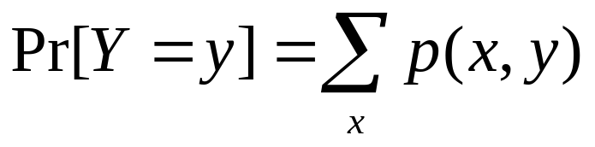
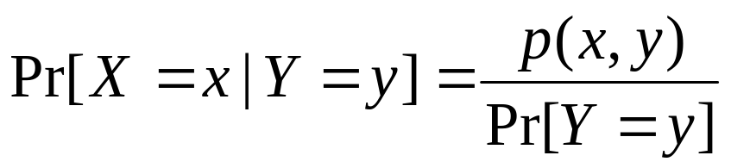
X,Y: discrete random variables defined over the same probability sample space.
p(x,y)=Pr[{X=x}∩{Y=y}]: the joint density function of X and Y.
Thus,
and

Slide 3
A sequence of random variables is called pairwise independent if for all i ≠j, and x,y ∈R, Pr[X_{i}=x|X_{j}=y]=Pr[X_{i}=x].
Let L be a language and A be a randomized algorithm for deciding whether an input string x belongs to L or not.

Slide 4
Given x, A picks a random number r from the range Z_{n}={0,1,..,n-1}, with the following property:
If x∈L, then A(x,r)=1 for at least half the possible values of r.
If x∉L, then A(x,r)=0 for all posssible choices of r.

Slide 5
Use k-wise ind, we can improve the bound further, but still within polynomial.
Observe that for any x∈L, a random choice of r is a witness with probability at least ½.
Goal: We want to increase this probability, i.e., decrease the error probability.

Slide 6
Strategy:
Pick t>1 values, r₁,r₂,..r_{t} ∈ Z_{n}.
Compute A(x,r_{i}) for i=1,..,t.
If for any i, A(x,r_{i})=1, then declare x∈L.
The error is at most 2^{-t}.
But use Ω(tlogn) random bits.

Slide 7
Actually, we can use fewer random bits.
Choose a,b randomly from Z_{n}.
Let r_{i}=a_{i}+b mod n, i=1,..,t. Compute A(x,r_{i}).
If for any i, A(x,r_{i})=1, then declare x∈L.
Now what is the error probability?

Slide 8
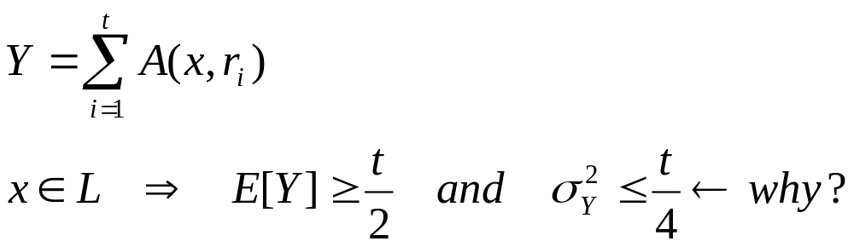
Ex: r_{i}=ai+b mod n, i=1,..,t.
r_{i}’s are pairwise independent.
Let

Slide 9
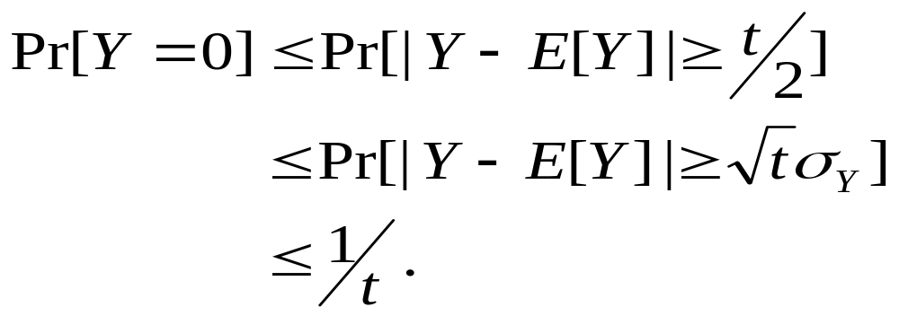
What is the probability of the event {Y=0}?
Y=0 ⇒ |Y-E[Y]| ≥ t/2.
Thus
Chebyshev’s Inq
Pr[|X- μ_{x}|≥ tσ_{x}] ≤1/t²

