Slide 1
Priority Inheritance Protocols:
An Approach to Real-Time Synchronization
김세화
Real-Time Operating Systems Laboratory
SoEE&CS, SNU

Slide 2
Outline
Introduction
  Synchronization problem
  Priority inversion problem
Assumptions and notations
Basic priority inheritance protocol
Priority ceiling protocol
Schedulability analysis
Conclusion

Slide 3
Synchronization Problem
Resource sharing
  Requires mutual exclusion
  Critical section
    A code section that should be executed mutually exclusively by tasks
  Semaphore
    One of synchronization primitives
Assumptions of this paper
  Fixed-priority preemptive scheduling
  A uniprocessor environment
  Binary semaphore (Mutex)
Notes:
Semaphore:
- Synchronization Primitives:
- semaphore 외에도 critical section에 있는 태스크는 선점 못하도록 하는 스케쥴 방식도 제안된 바 있다.
<binary semaphore 방식으로 설명하고, 본래 semaphore는 자원 개수의 정보를 가질 수 있다고 얘기할 것.>
- critical section을 guard하기 위한 lock이라고 할 수 있습니다.
각 자원에 대하여 semaphore가 정의됩니다.
그 자원은 동시에 여러 task가 사용할 수 없고, 단지 한 태스크가 사용할 수 있는 binary semaphore를 가정합시다.
어떤 자원을 사용하려 하면, 먼저 해당 semaphore의 lock을 얻어야 critical section에 들어갈 수 있습니다.
그렇지 않으면 semaphore의 lock을 잡을 때 까지 기다리게 됩니다.

Slide 4
Priority Inversion Problem
Priority inversion
  Phenomenon where a higher priority job is blocked by lower priority jobs
Indefinite priority inversion
  Occurs when a task of medium priority preempts a task of lower priority which is blocking a task of higher priority.
Notes:
Uncontrolled priority inversion

Slide 5
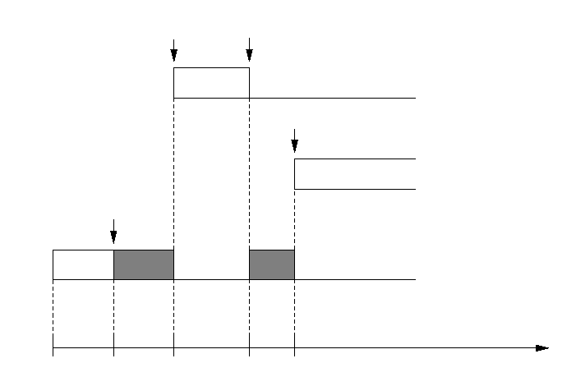








Indefinite Priority Inversion
preempt J3
(try to lock S)
blocked by J3
indefinite blocking !
• • •
preempt J3
• • •
lock S
time

Slide 6
Outline
Introduction
  Synchronization problem
  Priority inversion problem
Assumptions and notations
Basic priority inheritance protocol
Priority ceiling protocol
Schedulability analysis
Conclusion

Slide 7
Notations (1/2)
J_{i}: A job, i.e., an instance of a task τ_{i}
  T_{i}: Period of τ_{i}
  P_{i}: Priority of τ_{i}
    Jobs J₁, J₂, …, J_{n} are listed in descending order of priority.
S_{i}: A Binary semaphore
  P(S_{i} ): Indivisible lock (wait) operation
  V(S_{i} ): indivisible unlock (signal) operation
z_{i,j}: The j-th critical section in job J_{i}
  S_{i,j}: The semaphore locked and released by critical section z_{i,j}
  z_{i,j} ⊂ z_{i,k}: The critical section z_{i,j} is entirely contained in z_{i,k}.
Notes:
수식 팩키지 깔자!

Slide 8
Notations (2/2)
Definition: A job J is said to be blocked by the critical section z_{i,j} of job J_{i}:
  If J_{i} has a lower priority than J but J has to wait for J_{i} to exit z_{i,j} in order to continue execution.
Definition: A job J is said to be blocked by job J_{i} through semaphore S:
  If the critical section z_{i,j} blocks J and S_{i,j} = S.
Blocking set
  β_{i,j}: The set of all critical sections of J_{j} which can block J_{i}
    β_{i,j} = { z_{j,k} | j > i and z_{j,k} can block J_{j} }
  β*_{i,j} : The set of all longest (outermost) critical sections of J_{j}
  which can block J_{i}.
    β*_{i,j} = { z_{j,k} | (z_{j,k} ∈ β _{i,j} ) Λ ( ∼ ∃ z_{j,m} ∈ β _{i,j} such that z_{j,k} ⊂ z_{j,m} }
  β*_{i}: The set of all longest (outermost) critical sections
  that can block J_{i}
    β*_{i} = U_{j>i} β*_{i,j}
Notes:
Notation에서 주의할 것은 Blocking set을 나타내는 Beta_i,j 와 Critical section을 나타내는 z_i,j 에서
해당 job의 id를 나타내는 suffix의 위치가 반대라는 점.
- Betai,j 는 J_j의 blocking set이며, z_i,j 는 J_i의 critical section임.
Beta의 정의에서 주의할 점:
정의는 단지 블록할 수 있는 낮은우선순위의 태스크의 critical section을 말하는 것.
같은 세마포어에 연관되어 있다든지에 관한 내포등은 되어 있지 않다.

Slide 9
Assumptions
No voluntary blocking
  Jobs do not suspend themselves, say for I/O operations.
Properly nested critical sections
  (ex)
J_{i} = {..., P(S₁), ..., P(S₂), ..., V(S₂), ..., V(S₁), ...}
Properly nested semaphores
J_{i} = {..., P(S₁), ..., P(S₂), ..., V(S₁), ..., V(S₂), ...}
Non-properly nested semaphores

Slide 10
Outline
Introduction
Assumptions and notations
Basic priority inheritance protocol (BPI)
  Description
  Examples
  Properties
  Problems
  Summary
Priority ceiling protocol
Schedulability analysis
Conclusion

Slide 11
Description of Basic Protocol
If job J blocks higher priority jobs:
  J inherits P_{H} , the highest priority of the jobs blocked by J .
Priority inheritance is transitive.
  If J₃ blocks J₂ and J₂ blocks J₁, J₃ would inherit the priority of J₁ via J₂.
When J exits a critical section:
  J resumes the priority it had at the point of entry into the critical section.

Slide 12
Outline
Introduction
Assumptions and notations
Basic priority inheritance protocol (BPI)
  Description
  Examples
  Properties
  Problems
  Summary
Priority ceiling protocol
Schedulability analysis
Conclusion

Slide 13
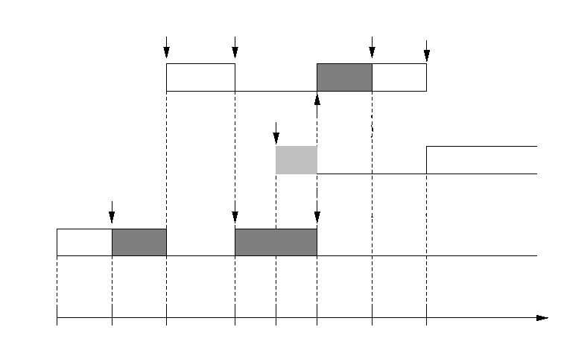



Examples for Basic Protocol (1/2)
preempt J3
(try to lock S)
blocked by J3
unlock S
complete
arrive
preempt J3
(lock S)
j3 inherits
priority of J1
lock S
unlock S
push-through
blocking
time

Slide 14
Examples for Basic Protocol (2/2)
J₁ = {..., P(S₂), ..., V(S₂), ...}
J₂ = {..., P(S₂), ..., P(S₁), ..., V(S₁), ..., V(S₂), ...}
J₃ = {..., P(S₁) , ..., V(S₁), ...}
nested semaphores
transitive blocking
(attempt to lock S2)
blocked by J2
unlock S2
lock
S2
complete
preempt J3
(attempt to lock S1)
blocked by J3
lock
S1
unlock
S1
complete
lock
S2
unlock
S2
complete
lock
S1
unlock
S1
time
t0
t1
t2
t3
t4
t5
t6
t7
t8
t9
t10
t11
t12
t13

Slide 15
Outline
Introduction
Assumptions and notations
Basic priority inheritance protocol (BPI)
  Description
  Examples
  Properties
  Problems
  Summary
Priority ceiling protocol
Schedulability analysis
Conclusion

Slide 16
Blocking in Basic Protocol
Three Types of blocking
  Direct blocking
    Ensures the consistency of shared data.
  Push-through blocking
    Prevents indefinite blocking due to priority inversion
  Transitive blocking
    By not-directly involved semaphores which are accessed in a nested form by blocking jobs.
    Transitive blocking is said to occur if a job J is blocked by J_{i} which, in turn, is blocked by another job J_{j} .

Slide 17
Properties of Basic Protocol (1/3)
A high priority job J_{H} can be blocked by a lower priority job J_{L}:
  [Lemma1: Blocking condition]: Only if J_{L} is executing within a critical section, z_{j,k} ∈ β*_{H.L} when J_{H} is initiated.
  [Lemma2: Blocking duration from one lower priority job]: For at most the duration of one critical section β*_{H.L}, regardless of the number of semaphores J_{H} and J_{L} share.
[Theorem 3: Blocking duration]: Given a job J₀ for which there are n lower priority jobs { J₁,..., J_{n} }:
  J₀ can be blocked for at most the duration of one critical section in each of β*_{0,i}, 1 ≤ i ≤ n.
    NOTE: Each of n lower priority jobs can block job J₀ for at most the duration of a single critical section in each of the blocking in sets β*_{0,i} .

Slide 18
Properties of Basic Protocol (2/3)
[Lemma 4: Push-through blocking condition]: Semaphore S can cause push-through blocking to job J:
  Only if S is accessed both (1) by a job which has priority lower than that of J and (2) by a job which has or can inherit priority equal to or higher than that of J .
    J is a medium-priority job which may have no relation with S
Notation
  ζ*_{i,j,k}: The set of all longest critical sections of job J_{j} guarded by semaphore S_{k} and block job J_{i} either directly or via push-trough blocking
  ζ*_{i,j,k} = { z_{j,p} | z_{j,p} ∈ β*_{i,j} and s_{j,p} = S_{k} }
  ζ*_{i,•,k} = U_{j≥i} ζ*_{i,j,k}

Slide 19
Properties of Basic Protocol (3/3)
[Lemma 5: Blocking frequency for each semaphore]: A job J_{i} can encounter blocking:
  By at most one critical section in ζ*_{i,•,k} for each semaphore S_{k}, 1 ≤ k ≤ m, where m is the number of distinct semaphores.
[Theorem 6: Blocking frequency]: If there are m semaphores which can block job J:
  J can be blocked at most m times.
Upper bound on the total blocking delay that a job can encounter
  Can be determined by studying:
    The durations of the critical sections in β*_{i,j} and ζ*_{i,•,k}
  From [Theorem 3: Blocking duration] and [Theorem 6: Blocking frequency]
Notes:
Lemma 5 증명:
- 일단 critical section을 빠져 나오면 낮은 운선순위의 태스크는 더 이상 높은 우선순위의 태스크를 블록시킬 수 없다.
Total blocking delay에서 베타까지 봐야 하는 이유:
- 즉 높은 우선순위의 태스크의 세마포어와 관련되지 않은 낮은 우선순위의 태스크의 critical section을 다 고려해야 되는 이유
- direct blocking 외에 push-through blocking(이건 처음 initiate 될 때만 발생),

Slide 20
Outline
Introduction
Assumptions and notations
Basic priority inheritance protocol (BPI)
  Description
  Examples
  Properties
  Problems
  Summary
Priority ceiling protocol
Schedulability analysis
Conclusion

Slide 21
Problems of Basic Protocol
Deadlocks
  Due to crossing nested semaphores
Long blocking delay
  Due to
    Transitive blocking
      Blocking by not-directly involved semaphores which are accessed in nested form by blocking jobs.
    Blocking chains
      Blocking can occur sequentially whenever accessing each semaphore.

Slide 22
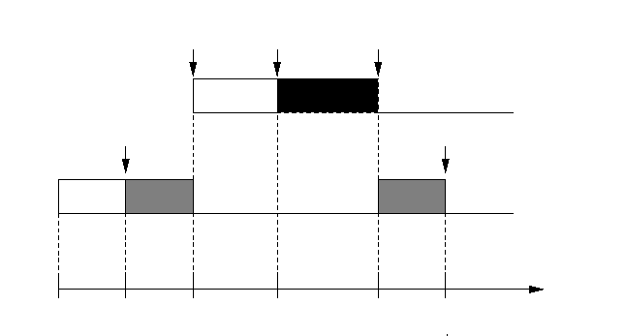
Deadlocks in Basic Protocol
J₁ = {..., P(S₂) ..., P(S₁),...,V(S₁) ...,V(S₂),...}
J₂ = {..., P(S₁) ..., P(S₂),...,V(S₂) ...,V(S₁),...}
crossing nested semaphores
(try to lock S1)
blocked by J2
preempt J2
lock S2
lock S1
(try to lock S2)
blocked by J1
deadlock!
time

Slide 23
Blocking Chains in Basic Protocol
J₁ = {..., P(S₁), ..., V(S₁), ..., P(S₂), ..., V(S₂), ...}
J₂ = {..., P(S₂) , ..., V(S₂), ...}
J₃ = {..., P(S₁) , ..., V(S₁), ...}
(attempt to lock S2)
blocked by J2
(attempt to lock S1)
blocked by J3
unlock S2
lock
S1
unlock
S1
lock
S2
complete
preempt J3
complete
lock
S2
unlock
S2
complete
lock
S1
unlock
S1
time
t0
t1
t2
t3
t4
t5
t6
t7
t8
t9
t10
t11
t12
t13

Slide 24
Summary of Basic Protocol
Basic Idea
  If a job blocks higher priority jobs, it inherits the highest priority of the jobs blocked by it.
Three types of blocking
  (1) Direct blocking, (2) push-through blocking, and (3) transitive blocking
Controlled priority inversion
  Upper bound on the total blocking delay that a job can encounter
    Can be determined by studying the durations of the critical sections in β*_{i,j} and ζ*_{i,•,k} .
Problems
  Deadlocks
  Long blocking delay
    Due to transitive blocking and blocking chains

Slide 25
Outline
Introduction
Assumptions and notations
Basic priority inheritance protocol (BPI)
Priority ceiling protocol (PCP)
  Overview
  Examples
  Properties
  Summary
Schedulability analysis
Conclusion

Slide 26
Overview of PCP
Goals:
  Solve problems of BPI.
    Prevent deadlocks, transitive blocking and blocking chains
Basic idea:
  Priority ceiling of a semaphore:
    The priority of the highest priority task that may use the semaphore
  Additional condition for allowing a job J to start a new critical section
    only if J’s priority is higher than all priority ceilings of all the semaphores locked by jobs other than J .

Slide 27
Outline
Introduction
Assumptions and notations
Basic priority inheritance protocol (BPI)
Priority ceiling protocol (PCP)
  Overview
  Examples
  Properties
  Summary
Schedulability analysis
Conclusion

Slide 28
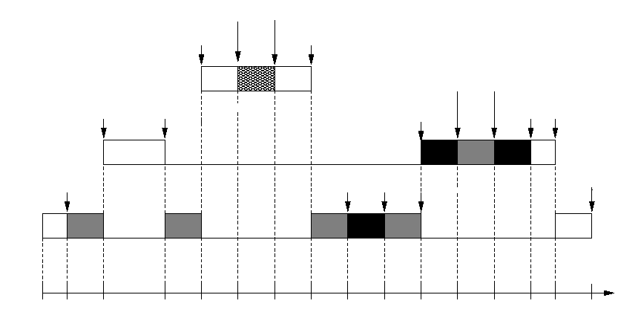








Examples for PCP (1/3)
Prevent deadlocks
J₁ = {..., P(S₀) ..., V(S₀),...}
J₂ = {..., P(S₁) ..., P(S₂),...,V(S₂) ...,V(S₁),...}
J₃ = {..., P(S₂) ..., P(S₁),...,V(S₁) ...,V(S₂),...}
nested crossing semaphores
lock S0
unlock S0
preempt J3
complete
lock S2
unlock S2
preempt J3
(attempt to lock S1)
blocked by J3
lock S1
unlock S1
complete
lock S2
unlock S1
lock S1
unlock S2
complete
time

Slide 29
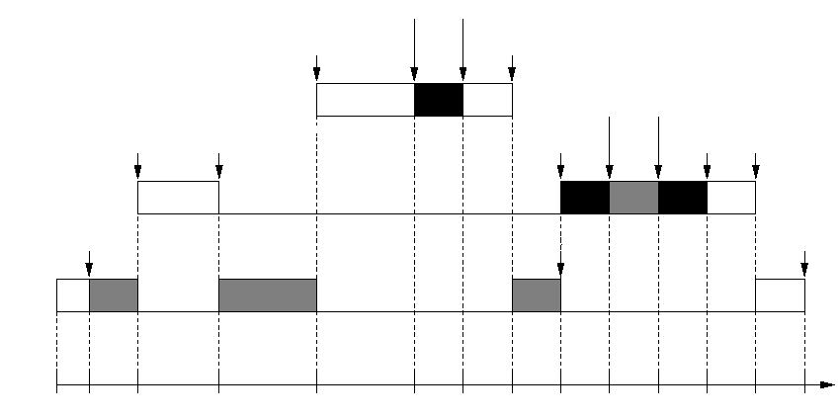
Examples for PCP (2/3)
Prevent transitive blocking
J₁ = {..., P(S₂) ..., V(S₂),...}
J₂ = {..., P(S₂) ..., P(S₁),...,V(S₁) ...,V(S₂),...}
J₃ = {..., P(S₁),...,V(S₁) ...,}
nested semaphores
lock S2
unlock S2
preempt J3
complete
lock S1
unlock S1
preempt J3
(attempt to lock S2)
blocked by J3
lock S2
unlock S2
complete
complete
lock S1
unlock S1
time

Slide 30
Examples for PCP (3/3)
Prevent blocking chains
J₁ = {..., P(S₁), ..., V(S₁), ..., P(S₂), ..., V(S₂), ...}
J₂ = {..., P(S₂) , ..., V(S₂), ...}
J₃ = {..., P(S₁) , ..., V(S₁), ...}
(attempt to lock S1)
blocked by J3
lock
S2
unlock S2
lock
S1
unlock
S1
complete
preempt J3
(attempt to lock S2)
blocked by J3
lock
S2
unlock
S2
complete
complete
lock
S1
unlock
S1
time
t0
t1
t2
t3
t4
t5
t6
t7
t8
t9
t10
t11
t12
t13

Slide 31
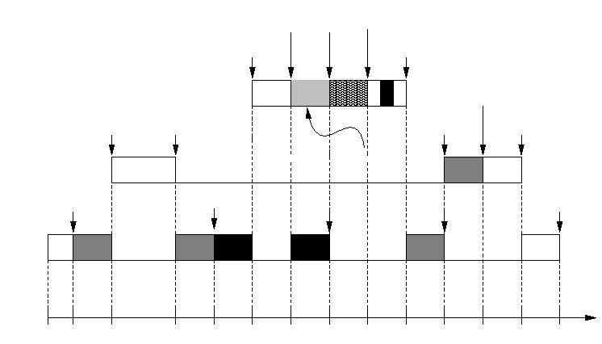
Examples for PCP (4/4)
A New type of blocking: Ceiling blocking
J₁ = {..., P(S₀), ..., V(S₀), ..., P(S₁), ..., V(S₁), ...}
J₂ = {..., P(S₂), ..., V(S₂), ...}
J₃ = {..., P(S₂), ..., P(S₁), ..., V(S₁), ..., V(S₂), ...}
(attempt to lock S0)
blocked by J3
lock S0
unlock S0
preempt J3
complete
unlock S2
preempt J3
(attempt to lock S2)
blocked by J3
lock S2
complete
ceiling blocking
lock S2
lock S1
unlock S1
unlock S2
complete
time

Slide 32
Outline
Introduction
Assumptions and notations
Basic priority inheritance protocol (BPI)
Priority ceiling protocol (PCP)
  Overview
  Examples
  Properties
  Summary
Schedulability analysis
Conclusion

Slide 33
Properties of PCP (1/2)
[Lemma 7: Blocking condition]: A job J can be blocked by a lower priority job J_{L},
  Only if the priority of job J is no higher than the highest priority ceiling of all the semaphores that are locked by all lower priority jobs when J enters its critical section.
[Lemma 8: Inheritance condition]: If z_{j,n} of J_{j} is preempted by J_{i} which enters z_{i,m ,}
  J_{j} cannot inherit a priority level which is higher than or equal to that of J_{i} until J_{i} completes.
[Lemma 9: No transitive blocking]: The priority ceiling protocol prevents transitive blocking.
[Theorem 10: No deadlocks]: The priority ceiling protocol prevents deadlocks.

Slide 34
Properties of PCP (2/2)
[Lemma 11: Blocking duration from one lower priority job]: J_{i} can be blocked by J_{L}
  For at most the duration of one critical section in β*_{i,L} .
[Theorem 12: Blocking duration]: J_{i} can be blocked
  For at most the duration of at most one element of β*_{i}.
→ The maximum blocking delay for a job is bounded by
  The duration of the longest critical section among those of lower priority jobs
[Corollary 13: Blocking duration]: If a generalized job J_{i} suspends itself n times during its execution, it can be blocked
  By at most n+1 not necessarily distinct elements of β*_{i}.

Slide 35
Summary of PCP
Basic Idea
  Priority ceiling of a semaphore:
    The priority of the highest priority task that may use the semaphore
  Additional condition for allowing a job J to start a new critical section
    only if J’s priority is higher than all priority ceilings of all the semaphores locked by jobs other than J .
PCP solves the problems of BPI
  No Deadlocks, no transitive blocking, and no blocking chains
Three types of blocking
  (1) Direct blocking, (2) push-through blocking, and (3) ceiling blocking
The maximum blocking delay for a job is bounded by
  The duration of the longest critical section among those of lower priority jobs

Slide 36
Outline
Introduction
Assumptions and notations
Basic priority inheritance protocol (BPI)
Priority ceiling protocol
Schedulability analysis
  Utilization bound based approach
  Time demand based approach
Conclusion

Slide 37
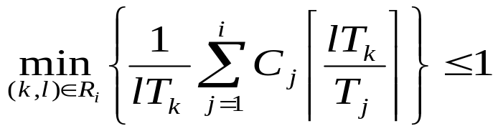

Schedulability Analysis
Goal:
  Extend the RMS algorithms
    Considering the effect of blocking under PCP
[Theorem 14: RMS theory of Liu & Layland]: Utilization bound based approach
[Theorem 15: RMS theory of Lehoczky et al]: Time demand based approach
Notation
  B_{i}: The worst case blocking time of a job in task τ_{i}
, where

Slide 38
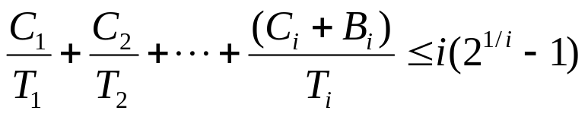
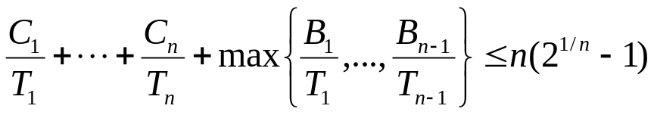

Utilization Bound Based Approach
[Theorem 16: Extension of Theorem 14]: A set of n periodic tasks using PCP can be scheduled by RMS if
  Proof
    The inequality holds when there is no blocking.
    Task τ_{i} still meets its deadline when its execution is delayed by B_{i}.
[Corollary 17]: A set of n periodic tasks using PCP can be scheduled by RMS if
  Proof
    If this equation holds, then all the equations in [Theorem 16] holds.
      max{B_{1/}B₁, …, B_{n-1/}B_{n-1}} ≥ B_{i/}B_{i}
Notes:
식 잘 못 된 것 수정

Slide 39
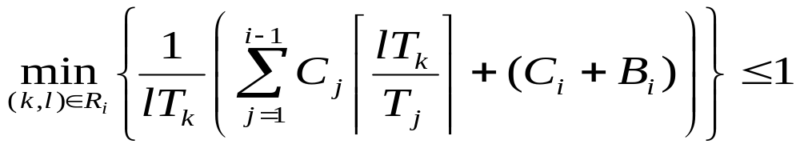
Time Demand Based Approach
[Theorem 18: Extension of Theorem 15]: A set of n periodic tasks using PCP can be scheduled by RMS for all task phasings if
  Proof
    identical to that of proof for [Theorem 16]
, where
Notes:
잘못된 수식 고치기

Slide 40
Outline
Introduction
Assumptions and notations
Basic priority inheritance protocol (BPI)
Priority ceiling protocol
Schedulability analysis
Conclusion

Slide 41
Conclusion
Problems in real-time synchronization
  Uncontrolled priority inversion (→ unbounded blocking delay)
Two Priority inheritance protocols
  BPI (Basic priority inheritance protocol)
    prevents indefinite blocking → bonded blocking delay
    3 types of blocking
      direct blocking, push-through blocking, and transitive blocking
    Problems
      Deadlocks, transitive blocking and blocking chains
  PCP (Priority ceiling protocol)
    Solves problems of BPI
    3 types of blocking
      direct blocking, push-through blocking, and ceiling blocking
    At most one blocking with no transitive blocking for each job

