Slide 1
Real-Time Scheduling
CIS700
Insup Lee

Slide 2
Outline
Real-time systems
Real-time scheduling algorithms
  Fixed-priority algorithm (RM)
  Dynamic-priority algorithm (EDF)

Slide 3
Real-Time Systems
Definition
  Systems whose correctness depends on their temporal aspects as well as their functional aspects
Performance measure
  Timeliness on timing constraints (deadlines)
  Speed/average case performance are less significant.
Key property
  Predictability on timing constraints

Slide 4
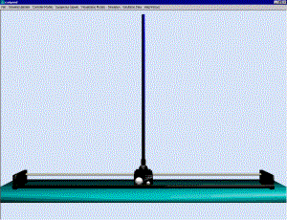
Real-Time System Example
Digital control systems
  periodically performs the following job:
  senses the system status and
  actuates the system according to its current status
Sensor
Control-Law
Computation
Actuator

Slide 5

Real-Time System Example
Multimedia applications
  periodically performs the following job:
  reads, decompresses, and displays video and audio streams
Multimedia

Slide 6
Fundamental Real-Time Issue
To specify the timing constraints of real-time systems
To achieve predictability on satisfying their timing constraints, possibly, with the existence of other real-time systems

Slide 7
Scheduling Framework Example
Digital Controller
Multimedia
OS Scheduler
CPU

Slide 8
Real-Time Workload
Job (unit of work)
  a computation, a file read, a message transmission, etc
Attributes
  Resources required to make progress
  Timing parameters
Absolute deadline
Released
Execution time
Relative deadline

Slide 9
Real-Time Task
Task : a sequence of similar jobs
  Periodic task (p,e)
    Its jobs repeat regularly
    Period p = inter-release time (0 < p)
    Execution time e = maximum execution time (0 < e < p)
    Utilization U = e/p
0
5
10
15

Slide 10
Deadlines: Hard vs. Soft
Hard deadline
  Disastrous or very serious consequences may occur if the deadline is missed
  Validation is essential : can all the deadlines be met, even under worst-case scenario?
  Deterministic guarantees
Soft deadline
  Ideally, the deadline should be met for maximum performance. The performance degrades in case of deadline misses.
  Best effort approaches / statistical guarantees

Slide 11
Schedulability
Property indicating whether a real-time system (a set of real-time tasks) can meet their deadlines
(4,1)
(5,2)
(7,2)

Slide 12
Real-Time Scheduling
Determines the order of real-time task executions
Static-priority scheduling
Dynamic-priority scheduling
(4,1)
(5,2)
5
10
15
(7,2)
5
10
15

Slide 13
RM (Rate Monotonic)
Optimal static-priority scheduling
It assigns priority according to period
A task with a shorter period has a higher priority
Executes a job with the shortest period
T₁
(4,1)
T₂
(5,2)
5
10
15
T₃
(7,2)
5
10
15

Slide 14
RM (Rate Monotonic)
Executes a job with the shortest period
T₁
(4,1)
T₂
(5,2)
5
10
15
T₃
(7,2)
5
10
15

Slide 15
RM (Rate Monotonic)
Executes a job with the shortest period
Deadline Miss !
T₁
(4,1)
T₂
(5,2)
5
10
15
T₃
(7,2)
5
10
15

Slide 16
Response Time
Response time
  Duration from released time to finish time
T₁
(4,1)
T₂
(5,2)
5
10
15
T₃
(10,2)
5
10
15

Slide 17
Response Time
Response time
  Duration from released time to finish time
Response Time
T₁
(4,1)
T₂
(5,2)
5
10
15
T₃
(10,2)
5
10
15

Slide 18
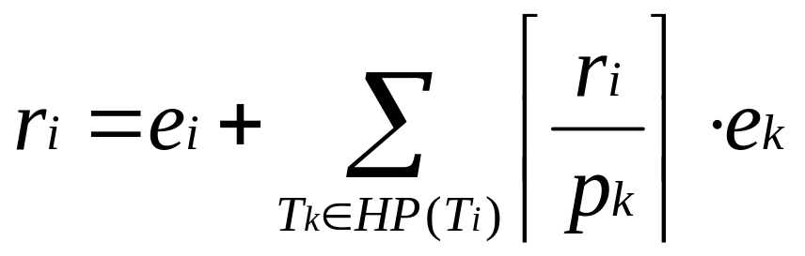
Response Time
Response Time (r_{i}) [Audsley et al., 1993]
HP(T_{i}) : a set of higher-priority tasks than T_{i}
T₁
(4,1)
T₂
(5,2)
5
10
T₃
(10,2)
5
10

Slide 19
RM - Schedulability Analysis
Real-time system is schedulable under RM
if and only if r_{i} ≤ p_{i} for all task T_{i}(p_{i},e_{i})
Joseph & Pandya,
“Finding response times in a real-time system”,
The Computer Journal, 1986.

Slide 20
RM – Utilization Bound
Real-time system is schedulable under RM if
∑U_{i} ≤ n (2^{1/n}-1)
Liu & Layland,
“Scheduling algorithms for multi-programming in a hard-real-time environment”, Journal of ACM, 1973.

Slide 21
RM – Utilization Bound
Real-time system is schedulable under RM if
∑U_{i} ≤ n (2^{1/n}-1)
Example: T₁(4,1), T₂(5,1), T₃(10,1),
∑U_{i} = 1/4 + 1/5 + 1/10
= 0.55
3 (2^{1/3}-1) ≈ 0.78
Thus, {T₁, T₂, T₃} is schedulable under RM.

Slide 22
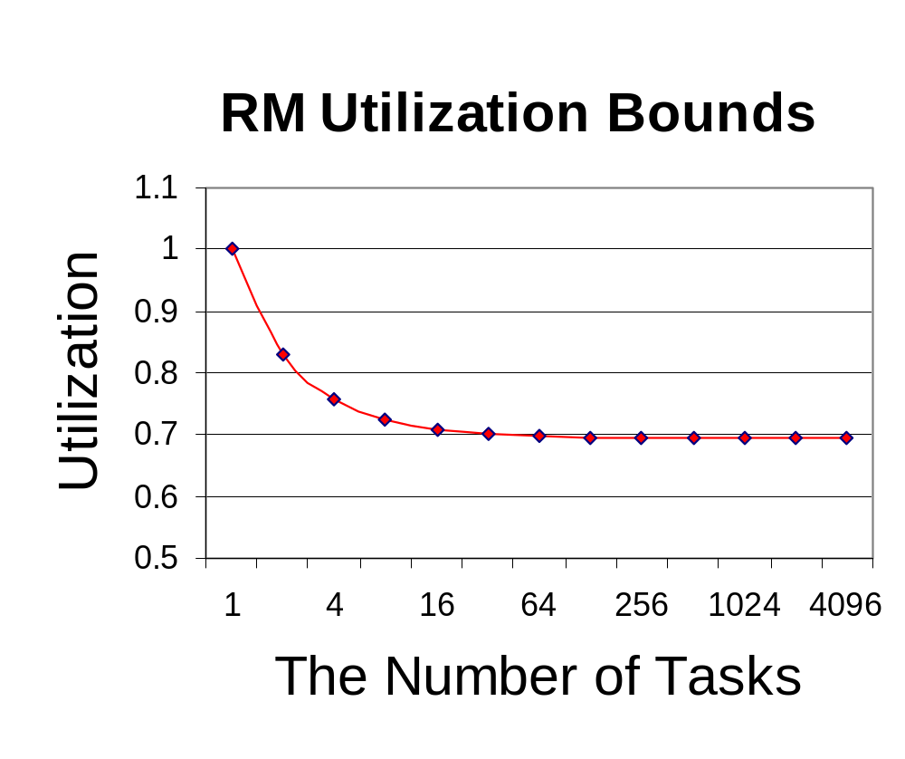
RM – Utilization Bound
Real-time system is schedulable under RM if
∑U_{i} ≤ n (2^{1/n}-1)

Slide 23
EDF (Earliest Deadline First)
Optimal dynamic priority scheduling
A task with a shorter deadline has a higher priority
Executes a job with the earliest deadline
T₁
(4,1)
T₂
(5,2)
5
10
15
T₃
(7,2)
5
10
15

Slide 24
EDF (Earliest Deadline First)
Executes a job with the earliest deadline
T₁
(4,1)
T₂
(5,2)
5
10
15
T₃
(7,2)
5
10
15

Slide 25
EDF (Earliest Deadline First)
Executes a job with the earliest deadline
T₁
(4,1)
T₂
(5,2)
5
10
15
T₃
(7,2)
5
10
15

Slide 26
EDF (Earliest Deadline First)
Executes a job with the earliest deadline
T₁
(4,1)
T₂
(5,2)
5
10
15
T₃
(7,2)
5
10
15

Slide 27
EDF (Earliest Deadline First)
Optimal scheduling algorithm
  if there is a schedule for a set of real-time tasks,
  EDF can schedule it.
T₁
(4,1)
T₂
(5,2)
5
10
15
T₃
(7,2)
5
10
15

Slide 28
Processor Demand Bound
Demand Bound Function : dbf(t)
  the maximum processor demand by workload over any interval of length t
t
T₁
(4,1)
T₂
(5,2)
5
10
15
T₃
(7,2)
5
10
15

Slide 29
EDF - Schedulability Analysis
Real-time system is schedulable under EDF
if and only if dbf(t) ≤ t for all interval t
Baruah et al.
“Algorithms and complexity concerning the preemptive
scheduling of periodic, real-time tasks on one
processor”, Journal of Real-Time Systems, 1990.
Demand Bound Function : dbf(t)
  the maximum processor demand by workload over any interval of length t

Slide 30
EDF – Utilization Bound
Real-time system is schedulable under EDF if and only if
∑U_{i} ≤ 1
Liu & Layland,
“Scheduling algorithms for multi-programming in a hard-real-time environment”, Journal of ACM, 1973.

Slide 31
EDF – Overload Conditions
Domino effect during overload conditions
  Example: T₁(4,3), T₂(5,3), T₃(6,3), T₄(7,3)
Deadline Miss !
T₁
T₂
T₃
T₄
0
3
5
6
7
Better schedules :
T₁
T₃
T₁
T₄
0
3
5
6
7
0
3
5
6
7

Slide 32
RM vs. EDF
Rate Monotonic
  Simpler implementation, even in systems without explicit support for timing constraints (periods, deadlines)
  Predictability for the highest priority tasks
EDF
  Full processor utilization
  Misbehavior during overload conditions
For more details: Buttazzo, “Rate monotonic vs. EDF: Judgement Day”, EMSOFT 2003.

