Slide 1
CprE 458/558: Real-Time Systems
Resource Access Control Protocols

Slide 2
Assumptions
Periodic tasks
Task can have resource access
Semaphore is used for mutual exclusion
RMS scheduling

Slide 3
Background – Task State diagram
Ready State: waiting in ready queue
Running State: CPU executing the task
Blocked: waiting in the semaphore queue until the shared resource is free
Semaphore types – mutex (binary semaphore), counting semaphore

Slide 4
Task State Diagram
scheduling
Activate
READY
RUN
Termination
Preemption
Signal free resource
Wait on busy resource
WAITING
Process/Task state diagram with resource constraints

Slide 5
Priority Inversion Problem
Priority inversion is an undesirable situation in which a higher priority task gets blocked (waits for CPU) for more time than that it is supposed to, by lower priority tasks.
Example:
Let T₁ , T₂ , and T₃ be the three periodic tasks with decreasing order of priorities.
Let T₁ and T₃ share a resource “S”.

Slide 6
Priority Inversion -- Example
T3 obtains a lock on the semaphore S and enters its critical section to use a shared resource.
T1 becomes ready to run and preempts T3. Then, T1 tries to enter its critical section by first trying to lock S. But, S is already locked by T3 and hence T1 is blocked.
T2 becomes ready to run. Since only T2 and T3 are ready to run, T2 preempts T3 while T3 is in its critical section.
Ideally, one would prefer that the highest priority task (T1) be blocked no longer than the time for T3 to complete its critical section. However, the duration of blocking is, in fact, unpredictable because task T2 got executed in between.

Slide 7

Priority Inversion example
A higher priority task waits for a lower priority task
Makes a request for resource S and gets blocked
Resource S is available and T1 is scheduled here
T1
Highest priority
T₁
T₁
T2 completes
Preempted by higher priority task T1
L1
T₂
T3 completes
T2
T3 is the only active task
Medium priority
Preempted by higher priority task T2
K3
K1
K2
T3
T₃
T₃
T₃
Least priority
0
T1 and T3 share resource S
Total blocking time for task T1 = (K1+K2+K3) + (L1)

Slide 8
Priority Inheritance Protocol
Priority inheritance protocol solves the problem of priority inversion.
Under this protocol, if a higher priority task T_{H} is blocked by a lower priority task T_{L}, because T_{L} is currently executing critical section needed by T_{H}, T_{L} temporarily inherits the priority of T_{H}.
When blocking ceases (i.e., T_{L} exits the critical section), T_{L} resumes its original priority.
Unfortunately, priority inheritance may lead to deadlock.

Slide 9
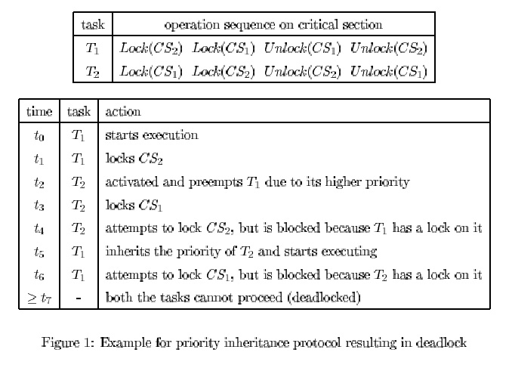
Priority Inheritance Protocol – Deadlock Assume T2 > T1 (i.e., T2 has high priority)

Slide 10
Priority Ceiling Protocol
Priority ceiling protocol solves the priority inversion problem without getting into deadlock.
For each semaphore, a priority ceiling is defined, whose value is the highest priority of all the tasks that may lock it.
When a task T_{i} attempts to execute one of its critical sections, it will be suspended unless its priority is higher than the priority ceiling of all semaphores currently locked by tasks other than T_{i}.

Slide 11
Priority Ceiling Protocol (Contd.)
If task T_{i} is unable to enter its critical section for this reason, the task that holds the lock on the semaphore with the highest priority ceiling is said to be blocking T_{i} and hence inherits the priority of T_{i}.
As long as a task T_{i} is not attempting to enter one of its critical sections, it will preempt every task that has a lower priority.

Slide 12
Priority Ceiling Protocol -- properties
This protocol is the same as the priority inheritance protocol, except that a task T_{i} can also be blocked from entering a critical section if any other task is currently holding a semaphore whose priority ceiling is greater than or equal to the priority of task T_{i}.
Prevents mutual deadlock among tasks
A task can be blocked by lower priority tasks at most once

Slide 13
Priority Celiling Protocol - Example
For the previous example, the priority ceiling for both CS₁ and CS₂ is the priority of T₂.
From time t₀ to t₂, the operations are the same as before.
At time t₃, T₂ attempts to lock CS₁, but is blocked since CS₂ (which has been locked by T₁) has a priority ceiling equal to the priority of T₂.
Thus T₁ inherits the priority of T₂ and proceeds to completion, thereby preventing deadlock situation.

Slide 14
Priority Inversion - Real-world Example
Mars Pathfinder mission (July 4, 1997)
VxWorks (real-time OS), preemptive priority scheduling of threads (e.g., RMS)
Priority inversion involving three threads:
  Information bus task (T1), meteorological data gathering task (T3), communication task (T2). Priority order: T1>T2>T3
  Shared resource: information bus (used mutex)
Same situation as described in the previous example had occurred
Findings: Priority ceiling protocol was found to be disabled initially, then it was enabled online and the problem was corrected

Slide 15
Priority Ceiling Emulation
Once a task locks a semaphore, its priority is immediately raised to the level of the priority ceiling of the semaphore.
Deadlock avoidance and block at-most-once result of priority ceiling protocol still holds.
Restriction: A task cannot suspend its execution within the critical section.

Slide 16
Modeling Blocking Time and Earlier Deadline
Blocking time (Bi) encountered by task Ti by lower priority tasks can be modeled by increasing Ti’s utilization by Bi/Pi.
Earlier deadline (Di < Pi) can also be modeled as blocking time for Ei = Pi – Di.
Net increase in task Ti’s utilization is
(Bi + Ei) / Pi.

Slide 17
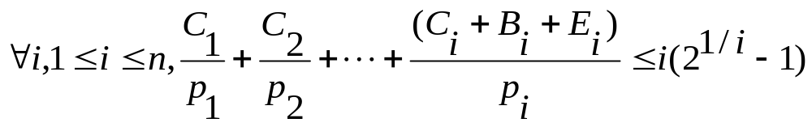
Modeling Blocking and Earlier Deadline (Cont.)
Schedulability Check (sorted order T1 > T2 > … > Tn) -- sufficient, but not necessary
Completion time Test (Exact analysis)
  Earlier deadline (di < pi) case: same as DMS exact analysis
  Blocking time (Bi) case:
    Let Ci’ = Ci + Bi
    While calculating Wi(t) for task Ti, use Ci’ for task Ti and for all other higher priority tasks Tj simply use Cj
  (Note: Blocking Time calculation will be learned thro homework)

