Slide 1
Security in Computing, 4th Ed, Pfleeger
Chapter 1
Is There a Security Problem in Computing?

Slide 2
Risk is a fact of life
Crossing the street is risky
  But, you still cross the street!
Using computers is risky (from the security and privacy perspectives)
  But, you still use computers!

Slide 3
Is There a Security Problem in Computing?
In this chapter
  The goals of secure computing: confidentiality, integrity, availability (CIA)
  The threats to security in computing: interception, interruption, modification, fabrication
  Controls available to address these threats: encryption, programming controls, operating systems, network controls, administrative controls, law, and ethics

Slide 4
What Does "Secure" Mean?
How do we protect our most valuable assets?
  bank robbery: bank robbery was, for a time, considered to be a profitable business. Protecting assets was difficult and not always effective.
  Today: asset protection is easier; Very sophisticated alarm and camera systems silently protect secure places, genetic material (DNA), fingerprints, retinal patterns, voice, etc.

Slide 5
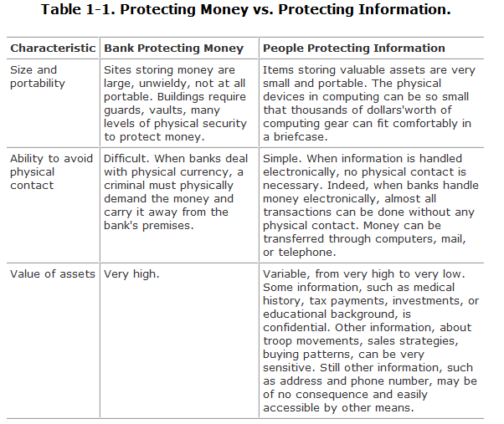
What Does "Secure" Mean?

Slide 6
This chapter
Examines what kinds of vulnerabilities computing systems are prone to.
Why these vulnerabilities are exploited
  different kinds of attacks that are possible.
This chapter's third focus is on who is involved
  the kinds of people who contribute to the security problem.
Finally, we introduce how to prevent possible attacks on systems.

Slide 7
Computing System Security
The computing system is a collection of hardware, software, storage media, data, and people that an organization uses to perform computing tasks.
  Sometimes, we assume that parts of a computing system are not valuable to an outsider, but often we are mistaken.
  Any system is most vulnerable at its weakest point.
  Any part of a computing system can be the target of a crime.

Slide 8
Principle of Easiest Penetration
“An intruder must be expected to use any available means of penetration.”
  The penetration may not necessarily be by the most obvious means,
  nor is it necessarily the one against which the most solid defense has been installed
  and it certainly does not have to be the way we want the attacker to behave.
This principle implies that computer security specialists must consider all possible means of penetration.

Slide 9
Principle of Easiest Penetration
Furthermore, the penetration analysis must be done repeatedly, and especially whenever the system and its security change.
Remember that computer security is a game with rules only for the defending team
  the attackers can (and will) use any means they can.

Slide 10
Attacks
When you test any computer system
  One of your jobs is to imagine how the system could malfunction.
  Then, you improve the system's design so that the system can withstand any of the problems you have identified.
In the same way, we analyze a system from a security perspective
  thinking about ways in which the system's security can malfunction and diminish the value of its assets.

Slide 11
Vulnerabilities, Threats, Attacks, and Controls
A vulnerability is a weakness in the security system (for example, in procedures, design, or implementation), that might be exploited to cause loss or harm.
A threat to a computing system is a set of circumstances that has the potential to cause loss or harm.
A human who exploits a vulnerability perpetrates an attack on the system.
How do we address these problems?
  We use a control as a protective measure. That is, a control is an action, device, procedure, or technique that removes or reduces a vulnerability.

Slide 12
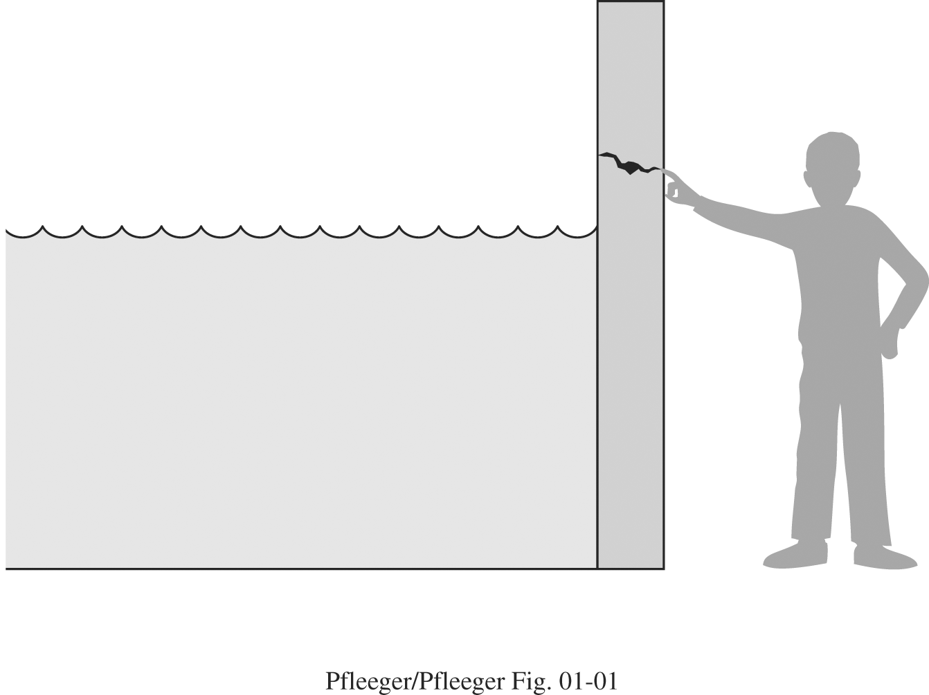
Vulnerabilities, Threats, Attacks, and Controls
the relationship among threats, controls, and vulnerabilities in this way:
  A threat is blocked by control of a vulnerability.
  To devise controls, we must know as much about threats as possible.

Slide 13
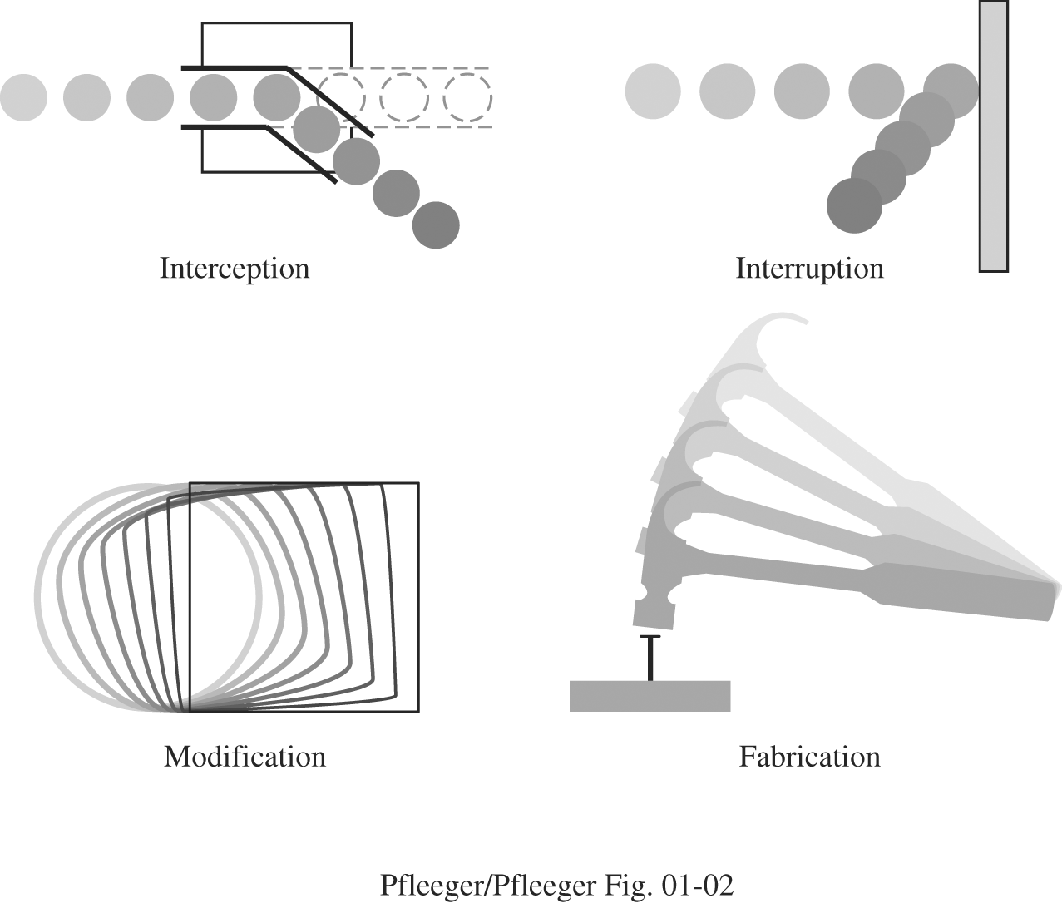
Threats
We can view any threat as being one of four kinds: interception, interruption, modification, and fabrication.

Slide 14
Threats
An interception means that some unauthorized party has gained access to an asset.
In an interruption, an asset of the system becomes lost, unavailable, or unusable.
If an unauthorized party not only accesses but tampers with an asset, the threat is a modification.
Finally, an unauthorized party might create a fabrication of counterfeit objects on a computing system.

Slide 15
Method, Opportunity, and Motive
A malicious attacker must have three things (MOM):
  method: the skills, knowledge, tools, and other things with which to be able to pull off the attack
    Knowledge of systems are widely available
  opportunity: the time and access to accomplish the attack
    Systems available to the public are accessible to them
  motive: a reason to want to perform this attack against this system

Slide 16
The Meaning of Computer Security
Security Goals
  When we talk about computer security, we mean that we are addressing three important aspects of any computer-related system: confidentiality, integrity, and availability (CIA)
  Confidentiality ensures that computer-related assets are accessed only by authorized parties.
    Reading, viewing, printing, or even knowing their existance
    Secrecy or privacy
  Integrity means that assets can be modified only by authorized parties or only in authorized ways.
    Writing, changing, deleting, creating
  Availability means that assets are accessible to authorized parties at appropriate times. For this reason, availability is sometimes known by its opposite, denial of service.

Slide 17
Confidentiality, Integrity, and Availability
One of the challenges in building a secure system is finding the right balance among the goals, which often conflict.
  For example, it is easy to preserve a particular object's confidentiality in a secure system simply by preventing everyone from reading that object. However, this system is not secure, because it does not meet the requirement of availability for proper access.

Slide 18
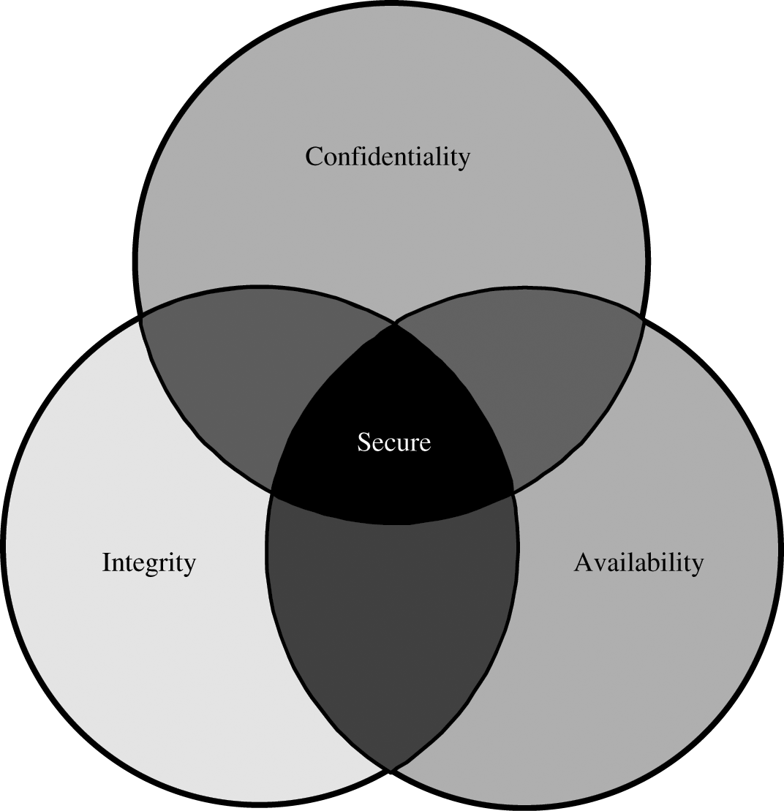
Confidentiality, Integrity, and Availability
In fact, these three characteristics can be independent, can overlap, and can even be mutually exclusive.

Slide 19
Confidentiality, Integrity, and Availability
Ensuring confidentiality can be difficult.
  For example, who determines which people or systems are authorized to access the current system? By "accessing" data, do we mean that an authorized party can access a single bit? the whole collection? pieces of data out of context? Can someone who is authorized disclose those data to other parties?
We understand confidentiality well because we can relate computing examples to those of preserving confidentiality in the real world.

Slide 20
Confidentiality, Integrity, and Availability
Integrity is much harder to pin down.
  Integrity means different things in different contexts.
    Precise, unmodified, modified only in acceptable ways, modified only by authorized people, modified only by authorized processes, consistent, meaningful and usable
Integrity can be enforced in much the same way as can confidentiality: by rigorous control of who or what can access which resources in what ways.

Slide 21
Confidentiality, Integrity, and Availability
Availability applies both to data and to services (that is, to information and to information processing). We say a data item, service, or system is available
  if there is a timely response to our request.
  Resources are allocated fairly so that some requesters are not favored over others.
  The service or system involved follows a philosophy of fault tolerance, whereby hardware or software faults lead to graceful cessation of service or to work-arounds rather than to crashes and abrupt loss of information.
  The service or system can be used easily and in the way it was intended to be used.
  Concurrency is controlled; that is, simultaneous access, deadlock management, and exclusive access are supported as required.

Slide 22
Vulnerabilities
When we prepare to test a system, we usually try to imagine how the system can fail; we then look for ways in which the requirements, design, or code can enable such failures.
  Imagine the vulnerabilities that would prevent us from reaching one or more of our three security goals.

Slide 23
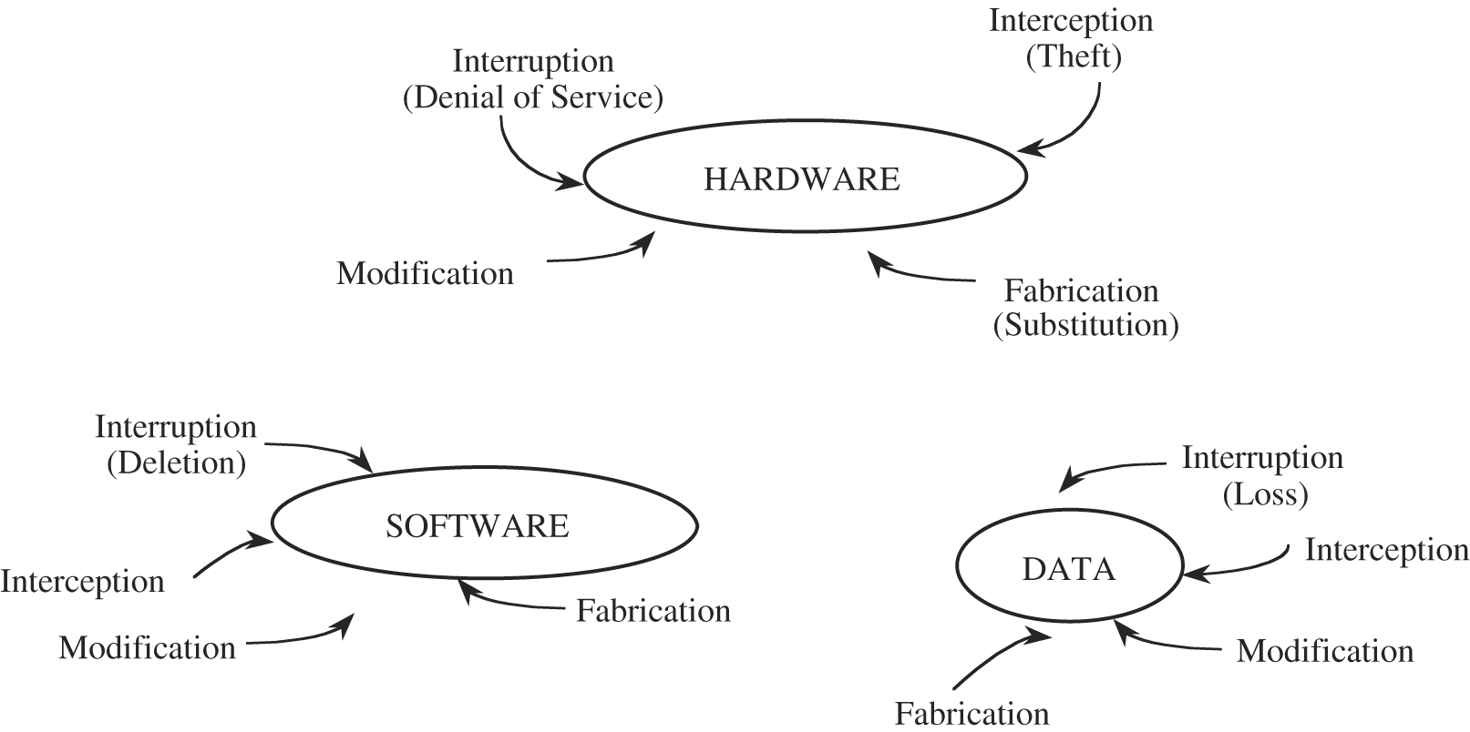
Vulnerabilities of Computing Systems

Slide 24
Vulnerabilities of Computing Systems
Hardware Vulnerabilities
  adding devices, changing them, removing them, intercepting the traffic to them, or flooding them with traffic until they can no longer function. (many other ways to harm the hardware).
Software Vulnerabilities
  Software can be replaced, changed, or destroyed maliciously, or it can be modified, deleted, or misplaced accidentally. Whether intentional or not, these attacks exploit the software's vulnerabilities.

Slide 25
Vulnerabilities of Computing Systems
Data Vulnerabilities
  data have a definite value, even though that value is often difficult to measure.
  Ex1: confidential data leaked to a competitor
    may narrow a competitive edge
  Ex2: flight coordinate data used by an airplane that is guided partly or fully by software
    Can cost human lives if modified

Slide 26
Vulnerabilities of Computing Systems
Principle of Adequate Protection: Computer items must be protected only until they lose their value. They must be protected to a degree consistent with their value.
  This principle says that things with a short life can be protected by security measures that are effective only for that short time. The notion of a small protection window applies primarily to data, but it can in some cases be relevant for software and hardware, too.

Slide 27
Other Exposed Assets
Networks
  Networks are specialized collections of hardware, software, and data.
  Can easily multiply the problems of computer security
    Insecure shared links
    Inability to identify remote users (anonymity)
Key People
  People can be crucial weak points in security. If only one person knows how to use or maintain a particular program, trouble can arise if that person is ill, suffers an accident, or leaves the organization (taking her knowledge with her).

Slide 28
Computer Criminals
Computer crime is any crime involving a computer or aided by the use of one.
One approach to prevention or moderation is to understand who commits these crimes and why.
  Many studies have attempted to determine the characteristics of computer criminals.
  By studying those who have already used computers to commit crimes, we may be able in the future to spot likely criminals and prevent the crimes from occurring.

Slide 29
Computer Criminals
Amateurs
  Ordinary computer users who while doing their jobs discover their ability to access something valuable
  Amateurs have committed most of the computer crimes reported to date.
Crackers or Malicious Hackers
  System crackers, often high school or university students, attempt to access computing facilities for which they have not been authorized.
  Others attack for curiosity, personal gain, or self-satisfaction. And still others enjoy causing chaos, loss, or harm. There is no common profile or motivation for these attackers.

Slide 30
Computer Criminals
Career Criminals
  By contrast, the career computer criminal understands the targets of computer crime.
  There is some evidence that organized crime and international groups are engaging in computer crime. Recently, electronic spies and information brokers have begun to recognize that trading in companies' or individuals' secrets can be lucrative.

Slide 31
Methods of Defense
We can deal with harm in several ways. We can seek to
  prevent it, by blocking the attack or closing the vulnerability
  deter it, by making the attack harder but not impossible
  deflect it, by making another target more attractive (or this one less so)
  detect it, either as it happens or some time after the fact
  recover from its effects

Slide 32
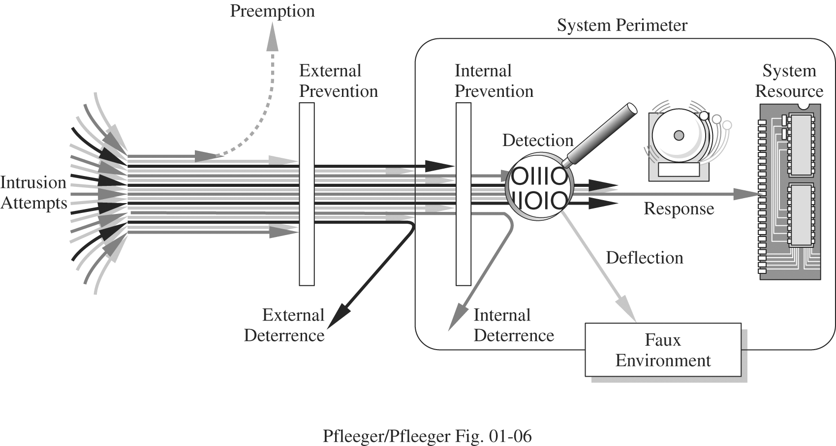
Methods of Defense
The figure illustrates how we use a combination of controls to secure our valuable resources. We use one or more controls, according to what we are protecting, how the cost of protection compares with the risk of loss, and how hard we think intruders will work to get what they want.

Slide 33
Controls Available
Encryption
  the formal name for the scrambling process.
  We take data in their normal, unscrambled state, called cleartext, and transform them so that they are unintelligible to the outside observer; the transformed data are called enciphered text or ciphertext.
  Encryption clearly addresses the need for confidentiality of data.
  Additionally, it can be used to ensure integrity; data that cannot be read generally cannot easily be changed in a meaningful manner.

Slide 34
Controls Available
Encryption does not solve all computer security problems, and other tools must complement its use.
Furthermore, if encryption is not used properly, it may have no effect on security or could even degrade the performance of the entire system.
Weak encryption can actually be worse than no encryption at all, because it gives users an unwarranted sense of protection.
Therefore, we must understand those situations in which encryption is most useful as well as ways to use it effectively.

Slide 35
Controls Available
Software/Program Controls
  Programs must be secure enough to prevent outside attack.
  They must also be developed and maintained so that we can be confident of the programs' dependability.
Program controls include the following:
  internal program controls: parts of the program that enforce security restrictions, such as access limitations in a database management program
  operating system and network system controls: limitations enforced by the operating system or network to protect each user from all other users
  independent control programs: application programs, such as password checkers, intrusion detection utilities, or virus scanners, that protect against certain types of vulnerabilities

Slide 36
Controls Available
  development controls: quality standards under which a program is designed, coded, tested, and maintained to prevent software faults from becoming exploitable vulnerabilities
Software controls frequently affect users directly, such as when the user is interrupted and asked for a password before being given access to a program or data.
  Because they influence the way users interact with a computing system, software controls must be carefully designed. Ease of use and potency are often competing goals in the design of a collection of software controls.

Slide 37
Controls Available
Hardware Controls
  Numerous hardware devices have been created to assist in providing computer security. These devices include a variety of means, such as
    hardware or smart card implementations of encryption
    locks or cables limiting access or deterring theft
    devices to verify users' identities
    firewalls
    intrusion detection systems
    circuit boards that control access to storage media

Slide 38
Controls Available
Policies and Procedures
  Sometimes, we can rely on agreed-on procedures or policies among users rather than enforcing security through hardware or software means. such as frequent changes of passwords
  We must not forget the value of community standards and expectations when we consider how to enforce security.
Physical Controls
  locks on doors, guards at entry points, backup copies of important software and data, and physical site planning that reduces the risk of natural disasters.

Slide 39
Effectiveness of Controls
Awareness of Problem
  People using controls must be convinced of the need for security. That is, people will willingly cooperate with security requirements only if they understand why security is appropriate in a given situation.

Slide 40
Effectiveness of Controls
Likelihood of Use
  Of course, no control is effective unless it is used.
  Principle of Effectiveness:
    Controls must be used and used properly to be effective. They must be efficient, easy to use, and appropriate.
    This principle implies that computer security controls must be efficient enough, in terms of time, memory space, human activity, or other resources used, that using the control does not seriously affect the task being protected. Controls should be selective so that they do not exclude legitimate accesses.

Slide 41
Effectiveness of Controls
Overlapping Controls
  Several different controls may apply to address a single vulnerability.
Periodic Review
  Just when the security specialist finds a way to secure assets against certain kinds of attacks, the opposition doubles its efforts in an attempt to defeat the security mechanisms. Thus, judging the effectiveness of a control is an ongoing task.

Slide 42
Principle of Weakest Link
Security can be no stronger than its weakest link.
  Whether it is the power supply that powers the firewall or the operating system under the security application or the human who plans, implements, and administers controls, a failure of any control can lead to a security failure.

Slide 43
Summary
Computer security attempts to ensure the confidentiality, integrity, and availability of computing systems' components(hardware, software, and data)
This chapter explored the meanings and the types of threats, vulnerabilities, attacks, and controls
Also, four principles affect the direction of work in computer security: the principle of easiest penetration, timeliness (adequate protection), effectiveness, and the weakest link

