Slide 1


TECHNO SCHOOL PROGRAM

Slide 2
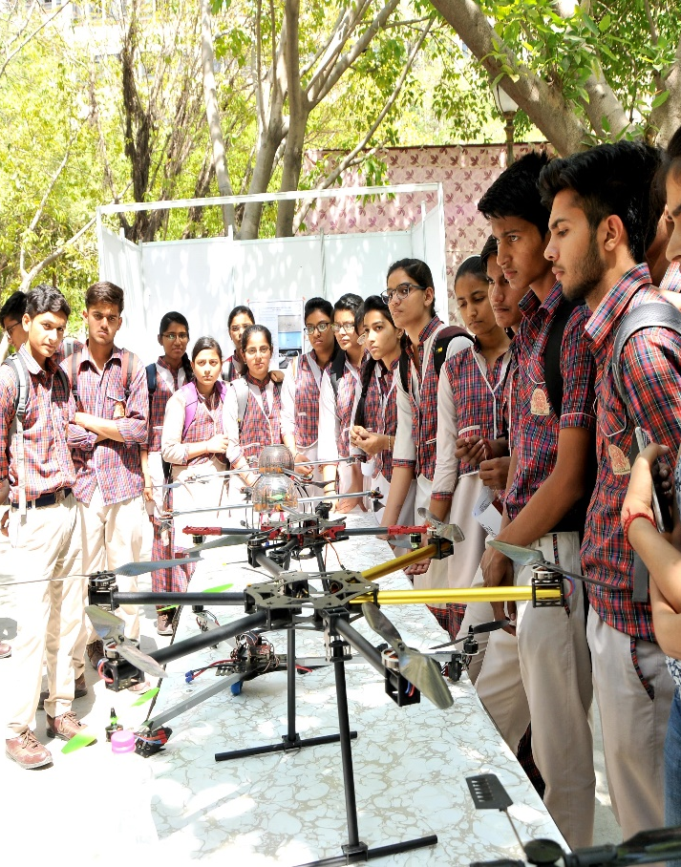
OBJECTIVE
Advitiya2020 is proud to announce the first ever school outreach program “Techno School Program”. This program aims at bringing together the best young minds from all over the country and to expose the students to the technical culture of IIT Ropar.

Slide 3
TECHNO SCHOOL PROGRAM INCLUDES
Advitiya Open Olympiad2020 for school students.
Techwalk (Technical Fest and Campus visit by the students )
Junior Scientist Competition (Inviting innovative projects by students)
Students can also participate in other events like MUN, astroquiz, robotics competitions etc.

Slide 4
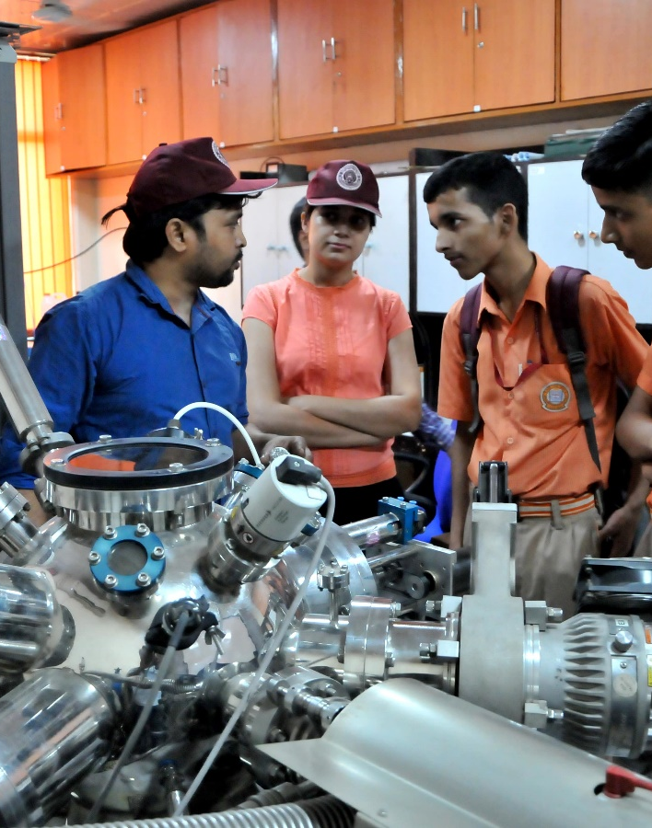
Incentives of TECHNO SCHOOL PROGRAM
Exciting cash prizes and goodies for the winners.
Certificate of appreciation and participation.
Students will be allowed entry in pro night and various talks by professionals.

Slide 5
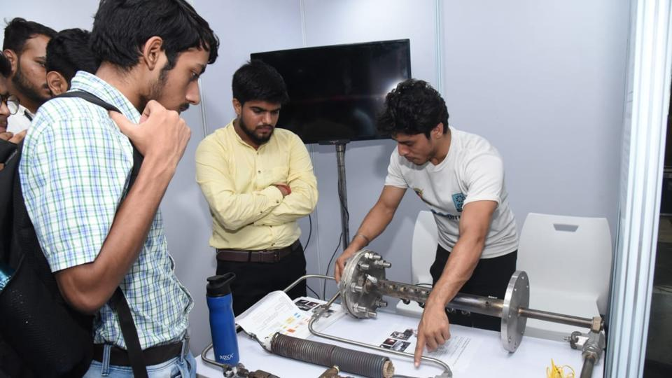
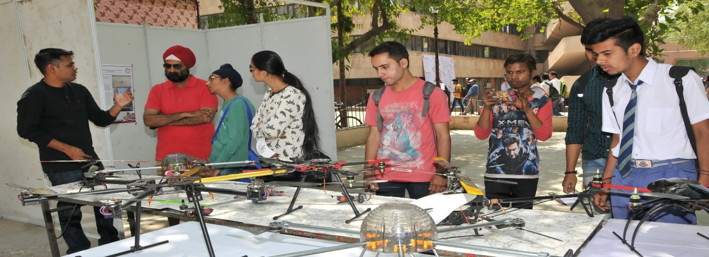
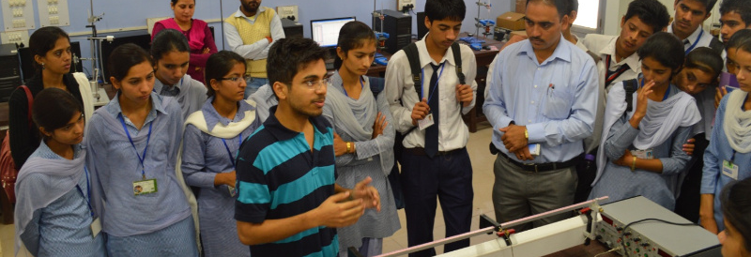
THANK YOU

