Slide 1
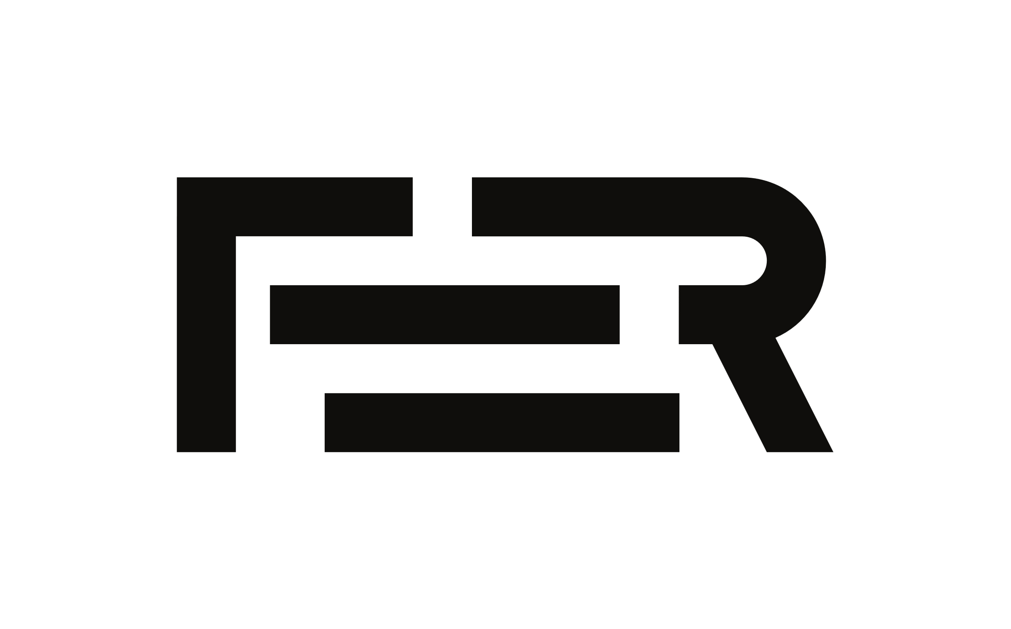

Crisis Guard
Software Engineering, Acad. Year 2024./25.

Slide 2
Contents
Task Description
Requirements Overview
Applied Tools and Technology
Architecture
Work Organisation
Experiences

Slide 3
Team Members
Borna Čović
Documentation, Backend
Boris Miličević
Frontend
Oleg Sergeiev
Backend, Documentation
Niko Škurla
Frontend
Juraj Velimirović, Team Leader
Backend
Pavle Žuljević
Backend – Database Development, Documentation

Slide 4
Task Description
Basic Idea Development of a WebApp for crisis management, providing an all-in-one approach to crisis reporting, tracking, and help
Goal Make crisis solving easier
Purpose Increase public crisis awareness and safety while increasing emergency services more productive and efficient
Similar Software Products Ushahidi, Sahana
Offer complex UI with a steep learning curve
Do not offer Mobile Responsiveness

Slide 5
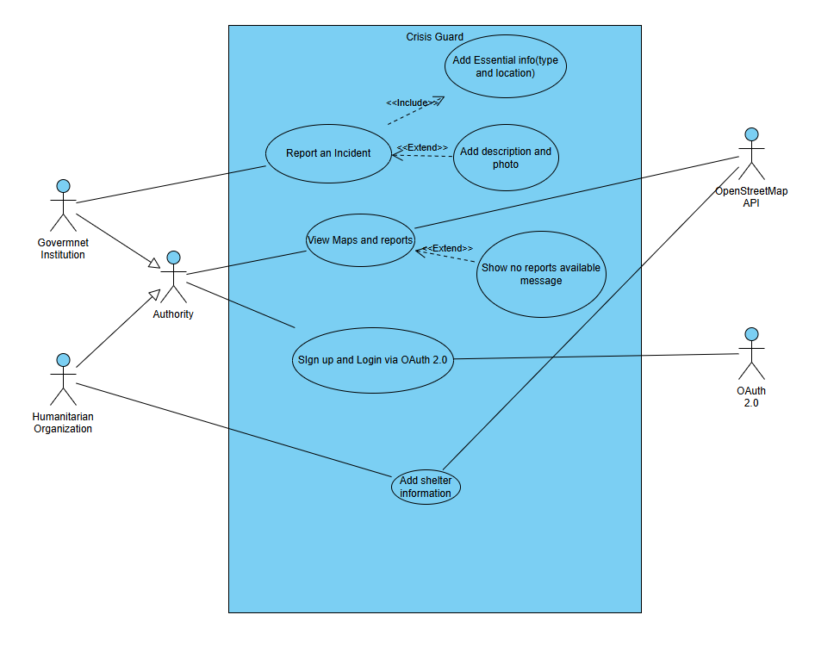
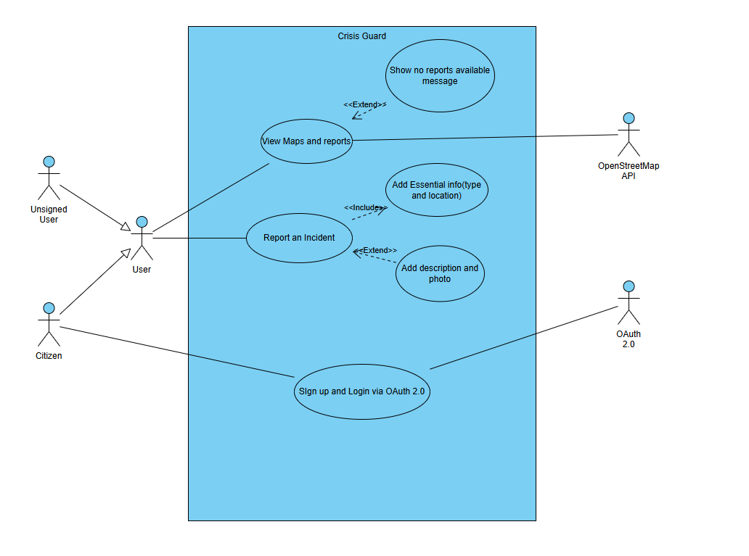
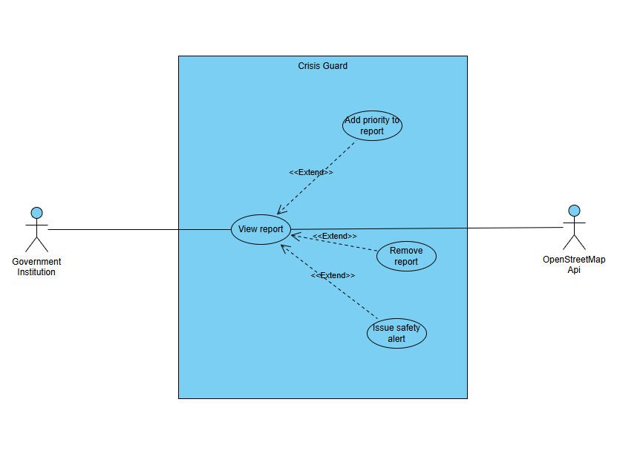
Requirements overview
Overview of main Funct. Requirements

Slide 6
Requirements overview
Non-functional and Domain requests
New reports should appear on the map within a few minutes of submission.
Ensure intuitive navigation for users with no technical expertise.
Use OAuth 2.0 with Google for authentication.
Use OpenStreetMap for map display and Firebase Cloud Messaging for notifications.
The application should work on both mobile devices (phones, tablets) and desktops.

Slide 7
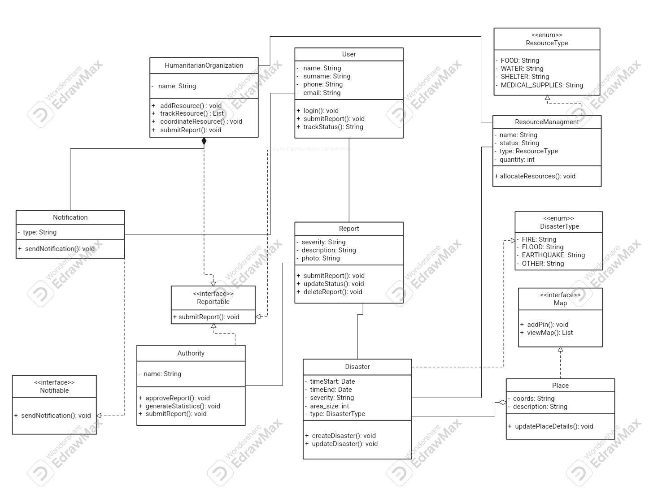
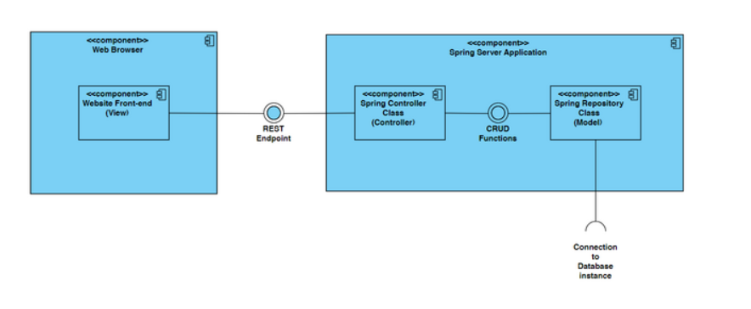
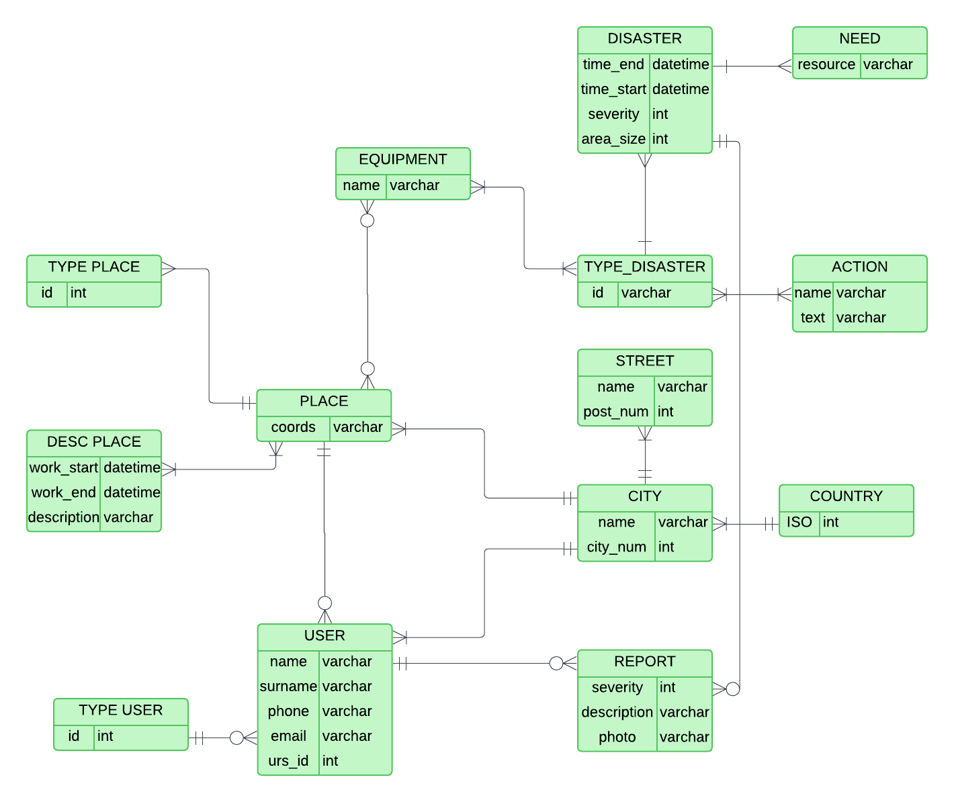
System Architecture

Slide 8
System Testing
Selenium tests
User login test
Report making test
Report viewing test

Slide 9
Applied Tools and Technology
Programming languages and technologies used
Frontend React.js
Backend Spring Boot
Database PostgreSQL
Tools used
AstahUML(diagram making)
Git(management and version control)
WhatsApp, MSTeams(communication)

Slide 10
SDLC model
During the development of our app we used the Waterfall model
The waterfall model is a software development model used in the context of large, complex projects, typically in the field of information technology. It is characterized by a structured, sequential approach to project management and software development
The decision was easy; the requirements were well defined, known and did not change during the development
The process phases were(in order): requirement analysis, system development, implementation, integration and testing
Key advantage of Waterfall model in our case was its compatibility for simpler projects

Slide 11
Work Organisation
Table showing the work division by team member
Name/Surname | Work hours
Borna Čović | 102
Boris Miličević | 118
Oleg Sergeiev | 122
Niko Škurla | 97
Juraj Velimirović | 98
Pavle Žuljević | 91

Slide 12
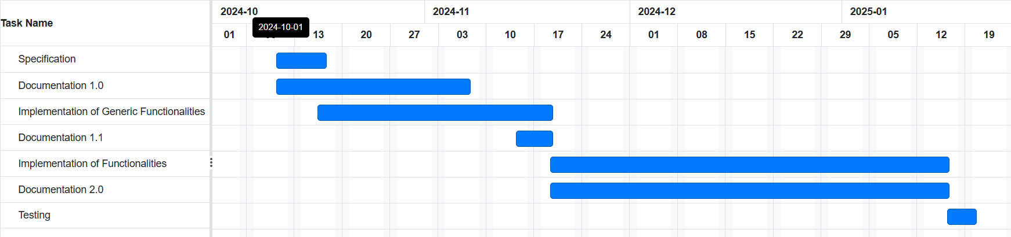
Work Organisation

Slide 13
Experience
Good
Teamwork
Expanding existing and creating new knowledge
Grasping Git and team project management
Needs Improvement
Time management
Concurrency control

