Slide 1
Software Engineering
Project 1
Software Maintenance
Team 14
Aditi Mavalankar (201201049)
Vanshika Srivastava (201201065)
Ramakrishna Vadla (201350850)

Slide 2
Project : Rasterization Polygon
Objective of this experiment is to understand the steps of filling a polygon in a 2D frame buffer. Given the vertices of the polygon, the experiment outputs a filled polygon. Here we have demonstrated the steps of Scan Line Poylgon Fill algorithm.

Slide 3
Milestone 1
• Test Cases for existing lab
The application was tested on the following parameters and a total of about 15 test cases were used.
  Usability
  Responsiveness
  Intuitiveness of the GUI
  Data type verification
  Out of range input values, and others

Slide 4
Milestone 1
• Defects / Issues
A total of about 4 issues were identified
  The application doesn't run in as a stand alone. It gives access control exception, java.io.FilePermission error. Looks to be a applet error.
  The invalid input co-ordinates enter into the "Enter co-ordinates" text box doesn't give the error message but simply ignores it. It should give the proper error message
  When clicked on "Start Experiment with Default Values" it displays the "Enter" button behind "Next iteration" button. The "Enter" button should not be displayed.
  The page doesn't refresh when experiment starts with the Default Values

Slide 5
Milestone 1
• Quality metrics of the existing code base
      Lines of code : 980
      Cyclomatic complexity : 5
      Coupling : Monolithic design
      Cohesion : Low
      Maintainability Index :
      Halstead Complexity Measure Volume: = 593.6
      MI = 171 - 5.2 * ln(V) - 0.23 * (G) - 16.2 * ln(LOC) = 25.114
      Web page loads in moderate time.
      Web page loads in moderate time.
      Web page responds in moderate time. Could not test the experiment loading time due to bugs in the code.

Slide 6
Milestone 2
Identifying
    code smells
    Anti-patterns
    design flaws
      Monolithic design
Java to JavaScript conversion
Integration and Testing
New Quality Metrics

Slide 7
Milestone 2
Code Smells
    Unnecessary comments
    Long Parameter List
    High conditional complexity
    Combinatorial Explosion
    Large Class
    Very uncommunicative names
    Inconsistent names
    Data Clumps
    Inappropriate Intimacy
    Middle man

Slide 8
Milestone 2
Anti-Patterns
  The Blob
    Single controller class
  Lava Flow
    Large commented-out code with no explanations
    Lot’s of TODOs
  Golden Hammer

Slide 9
Static Code analysis and metrics
Re-written entire code using Java script and HTML5
Can be executed off-line.
Used Builder Pattern while refactoring
Quantitative Measures
Metrics | Ideal and Suggested Value | Javascript Value
Cyclomatic Complexity | 01-05 | 03 (Average) 06(Max)
Lengthy Methods | 15-20 | 16(Average) 31(Max)
Number of Parameter | 05-10 | 0-4
LOC |  | 250

Slide 10
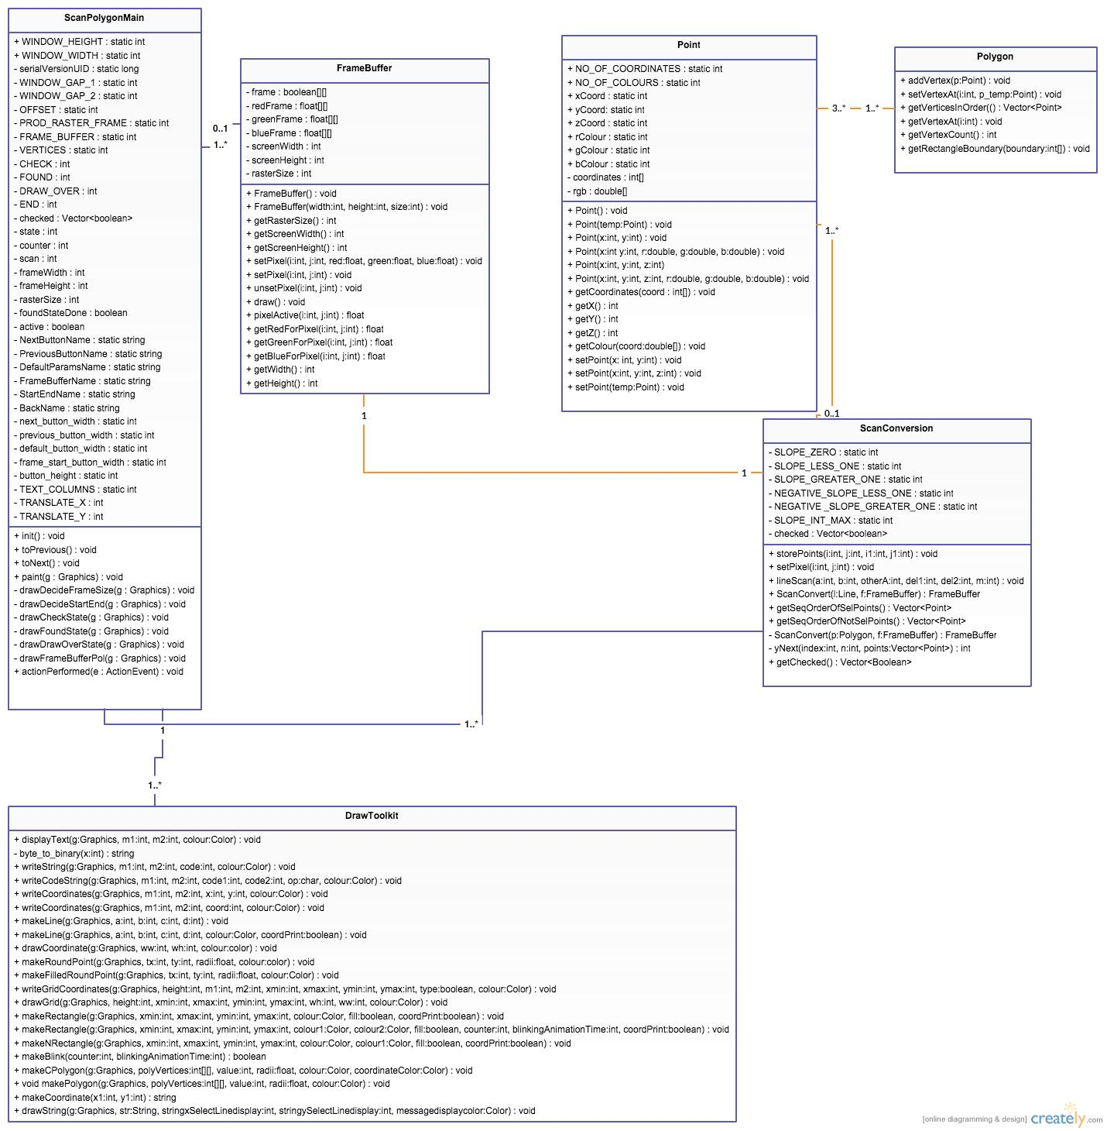
UML Class Diagram for Java Code

Slide 11
Thank You

