Slide 1
Software Engineering Project 1
MIPS Assembly Language Programming - 1
Team-19
Pulkit Agarwal (201201188) and Aman Arora (201201162)

Slide 2
Introduction
Given: MIPS Simulator, written in Java. It is an experiment under the lab Computer System Organization.
MIPS stands for Microprocessor without Interlocked Pipeline Stages.
It is a reduced instruction set computer (RISC) instruction set architecture (ISA) developed by MIPS Technologies (formerly MIPS Computer Systems, Inc.).
Aim : Reengineer the code base, to rewrite the simulator based on JavaScript.

Slide 3
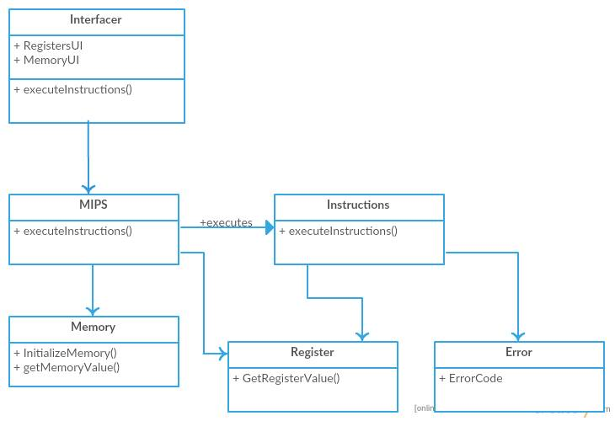
Original code’s Class Diagram

Slide 4
Code Smells in the original code
MIPSProgram.java 1. BLOB - 25 member functions. 2. Dead Code/ Unnecessary Comments 3. Large class
Memory.java 1. Dead Code 2. Lack of proper indentation. 3. Lack of error handling. 4. Indecent Exposure (all data members are public)

Slide 5
Code Smells in the original code
Error.java 1. Lack of proper indentation 2. Lack of comments 3. Indecent Exposure (all data members are public)
Register.java 1. Conditional Complexity 2. Lack of proper indentation and presence of dead code 3. Hard coding the address values.

Slide 6
Code smells in the original code
Instruction.java 1. Code Duplication 2. Conditional complexity 3. Indecent Exposure
MyLibrary.java 1. Functional Class 2. Indecent Exposure
Lack of proper documentation

Slide 7
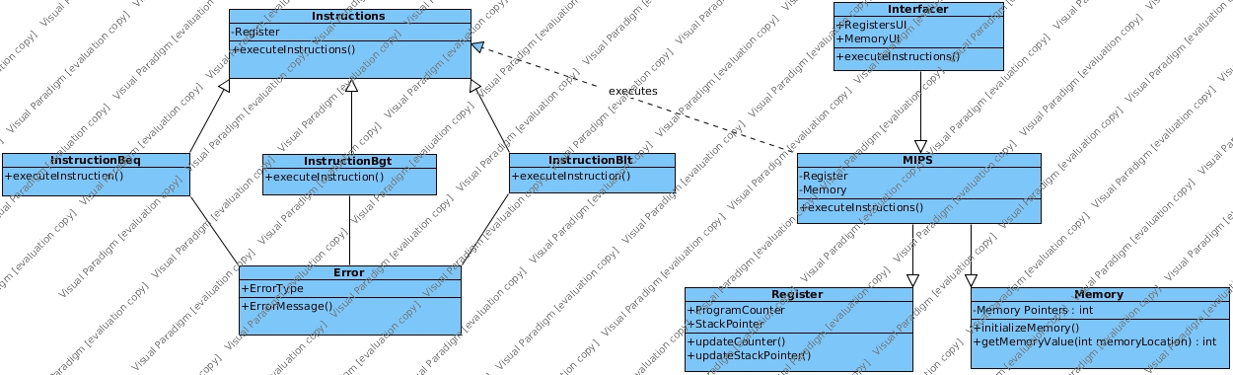
Proposed System’s Class Diagram

