Slide 1
Notes:
⚠️ [AUTOMATIC TRANSITION – DO NOT CLICK] ⚠️

Slide 2


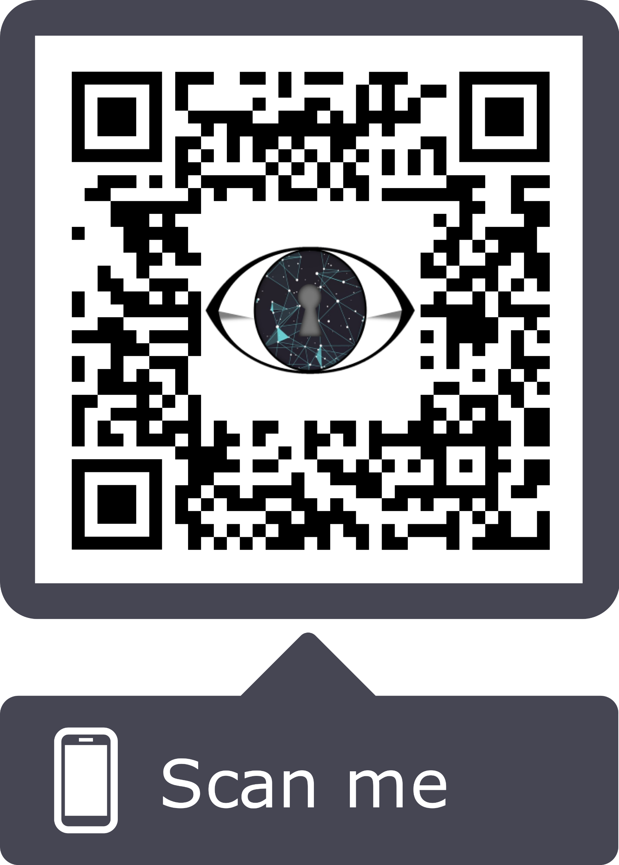
Demo 2 Roadmap
Web App Login
Access the web application:
https://smart-lock-demo.netlify.com/
Notes:
⚠️ [AUTOMATIC TRANSITION – DO NOT CLICK] ⚠️

Slide 3
Demo 2 Roadmap
Temporary Visitor Authentication
View temporary authentication information.
Copy & Delete temporary authentication URLs
Add & remove temporary Visitors
QR code unlock
Notes:
⚠️ [AUTOMATIC TRANSITION – DO NOT CLICK] ⚠️

Slide 4
Demo 2 Roadmap
Live Video Feed & Facial Recognition
View live footage from camera
Residents Interface
Facial Recognition
Notes:
⚠️ [AUTOMATIC TRANSITION – DO NOT CLICK] ⚠️

Slide 5
Demo 2 Roadmap
Statistics, Events, & Stranger Reporting
Visually see usage statistics
View event log
Use heatmap of stranger reports in the area
Notes:
⚠️ [AUTOMATIC TRANSITION – DO NOT CLICK] ⚠️

Slide 6
Demo 2 Roadmap
Conclusion & Questions
Our goal
Technical Challenges
Software Engineering Techniques
Notes:
⚠️ [AUTOMATIC TRANSITION – DO NOT CLICK] ⚠️

