Slide 1
Innovation & Design
Creative Thinking
Design
Architecture

Slide 2
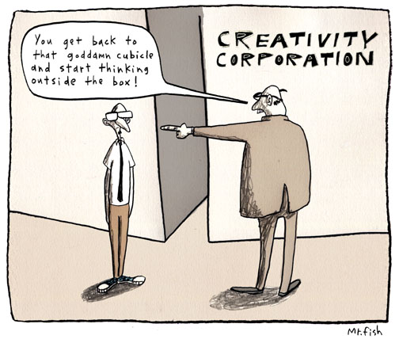
Creativity is looking at the same thing as everyone else and thinking something different (A. Szent-Gyorgyi)

Slide 3
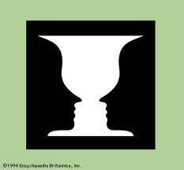
What do you see?

Slide 4
Circle the figure that is different from all the others. Explain the reason for your choice.
a. @b. c.
d. e. ∆f.
Adapted from: Creative problem solving and Engineering Design, Lumsdaine et al 1999
Notes:
We are trained to one right answer.
Each of these has unique properties,
Each also has commonalities

Slide 5
How many squares do you see?
Adapted from: Creative problem solving and Engineering Design, Lumsdaine et al 1999

Slide 6
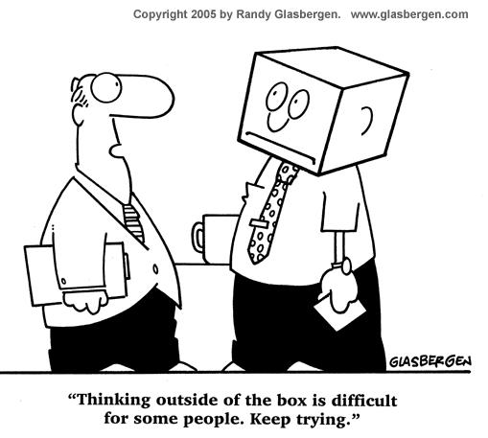
How creative are you?

Slide 7
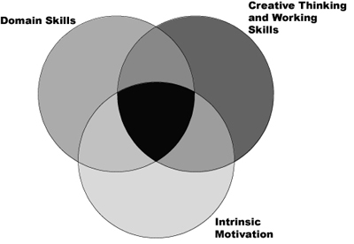
Creativity
Amabile HBR 1998
Notes:
Intrinsic motivation – ability
Domain skills
Creative Thinking and Working Skills
- These last 2 show you cannot do in isolation just based on ability

Slide 8
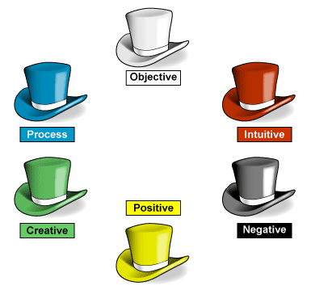
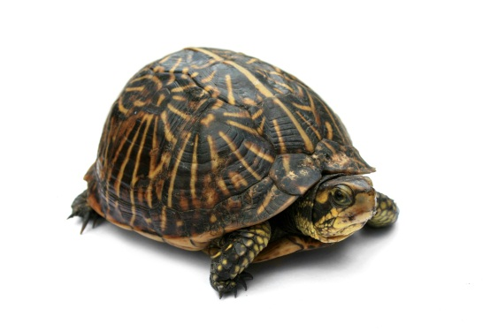
Creative Thinking
Becoming more creative
Removing habit barriers
  There is only one right answer
  Looking at a problem in isolation
  Following the rules
Remove attitude barriers
  Discomfort with ambiguity
  Negative pessimistic thinking
  Risk-avoidance or fear of failure
Adapted from: Creative problem solving and Engineering Design, Lumsdaine et al 1999
Notes:
“lateral thinking”

Slide 9
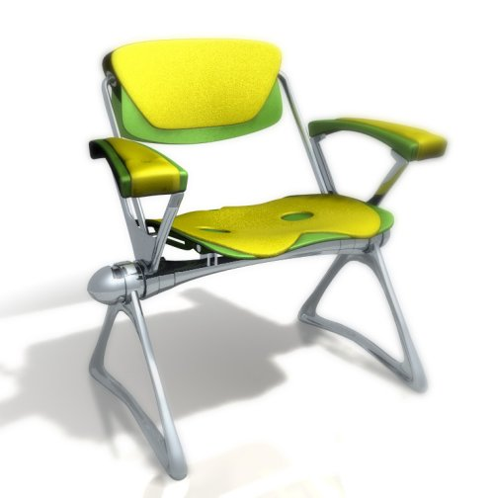
What is Design?
“1) to create, fashion, execute, or construct according to plan; 2) to conceive and plan out in the mind” – Webster’s
“Good design keeps the user happy, the manufacturer in the black and the aesthete un-offended” – Raymond Loewy
“The Wright brothers' design allowed them to survive long enough to learn how to fly” – Michael Potts, Beech Aircraft
“When you're a carpenter making a beautiful chest of drawers, you're not going to use a piece of plywood on the back, even though it faces the wall and nobody will ever see it. You'll know it's there, so you're going to use a beautiful piece of wood on the back. “
Notes:
I like the emphasis on planning in Webster’s definition. Design is about planning/organizing/strategizing to construct something.
Raymond Loewy was an American industrial designer. Much about balance, right blend of function/features, cost concerns, and elegance. Covers everyone on the projects – users, customer, and the casual observer and/or developer (aesthetics).
Wright brothers – good enough for the current situation. It met its needs given available resources. But, we won’t use it to fly cross country!
The plan word is the lead-in to architecture. Where do we get the plan? There is an underlying art, science, and/or practice that provides the guidance. The “plan”

Slide 10
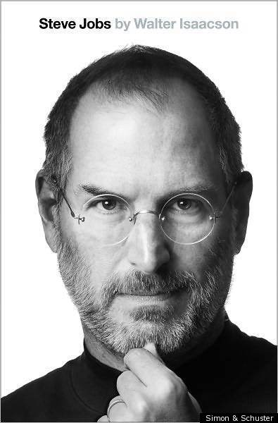


Slide 11
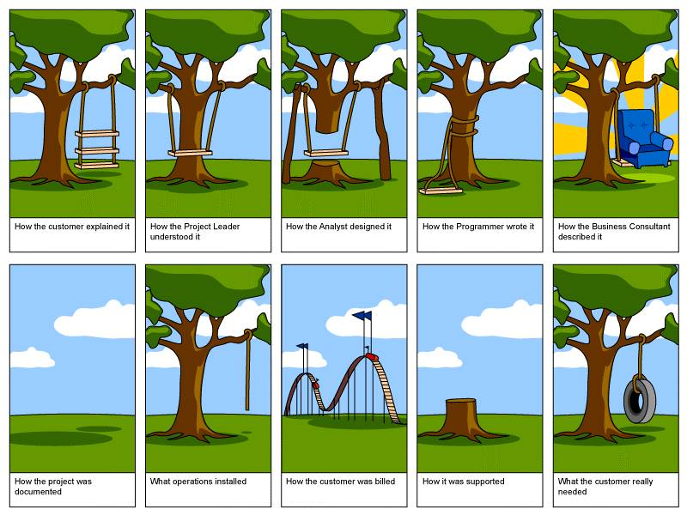
Software Design
Notes:
Stakeholders don’t know what they really want
Stakeholders express requirements in their own terms
Different stakeholders may have conflicting requirements
Organisational and political factors may influence the system requirements
The requirements change during the analysis process. New stakeholders may emerge and the business environment change

Slide 12
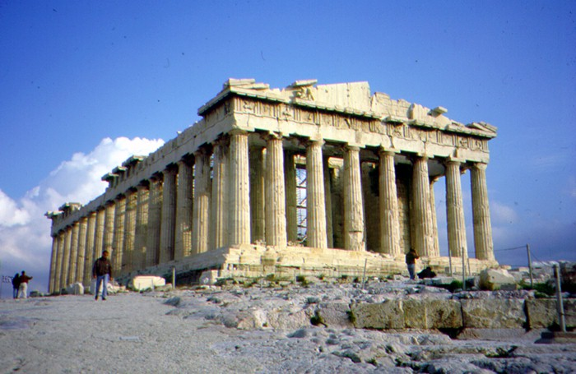
What is Architecture?
“1) the art or science of building; 2) formation or construction as or as if as the result of conscious act, a unifying or coherent form or structure” – Webster’s
“Architecture is the imaginative blend of art and science in the design of environments for people. Decision-making, team leadership, and creativity are key elements of making architecture” – akropolis.com

Slide 13
Design & Architecture
Architecture guides design, which guides implementation
  Limits the scope of decisions at various levels
  Architecture change have a larger impact on the rest of the system
Architecture
Design
Implementation

Slide 14
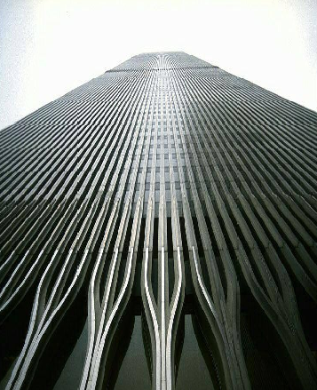
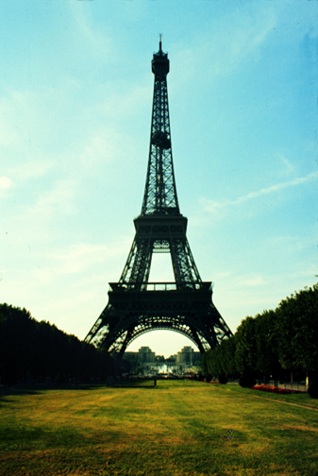
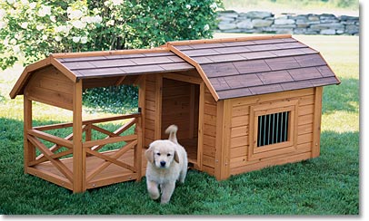
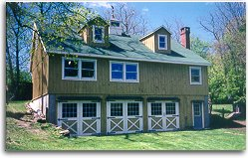
How much Design& Architecture?
Influenced by project size, complexity, team, etc.
Decisions drive:
  Amount of process and planning
  Types of tools
  Need and use of modeling

Slide 15

Design Exercise
  List three items from your everyday life that you consider to be a good design. Briefly describe the qualities that make that design appealing.
  1.
  2.
  3.

Slide 16
Follow-up
Do any of the 3 things you listed demonstrate a good architecture?
  If yes, why? how?
  If no, think of another example that does, and why does it (and how is that different than your design examples?)

Slide 17
