Slide 1
Software Design Overview

Slide 2




How this class is organized
Your satisfied
end users
The integration,
Or what delivers value
Applications
The “backend”
Software Design
UIDesign
The “frontend”
Software Complexity
Complicating
Factor
Engineering Design Processes
Foundational, Broadening

Slide 3
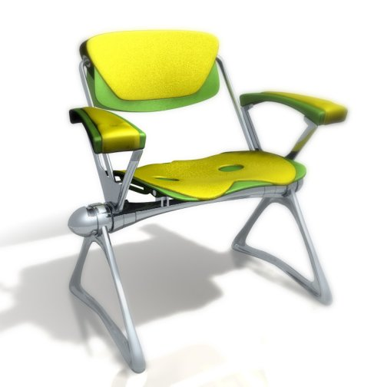
What is Design?
“1) to create, fashion, execute, or construct according to plan; 2) to conceive and plan out in the mind” – Webster’s
“Good design keeps the user happy, the manufacturer in the black and the aesthete un-offended” – Raymond Loewy
“The Wright brothers' design allowed them to survive long enough to learn how to fly” – Michael Potts, Beech Aircraft
“When you're a carpenter making a beautiful chest of drawers, you're not going to use a piece of plywood on the back, even though it faces the wall and nobody will ever see it. You'll know it's there, so you're going to use a beautiful piece of wood on the back. “
Notes:
I like the emphasis on planning in Webster’s definition. Design is about planning/organizing/strategizing to construct something.
Raymond Loewy was an American industrial designer. Much about balance, right blend of function/features, cost concerns, and elegance. Covers everyone on the projects – users, customer, and the casual observer and/or developer (aesthetics).
Wright brothers – good enough for the current situation. It met its needs given available resources. But, we won’t use it to fly cross country!
The plan word is the lead-in to architecture. Where do we get the plan? There is an underlying art, science, and/or practice that provides the guidance. The “plan”

Slide 4

UI Design
We will attack this in 2 parts:
Interaction design
  How does a human interact with your system?
User Interface Principles
  How is information presented to the user?
  How does the UI support the Interaction Design?

Slide 5
What is Software Design?
“The phase of the system development process whose primary purpose is to decide how the system will be implemented” – UML*
“The process of defining the architecture, components, interfaces, and other characteristics of a system or component” – ANSI/IEEE Std 610.12-1990
Notes:
Mode change, let’s now discuss software design and architecture.

Slide 6
Application Design
Pyramid isn’t intuitively correct
  Application design is usually more closely related to Interaction/UI Design
  Software Design is considered the magic behind the curtain
But…
  Software Design addresses many of the classic “-ilities” of software engineering
    Reliability, Maintainability, Adaptability
  A design process resulting in an architecture enables reusability, or the ability to create once and support families of (un)related applications

