Slide 1
Software Process
Process Phases
Process Lifecycle Models

Slide 2
Outline
Software Process Phases
Software Lifecycle Models
  Build-and-Fix
  Waterfall model
  Evolutionary development
  Iterative and Incremental
  Spiral model
  RUP
  Agile/XP
Summary of Pros/Cons of each model

Slide 3
Software Process Flow (10K ft)
Requirements:
Business
Vision /
Roadmap
Requirements
Document
Informal
Requirements
Requirements
Elicitation and
Analysis
Requirements
Analysis
Feasibility/Cost
Analysis
SOW(s)
Customers
Business
Stakeholders
Requirements
Analysts
QA

Slide 4
Software Process Flow (10K ft)
Analysis Modeling, Architecture, and Design:
Analysis Models
Requirements
Document
Architecture
Descriptions
Requirements
Analysis
Analysis Modeling
Architecture &
Design
Design
Documents
Legacy
Constraints
QA
Software
Designers
Prototype(s)

Slide 5
Software Process Flow (10K ft)
Implementation Phase:
Requirements
Document
Code
Design
Documents
Implementation
Code Review
Completions
Architecture
Specification
Unit Test
Cases
Code Review
Templates
QA
Software
Developers
User Guides
Unit Test
Processes

Slide 6
Software Process Flow (10K ft)
Testing Phase:
Test Plans
Requirements
Documents
Test Scripts
Design
Documents
Testing
Test Results
Code
QA
Software
Developers
Higher Quality
Software

Slide 7
Deployment
Requirements
Documents
Deployment
Plans
Architecture
Specification
Deployment
Operational
Software
Test Scripts
(Smoke, Perf)
QA
Architect
Application
Support
Operations
Account
Manager
Call
Center
Training
Website /
KB / FAQ

Slide 8
Maintenance and Evolution
Maintenance and Evolution are discussed synonymously, but they really aren’t
  Maintenance: The ability to support the correct functioning of the current release in the face of incremental changes in requirements
  Evolution: The ability to incorporate significant changes in product direction in the current architecture
Software Patches
Defect Queue
Maintenance
Enhancement Reqs
Incremental
Release
Product Roadmap
Evolution
New Major Release
Sales Input

Slide 9
Software Process Phases
How are the phases connected?
  Now that we have studied each phase, what transitions exist between each phase?
  What data is needed by each phase?
  What data is produced by each phase?
  Who are the players (the actors) involved in each phase?
Given what we have covered in each phase, what is the lifecycle model that captures software process?
Input Product
Phase
Activity
Output Product
Actor

Slide 10
Generic software process models
Build-and-Fix
  The “defacto” process
Waterfall model
  Distinct phases of specification, development & test
Evolutionary development
  Specification and development are interleaved
Iterative and Incremental
  Iterate over phases, build the system incrementally
Spiral model
  Risk management as a key phase in the process
RUP
  Use-case driven, architecture-centric
Agile/XP
  Embrace change; empower people; code!

Slide 11
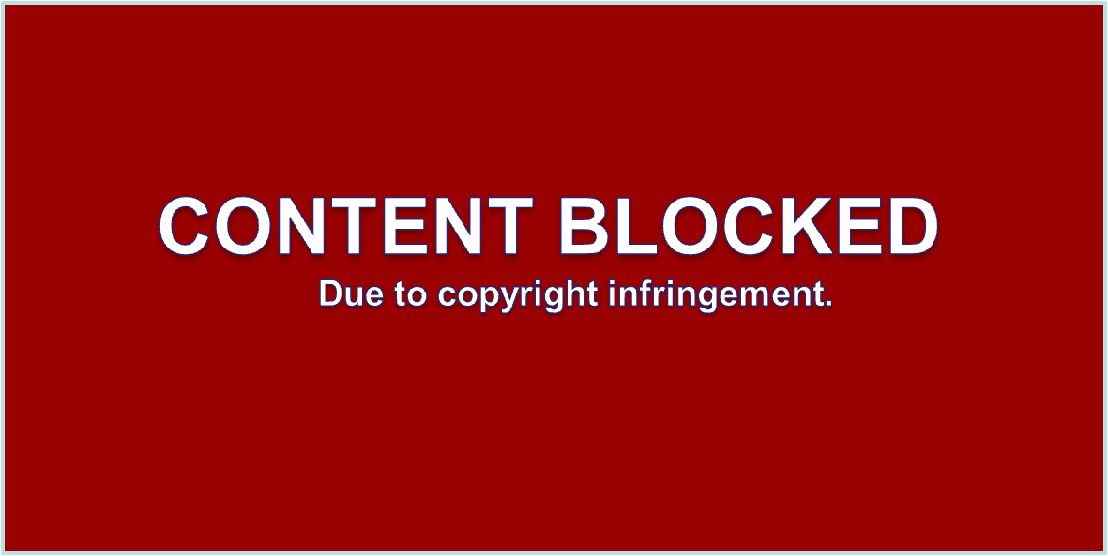
Build-and-Fix
Build first
version
Modify until
client is satisfied
Operations mode
Development
Retirement
Maintenance

Slide 12
Build and Fix: Pros and Cons
Pros:
  No process overhead; programmers program!
Cons:
  CHAOS!
  Requirements may change; even when they don’t how do we track progress against them?
  No Quality Management
  No design documentation; No sustainable architecture
  Communication problems abound!
  Budget overruns; product doesn’t meet expectations; poor quality → project (organizational?) failure!
When to use:
  When you have no other choice!

Slide 13
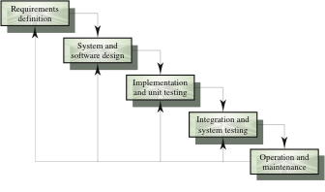
Waterfall model
Developed in the mid 1970s

Slide 14
Waterfall model pros and cons
Pros:
  Each process phase well-defined
  Inputs and Outputs of each phase defined
Cons:
  Inflexible partitioning of the project into distinct stages
  Difficult to respond to changing customer requirements
  Difficult to accommodate change of any kind
  Document-centric
When to use:
  This model is only appropriate when the requirements are well-understood and truly “frozen”

Slide 15
Waterfall: What Happens in Practice
Sequential activities:
Requirements Design Code Integration Test
100%
Integration
Begins
Late Design
Breakage
Development Progress
(% coded)
Original
Target Date
Project Schedule
Courtesy IBM Academic Initiative

Slide 16
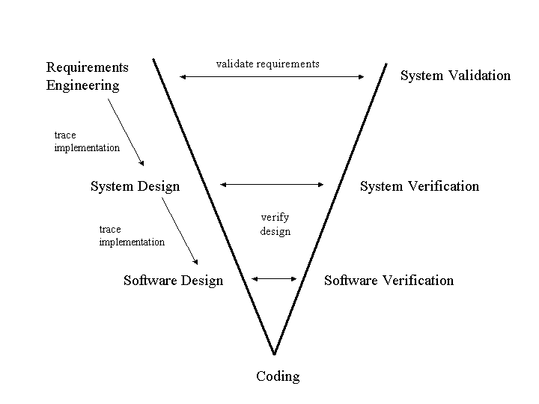
V-Model
An extension of the waterfall model with roots in the System Engineering process
Note:
Down left side is a “waterfall”
Right-side has parallel validation activities
Recommended practice now is to “chain” or “cycle” many V-models

Slide 17
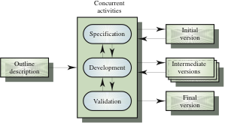
Evolutionary development
Objective is to work with customers and to evolve a final system from an initial outline specification. Should start with well-understood (but perhaps vague) requirements

Slide 18
Evolutionary: Pros and Cons
Pros:
  Work is not delayed by “thrashing” in requirements
  All roles engaged
Cons:
  Lack of process visibility
  Systems are often poorly structured
  Special skills (e.g. in languages for rapid prototyping) may be required
When to use:
  For small or medium-size interactive systems
  For parts of large systems (e.g. the user interface)
  For short-lifetime systems (research projects)

Slide 19
Process iteration
Assumption:
  Requirements ALWAYS evolve in the course of a project so process iteration where earlier stages are reworked is always part of the process for large systems
Iterative process models are considered the current “best practice” for software methodologies
Approaches that incorporate iteration
  Iterative and Incremental
  Synchronize and Stabilize
  Spiral development
  RUP
  XP

Slide 20
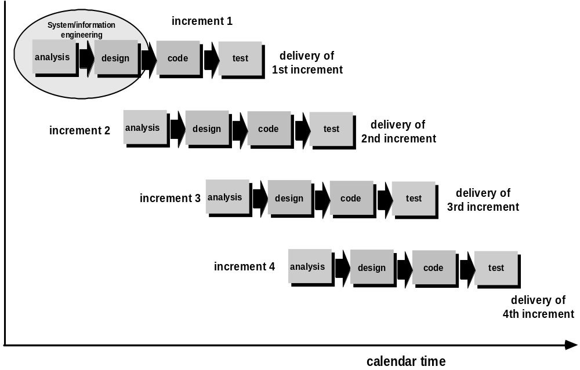
The Iterative & Incremental Model

Slide 21
Iterative & Incremental development
Delivery of the system is broken down into increments
  Not a single delivery
  Each increment delivers part of the required functionality
  Each increment may (in theory) use its own process model
User requirements are prioritized
  Highest priority requirements done in the 1st increments
  The rub: Users’ priorities may class with architect’s
Once the development of an increment is started, the requirements are frozen in that iteration
  Requirements for later increments can continue to evolve
  However, in practice I find significant scoping work is done in order to allow bidders to control risk

Slide 22
Iterative & Incremental: Pros & Cons
Pros:
  Project broken into smaller, more manageable pieces
    Easier to clarify requirements
    Small teams may be used to address each increment
Cons:
  Poor system architecture
    “narrow” prioritizing by customer
    Each increment evolves independently
  Localizing requirements creep to a particular increment
  “Big-bang” integration
    What happens when the increments don’t line up?
When to use:
  When top-level requirements are properly partitioned
  When a lot of outsourcing/COTS is used

Slide 23
Synchronize and Stabilize
Synch
Specifications
Design
Implementation,
Integration
Stabilize
Master List
of
Requirements
Specifications
Design
Implementation,
Integration
Freeze and Fix
Specifications
Design
Implementation,
Integration
Specifications
Design
Implementation,
Integration
Specification team
Design team
Implementation/integration team
Notes:
Synchronization is very frequent - nightly builds - to mitigate feature creep and “big-bang” integration

Slide 24
Synchronize & Stabilize: Pros and Cons
Pros:
  Customer value can be delivered with each increment so system functionality is available earlier
  Early increments act as a prototype to help elicit requirements for later increments
  Smaller teams can still be applied to each increment
  The Key: communication flows to other increments!
Cons:
  Requirements creep in earlier increments
  More complex to manage
    “Ivory Tower” mentality
  Architectural complexity
When to use:
  Medium-Large scale projects

Slide 25
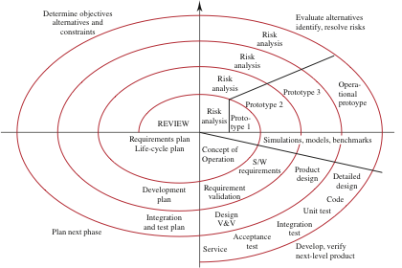
Spiral model of the software process
Notes:
Determine Objectives
Specific objectives for the phase are identified
Evaluate Alternatives
Risks are assessed and activities put in place to reduce the key risks
Development and Verification
A development model for the system is chosen which can be any of the generic models
Planning
The project is reviewed and the next phase of the spiral is planned
Process is represented as a spiral rather than as a sequence of activities with backtracking
Each loop in the spiral represents a phase in the process.
No fixed phases such as specification or design - loops in the spiral are chosen depending on what is required
Risks are assessed & resolved throughout the process
A “meta-model” – Each “spiral” managed as its own project, risks are constantly identified and addressed
WINWIN variant
Adds negotiation activities to the spiral model
Customers & engineers negotiate mutual win conditions
Activities introduced at the beginning of each cycle
Stakeholders identified
Identify win conditions on each side
Iterate over win conditions as part of negotiation

Slide 26
Spiral Model: Pros and Cons
Pros:
  Each iteration should bring you closer to a finished product
    “Convergence”
  Risks are quickly identified and addressed
  Provides a distinct communication point between engineers and managers
  Free to use any specific model in each “cycle”
Cons:
  If you “diverge”, you are “spiraling out of control”!
When to use:
  On large projects

Slide 27
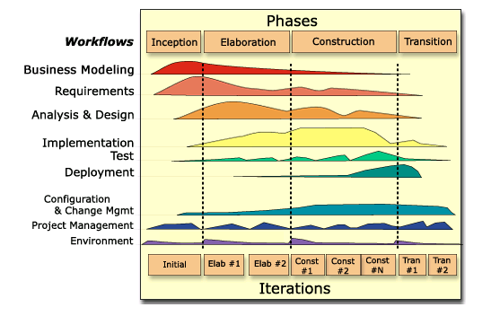
Rational Unified Process (RUP)
Notes:
Can iterations overlap?
No. Our model is to show no overlap among iterations. In a large project, several teams may work in parallel on their portions of the iteration, but we do not consider these to be separate iterations.
How many iterations should you have?
It depends on many factors. Err on the side of too many iterations.
Animation note: The callouts and black rectangle appear 2 seconds after the slide.
This graphic illustrates how phases and iterations (the time dimension) relate to the development activities (the workflow dimension). The relative size of the color area indicates how much of the activity is performed in each phase/iteration.
Each iteration involves activities from all workflows. The relative amount of work related to the workflows changes between iterations. For instance, during late Construction, the main work is related to Implementation and Test and very little work on Requirements is done.
Note that requirements are not necessarily complete by the end of Elaboration. It is acceptable to delay the analysis and design of well-understood portions of the system until Construction because they are low in risk.
RUP Core Workflows
An Iterative Approach
Guidance for activities and work products (artifacts)
Process focus on architecture
Use cases which drive design and implementation
Models which abstract the system

Slide 28
RUP: Pros and Cons
Pros:
  Popular language (UML) and process model
    Good tool support
  Core workflow definitions and incorporation of BP
  Explicit recognition of deployment activities
  Architecture-centric / Component-based
Cons
  Some “gaps” or disconnects in the model
  Pitched as a “all-or-nothing” process commercially
    IBM now owns Rational – is this a good or bad thing?
  Tries to be “all things to all people”
When to use?
  Suggested for medium to large scale projects

Slide 29
Agile Methods and XP
Agile methods:
From “The Agile Manifesto” (Fowler and Highsmith, Software Development Online, 8/01):
“The agile methodology movement is not anti-methodology; in fact, many of us want to restore credibility to the word. We also want to restore a balance: We embrace modeling, but not merely to file some diagram in a dusty corporate repository. We embrace documentation, but not to waste reams of paper in never-maintained and rarely-used tomes. We plan, but recognize the limits of planning in a turbulent environment…”
AND:
“We value:
    Individuals and interactions over processes and tools.
    Working software over comprehensive documentation.
    Customer collaboration over contract negotiation.
    Responding to change over following a plan.”
Agile methods refer to a collection of processes that incorporate these principles. Examples include SCRUM and XP

Slide 30
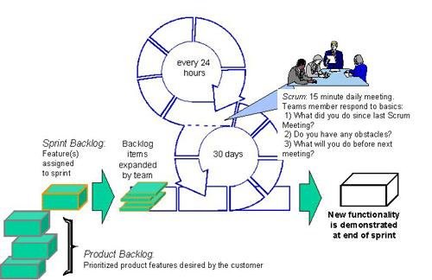
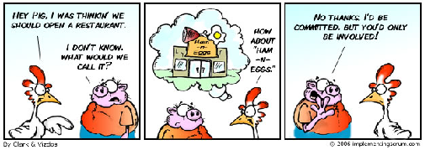
Scrum
Uses an Empirical Process control model instead of a Defined Process control model.
Who’s Who: Scrum Master and Product Owner
What’s What: Product Backlog and Sprint Backlog
Why?: The Sprint Goal
When?: Daily Scrum, Sprint Planning, Sprint Review
Where?: Teams work together
And finally, How?:
  Sprint teams are totally empowered
  to do whatever they deem necessary
  to achieve the Sprint Goal

Slide 31
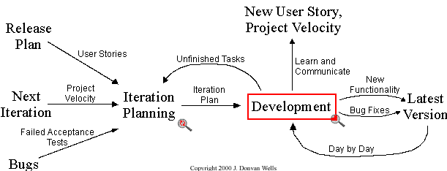
Agile Methods and XP
eXtreme Programming
  The most popular of the Agile methodologies
  Four core principles:
    Communication: always and constantly!
    Simplicity: do it simple now, don’t do an unused complicated thing
    Feedback: get it from customer & team as often as possible
    Courage: Move fast and with confidence in doing the right thing

Slide 32
Agile Methods and XP
Pros:
  Let’s coders code!
  People-centric: Is this a benefit?
  Strong emphasis on current Best Practices
  Embraces change
Cons:
  Relies on highly-skilled and experienced developers
    Detractors say successful XP projects were successful because of the talent level of the people, not for the process
  A frustrating model to communicate to stakeholders
    Business stakeholders want cost & schedule promises
When to use?
  On fast and light projects that must react to change
  When you have an experienced development team

Slide 33
A Comparison of Life Cycle Models
Model | Strengths | Weaknesses
Build-and-Fix | Fine for small programs that do not require much maintenance | Totally unsatisfactorily for nontrivial programs
Waterfall | Disciplined approach Document driven | Delivered product may not meet client’s needs
Incremental | Manageable increments User sees end functionality sooner | Architecture mismatch Lack of communication
Synchronize & Stabilize | Requirements change is manageable Ensures components can be successfully integrated | Complex to manage Complex to architect
Spiral | Incorporates features of all the above models Global view always revisited | Can be used only for large-scale products Engineers have to be competent at risk-analysis
RUP | Incorporates current process thinking Strong tool support Recognizes deployment | Commercially-driven All things to all people
Agile/XP | Light process that “stays out of the way” Recognize and embrace change | Scalability is a question Relies on experienced developers

