Slide 1
Software Project Tracking
Project Tracking
Earned Value Analysis
Agile Thoughts
Tips and Tricks

Slide 2
Project Tracking
Tracking follows your approach to defining tasks
  Bottom-up:
    Get data points on the tasks in your work list
    Evaluate whether you are “slipping” or not
      Use threshold criteria to trigger a risk mitigation/contingency plan!
      WATCH THAT CRITICAL PATH!!! (stay tuned…)
  Top-down:
    Using project-as-a-whole level measures
Project cost control includes (Course Technology, 1999)
  Monitoring cost performance
  Ensuring only appropriate project changes are included in a revised cost baseline
  Informing project stakeholders of authorized changes to the project that will affect costs (Change Requests)

Slide 3
Project Tracking
Why is project tracking hard on software projects?
  Things (requirements, resources, costs) keep changing
  Resource turnover/competition/mismatch
  You can’t see it (or if you can it may be misleading)
Just because you are getting the tasks done doesn’t always mean you are gaining on the software!
What do you track?
  Requirements met/Work completed
  Time
  Costs
  Quality
  Customer happiness ☺
Time
Quality
Expectations
Cost
Scope

Slide 4
Tracking Using EVA
Earned Value Analysis is an important tracking tool
  EVA is a project performance measurement technique that integrates scope, time, and cost data
    Popular since DoD started requesting in the early 90s.
    Does not measure customer sat. or quality.
  Given a baseline (original plan plus approved changes), determine how well the project is meeting its goals
    Meeting its goals within costs, and by what productivity.
  Enter tracking information periodically/often to use EVA.
  Figure in next slide shows example EVA tracking chart
    You need to learn how to read such a chart!
Adapted from Course Technology, 1999

Slide 5
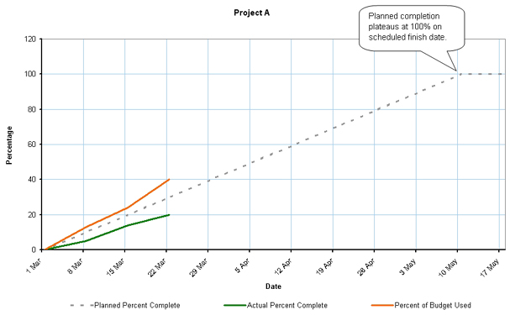
Example EVA Tracking Chart
BCWS
ACWP
BCWP
Terminology:
BCWS: “Budgeted cost of work scheduled”. i.e. How much you have to spend in this iteration
ACWP: “Actual cost of work performed”. Your direct+indirect costs in this iteration
BCWP: “Budgeted cost of work performed”. % of work actually completed
  BCWP is your Earned Value for this iteration!
Adapted from Course Technology, 1999

Slide 6
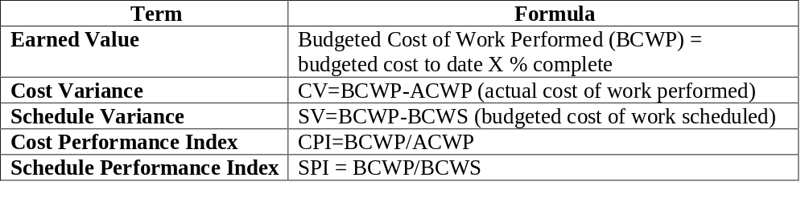
Earned Value Math
Earned Value Formulas:
Earned Value Numbers
  Negative numbers for cost and schedule variance indicate problems in those areas.
    The project is costing more than planned or taking longer than planned
  CPI and SPI less than 100% indicate problems
Course Technology, 1999

Slide 7
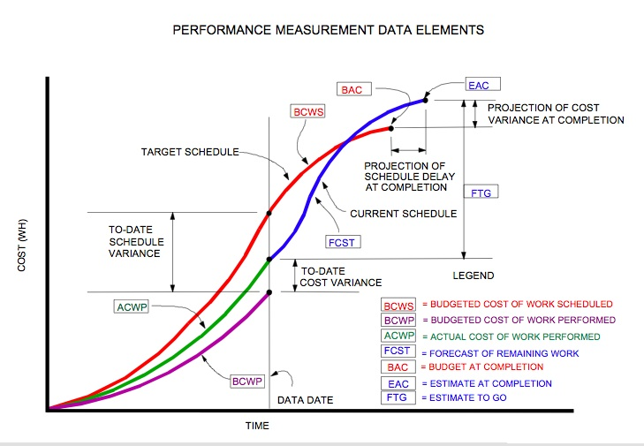

EVA: Another View
Wilkins, EVA Clear and Simple, 1999

Slide 8
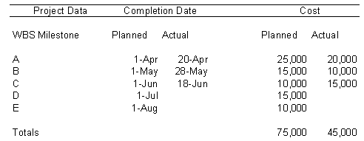
EVA Example
Value
15,000
12,000
20,000
As of 1-July where are we?
BCWS
BCWP
ACWP
CV
SV
CPI
SPI

Slide 9
Earned Value Summary
Why is EVA useful?
  It provides you a measure of how much you are progressing against your estimates.
  It is cost-oriented in practice, meaning it tracks actual versus expected costs as well as progress.
EVA: Task-oriented or Product-oriented?
  The way shown here is task-oriented, meaning it measures cost by work performed
  An alternative view would be product-oriented
    Measure progress by business value delivered
    Assign a value to each requirement and an expected cost of delivery (direct + indirect), then measure what you deliver each iteration versus what it actually cost.
Notes:
Note that in Jazz, the standard burndown chart goes by work items. Our customized one goes by story points

Slide 10
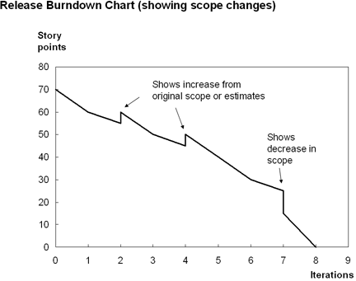
Agile Methods: Burndown charts
Burndown (“up”) charts are like earned values
  Plot iteration expectations via story “points” summed up from relevant user stories
  When a user story is completed you can subtract it from the total left to do
  Unlike EVA, you can
  incorporate change!
This chart, taken from Cockburn’s
paper, shows a burndown chart
with allocations for increases and
decreases in project scope
Notes:
Note that in Jazz, the standard burndown chart goes by work items. Our customized one goes by story points

Slide 11
Project Tracking Guidelines
Set intermediate goals
Set measurable goals
Create “stateful” goal descriptions
Don’t vary your goals or your estimates in the face of deadline or other external pressures
Understand a priori the impact of change
Track effort expended and business value created
Measure progress, not rate!
  Be wary of measures like LOC; if you track against it there is an excellent chance your estimate is wrong to start with!

