Slide 1
Defect Management
Defect Injection and Removal
Defect Detection and Containment
Defect Estimation
Defect Tracking

Slide 2
Overview
Review of defect concepts
Defect Management Process
  Defect costs
  Defect containment
  Defect reduction techniques
  Defect estimation
    Survey of techniques
  Defect tracking (last week)
Summary: impacts to your project

Slide 3
Review: Reliability Terminology
Failure
  Incorrect or unexpected output
  Symptom of a fault
Fault
  Invalid execution state
  Symptom of an error
  May or may not produce a failure
Error
  Defect or anomaly in source code
  Commonly referred to as a “bug”
  May or may not produce a fault
Defects may be injected at any time in the lifecycle
Recall Watts Humphrey (father of PSP):
(paraphrase) A defect is anything that necessitates a change in the code

Slide 4
Defect Costs
Questions:
  When you find one, how much will it cost to fix?
    How much depends on when the defects was created vs. when you found it?
  Just how many do you think are in there to start with?!
Cost
Development Phases
The cost of fixing a defect rises exponentially by lifecycle phase
  But this is simplistic
    When were the defects injected?
    Are all defects treated the same?
    Do we reduce costs by getting better at fixing or at prevention?

Slide 5
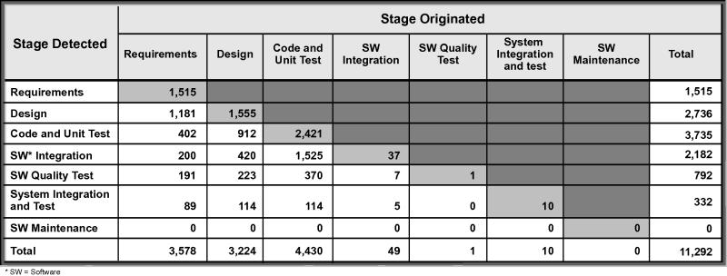
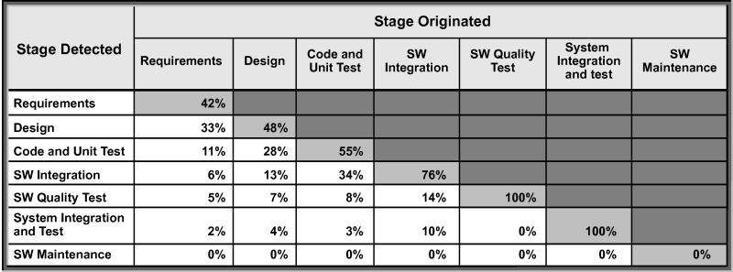

Defect Containment
Table to right shows the number of defects contained in a phase
  Defect injected/detected in the same phase (gray boxes)
  vs. number detected out-of-phase
This table shows the %s of defects injected and detected in the same phase
Why are these numbers important?
  Humphrey showed defects cost more to fix when they are detected out-of-phase ->
  The conclusion is obvious – “detect when you inject”
Frost & Campo (Crosstalk, Dec. 2007)

Slide 6

Defect Reduction
Boehm’s Top 10 Defect Reduction List (2003)
Finding and fixing a software problem after delivery is 100 times more expensive than finding & fixing it during the requirements & design phase.
About 40-50% of the effort on current software projects is spent on avoidable rework.
About 80% of the avoidable rework comes from 20% of the defects.
80% of the defects come from 20% of the modules & half of the modules are defect free.
About 90% of the downtime comes from at most 10% of the defects.
Peer reviews catch 60% of the defects.
Perspective-based reviews catch 35% more defects than non-directed reviews.
Disciplined personal practices can reduce defect injection rates up to 75%
It costs 50% more per source instruction to develop high-dependability software products than to develop low-dependability software products. However, the investment is more than worth it if significant operations and maintenance costs are involved.
About 40-50% of user programs enter use with nontrivial defects.
  Recall all of the defect prevention techniques (low-level) from 316 last year:
      Code reviews, unit-testing, TDD, better CM, Refactoring, static and dynamic analysis, metrics, defensive programming
    Quality injection techniques (presumably) will significantly increase defect prevention, thereby lowering costs
Moral of the story: To reduce costs, get better at finding defects
when they occur, and reducing the number of defects over all

Slide 7
Defect Estimation
How do we estimate how many defects to expect?
Methods:
  Empirical project data analysis
  Orthogonal Defect Classification
  Analytical models
  Fault-prone analysis
  Algorithmic models
  Capture-recapture method (CRM)

Slide 8
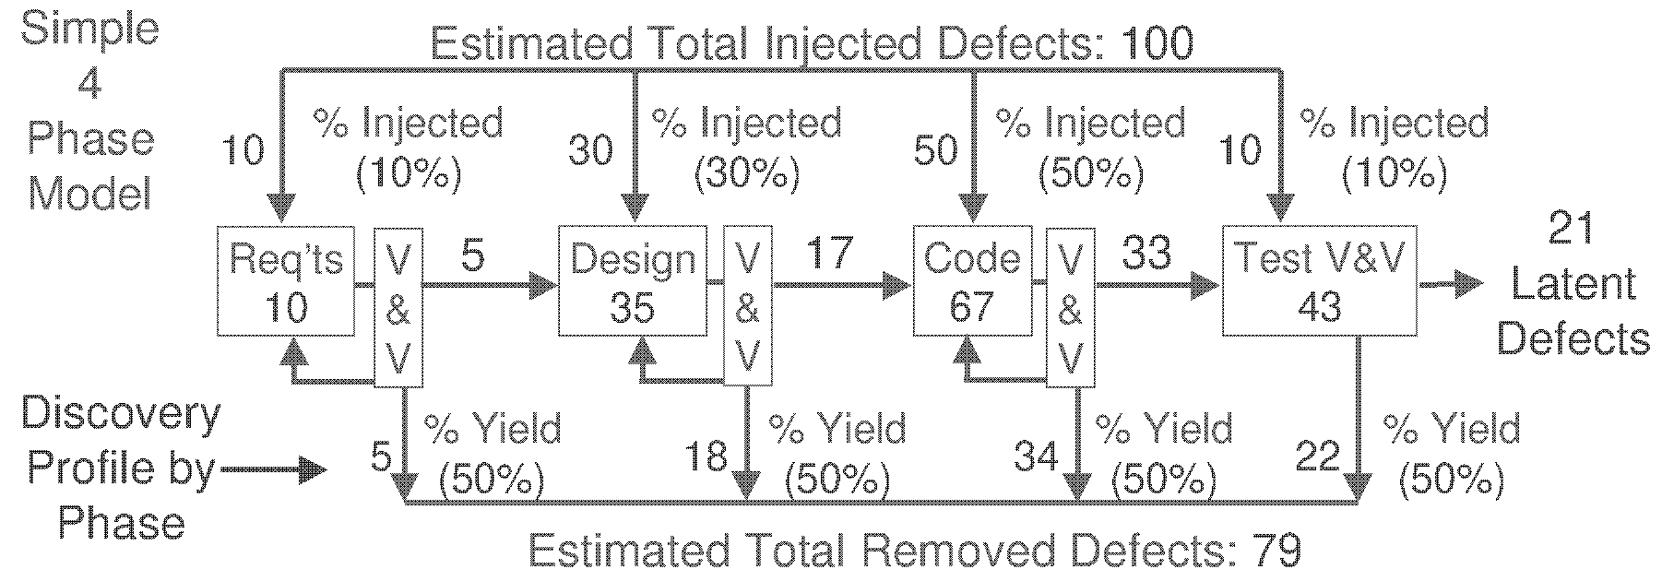
Defect Estimation
1. Empirical project data analysis
  Use historical project data to predict injection rates on this project
  Sounds very PSP/TSP-like - how would Humphrey estimate?
    Data-driven as always! Track the number of defects on past projects, and used this to project future projects
    Uses defect yield % to represent ratio of injected to removed by phase
    PSP also tracks what kinds of defects you inject
  This information allows you to tailor your estimate by project size, phase you are in, and your tendencies
Clark & Zubrow (SEI, 2001)

Slide 9
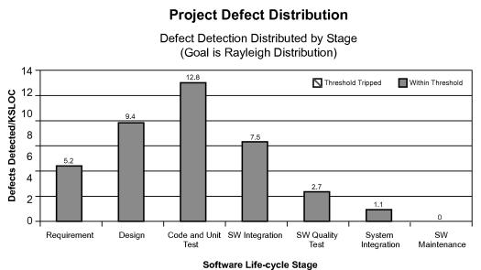
Defect Estimation
2. Orthogonal Defect Classification (ODC)
  Classify defects by type and trigger
    Type is not phase; it is what is required for the fix
      e.g. “algorithm”, “timing”
    Triggers are the activity that discovered the defect
      E.g. unit test, code review
    Use these with historical data to project
3. Analytical models
Classically in software eng., defect detection by phase follows a Rayleigh distribution (as shown to the right)
Use this curve as a model of expectation
Frost & Campo (Crosstalk, Dec. 2007)

Slide 10

Defect Estimation
4. Fault-prone analysis
  “Faults” are more likely (“prone”) to occur in parts of your code that exhibit particular characteristics
    What is a “characteristic”? - value ranges for attributes
    In other words, key metrics can indicate where errors are likely to occur, and even correlate to how many errors.
  Example: data shows that boundary and logic conditions may account for up to 90% of all defects
    So, look at metrics like cyclomatic complexity and fan-in/out!
5. Algorithmic models (Yes, a COCOMO for defects!)
  COQUALMO: same process, rate yourself
  according to 21 Quality Attribute Factors (QAF)
  Plug into a formula based on size and a fudge
  factor exponent and out pops a number

Slide 11
Defect Estimation
6. Capture-Recapture Method (CRM)
Example by Watts Humphrey (TSP)
  Say you want to find out how many fish are in a pond
    Have one person capture a sample and tag them. Say 20 fish are tagged. Release the fish and allow them to mingle back in.
    Have a 2nd person capture a 2nd sample, say 25 fish.
    Suppose 5 of those 25 in the 2nd sample were tagged
    Then: 20/X = 5/25, solve for X=100
Apply the same technique to defects (Schofield 2007)
  Have 3 developers (Moe,Larry, and Curly) find a number of defects in code X
  Assume Larry has found the most defects
  Now organize the defects in the following way:

Slide 12
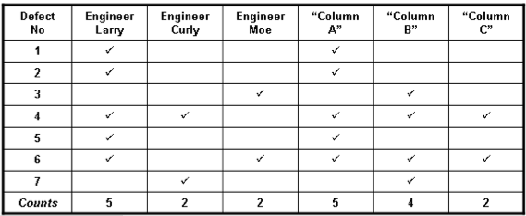
Defect Estimation - CRM
Larry finds the most and is replicated in Column A
Column B is the union of everyone except Larry
Column C is the intersection of Columns A and B
CRM = (A*B)/2 -> 5*4/2=10
Developers found 7, implies 3 are left undetected!

Slide 13
Summary
Impacts to projects
  Try and find defects sooner to when injected (avoid slope of that cost curve)
  Try to design your system and process in such a way as to minimize scope of impact (decouple)
  Quality improvement measures in all phases can lead to reduction (even if Rayleigh curve holds)
    316 coding practices are an example. Invest extra time to improve quality, resulting in recouped costs in defect resolution, and indirect profits through better customer satisfaction!
Estimation - your PM wants predictability again!
Track your defects (last week) - they don’t just “fade away”
The better data you collect the better process improvement you can do later.

