Slide 1
Requirements Engineering
Requirements Elicitation
Requirements Analysis
Requirements Validation
Requirements Management

Slide 2
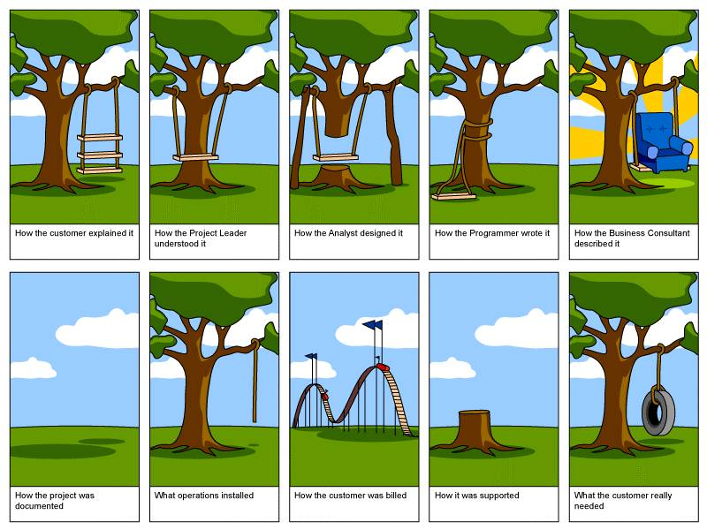
Why are we talking RE?
Ever build a swing?

Slide 3
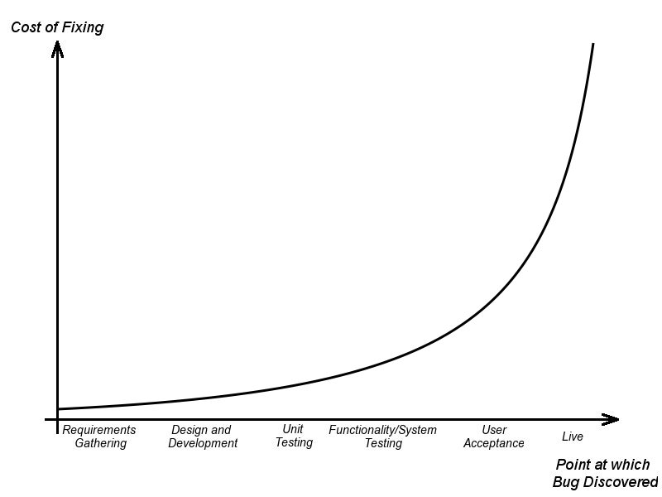
But seriously…
The classic cost of a requirement defect curve:

Slide 4
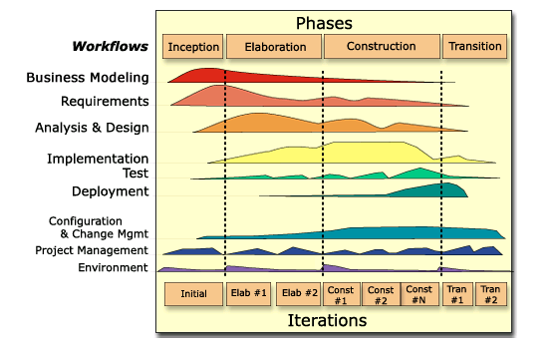
Where are we?
RUP Inception and Elaboration (we’ll discuss next)
Workflows pertaining to Requirements Engineering
  Business Modeling - Implementation
  Requirements - Project Management
  Analysis

Slide 5

Requirements Engineering
Software Requirements Engineering
  The process of establishing the services that the customer requires from a system and the constraints under which it operates and is developed
  The requirements themselves are the descriptions of the system services and constraints that are generated during the requirements engineering process
  The output of the RE phase serves as inputs to many other process phases
The processes used for RE vary widely depending on the application domain, the people involved and the organisation developing the requirements
  However, these phase activities are common to all processes:
    Requirements elicitation
    Requirements analysis
    Requirements validation
    Requirements (change) management

Slide 6


Requirements Elicitation
Sometimes called discovery or gathering
  Involves technical staff working with customers to find out about the application domain, the services that the system should provide and the system’s operational constraints
  May involve end-users, managers, engineers involved in maintenance, domain experts, trade unions, etc. These are called stakeholders

Slide 7
Requirements Elicitation
(Just some of the) Problems of eliciting requirements
  Stakeholders don’t know what they really want
  Stakeholders express requirements in their own terms
  Different stakeholders may have conflicting requirements
  Organisational and political factors may influence the system requirements
  The requirements change during the analysis process. New stakeholders may emerge and the business environment change
Meanwhile, back on the ranch, you have to figure out how to partition the problem space and come up with an analysis model

Slide 8

Requirements Analysis
How do we take requirements, expressed as the needs of a software system in a domain, and translate them into software products?
Requirements Analysis is a collection of activities whose objective is to provide a communicative model to bridge the chasm between business stakeholders and implementors.
Warning:Many methodologies do not recognize the value of analysis!
  Creates artifacts not directly deliverable to the customer
  Analyses and designs rapidly fall out of synch with code
  Analysis loses information in translation
  Analysis paralysis a real problem
Requirements
Code

Slide 9
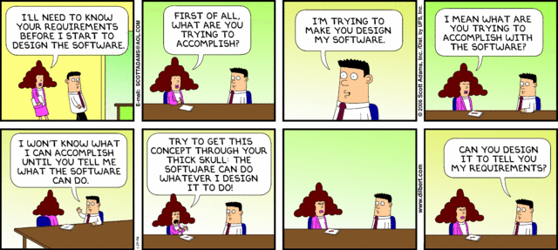
Requirements Validation
Demonstrating that the requirements define the system that the customer really wants
  Requirements error costs are high
  Fixing a requirements error after delivery may cost up to 100 times the cost of fixing an implementation error
During validation, these questions must be revisited
  Does each describe something the customer needs?
  Are they correct?
  Are they consistent?
  Are they complete?
  Are they realistic?
  Are they verifiable?
  Are they traceable?

Slide 10
Requirements Management
Change is a Risk!
  The priority of requirements from different viewpoints changes during the development process
  System customers may specify requirements from a business perspective that conflict with end-user requirements
  The business and technical environment of the system changes during its development
Requirements Management is a process for managing change
  Should apply to all proposed changes to the requirements
Principal stages
  Problem analysis. Discuss requirements problem and propose change
  Change analysis and costing. Assess affects of change on other reqs
  Change implementation. Modify requirements document and other documents to reflect change

Slide 11

Requirements management planning
During the requirements engineering process, you have to plan:
  Requirements identification
    How requirements are individually identified
  A change management process
    The process followed when analysing a requirements change
  Traceability policies
    The amount of information about requirements relationships that is maintained
  CASE tool support
    The tool support required to help manage requirements change

