Slide 1


Smart Parking
Software Engineering Project
CSCI441
Group member:
Thomas
Evan
Alex
Alan
Group member:Thomas
Evan
Alex Alan

Slide 2
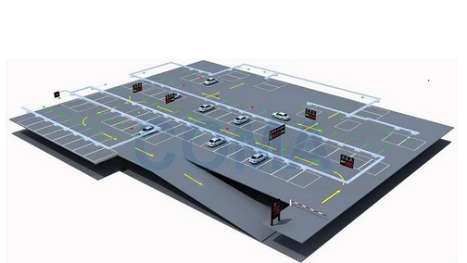
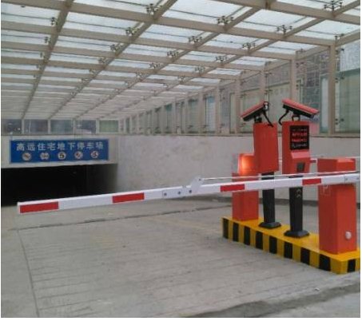
Traditional garage

Slide 3
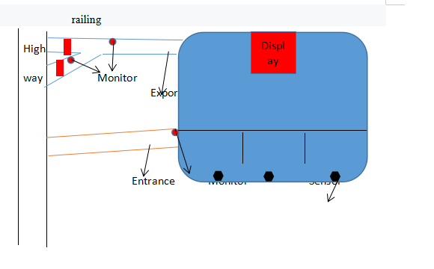
Smart parking system
01
点击输入标题

Slide 4
Use Case Diagram 1：Payment
UC1：查询车牌
UC2：车牌识别
UC3：传感器
UC4：验证车牌信息
UC1: Inquiry license plate
UC2: License Plate Recognition
UC3: sensor
UC4: Verify license plate information
Use Case Diagram:Payment
The user directly queries the license plate information with the app, and then enters the database query, and according to the data, the payment is made.
participate
Include
UC4: Verify license plate information
Database
initiate
initiate
UC1: Inquiry license plate
User
participate+initiate
Payment

Slide 5
Use Case Diagram 2：Parking warehousing
Use Case Diagram:Parking warehousing / picking up the car
initiate
initiate
UC2: License Plate Recognition
The user first passes the license plate identifier and then stores the license plate information in the database and starts timing. When the user parks the car in position, the sensor sends a message to the display, which has a car.
Database
participate+initiate
User
initiate
UC3: sensor
Timer
participate+initiate
Display

Slide 6
Use Case Diagram 3：Going Out
UC1：查询车牌
UC2：车牌识别
UC3：传感器
UC4：验证车牌信息
Use Case Diagram:Going out
Verify vehicle information
participate
UC4: Verify license plate information
Database
The user drives out, recognizes the license plate at the door, and then the license plate is verified in the database. If the condition is met, the rail is opened.
initiate
UC2: License Plate Recognition
User
participate+initiate
Rail

Slide 7
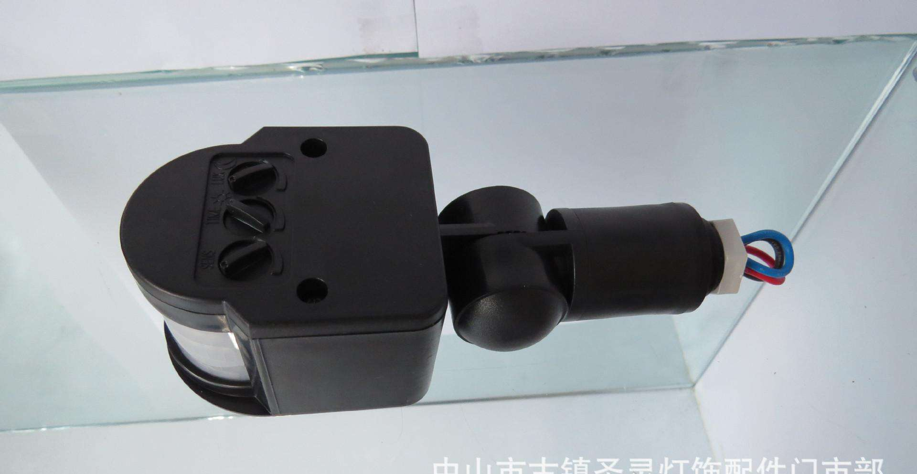
4
Camera sensor
1.Read the owner's license plate information, vehicle color
2.Upload vehicle information to the database
3.Database feedback information to the mobile client
4.Identify vehicle information, whether to pay, payment time
5.Passing information to the exit information fence

Slide 8
5
Timer
A.Ready to timing
B.start the timer
C.End timing
D.Calculate the charge
Sensor transfer information
Start charging for this vehicle in the database
End parking record for this vehicle
The database starts to charge according to the set bill

Slide 9
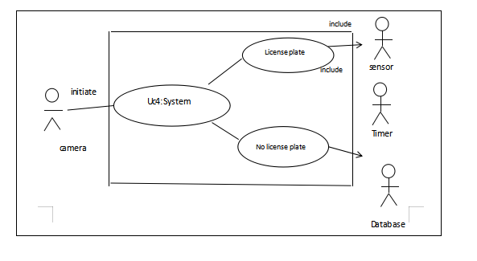
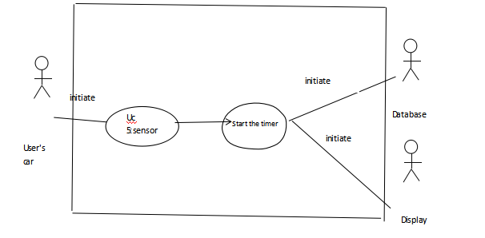
Use Case Diagram

Slide 10
Use case Diagram 6:No Availability
Function: When the user enters the parking lot,the sensor scans his license plate number and relases the
data into the database.
Use Case Diagram:No Availability
Uc 8:sensor
initiate
And this is going to play a big role in the system as go in and he's going to lay the
groundwork for the billable by hour
initiate
Include
User's car
scan the license plate number
Database

Slide 11
Use Case Diagram 7:Register
The user enters the parking lot and sees the empty space assigned by his/her license plate number displayed on the big screen
Use Case Diagram:Register
Look at the screen
Parking
This function is a very important part of the project, which provides users with convenience and is conducive to the systematic management of the parking order
Display position
User
Database

Slide 12
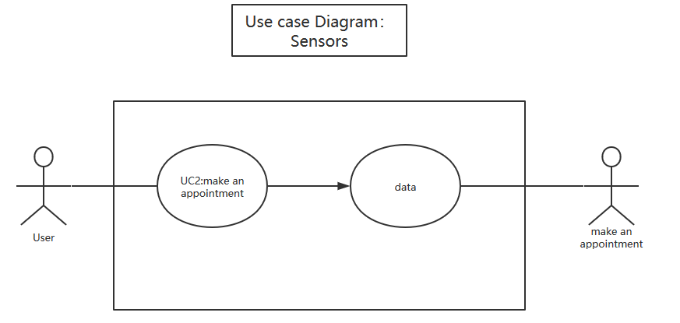
Use case Diagram 8：sensors
Function: The sensor will detect the parking space information in real time and refresh the parking space information in the database when the user needs it.
This feature is an important part of the project and provides basic information for users to view and select empty parking spaces.

Slide 13
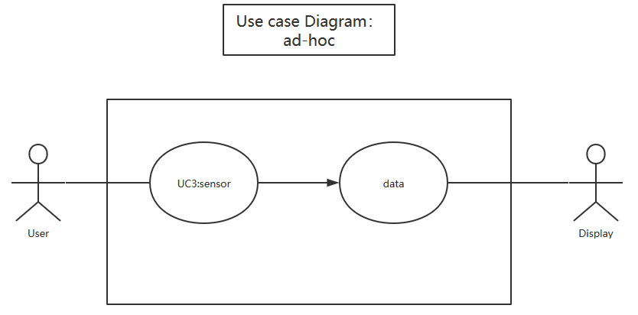
Use case Diagram 9：
ad-hoc
Function:The user selects and parks according to the empty parking space detected by the sensor.
This function provides users with convenience, which is convenient for users to quickly find parking spaces without causing traffic congestion and improve user satisfaction.

Slide 14
Database section

Slide 15
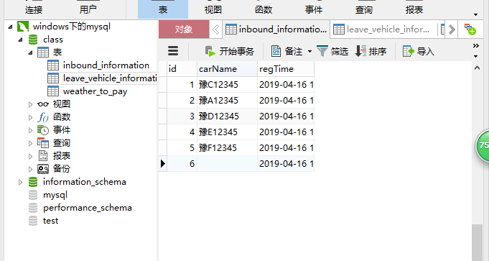
inbound information
The id is the primary key, the meaning of the order.
id
carName
Stored license plate information
regTime
Time when the stored vehicle enters the garage

Slide 16
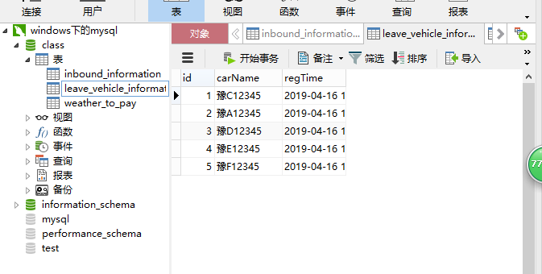
leave vehicle information
The id is the primary key, the meaning of the order.
id
carName
Stored license plate information
regTime
Time when the stored vehicle leaves the garage

Slide 17
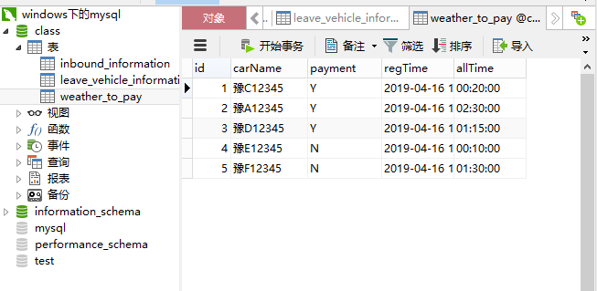
Whether to pay
The id is the primary key, the meaning of the order.
id
carName
Stored license plate information
payment
Whether the user pays
regTime
Time when the stored vehicle leaves the garage
allTime
Time spent by users

Slide 18
THANKS

