Slide 1

Smart parking Technical documentation v1.0

Slide 2
录
目
01
Introduction
CONTENTS
02
Program overview
03
Specific needs
04
Main interface of the system

Slide 3
01
Introduction

Slide 4
Section directory
Purpose of writing
Scope of use
Reference materials

Slide 5
Purpose of writing
This program is written to make it easier for the owner to know the number of free parking spaces in the entire parking lot and prevent traffic congestion caused by blindly searching for parking spaces. And the program supports online payment, so that the owner can quickly leave the parking lot without waiting at the exit.

Slide 6
Scope of use
Program Name: Smart parking
Program function: query parking lot free parking space, free parking space location, vehicle inquiry and positioning, online payment, information about, exit, etc.
Programmer: Thomas Evan Alan Alex
Program users: owner and parking lot.

Slide 7
Reference materials
References from:
http://www.itdlc.com/programview/558.html?bd_vid=75740431821157
References from:
http://www.sohu.com/a/240932817_775892

Slide 8
02
Program overview

Slide 9
Section directory
Product objectives
Product Features
User characteristics

Slide 10
Product objectives
Development intention
Program objectives
Background
1. In order to facilitate the owner to know the number of free parking spaces in the parking lot
2. To reduce the time it takes for the owner to find an empty parking space
3. In order to facilitate the payment waiting time when the owner leaves
Through this procedure, the owner is prevented from spending a lot of time searching for parking spaces and causing traffic congestion, and saving payment waiting time. The owner can conveniently and quickly query and locate the empty parking space.
As we all know, due to China's large population, with the progress of society, there will be more and more private cars on the road, but the corresponding parking lot is small and chaotic. In fact, the biggest headache for car owners is not traffic, but parking. Not only is space small, but parking requires a lot of skill. Especially in places with heavy traffic, the owners do not know where there are free parking spaces, so they are crowded together, causing traffic jams in the parking lot. This program was developed to facilitate the owner's parking.

Slide 11
Product Features
The detection system realizes the automation of the vehicle out of the warehouse. If the vehicle has already paid the fee, it will automatically raise the bar, otherwise it must go to the manual window to pay the fee.
The mobile payment system reduces the time to wait in line for payment.
04
The system consists of four main modules: monitoring system, display and sensor system, mobile application payment system and detection system. The specific functions are as follows:
03
The display shows the number of remaining parking spaces and location of the parking lot. The infrared sensor detects whether there is a car in the parking space and transmits the signal to the database.
Record the vehicle's entry and exit time, identify the vehicle's license plate number and color, and locate the vehicle's location.
02
01
Main function module

Slide 12
User characteristics
The end user of the software is for parking lot administrators and car owners. It does not require a certain program application basis and will use electronic products (mobile phones, etc.).

Slide 13
03
Specific needs

Slide 14
Section directory
Functional requirements
External interface requirements
Performance requirements
Design constraints
Properties
Other needs

Slide 15
System help
05
Description: Detailed user guide for the system provided to the user
Departure detection
Description: The relevant information (color, license plate number, departure time, etc.) of the collected vehicles is compared in the system.
Enter:
Vehicle related information
Deal with:
Use keywords to compare in the database
Output:
Allow to leave the parking lot or not allowed to leave the parking lot
04
Payment
Description: Write information about the vehicle leaving the parking lot (including: color, license plate number, parking space location, departure time, etc.) to the system.
Enter:
The license plate number of the vehicle.
Deal with:
Use the keyword to find information about this vehicle in the inbound information and transfer the information to the leave vehicle information.
Output:
The owner pays the amount and the latest departure time.
03
Vehicle information collection
Description: All vehicle information (including: color, license plate number, entry time, location, etc.) collection
Enter:
The license plate number of the vehicle.
Deal with:
Use the keyword to find information about this vehicle in the inbound information.
Output:
Information about the vehicle.
02
Parking information collection
Description: All information of the parking space (including: number, position, size, etc.) collection
Enter:
Full information on the parking space.
Deal with:
Write to the database through the program.
Output:
Full information on the parking space.
01
Functional requirements

Slide 16
External interface requirements
User Interface
Hardware Requirements
Software Requirements
Users of this product generally need to operate through the mobile phone or terminal, enter the main interface and click the corresponding window to enter the corresponding interface. User maintenance of the program, it is best to have a backup.
Service-Terminal:
CPU: I3-4170 or higher
Memory: 4GB or more
Display: 1280*720 or more
Storage space: 100GB or more
Mobile terminal:
Screen pixel: 1280*720 or more
Memory: 1GB or more
CPU: MSM8939 or higher
Service-Terminal:
Operating system: Chinese WindowsXP or above
JRE environment: JRE1.7 or later
Mobile terminal:
Operating system: Android 4.0 or above

Slide 17
Performance requirements
Because this program is for parking lots, it is used more frequently and has higher requirements for use:
1. Accuracy requirements
In terms of accuracy requirements, according to the needs of use, various accuracy requirements can be met during the input, output and transmission of various data.
2. Time requirements
In terms of software, response time and update processing time are faster and faster, fully meeting the requirements of users.
3. Flexibility
When the user needs, such as the operation mode, the operating environment, etc., the design procedure needs to be properly adjusted, and the flexibility is very large.
4. Troubleshooting
The program can be backed up manually or automatically due to the fault-tolerant function of the user's improper operation. The program restart time is no more than five minutes.
In short, the requirements are stable, safe, convenient, and easy to manage and operate.

Slide 18
Design constraints
Hardware constraints
The computer that runs the database must be a computer with I3-4170 or higher and 4 GB or more of memory. The mobile phone must be a mobile phone with MSM8939 or higher and a memory of 1 GB or more, and has the function of accessing the network.

Slide 19
Properties
Security
Maintainability
Compatibility
The system is small in scale and only uses security technology in data transmission; it restricts the operation of certain data in one program and assigns different functions to different modules.
The system has strong independence, high degree of modularity, high cohesion and low coupling, and is relatively simple to maintain.
The database is compatible with WindowsXP and above; the software is compatible with Android 4.0 and above; no part is allowed to be modified.

Slide 20
Other needs
Occasional adaptation requirements
Database
The program database mainly uses three basic tables, namely inbound_information, leave_vehicle_information, and weather_to_pay table. The specific description of each table is as follows:
1.inbound_information table,Specific information for storing vehicles entering the parking lot
2.leave_vehicle_information table for storing specific information about vehicles leaving the parking lot
3.weather_to_pay table, used to store the specific information of the owner's payment
This system must be used in a network environment.
function name：inbound_information table
Storage location: database | Storage method: one record for one car | Primary key:number
Data element | Data collection method | Description
Number | Automatic acquisition | Primary key, must be collected
Intime | Automatic acquisition | must be collected
Parking number | Automatic acquisition
Color(optional) | Automatic acquisition
Rntry location(optional) | Automatic acquisition
Photo | Automatic acquisition
function name：leave_vehicle_information table
Storage location: database | Storage method: one record for one car | Primary key:number
Data element | Data collection method | Description
number | Automatic acquisition | Primary key, must be collected
Intime | Automatic acquisition | must be collected
Parking number | Automatic acquisition
Color(optional) | Automatic acquisition
Departure location(optional) | Automatic acquisition
Outtime | Automatic acquisition | must be collected
Photo | Automatic acquisition
function name：weather_to_pay table
Storage location: database | Storage method: one record for one car | Primary key:number
Data element | Data collection method | Description
Number | Manual acquisition | Primary key, must be collected
Cost | Automatic acquisition | must be collected
Photo (optional) | Automatic acquisition
Parking number(optional) | Automatic acquisition
Intime | Automatic acquisition
Outtime | Automatic acquisition

Slide 21
04
Main interface of the system

Slide 22
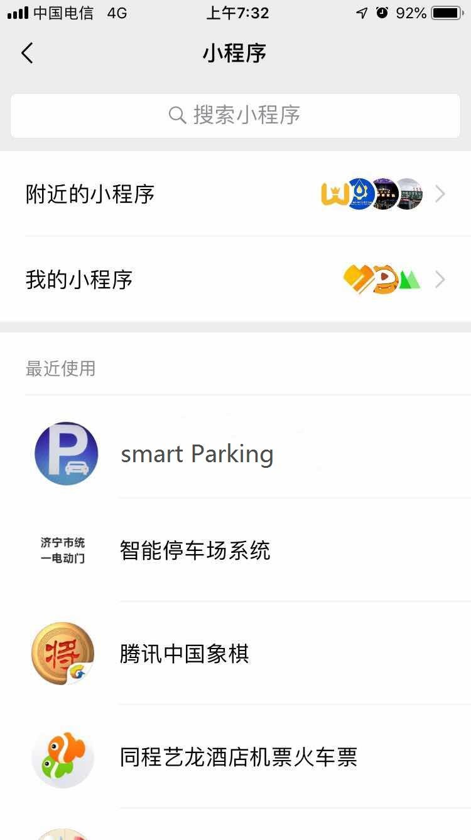
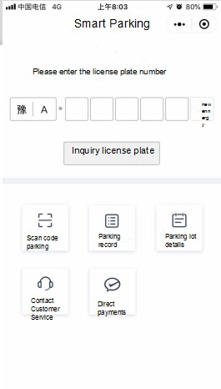
Introduction to preliminary design and description
1.Open the applet
2.Applet homepage
Select smart parking to enter the main program interface of the Apple version.
The upper part of the interface is the place where the license plate information is queried. The lower part is the scanning parking QR code, parking record inquiry, parking space details, online customer service and online payment.

Slide 23
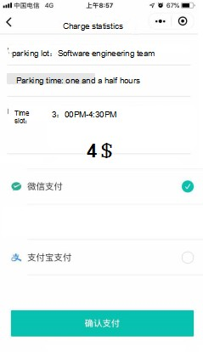
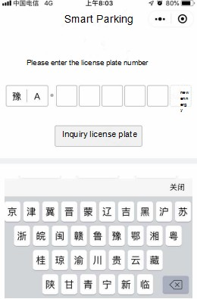
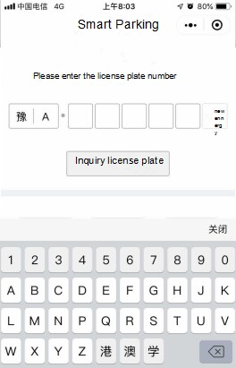
Introduction to preliminary design and description
4. Payment
3. Enter license plate information
Enter the license plate number in the input box to check the parking time and fare of the vehicle.
In the payment interface, you can choose to pay online via WeChat or Alipay.

Slide 24
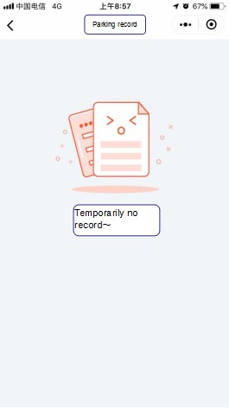
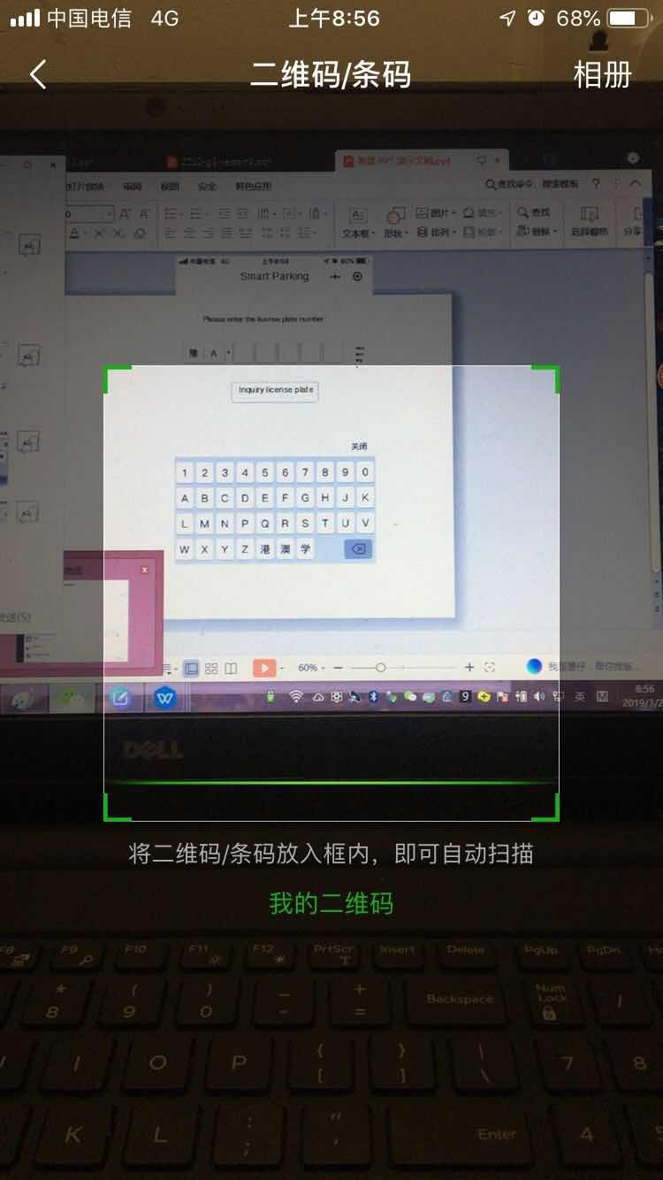
Introduction to preliminary design and description
6.Parking Record
5.Scan code parking
Here you manually scan the parking lot's payment QR code to enter the payment interface to select the payment method and payment amount.
Here you can check the parking information of the vehicle (such as parking space, parking time, etc.).

Slide 25
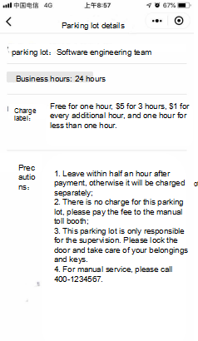
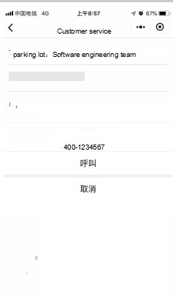
Introduction to preliminary design and description
7.Precautions
8.Customer service
Here you can check the parking lot's precautions and charging rules, etc.
In the online customer service interface, you can choose to get online customer service through WeChat or phone.

Slide 26
THANKS

